Slide 1

Geospatial Clean Cooking access modelling using OnStove
LECTURE 4
ONSTOVE THEORY 1
Version 1.0

Slide 2
Learning Outcomes
By the end of this lecture, you will:
ILO1: Understand the reason for calibrating the study area and what is calibrated
ILO2: Explain how the calibration is conducted for each category
Notes:
The following slide lists the intended learning outcomes of this presentation. Here you will:
Understand in detail the importance of calibrating the study area
Understand how the calibration is done

Slide 3
4.1 The four steps to running OnStove
Step 1: GIS processing
Deals with all of the geo-processing steps needed to transform the spatial data into the right format for the OnStove analysis. Includes processes such as reprojection, masking and clipping, resampling and aligning. This is the step that we have had already looked at during this course,
Step 2: Model calibration
Calibrates key data for the study area for it to be in line with national statistics. This step will be focused on in this presentation and the following hands-on exercise
Step 3: Net-benefit calculations
Calculates all of the costs and benefits of switching from the current ways of cooking, to every defined alternative. This is done on a relative basis, meaning that the costs and benefits are the additional expenses or benefit gains against the current cooking option.
Step 4: Result visualization
Presents the results on graphical (plots and maps) and tabular formats of the technology split that maximizes the net-benefits in every region of the study area.

Slide 4
4.1 Calibration in OnStove
Determines
Which areas are urban and which are rural
Current population in different parts of a study area
Current electricity access rates across the study area
Who is cooking with what across the study area
Notes:
In this presentation we will focus on the calibration step of the analysis. This step consists of 4 processes were we determine:
Which areas are urban and which are rural
The current population in different parts of a study area
The current electricity access rates across the study area, and
Who is cooking with what across the study area

Slide 5
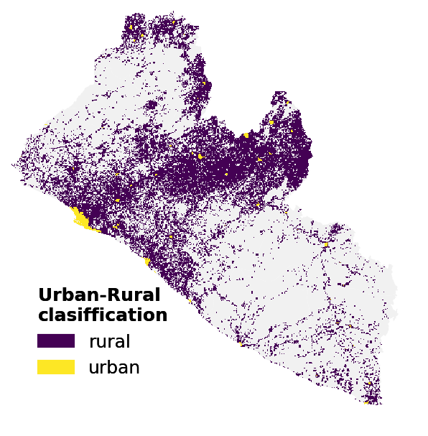
4.2 Urban-rural areas calibration
Two methods available
Using population density and population size of settlements.
Using the GHS urban-rural split geospatial layer, which classifies cells into different rural, urban and peri-urban classes (default option).
 | Urban | Peri-urban | Rural
Density threshold | 1,500 people/sq.km | 300 people/sq.km | < 300 people/sq.km
Size threshold | 50,000 people | 5,000 people | <5,000 people
Notes:
First the urban and rural division of the study area is determined. This is done in OnStove using either an external layer or manually with population densities. If the manual method is used, the thresholds in the table are used as starting values for what is considered urban, peri-urban and rural respectively. These thresholds are then altered for the total urban rate of the study area to match the values given by the user.
If instead an external layer is used, this external layer is directly extracted to the main dataframe and its classification is used to determine what is considered urban or rural.
Understanding which areas are rural and urban is important as clean cooking shares tend to be higher in urban areas and in many cases, the barriers that we have previously discussed to adoption of clean cooking are more pronounced.

Slide 6
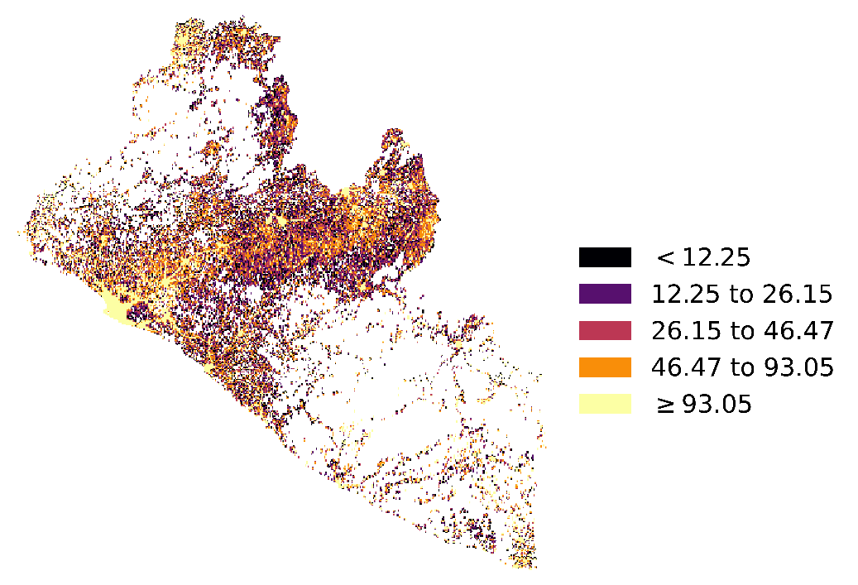

4.2 Current population in different parts of a study area
Original population
layer
There is usually a mismatch between actual population and the population that actually live in a study area
Population calibration ensures that the right number of people live in the study area.
It uses the population GIS data as well as the total population number defined by the user based on national statistics.
Calibrated population
layer
Notes:
Next, the current population of the study area is calibrated. The calibration ensures that the total number of people in the study area is equal to what is entered by the user. The calibration is done by multiplying a factor to urban areas and another to rural areas. The reason for using two distinct factors is because we want the urban rate determined in the urban calibration to remain true.
Calibrating population is important as many of the raster datasets that are used for population count are outdated in terms of total number of people. The two maps on this slide show the non-calibrated population (top) and the calibrated population maps of Liberia (bottom). As can be seen the distribution stays the same but the total numbers increase, indicating that the original dataset underestimated the population counts and that the calibrated population retains the patterns from the non-calibrated map.

Slide 7
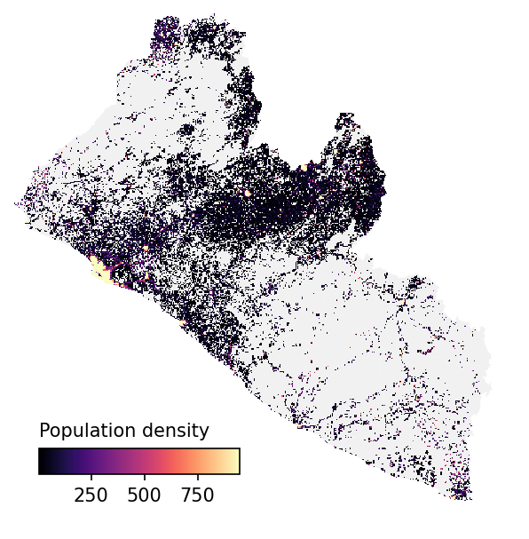
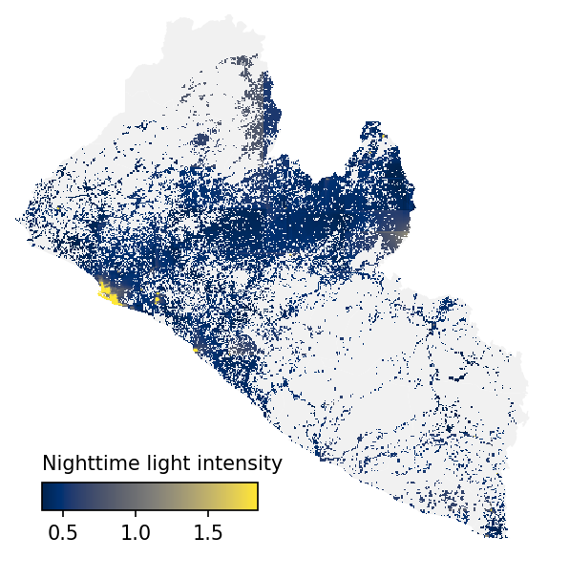
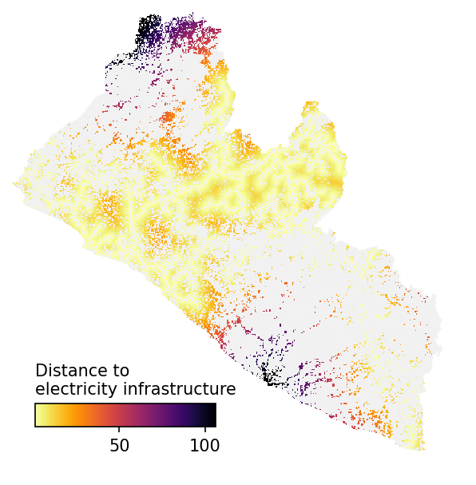
4.3 Current electricity access rates across the study area
OnStove conducts a Multi-criteria analysis using three different datasets to estimate who currently has access to electricity (examples for Liberia)
Notes:
Calibrating current electricity access is important as it determines who can potentially cook with electricity and who can not (OnStove does not account for an improvement in electricity access rates by itself, so whoever has access to electricity today can cook with it). The calibration of electrified population is preformed with a Mutli-Criteria Analysis (MCA). An MCA takes a number of different criteria and arrives at a result depending on a number of set relations and weights.
In the MCA for electricity access, OnStove uses three geospatial layers: population density, nighttime light intensity and distance to closest electricity related infrastructure. As infrastructure OnStove uses either distribution transformers, medium-voltage lines or high-voltage lines (in this order and depending on availability).

Slide 8
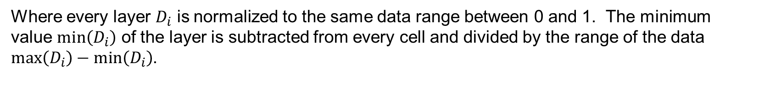
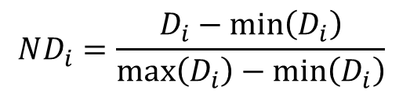
4.3 Current electricity access rates across the study area
The three layers are normalized using a Min-Max approach
$$ND_{i}=\frac{D_{i}−min\left(D_{i}\right)}{max\left(D_{i}\right)−min\left(D_{i}\right)}$$
Where every layer $D_{i}$ is normalized to the same data range between 0 and 1. The minimum value $min\left(D_{i}\right)$ of the layer is subtracted from every cell and divided by the range of the data $max\left(D_{i}\right)−min\left(D_{i}\right)$.
Notes:
Each one of the datasets are first normalized. These normalized versions of the datasets acts as scores. Higher scores indicate a higher likelihood for electricity access. Highest scores are given to areas with large population density, high nighttime light intensity and areas close to electricity related infrastructure.

Slide 9
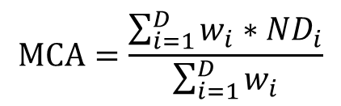
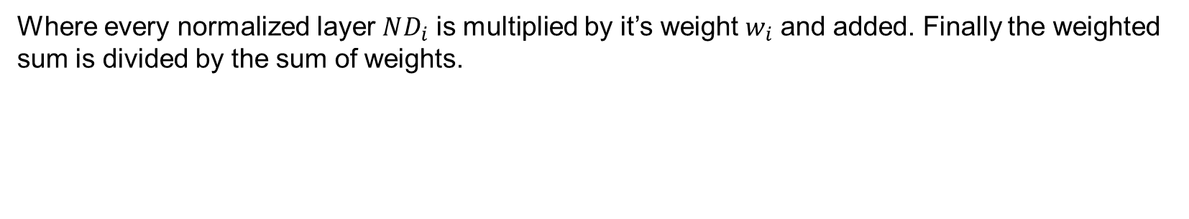
4.3 Current electricity access rates across the study area
Weights for each factor is given and the weighted average is calculated
By assigning weights we give more or less importance to each of the three layers. Enabling the user to produce custom calibrations for their area of interest.
$$MCA=\frac{\sum_{i=1}^{D}{w_{i}}∗ND_{i}}{\sum_{i=1}^{D}{w_{i}}}$$
Where every normalized layer $ND_{i}$ is multiplied by it’s weight $w_{i}$ and added. Finally the weighted sum is divided by the sum of weights.
Notes:
The scores of the datasets are combined with each other together with weights describing each score’s importance. Higher weight means that we consider one parameter more important than another. As default, OnStove use a weight of 1 for the population density and nighttime lights and 2 for the distance to electricity infrastructure, but these weights can be easily altered by the user.

Slide 10
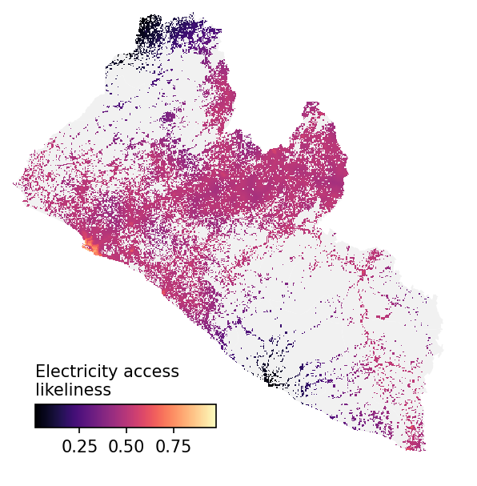
4.3 Current electricity access rates across the study area
Output of the MCA analysis showing the likeliness of population having access to electricity
Notes:
The result of the MCA ranks the populated areas from 0 to 1 according to their scores achieved from the three included layers. The closer the rank is to 0, the lower is the likelihood for electricity access.
This output is then used by OnStove to calibrate who has access to electricity giving access first to population in the highly ranked areas until a threshold is reached. This threshold is based on the region’s current statistics of access (e.g. 12% of the total population).
Moreover, cells can have full, partial or no access.

Slide 11
4.4 Current Cooking fuels calibration
Determines who is cooking with what in different settlement across the study area
Important as all benefits and costs are calculated directly relative to the current cooking situation
Uses current shares for each cooking fuel defined by the user, differentiated between rural and urban areas (defined in the techno-economic specifications).
All stoves do not have to be included in the base-line and all base-line stoves do not have to be included in the net-benefit calculations.
Notes:
The last step of the calibration is to determine the cooking shares across the study area. All urban and rural cells are calibrated so the model knows what households in each cell use in terms of cooking fuels. Thus, if a cell has access to e.g., 50% LPG, 20% traditional biomass and 30% charcoal, it means that 50% of households within that cell use LPG etc.
When a cell does not have current access to a resource (e.g. electricity or biogas potential) and the baseline says people is using those fuels for cooking (due to the shares entered for urban and rural areas), then the model makes the shares of those technologies 0% for those cells and distribute the households proportionally to the other technologies. Moreover, it balances out the population cooking with the other technologies in the remaining cells, so the totals of the spatial data always match the national statistics defined by the user.
This step of the calibration is very important as all costs and benefits are directly relative to what is being used today.

Slide 12
References
Khavari, B., Ramirez, C., Jeuland, M. and Fuso Nerini, F. “A geospatial approach to understanding clean cooking challenges in sub-Saharan Africa,” Nat. Sustain., pp. 1–11, Jan. 2023, doi: 10.1038/s41893-022-01039-8.
Burnett, R. T. et al. An Integrated Risk Function for Estimating the Global Burden of Disease Attributable to Ambient Fine Particulate Matter Exposure. Environmental Health Perspectives 122, 397–403 (2014).
Jeuland, M., Tan Soo, J.-S. & Shindell, D. The need for policies to reduce the costs of cleaner cooking in low income settings: Implications from systematic analysis of costs and benefits. Energy Policy 121, 275–285 (2018).
University of Washington. GBD Compare | IHME Viz Hub. http://vizhub.healthdata.org/gbd-compare.
Valuing Statistical Lives: Concepts, Current Practices, and Challenges - with Lisa Robinson. (2020).

Slide 13
Thank you
for your attention
in this lecture!

Slide 14

Khavari B., Ramirez C. 2023.
Lecture 4: Geospatial Clean Cooking access modelling using OnStove. Release Version 1.0.[online presentation]. Climate Compatible Growth Programme, Energy Sector Management Assistance Program and World Bank Group
CCG courses (this will take
you to the website link http://www.ClimateCompatibleGrowth.com/teachingmaterials)

