Slide 1
Lecture 7: Making decisions for infrastructure resilience

Slide 2
Learning Outcomes
By the end of this lecture, you will:
Have looked at the decision-making process for infrastructure resilience
Be able to identify which interventions can reduce asset risk and improve infrastructure network resilience and discuss and evaluate different ways to decide what interventions are most suitable
Know traditional evaluation approaches (cost-benefit analysis) as well as frameworks that look at making optimal decisions under uncertainty
Have clear the processes for good decision-making by including stakeholders, deciding upon tolerable thresholds and identifying adaptation pathways

Slide 3
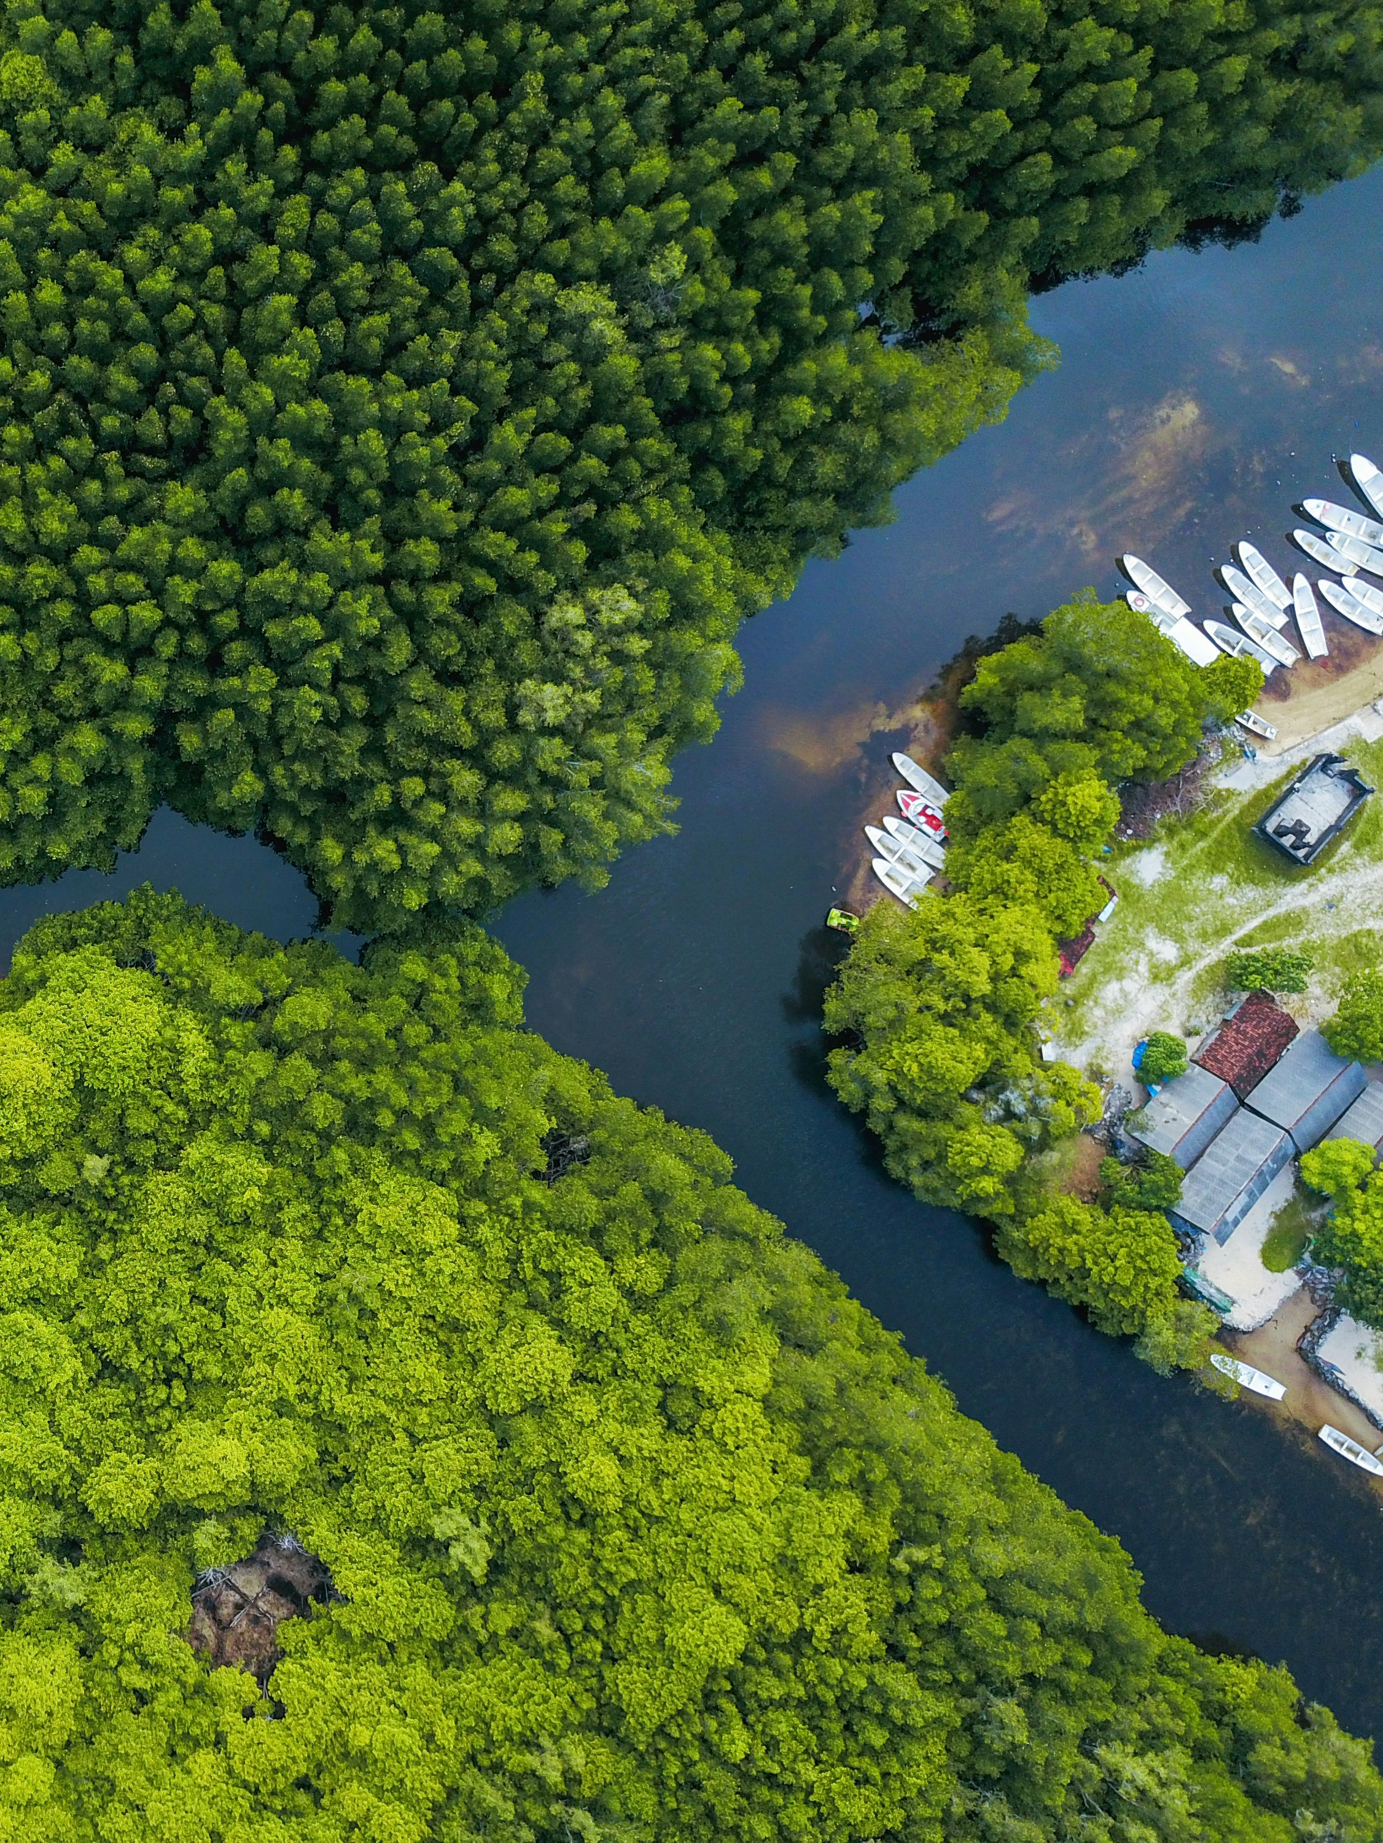
7.1 Actions for enhancing resilience
Learning Objectives
Compare and contrast different types of interventions to improve resilience
Identify how interventions can reduce risk in different ways
Describe how to improve the resilience of infrastructure networks

Slide 4
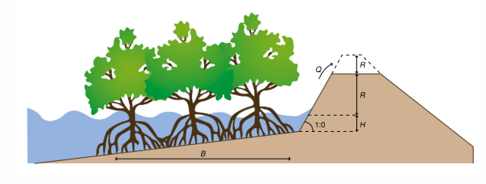
7.1 Actions for enhancing resilience
Introduction
Decision-makers are implementing various strategies to reduce physical asset damage and improve overall network resilience:
Structural Solutions (Engineered Solutions) - Physical constructions aimed at mitigating hazard impacts:
Hard Structures: Embankments, floodproof housing, reservoirs, shelters
Soft Structures: Mangrove restoration, artificial nourishment to create natural buffers.
Hybrid Solutions:
Combine hard and soft measures (e.g., mangrove restoration in front of embankments for wave dampening)
Beach nourishment alongside seawalls to enhance protection during storms
Non-Structural Solutions:
Use of policies and awareness measures to reduce hazard risk
(Jongman 2018)
Notes:
Figure: An example of a hybrid solution in which mangrove reforestation in front of embankments can allow reduced embankment height
Examples include building codes, land-use planning, public awareness campaigns, emergency preparedness programs, and insurance.

Slide 5
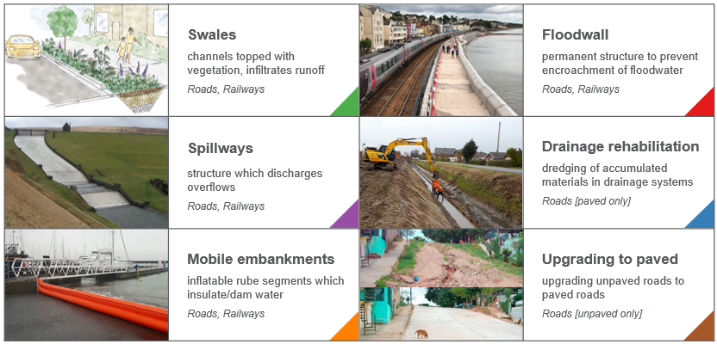
7.1 Actions for enhancing resilience
Adaptation
Adaptation refers to adjustments in ecological, social or economic systems in response to actual or expected climatic stimuli and their effects
It refers to changes in processes, practices and structures to moderate potential damages or to benefit from opportunities associated with climate change
These adaptation measures include structural (e.g., embankments, mangrove restoration) and non-structural (e.g., policies, awareness programs) solutions aimed at protecting physical assets and improving system-wide preparedness
https://unfccc.int/topics/adaptation-and-resilience/the-big-picture/introduction#:~:text=Adaptation%20refers%20to%20adjustments%20in,opportunities%20associated%20with%20climate%20change

Slide 6
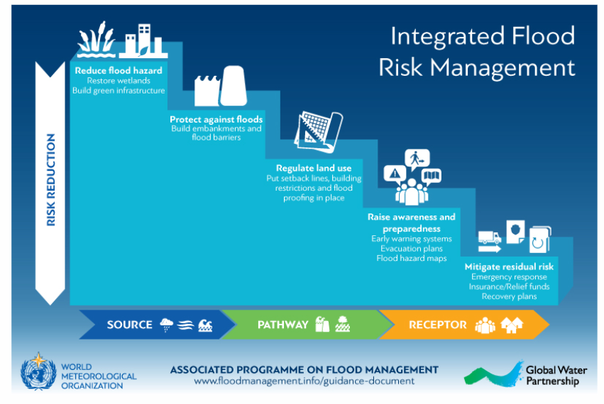
7.1 Actions for enhancing resilience
Risk cascade
Often a portfolio of structural and non-structural interventions is designed, aimed at reducing risk (Jongman 2018)
Risk cascade looks at the sequence of how interventions can reduce risk, either at the source, the pathways of impact, or the receptor
It has been recognised that relying on a single cascade will not be efficient in reducing risk (wetlands might buffer small events, but not very severe events)
Solely relying on structural measures might make a disaster very severe when it happens, because there is a lack of awareness and preparedness for such an event
A well-designed portfolio of risk and resilience measures therefore combines interventions from different cascades
(APFM 2020).
Notes:
Figure: The risk cascade ofr flood risk management. Interventions that reduce the hazards, such as wetland restoration or mangroves, are found at the top (the source). Protection measures (e.g. embankments) reduce the hazard and exposure of assets. Land-use planning does not influence the source of the hazard much, but does influence the exposure of assets. Finally, awareness and preparedness systems and interventions targeted at reducing residual risk (e.g. insurance, recovery) mainly help the receptors of the hazard to become less vulnerable or may help them recover quickly.

Slide 7
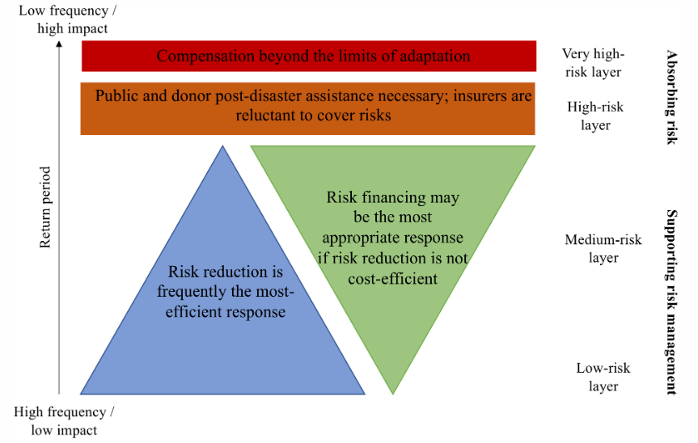
7.1 Actions for enhancing resilience
Risk layering
(adapted from Mechler et al. 2014).
Notes:
Figure: The risk layering concept with the return period on the left and the balance of risk reduction and risk financing in the middle. It emphasises that different risk and resilience strategies need to be targeted for different types of events
The ‘risk layering’ concept differentiates between levels of risk based on probability and stress
Risk layering aids in designing effective risk management strategies for varying probability events, considering community and government absorption capacity
Frequent low-impact events benefit most from hazard reduction, protection, and land-use planning measures
Medium-layer risks require a combination of source/pathway risk reduction interventions, insurance, and financial instruments for residual risk management
For rare and catastrophic events, public and international assistance, including donor support for low-income countries, is essential
Infrastructure systems also follow a similar risk layering concept; engineering standards help protect against frequent events
For extreme events causing significant damage, having a financial buffer and insurance is critical for quick recovery and reconstruction
Stress-testing exercises are beneficial for understanding the response of systems to different risk layers

Slide 8
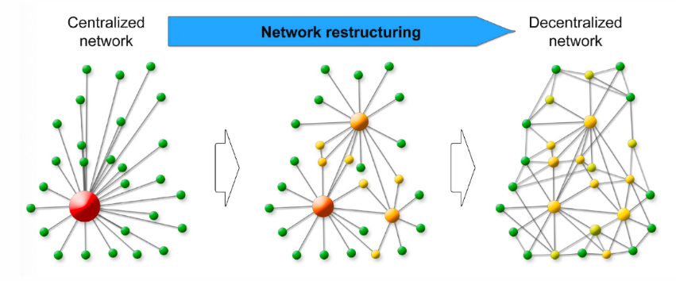
7.1 Actions for enhancing resilience
Improving network resilience: Theory
Infrastructure systems can face significant systemic impacts from single node failures, necessitating a broader focus on systemic risks
Effective interventions should aim to minimize cascading effects of failures, including backup options, network restructuring, and increased redundancy
Important network-wide strategies include accelerating recovery of damaged assets to restore normal service levels
A balanced mix of asset-level and complex network-wide interventions is essential for improving resilience
Centralized networks are more vulnerable to systemic shocks, while decentralized networks offer buffering through redundancy, highlighting the need to balance redundancy with transmission risk
(Hochrainer-Stigler et al. 2020)
Notes:
Figure: An example of network restructuring from a centralised network towards a decentralised network

Slide 9
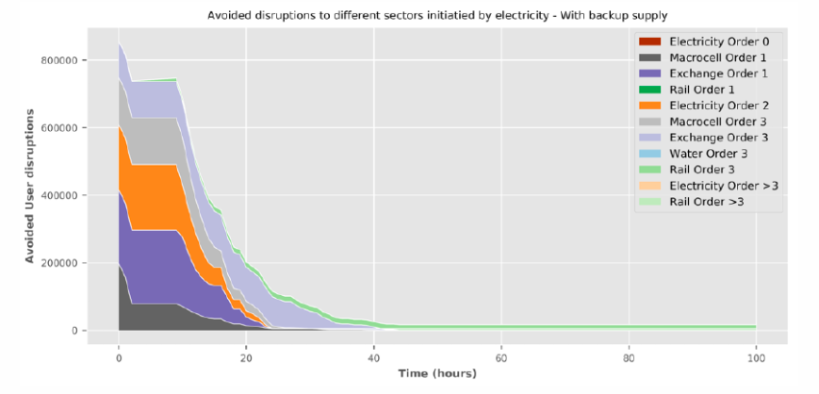
7.1 Actions for enhancing resilience
Improving network resilience in practice
Improving network resilience in real-world infrastructure is challenging due to fixed structures and complex interactions
The benefits of enhancing network resilience are often harder to measure compared to reducing asset risks
(Pant et al. 2020)
Notes:
Figure: The avoided number of users that are disrupted by electricity failure; illustrating the difference between a scenario with backup generators to a scenario without in the United Kingdom
A study in the UK assessed the impact of adding backups to the electricity network, considering the potential for cascading failures to other systems
In a simulated 100-hour disruption, backup systems reduced the total affected customer-hours from 118 million to 104 million, highlighting a 14 million customer-hours improvement
Such model experiments provide insights into network resilience benefits, but results should be cautiously applied to different infrastructure systems due to their specific characteristics

Slide 10
7.1 Actions for enhancing resilience
Summary
We summarised the different types of interventions to improve both asset and network resilience
We discussed how different interventions reduce risk in different ways and highlighted that portfolios of complementary interventions need to be designed that are optimised for the local context

Slide 11
7.1 Actions for enhancing resilience
Bibliography
APFM. 2020. “Integrated Flood Risk Management Cascade.” https://www.floodmanagement.info/integrated-flood-risk-management-cascade/.
Hochrainer-Stigler, Stefan, Célian Colon, Gergely Boza, Sebastian Poledna, Elena Rovenskaya, and Ulf Dieckmann. 2020. “Enhancing resilience of systems to individual and systemic risk: Steps toward an integrative framework.” International Journal of Disaster Risk Reduction 51 (January). https://doi.org/10.1016/j.ijdrr.2020.101868.
Jongman, Brenden. 2018. “Effective adaptation to rising flood risk.” Nature Communications 9 (1): 9–11. https://doi.org/10.1038/s41467-018-04396-1.
Mechler, Reinhard, Laurens M. Bouwer, Joanne Linnerooth-Bayer, Stefan Hochrainer-Stigler, Jeroen C. J. H. Aerts, Swenja Surminski, and Keith Williges. 207. “Managing unnatural disaster risk from climate extremes.” Nature Climate Change 4 (4): 235–37. https://doi.org/10.1038/nclimate2137.
Pant, Raghav, Tom Russell, Conrad Zorn, Edward Oughton, and Jim Hall. 2020. “Resilience Study Research for NIC: Systems analysis of interdependent network vulnerabilities.” April. Oxford: Environmental Change Institute, University of Oxford.

Slide 12

7.2 Evaluating actions
Learning objectives
Understand the history, rationale, and limitations of cost-benefit analysis
Recognise alternative methods to cost-benefit analysis for option evaluation
Demonstrate the use of multi-objective analysis to evaluate actions

Slide 13
7.2 Evaluating actions
Introduction
Decision-makers in government and funding bodies assess investment options for critical national infrastructure to allocate limited funds effectively
Industries like water, energy, and transport often rely on public funding and are not typically fiscally profitable, leading to intense competition for resources
Cost-benefit analyses (CBAs) are utilized to evaluate the costs and benefits of various projects to identify the most valuable investment opportunities
CBA compares the cost-benefit ratio (CBR) of different projects, aiming to select the least-cost option that offers the greatest benefit
Though CBA has historical significance dating back to the 1840s, its applicability in modern sustainable development is being challenged as too simplistic

Slide 14
7.2 Evaluating actions
Cost-Benefit Analysis (CBA)
Do the risk analysis without an adaptation option
Introduce an adaptation option
Get the initial investment costs + maintenance costs (C = Costs)
Redo the risk analysis with the effect of the adaptation option
Find the avoided losses (B = Benefits)
Find the NPV (Net Present Value) of costs (NPV C) and NPV avoided loss (NPV B)
Assume a discount rate
Find the Benefit Cost ratio (BCR) = NPV B/NPV C

Slide 15
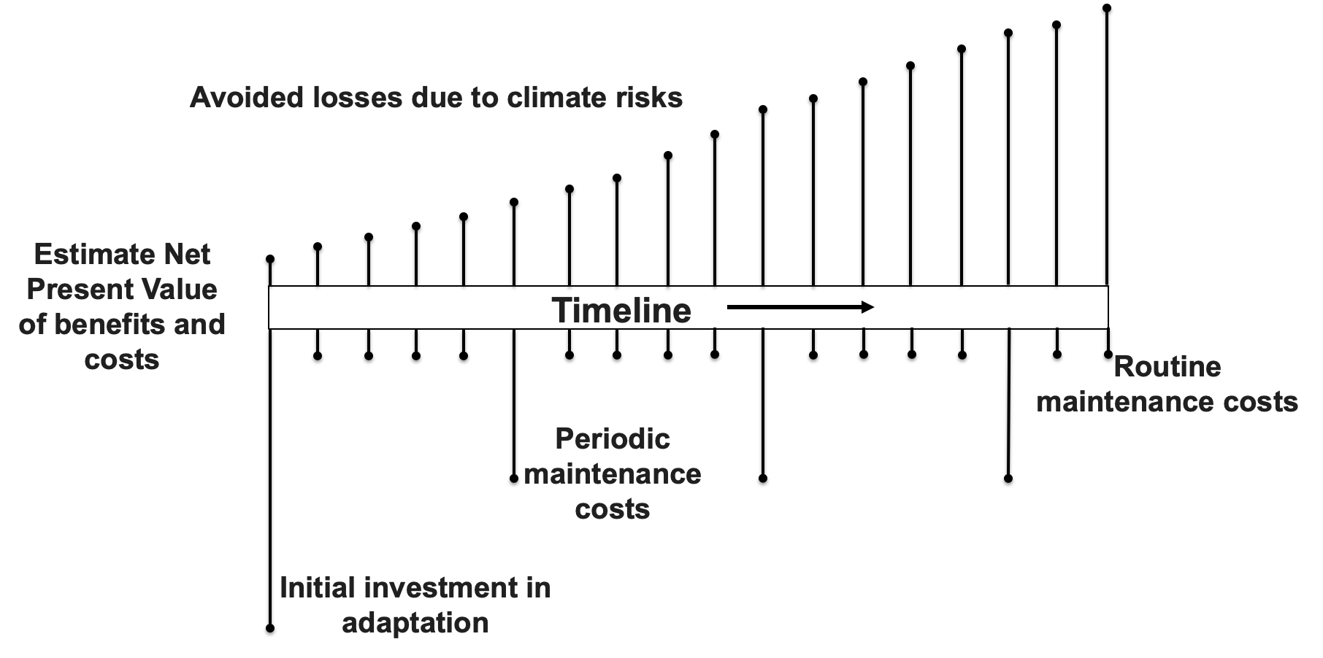
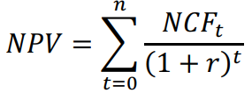
7.2 Evaluating actions
CBA – Net Present Value and maintenance costs
Net Present Value (NPV) quantifies value in today's terms
Handles risk through discounting
Maintenance costs are ongoing expenses to keep a project’s outputs functional and efficient. They include repairs, updates, cleaning, staff, and utilities, and are key to long-term sustainability
NPV = net present value
NCFt = net cash flow in year t
r = discount rate
Notes:
Cost-Benefit Analysis – Net Present Value and maintenance costs

Slide 16
7.2 Evaluating actions
CBA - pros and cons
Complexity of Externalities: While direct costs like materials and labor are easy to estimate, evaluating externalities—such as ecological damage from a hydroelectric dam—is far more challenging
Valuation Challenges: CBA struggles to assign meaningful monetary values to intangible elements like ecosystem displacement, customer willingness to pay, and local community preferences
Oversimplification Risk: The method requires converting all variables into absolute monetary terms, which can oversimplify or misrepresent complex social and environmental impacts
Enduring Popularity with Limitations: Despite its shortcomings, CBA remains a standard tool in infrastructure finance, especially for large-scale projects
Alternative approaches:
Multi-objective analysis
Decision-making under uncertainty
Cost-effectiveness analysis
Holistic comparison of costs and benefits
(Ratnaweera, Heistad, and Navrud 2020)
Notes:
Several critiques of Cost-Benefit Analysis (CBA) have emerged in recent literature
Example: Evaluating a hydroelectric dam project over an ecologically diverse forest
Easy to cost in terms of materials and labor, but challenging to assess externalities and benefits
Questions include the value of the displaced ecosystem, customer willingness to pay, and resident preferences
CBA requires absolute monetary values for complex variables, which it may not adequately address
Despite its limitations, CBA remains widely used in financial analysis of infrastructure projects
The ongoing political debate focuses on whether CBA should continue being the standard, with some advocating for improved frameworks
Four alternative approaches to cost-benefit analyses include:
Multi-objective analysis
Decision-making under uncertainty
Cost-effectiveness analysis
Holistic comparison of costs and benefits
Focus on multi-objective analysis, as it is commonly used in infrastructure research

Slide 17
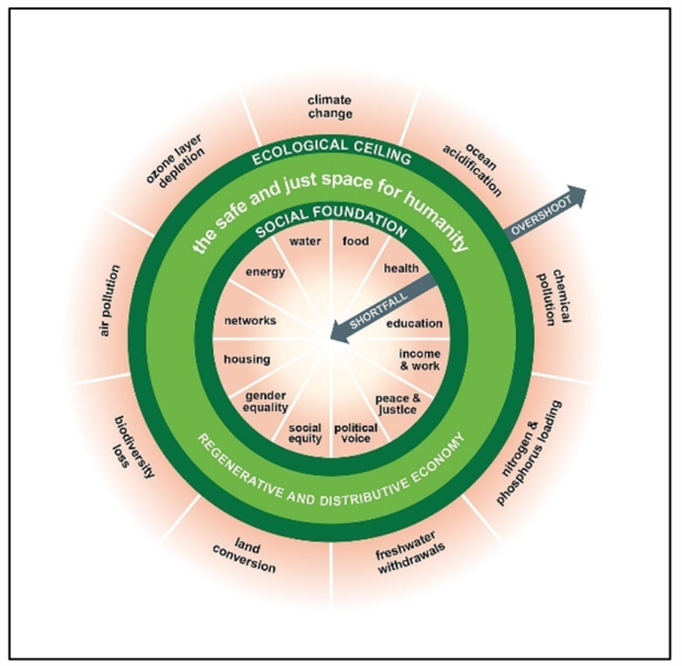
7.2 Evaluating actions
Multi-objective analysis
Cost-Benefit Analysis (CBA) evaluates actions solely based on monetary value, allowing for straightforward comparisons of commodities
Multi-objective analysis (or multi-criteria analysis) assesses actions across multiple dimensions, explicitly defining key objectives and performance criteria
This analysis can consider various factors such as cost, carbon emissions, land use, water requirements, and rare earth metal usage, providing greater transparency than CBA
Multi-objective analyses do not identify a single best solution but highlight trade-offs among different criteria to help stakeholders make informed decisions
The rise in multi-objective analyses is linked to the doughnut economics model, which promotes meeting human needs while staying within planetary boundaries
(Commons 2017)
(Raworth 2017)
Notes:
Figure: The doughnut economics model

Slide 18
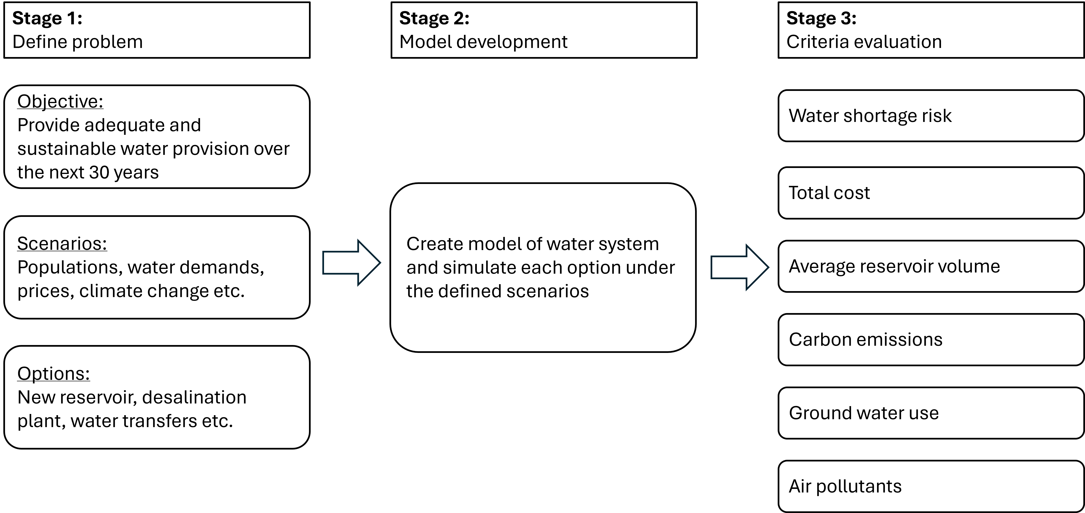
7.2 Evaluating actions
Multi-objective analysis: An example (part I)
Notes:
Objective: Plan water resources for London over the next 30 years to ensure adequate drinking water supplies
Framework Stages:
1. Problem Definition:
Discuss scope with stakeholders
Use scenarios to capture uncertainties (e.g., population growth, water demand, climate change)
Define options for infrastructure and policy interventions
2. Model Development & Simulation:
Simulate each option under defined scenarios
Explore "what-if" scenarios for anticipated outcomes
3. Criteria Evaluation:
Minimize risk of water shortages
Minimize total carbon emissions
Minimize air pollutants from the water system
Minimize groundwater usage
Maximize average water storage levels
Minimize total expenditure
Figure: An example framework for water sector planning using multi-criteria analysis

Slide 19
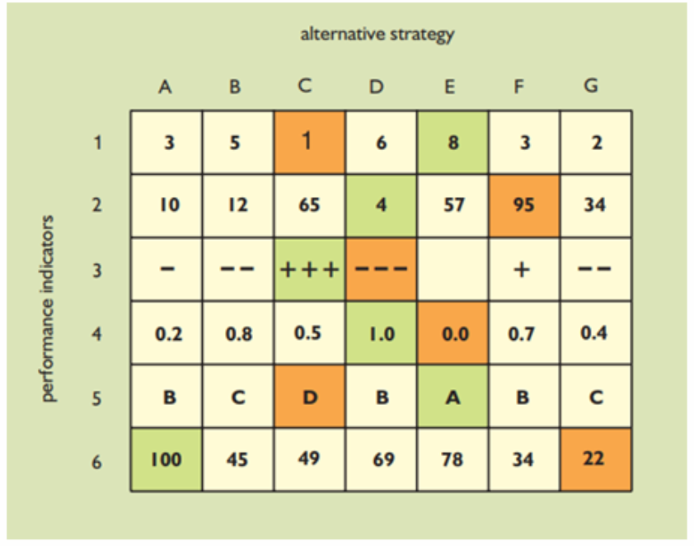
7.2 Evaluating actions
Multi-objective analysis: An example (part II)
The final stage of the decision framework is to evaluate system performance criteria
Each indicator represents a variable of interest to analysts and decision-makers
Statistical analysis is used to compute aggregated values based on data from each option and scenario (geometric and arithmetic means, minimum, and maximum values)
It is also common to calculate probabilistic values such as exceedance curves
Such computations are the basis of the key performance metrics
(Loucks and Van Beek 2017)
Notes:
Figure:An example scorecard of system performance indicators
The example we consider here evaluates six performance indicators as detailed above
Multi-objective analyses usually output large amounts of data

Slide 20
7.2 Evaluating actions
Summary
This lecture introduced how decision-makers can evaluate options when devising investment strategies
We discussed that cost-benefit analyses are too reductive for problems related to infrastructure and the environment
We showed how an alternative evaluation framework, multi-objective analysis, can be used in the decision-making process

Slide 21
7.2 Evaluating actions
Bibliography
Ackerman, Frank, and Lisa Heinzerling. 2002. “Pricing the Priceless: Cost-Benefit Analysis of Environmental Protection.” University of Pennsylvania Law Review 150 (5): 1553–84.
Commons, Wikimedia. 2017. “Doughnut Economic Model.” 2017. https://en.wikipedia.org/wiki/Doughnut_(economic_model).
Loucks, Daniel P, and Eelco Van Beek. 2017. Water Resource Systems Planning and Management: An Introduction to Methods, Models, and Applications. Springer.
Ratnaweera, Dino, Arve Heistad, and Ståle Navrud. 2020. “The Current Use and Potential of Cost Benefit Analysis in Water Sector Projects.” Water Supply.
Raworth, Kate. 2017. Doughnut Economics: Seven Ways to Think Like a 21st-Century Economist. Chelsea Green Publishing.

Slide 22
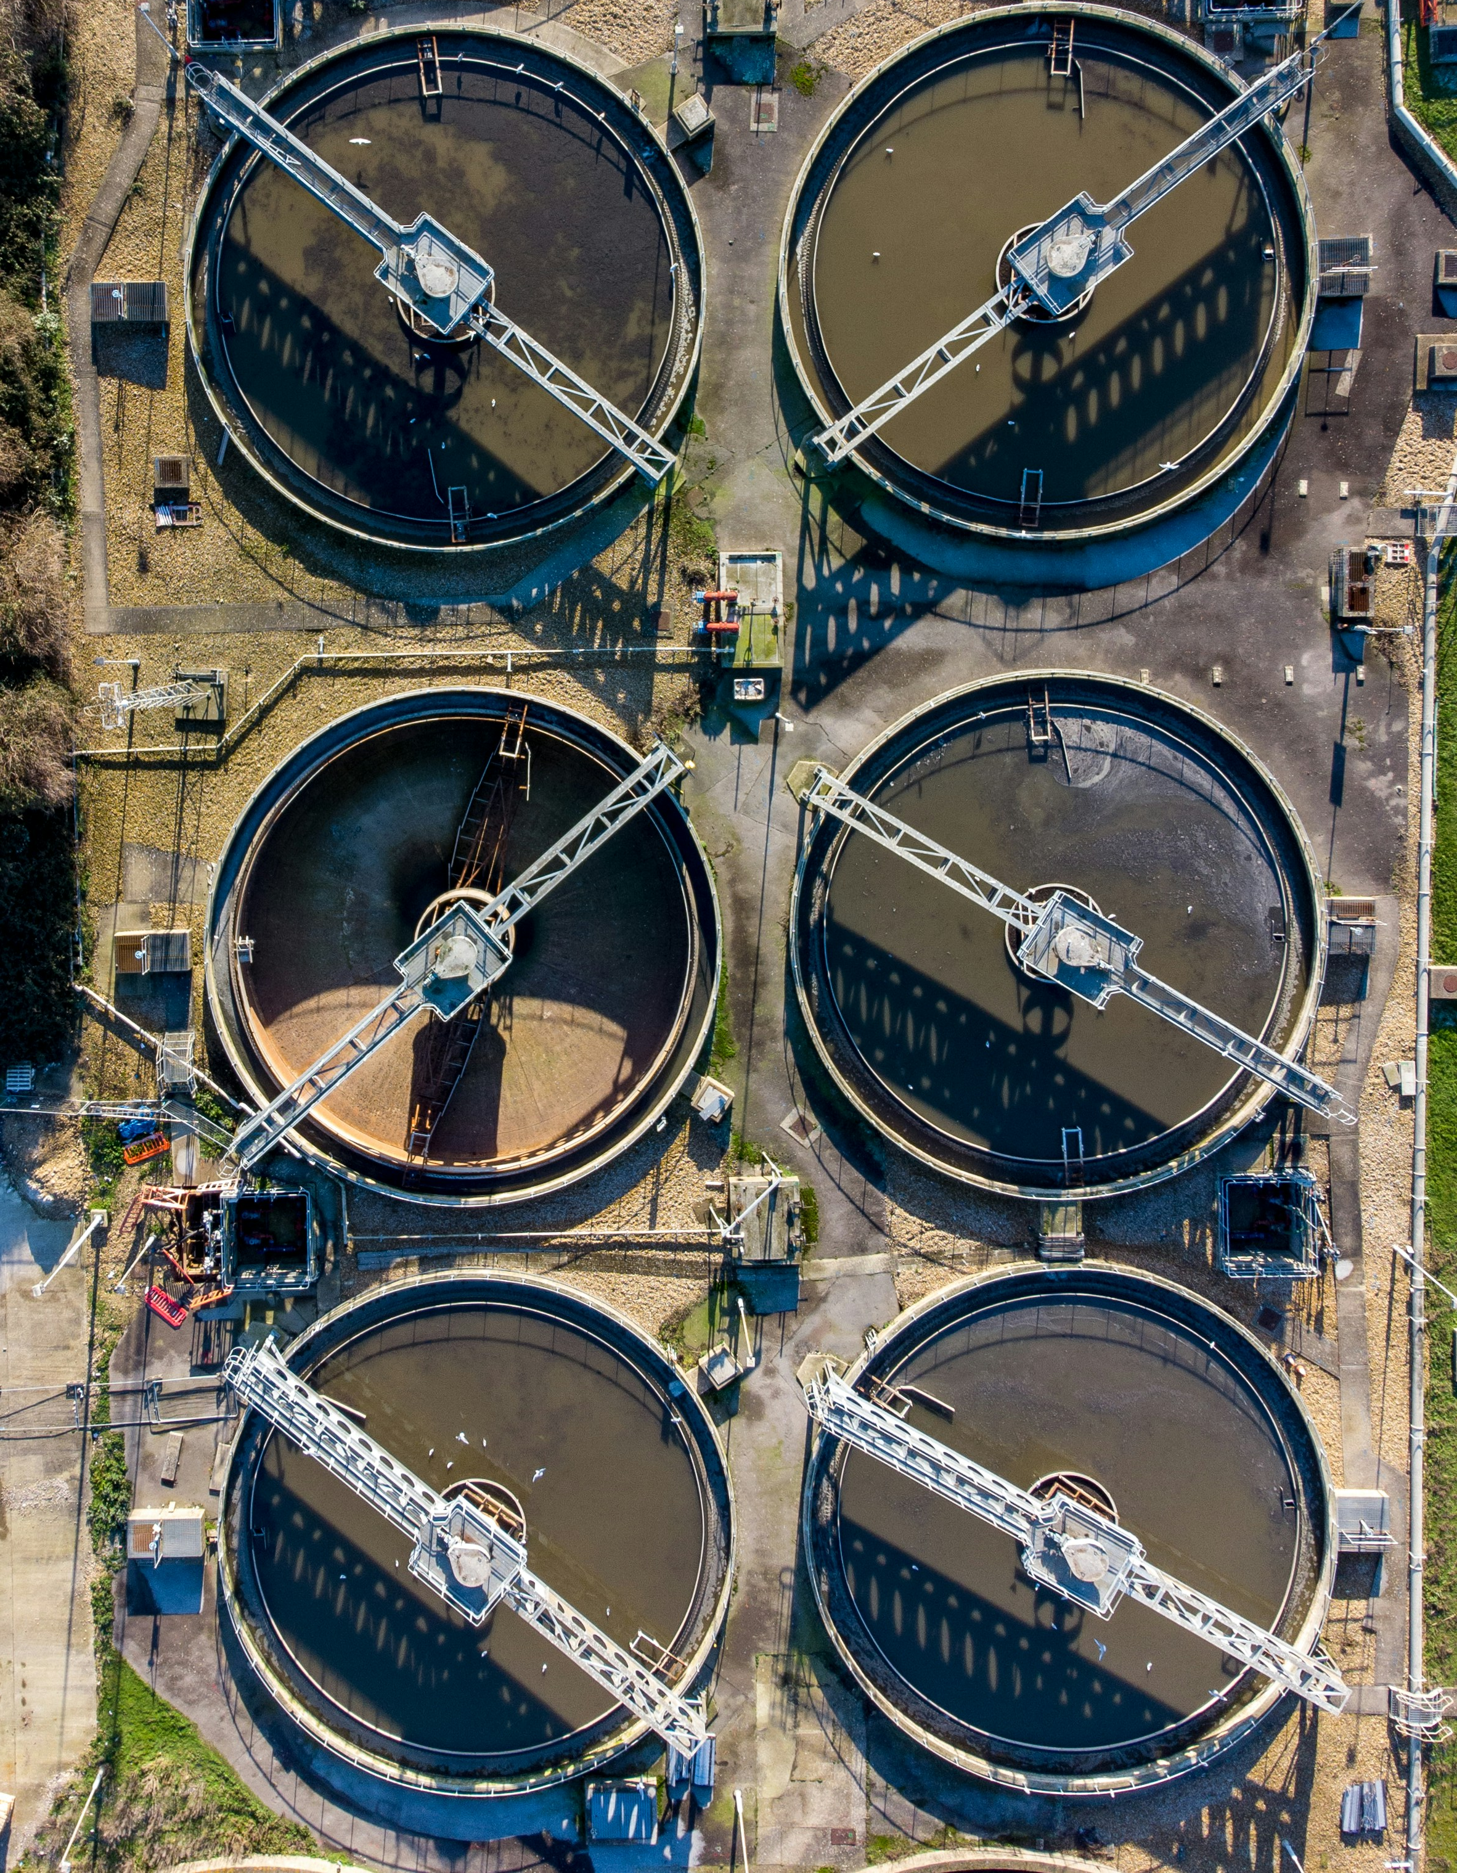
7.3 Decision-making under uncertainty
Learning objectives
Be able to define and categorise uncertainties
Understand the tenets of frameworks within decision theory under uncertainty
Recognise the importance of robustness within decision-making frameworks

Slide 23
7.3 Decision-making under uncertainty
Uncertainty and decision-making
Making decisions about infrastructure and environmental systems necessitates a process to anticipate and manage change
Complicated as populations are changing rapidly, technological development is accelerating at an unprecedented pace, and climate change is a serious operational risk to be managed
Example: how energy sector managers need to ensure reliable future supplies of electricity for a growing population whilst decarbonising supply sources, as well as managing the impacts from climate change and rapidly changing regulation
These issues are defined by uncertainty, defined as a situation involving imperfect or unknown information about the past, present, or future events
For a decision-maker, uncertainty represents the gap between the best information available to them and the knowledge they would need in order to make the best choice (Marchau et al. 2019)
Decision-making under uncertainty (DMUU) is a rich and developed field that is concerned with making the best possible choices based on imperfect or incomplete information

Slide 24
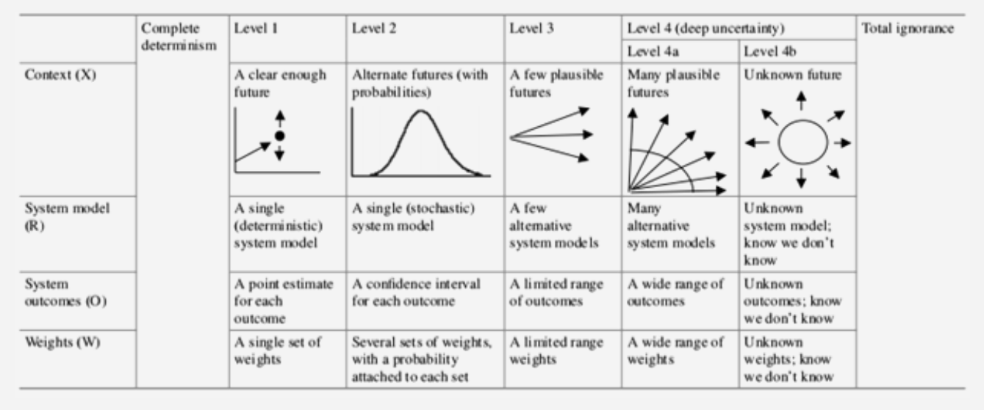
7.3 Decision-making under uncertainty
Types of uncertainty
We can define two extremes of uncertainty: complete determinism and total ignorance, within which four levels of uncertainties exist (Walker et al. 2003)
Levels of uncertainty (Marchau et al. 2019)
Notes:
Complete Determinism: Represents total uncertainty; nearly unattainable
Level 1 Uncertainty: Historical data can predict future outcomes
Examples: Operational conditions (scheduled maintenance) and asset parameters (power plant efficiency)
Level 2 Uncertainty: Defined through probabilistic models
Example: Total solar irradiance at a solar energy farm
Level 3 Uncertainty: Not describable probabilistically; not solely based on historical data
Treated through scenario analysis
Example: Rate of population change in a region
Level 4 Uncertainty: Deeply uncertain factors capturing a wide range of assumptions (4a) or unknown futures (4b)
Examples: Electricity prices (4a) and global financial crises (4b)
Initial Step in Managing Uncertainties: List and categorize relevant uncertainties to determine the best approach for decision-making

Slide 25
7.3 Decision-making under uncertainty
Dealing with uncertainty
There has been an increase in methodologies for decision-making under uncertainty, including robust decision-making, decision scaling, real options analysis, dynamic adaptive policy pathways, and info-gap analysis
These methodologies share common principles: extensive testing of uncertainties, use of multiple objectives, and identification of robust solutions
Investment plans undergo rigorous stress-testing against identified uncertainties during the formulation stage
Results from stress tests are evaluated based on multiple performance criteria
Decision-makers seek satisficing solutions that perform adequately across various scenarios and objectives
The focus on identifying robust solutions is a key aspect of decision theory under uncertainty, highlighting that no single optimal option exists
(Lempert, Popper, and Bankes 2010; De Neufville, Scholtes, and Wang 2006; Haasnoot et al. 2013; Hall et al. 2020)

Slide 26
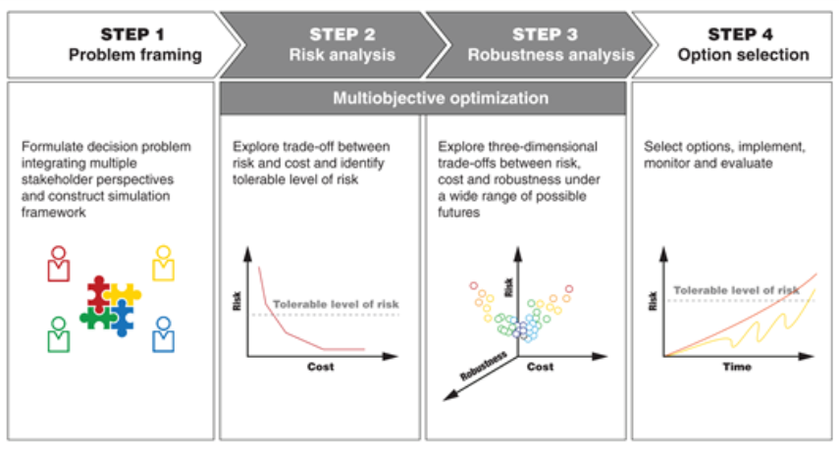
7.3 Decision-making under uncertainty
Robust decision-making: An example (part I)
Consider a planning problem in which we wish to ensure safe and reliable water supplies over the next three decades
Using a generic for decision-making under uncertainty, our methodology could be partitioned into four steps
For our specific problem, the following uncertainties can be identified:
Water demands (Level 3)
Hydrological variability (Level 2)
Electricity prices (Level 4a)
Groundwater abstraction licences (Level 1)
Water system operational parameters (Level 1)
The next stage is to create a computer model representation of the water system
It is common for decision-makers to deploy simulation models, which are a digital representation of a real-world system
A simulation model is a handy instrument in the planner’s toolbox as it allows us to conduct thousands of simulations of alternative strategies over a vast range of scenarios. Hence, we can exhaustively stress-test each strategy to see what happens (severity) and for how long (duration)
Notes:
Figure: An example simulation model constructed for the Thames basin, England, using the WATHNET platform

Slide 27
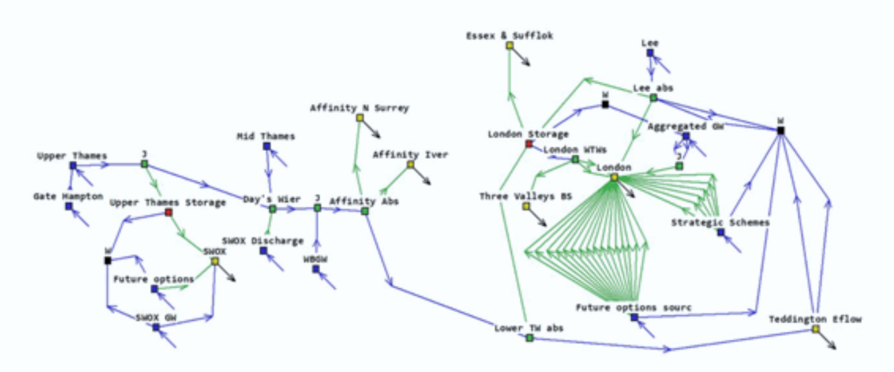
7.3 Decision-making under uncertainty
Robust decision-making: An example (part I)
Notes:
Figure: An example simulation model constructed for the Thames basin, England, using the WATHNET platform

Slide 28
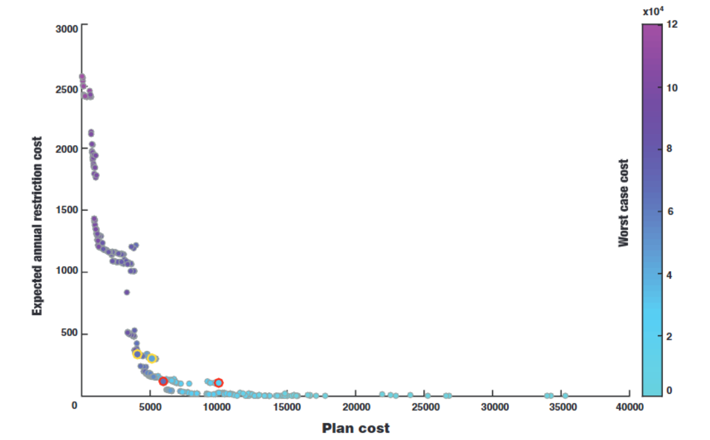
7.3 Decision-making under uncertainty
Robust decision-making: An example (part II)
Once we have constructed a system model and formulated a set of uncertainties and options, we can begin conducting vast number of simulations in an iterative fashion
Visualize through a curve the trade-offs between three objectives: cost (x-axis), water shortage risks (y-axis), and plan robustness (colour bar; increasing scale represents decreasing robustness)
This curve—known as the Pareto frontier—shows a set of solutions that are equally efficient in that the performance of one objective cannot be improved without harming the performance of another objective
Each point on the Pareto frontier represents a unique water investment plan
The objective is to find a set of solutions that are efficient in relation to the defined uncertainties, which are shown by the Pareto frontier
Decision-makers can evaluate the frontier and pick solutions for further investigation that meet their risk thresholds with regards to the three objectives. In this example, the solutions circled in yellow and red were analysed further
(Borgomeo et al. 2018)
Notes:
Figure: Trade-off curve between cost, water security, and robustness

Slide 29
7.3 Decision-making under uncertainty
Summary
Making decisions under uncertainty is an inherent part of infrastructure planning
Whilst it is nearly impossible for us to gain perfect information, it is possible for us to manage uncertainties when making decisions
This lecture introduced fundamental concepts within decision theory in conditions of imperfect or partial information
We highlighted the concept of robustness, which seeks to identify options that perform adequately across a range of uncertain conditions

Slide 30
7.3 Decision-making under uncertainty
Bibliography
Ben-Haim, Yakov. 2006. Info-Gap Decision Theory: Decisions Under Severe Uncertainty. Elsevier.
Borgomeo, Edoardo, Mohammad Mortazavi-Naeini, Jim W Hall, and Benoit P Guillod. 2018. “Risk, Robustness and Water Resources Planning Under Uncertainty.” Earth’s Future 6 (3): 468–87.
Brown, Casey, Yonas Ghile, Mikaela Laverty, and Ke Li. 2012. “Decision scaling: Linking bottom-up vulnerability analysis with climate projections in the water sector.” Water Resources Research 48 (9): 1–12. https://doi.org/10.1029/2011WR011212.
De Neufville, Richard, Stefan Scholtes, and Tao Wang. 2006. “Real Options by Spreadsheet: Parking Garage Case Example.” Journal of Infrastructure Systems 12 (2): 107–11.
Haasnoot, Marjolijn, Jan H Kwakkel, Warren E Walker, and Judith ter Maat. 2013. “Dynamic adaptive policy pathways: A method for crafting robust decisions for a deeply uncertain world.” Global Environmental Change 23 (2): 485–98. https://doi.org/10.1016/j.gloenvcha.2012.12.006.
Hall, Jim W, Mohammad Mortazavi-Naeini, Edoardo Borgomeo, Bill Baker, Helen Gavin, Meyrick Gough, Julien J Harou, et al. 2020. “Risk-Based Water Resources Planning in Practice: A Blueprint for the Water Industry in England.” Water and Environment Journal 34 (3): 441–54.
Lempert, Robert J, Steven W Popper, and Steven C Bankes. 2010. “Robust Decision Making: Coping with Uncertainty.” The Futurist 44 (1): 47.
Marchau, Vincent AWJ, Warren E Walker, Pieter JTM Bloemen, and Steven W Popper. 2019. Decision Making Under Deep Uncertainty: From Theory to Practice. Springer Nature.
Walker, Warren E, Poul Harremoës, Jan Rotmans, Jeroen P Van Der Sluijs, Marjolein BA Van Asselt, Peter Janssen, and Martin P Krayer von Krauss. 2003. “Defining Uncertainty: A Conceptual Basis for Uncertainty Management in Model-Based Decision Support.” Integrated Assessment 4 (1): 5–17.

Slide 31

7.4 Methods and processes for decision-making
Learning objectives
Identify the key processes of stakeholder engagement
Explain what a bottom-up vulnerability analysis is
Understand the need for sequential decision-making for adaptation purposes

Slide 32
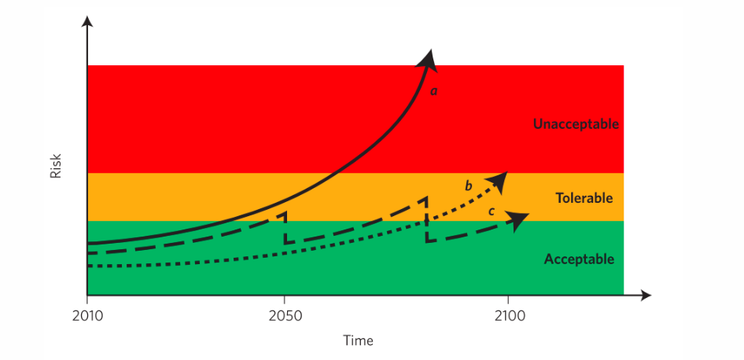
7.4 Methods and processes for decision-making
Introduction
Risk analyses methods consider uncertainties and identify robust interventions, often used for stress-testing exercises
Early stakeholder engagement is essential to
(1) guide the modeller by understanding the uncertainty space that they need to consider
(2) helps to effectively communicate the results
Key stages of stakeholder engagement include data gathering, prioritizing variables, and identifying critical thresholds for system failure
Establishing critical thresholds is difficult and depends on the decision-maker’s risk aversion, often leading to necessary decisions like infrastructure upgrades
Policy tipping points occur when critical thresholds are exceeded, affecting risk outcomes across different infrastructure paths
(Hall et al. 2012)
Notes:
Figure: Three strategies and their resulting risk outcome, which can be either unacceptable, tolerable or acceptable: (a) is the do-nothing scenario in which risk will increase in the future, (b) is the upfront investment scenario to keep risk tolerable, and (c) is the periodic upgrading scenario to keep risk tolerable

Slide 33
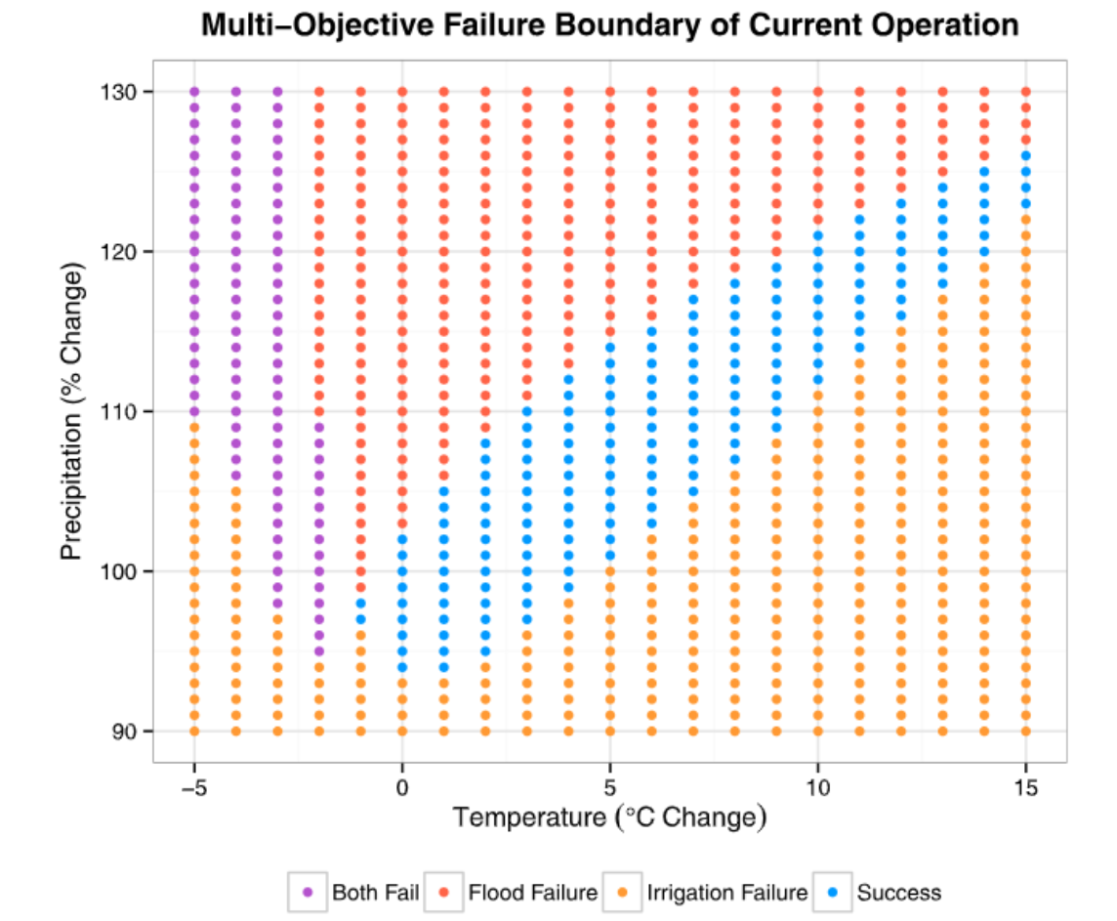
7.4 Methods and processes for decision-making
Bottom-up vulnerability analysis
A bottom-up vulnerability analysis, starts with exploring the different thresholds that are deemed to be intolerable, and the associated decisions that must be made when these thresholds are exceeded
For the scenario leading to the undesirable state, we can estimate what the risk exceeding this state is, and the combination of parameters that lead to this undesirable state (Brown et al. 2012)
This combination of parameters and their resulting system state is sometimes called a ‘response surface’
(Culley et al. 2016)
Notes:
Figure: A system response surface of a reservoir in northern Italy with changes in temperature and precipitation as the critical parameters. The blue dots illustrate the conditions at which the reservoir can continue to operate
Examples of threshold: the amount of sea level rise that flood defences can manage before needing an upgrade, or the changes in temperature and precipitation, which water utilities need to expand storage capacity for

Slide 34
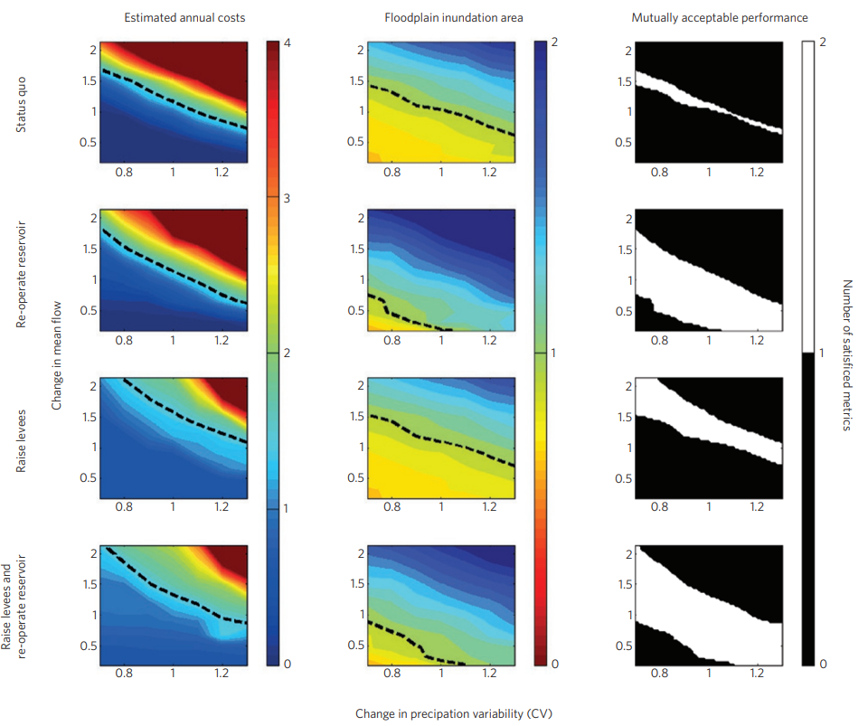
7.4 Methods and processes for decision-making
Adaptation pathways for multiple criteria
Stakeholder engagement is essential throughout the decision-making process to achieve informed and robust outcomes
A multi-stakeholder platform is necessary to build consensus on critical thresholds required for designing effective adaptation options
Consideration of multiple objectives is vital when evaluating adaptation options
Identifying mutually acceptable adaptation strategies is important, especially in the context of uncertainty around precipitation and streamflow
Establishing suitable indicators that align with stakeholders' demands helps to navigate trade-offs and synergies between different objectives
(Poff et al. 2016)
Notes:
Figure: The solution space of acceptable outcomes (white in right panels) taking into account cost constraints (left), flood risk reduction (middle-left) and ecology (middle-right). The top row is the status quo, while the next three rows cover different adaptation options. The solution space is set out against changes in precipitation and mean river flow

Slide 35
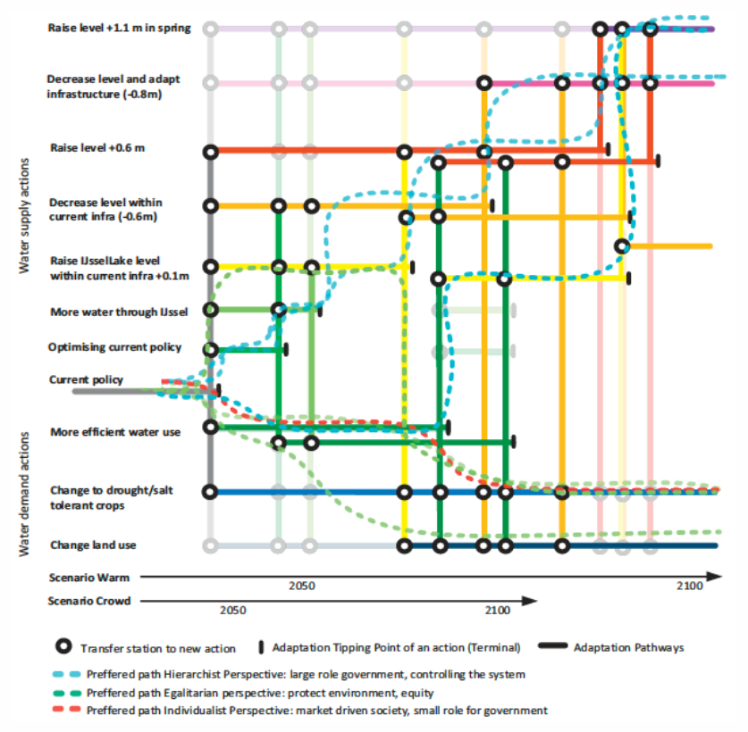
7.4 Methods and processes for decision-making
Dynamic adaptation pathways
Evaluating decision-making timing and sequential options is crucial for identifying optimal pathways to prevent critical failure states in systems
Long lead times for infrastructure interventions necessitate advance planning to implement adaptation options and avoid exceeding critical thresholds
Decision-making can be challenging without clear indicators of required interventions; methods like dynamic adaptive policy pathways can help guide this process
The approach allows for the assessment of numerous options and their outcomes, providing a structured blueprint for planning and effective communication with policymakers
(Haasnoot et al. 2013)
Notes:
Figure: An example of the application of dynamic adaptative pathways for the water supply system of The Netherlands. The (thick) coloured lines show all possible pathways to maintain system functioning until 2100 without exceeding any adaptation tipping points

Slide 36
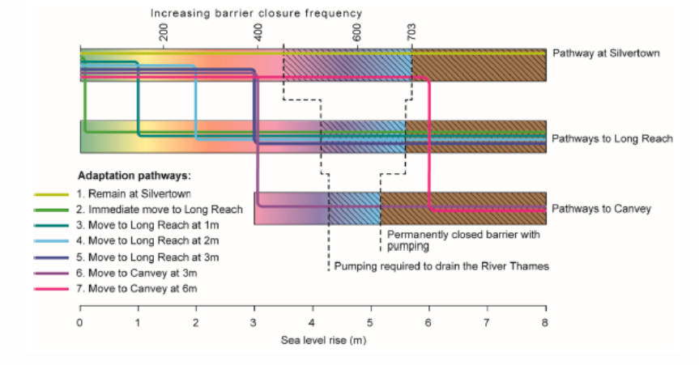
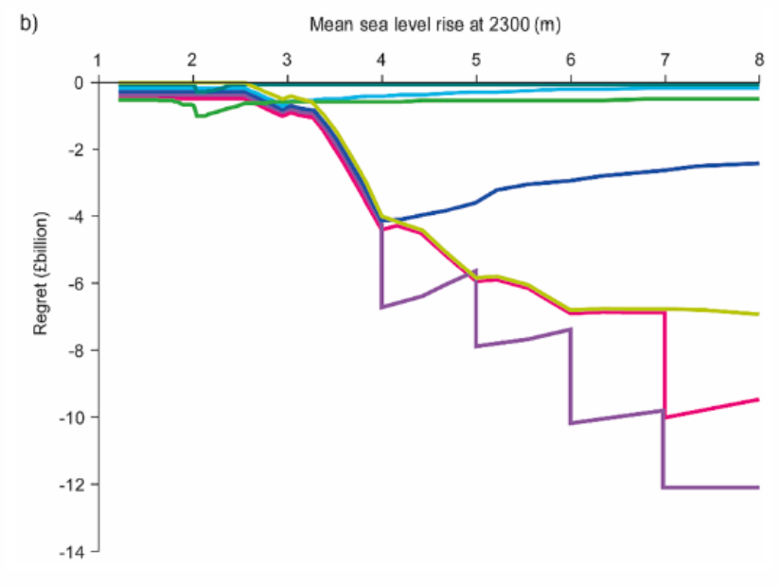
7.4 Methods and processes for decision-making
Exploring long-term adaptation options
The Thames Estuary 2100 project focuses on developing adaptation pathways to protect London from flooding over the next 300 years
Key decisions involve whether to raise the existing Thames barrier or relocate it, contingent on anticipated sea level rise rates
Relocating the barrier to Long Reach or Canvey is explored to mitigate flood risks more effectively
Various adaptation solutions have different cost structures, with high upfront costs but potentially low variable costs for solutions like increasing crest levels of defenses
Analysis of adaptation pathways highlights potential decision regrets, especially under extreme sea level rises (>3m), where both staying at Silvertown and moving to Canvey are costly with limited risk benefits
(Hall, Harvey, and Manning 2019)
(Hall, Harvey, and Manning 2019)
Notes:
Left figure: The different adaptation pathways as a function of the rise in sea level by 2300
Right figure: The regret of choosing a certain pathway compared to the best performing pathway given different sea level rise scenarios for 2300

Slide 37
7.4 Methods and processes for decision-making
Summary
We looked at processes for good decision-making that start with the identification and involvement of all stakeholders
These stakeholders are important as they help identify tolerable risk thresholds and acceptable adaptation options
Different methodologies are presented to identify and communicate suitable adaptation pathways towards resilience

Slide 38
7.4 Methods and processes for decision-making
Bibliography
Brown, Casey, Yonas Ghile, Mikaela Laverty, and Ke Li. 2012. “Decision scaling: Linking bottom-up vulnerability analysis with climate projections in the water sector.” Water Resources Research 48 (9): 1–12. https://doi.org/10.1029/2011WR011212.
Culley, S., S. Noble, A. Yates, M. Timbs, S. Westra, H. R. Maier, M. Giuliani, and A. Castelletti. 2016. “A bottom-up approach to identifying the maximum operational adaptive capacity of water resource systems to a changing climate.” Water Resources Research 52 (9): 6751–68. https://doi.org/10.1002/2015WR018253.
Haasnoot, Marjolijn, Jan H Kwakkel, Warren E Walker, and Judith ter Maat. 2013. “Dynamic adaptive policy pathways: A method for crafting robust decisions for a deeply uncertain world.” Global Environmental Change 23 (2): 485–98. https://doi.org/10.1016/j.gloenvcha.2012.12.006.
Hall, Jim W., Sally Brown, Robert J. Nicholls, Nick F. Pidgeon, and Robert T. Watson. 2012. “Proportionate adaptation.” Nature Climate Change 2 (12): 833–34. https://doi.org/10.1038/nclimate1749.
Hall, Jim W., Hamish Harvey, and Lucy J. Manning. 2019. “Adaptation thresholds and pathways for tidal flood risk management in London.” Climate Risk Management 24 (August 2018): 42–58. https://doi.org/10.1016/j.crm.2019.04.001.
Poff, N. Leroy, Casey M. Brown, Theodore E. Grantham, John H. Matthews, Margaret A. Palmer, Caitlin M. Spence, Robert L. Wilby, et al. 2016. “Sustainable water management under future uncertainty with eco-engineering decision scaling.” Nature Climate Change 6 (1): 25–34. https://doi.org/10.1038/nclimate2765.

Slide 39

Cannone, C., Collett, K.A., Charbonnier F., Ahsan A., Halloran C., Vijay,A.,Berdellans I., Hasanovic S., Gritsevskyi A,Stankeviciute L., Tot M.; Welsch M., Hirmer S., 2023. Lecture 1: "COURSE INTRODUCTION TO MAED" , Energy Demands Projections with MAED (Model for Analysis of Energy Demand). Release Version 2.0. [online presentation]. Climate Compatible Growth & Programme and International Atomic Energy Agency.
CCG courses (this will take you to the website link http://www.ClimateCompatibleGrowth.com/teachingmaterials)

