Slide 1
Lecture 6: Analysing future risks (Part 2)

Slide 2
Learning Outcomes
By the end of this lecture, you will:
Have seen the change in future risk to infrastructure because of changes in the use and expansion of infrastructure networks
Have looked more closely into future socio-economic growth scenarios and how they can inform infrastructure expansion and risk
Have an overview of additional methodologies and considerations to predict future infrastructure needs and inform planning
Have seen two case studies on St Lucia and Curaçao

Slide 3

6.1 Introduction to the future needs for infrastructure
Learning Objectives
Know what the future infrastructure investment gap is
Compare and contrast the different Shared Socio-economic Pathway (SSP) scenarios
Interpret studies that use SSP scenarios for future risk estimates

Slide 4
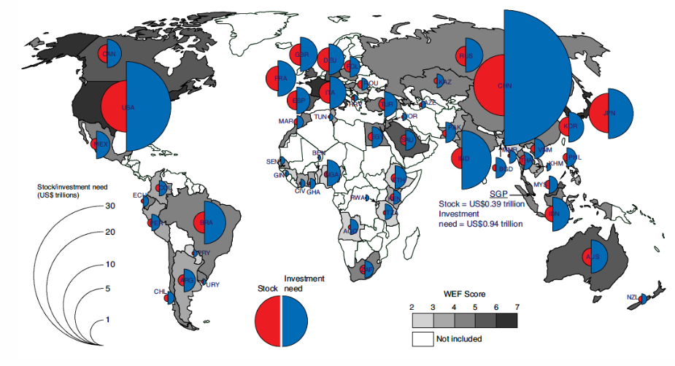
6.1 Introduction to the future needs for infrastructure
Introduction
It is not yet clear how much infrastructure is needed in the near and distant future
Some initial estimates show that an additional USD94 trillion of investments is needed by 2040, which is more than the value of existing infrastructure (USD50 trillion) (Thacker et al. 2019)
Others have estimated that low- and middle-income countries require investments of around 4.5% of GDP to achieve the infrastructure-related Sustainable Development Goals (SDGs) and stay on track to limit climate change to 2°C (Rozenberg and Fay 2019)
Projections made by the Organisation for Economic Co-operation and Development (OECD) and the International Energy Agency (IEA) estimate that an additional 60% increase in length of road and railway is needed by 2050, which is equal to around USD45 trillion (Dulac 2013)
(Thacker et al. 2019)
Notes:
Figure: An illustration of the global infrastructure gap for 2040, with the red circle showing the current stock and the blue circle the investment need

Slide 5
6.1 Introduction to the future needs for infrastructure
Drivers of infrastructure needs
Most infrastructure networks, such as road, rail, water, electricity and telecommunications are directly coupled to the growth in populations
Socio-economic growth may also change the ways in which we can afford certain infrastructure services, shifting demand (people might buy a car and start using the road network, while initially they could only afford taking the bus)
Larger wealth may shift the quality of infrastructure being provided ( water was initially only treated up to certain standards, but this will be upgraded to higher standards given society’s ability to pay for better quality water)
Wealth changes might shift the need for a denser network, such as a larger number of telecommunications towers, to increase service speed
Ports and airports, are more dependent on developments in terms of international trade flows or tourism, which are not just confined to national boundaries (increasing demand for products from a certain country requires that country to increase the port capacity)

Slide 6
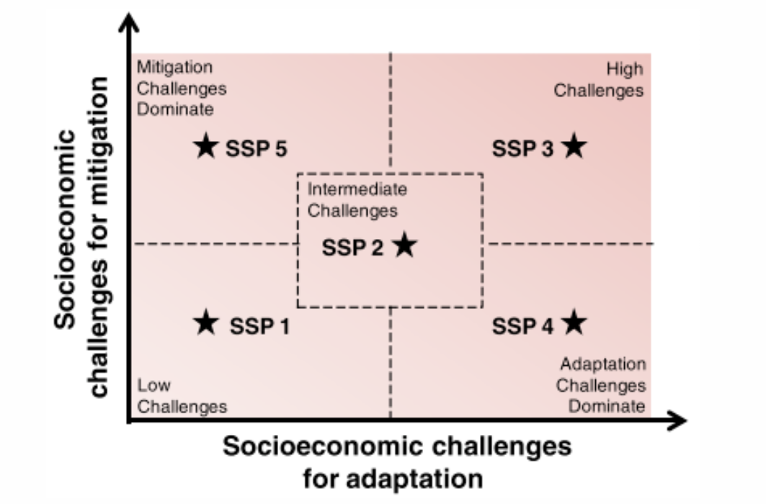
6.1 Introduction to the future needs for infrastructure
Introduction to Shared Socio-economic Pathways
(O’Neill et al. 2014)
Notes:
The Shared Socio-economic Pathways (SSP) are scenarios of global socio-economic development that account for uncertainties in future conditions, encompassing both qualitative and quantitative components
Five distinct SSP scenarios are constructed, ranging from sustainability-focused (SSP1) to inequality-focused (SSP4) and fossil-fuel-driven development (SSP5), reflecting varying challenges in mitigation and adaptation
Key demographic factors driving these models include population growth, fertility, mortality, migration, and urbanization, while human development factors include education, health, equity, gender equality, and social cohesion
Economic, institutional, technological, and natural resource drivers, such as trade, environmental policies, energy intensity, and land-use, play a critical role in shaping these scenarios
Figure: The five SSP scenarios and how they relate to the challenges for adaptation and mitigation. The key words show the main differences between the scenarios

Slide 7
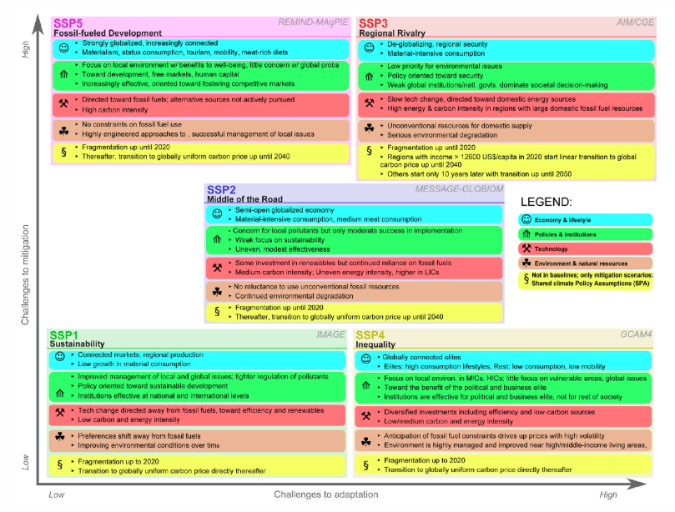
6.1 Introduction to the future needs for infrastructure
SSPs differences
(Bauer et al. 2017)
Notes:
SSP1: Focuses on sustainable development, with sharp income growth, reduced inequality, strong institutions, and low challenges for both mitigation and adaptation
SSP3: Represents high challenges for both mitigation and adaptation, characterized by slow income and technological growth, ineffective institutions, and limited human capital
SSP2: A "middle-of-the-road" scenario with intermediate challenges for mitigation and adaptation.
SSP4 and SSP5: Mixed scenarios; SSP4 features high inequality with low adaptation but low mitigation challenges due to high technological growth, while SSP5 emphasizes economic growth and low adaptation challenges but faces high mitigation challenges due to reliance on fossil fuels
Figure:The key assumptions of, and main differences between, the SSP scenarios with regards to adaptation and mitigation

Slide 8
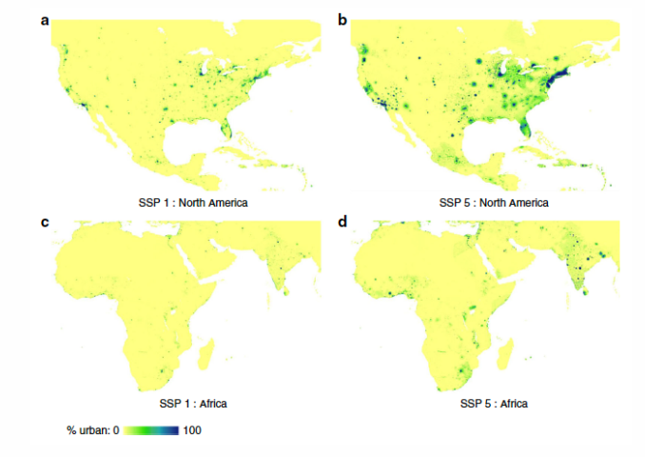
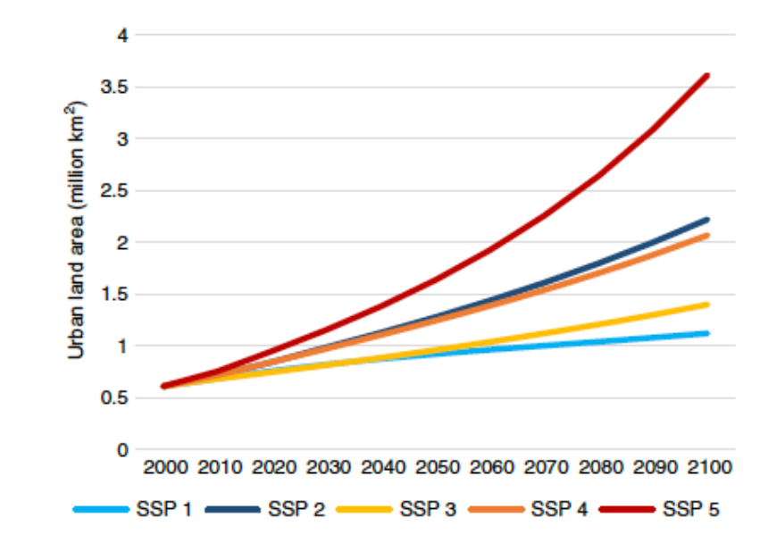
6.1 Introduction to the future needs for infrastructure
Applications of SSP scenarios
2. SSP scenarios were used to project future risk from riverine flooding
1. SSP scenarios used to model the future evolution of urbanisation
Spatial patterns of urbanisation in 2100 for two regions (North America, Africa) and two SSP scenarios (SSP1, SSP5) (Gao and O’Neill 2020)
The evolution of global urban land over the 21st century for different SSP scenarios (Gao and O’Neill 2020)

Slide 9
6.1 Introduction to the future needs for infrastructure
Summary
We have identified the main drivers of future infrastructure needs and the total infrastructure investment gap
We discussed the different scenarios of future socio-economic growth
We illustrated how these scenarios can be used to model changes in urbanisation rate and flood risk

Slide 10
6.1 Introduction to the future needs for infrastructure
Bibliography
Bauer, Nico, Katherine Calvin, Johannes Emmerling, Oliver Fricko, Shinichiro Fujimori, Jérôme Hilaire, Jiyong Eom, et al. 2017. “Shared Socio-Economic Pathways of the Energy Sector – Quantifying the Narratives.” Global Environmental Change 42: 316–30. https://doi.org/10.1016/j.gloenvcha.2016.07.006.
Dulac, John. 206. “Global land transport infrastructure requirements - Estimating road and railway infrastructure capacity and costs to 2050.” Paris, France: International Energy Agency.
Gao, Jing, and Brian C. O’Neill. 2020. “Mapping global urban land for the 21st century with data-driven simulations and Shared Socioeconomic Pathways.” Nature Communications 11 (1): 1–6. https://doi.org/10.1038/s41467-020-15788-7.
O’Neill, Brian C., Elmar Kriegler, Kristie L. Ebi, Eric Kemp-Benedict, Keywan Riahi, Dale S. Rothman, Bas J. van Ruijven, et al. 2017. “The roads ahead: Narratives for shared socioeconomic pathways describing world futures in the 21st century.” Global Environmental Change 42: 169–80. https://doi.org/10.1016/j.gloenvcha.2015.01.004.
O’Neill, Brian C., Elmar Kriegler, Keywan Riahi, Kristie L. Ebi, Stephane Hallegatte, Timothy R. Carter, Ritu Mathur, and Detlef P. van Vuuren. 2014. “A new scenario framework for climate change research: The concept of shared socioeconomic pathways.” Climatic Change 132 (3): 387–400. https://doi.org/10.1007/s10584-013-0905-2.
Rozenberg, Julie, and Marianne Fay. 2019. Beyond the Gap: How Countries Can Afford the Infrastructure They Need while Protecting the Planet. Washington, DC: World Bank. https://doi.org/10.1596/978-1-4648-1363-4.
Thacker, Scott, Daniel Adshead, Marianne Fay, Stéphane Hallegatte, Mark Harvey, Hendrik Meller, Nicholas O’Regan, Julie Rozenberg, Graham Watkins, and Jim W. Hall. 2019. “Infrastructure for sustainable development.” Nature Sustainability 2 (4): 324–31. https://doi.org/10.1038/s41893-019-0256-8.
Winsemius, Hessel C., Jeroen C. J. H. Aerts, Ludovicus P. H. Van Beek, Marc F. P. Bierkens, Arno Bouwman, Brenden Jongman, Jaap C. J. Kwadijk, et al. 2016. “Global drivers of future river flood risk.” Nature Climate Change 6 (4): 381–85. https://doi.org/10.1038/nclimate2893.

Slide 11
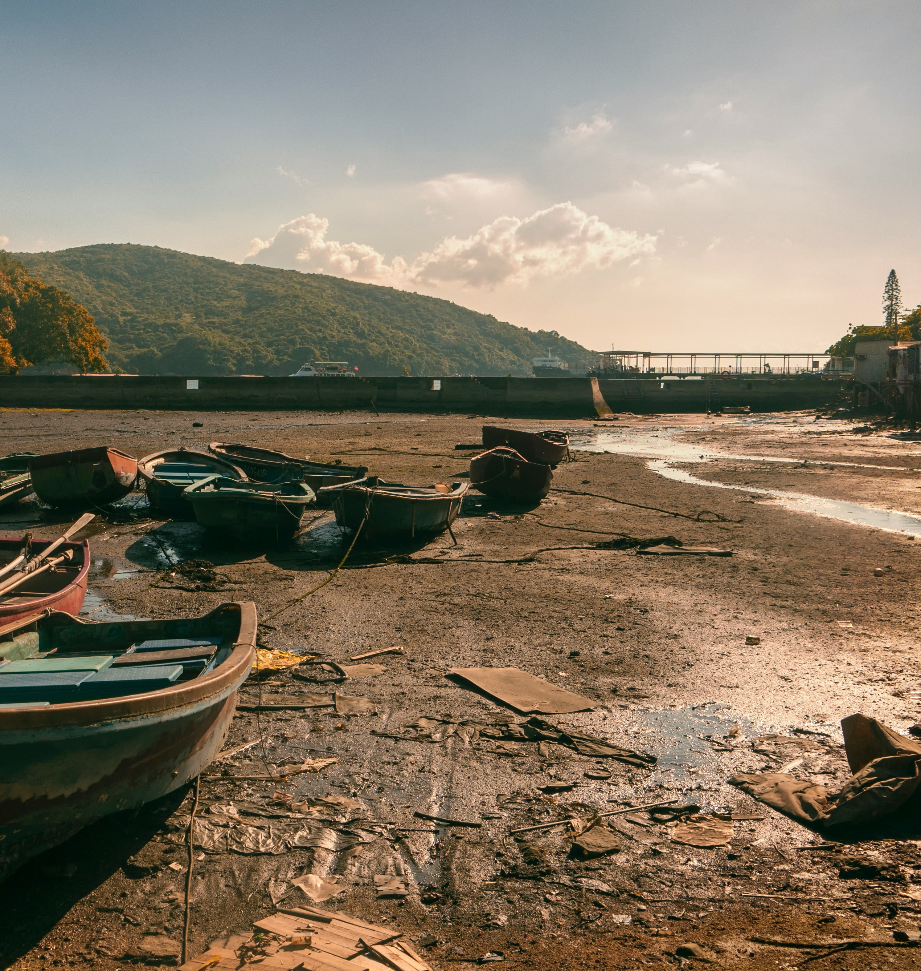
6.2 Projecting future infrastructure networks
Learning objectives
Recognise the different ways of projecting future infrastructure developments
Gain insight into future risks of infrastructure disruptions due to infrastructure development
Acknowledge the need to incorporate resilience into future infrastructure projects

Slide 12
6.2 Projecting future infrastructure networks
Introduction
Discuss methods for forecasting infrastructure needs related to expansion and new construction
Approaches vary by infrastructure type, growth drivers, and time frame:
Large-scale projects (e.g., hydropower dams) often have existing plans
Local expansions (e.g., roads) benefit from predictive modeling over longer periods
Integrate projections with hazard information to assess exposure risks and service disruptions
Key Cases:
1. Dam development and drought vulnerability
2. Port development and adaptation to sea-level rise
3. Future changes in road development
4. Future transport networks and potential disruptions

Slide 13
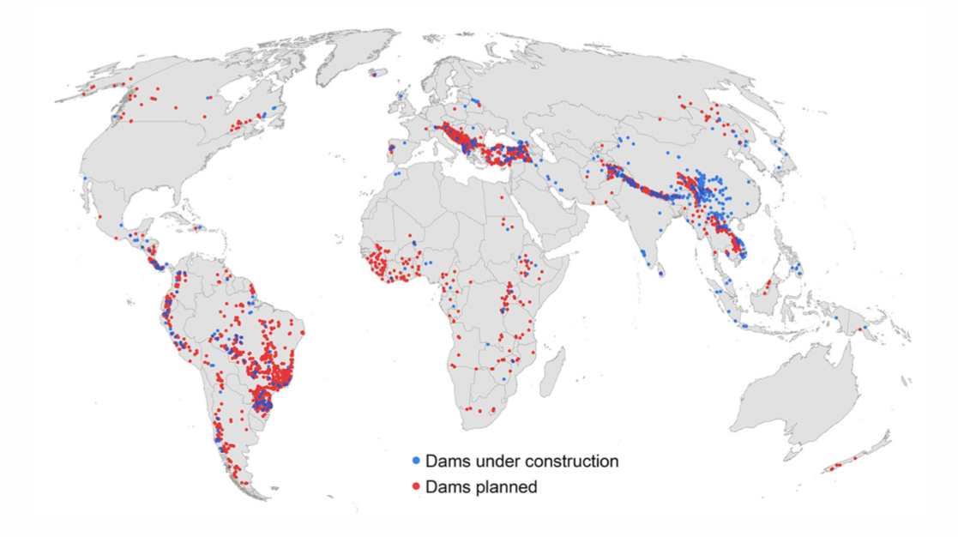
6.2 Projecting future infrastructure networks
Future dam development
Large infrastructure projects often require years for planning and execution
Databases of planned projects are available for the next 10-20 years
Hydropower dams exemplify this trend:
Renewable energy source, constituting 80% of global renewable production.
Only 22% of feasible hydropower potential is currently exploited (Zarfl et al. 2015).
Zarfl et al. (2015) created a database of all planned and under-construction hydropower dams
Key areas of planned development:
South America, Himalayas, Mekong Basin, Turkey, Balkan region
Ongoing projects primarily in Asia, especially China
Approximately 3,700 dams (>1 MW) expected to double global hydropower capacity in 10-20 years
Risk analysis overlaid with hazard information:
Insight into developments in hazard-prone areas
Conway et al. (2017) evaluated potential hydropower supply disruptions in Africa due to drought
Findings assist in understanding risks and identifying mitigation strategies
The location of dams currently under construction and planned (Zarfl et al. 2015)

Slide 14
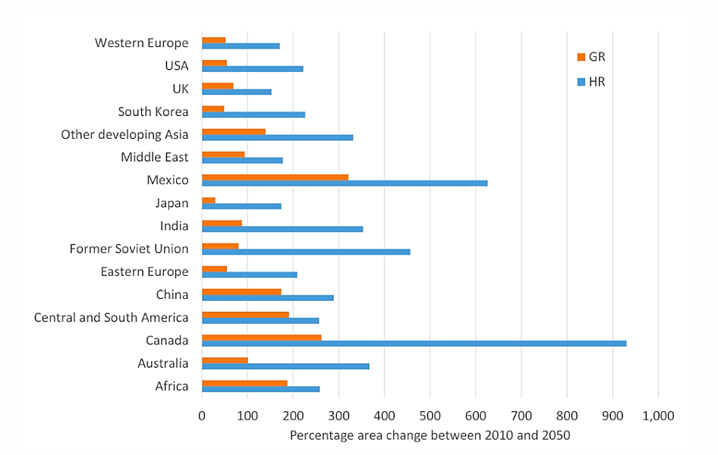
6.2 Projecting future infrastructure networks
Future port development
Long-term Infrastructure Needs (2050-2100): Demand for port infrastructure driven by future trade scenarios, influenced by population and economic changes
Maritime freight flows may triple by 2050, leading to inadequate port capacity by 2030
In the same timeframe ports must raise land areas to adapt to expected sea-level rise (SLR)
In Hanson and Nicholls (2020) two trade scenarios were considered:
mitigated future (green future + low SLR)
unmitigated future (fossil-fuel intensive future + high SLR)
Estimated global need increases from 1,364 km² to 2,500-5,000 km² by 2050, with significant increases expected in Mexico, Russia, Canada, and India
By 2050, construction costs entirely driven by new port areas
By 2100, adaptation costs rise significantly in the unmitigated scenario, though still lower than construction costs
(Hanson and Nicholls 2020)
Notes:
Figure: The percentage change in port areas between 2010 and 2050 for two scenarios (GR - mitigated; HR - unmitigated)

Slide 15
6.2 Projecting future infrastructure networks
Spatial developments of global roads
For infrastructure types that cover the whole country, such as roads, we are interested in the prediction of the spatial pattern of infrastructure development
Total length of roads globally will increase by 14-23% (Meijer et al. 2018)
A grid-based regression model is constructed to predict road density in grid cells based on:
  Population
  Degree of urbanization
  Local GDP
A general additive model is used because it accommodates non-linear relationships, capturing how road expansion may depend on development status
The model predicts road expansion by 2050 under the SSP4 scenario, with key findings:
  Significant road development is expected in China, India, and parts of Europe, aligning with SSP-driven changes in population and urbanization
  Many new roads are projected along coastal areas (e.g., China and Japan).
Climate change risks should be carefully factored into road development projects, particularly in vulnerable coastal regions
Notes:
Figure: The change in future road density per grid cell for 2050 (compared to 2010) under the SSP4 scenario

Slide 16
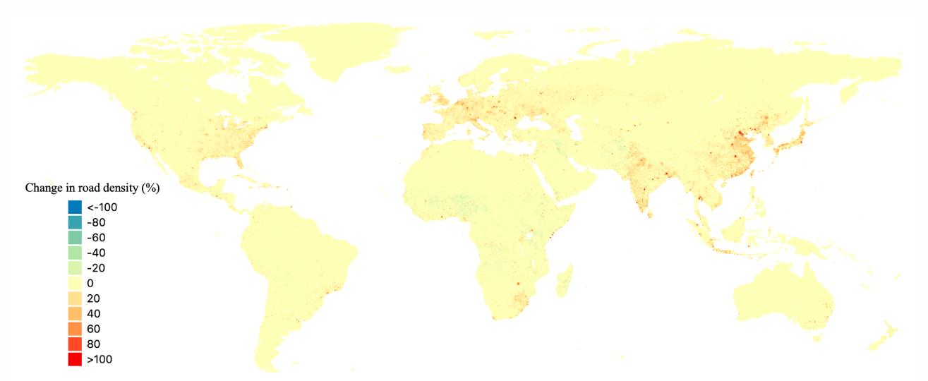
6.2 Projecting future infrastructure networks
Notes:
Figure: The change in future road density per grid cell for 2050 (compared to 2010) under the SSP4 scenario

Slide 17
6.2 Projecting future infrastructure networks
Future infrastructure risk
In a transport risk analysis for Tanzania (Pant et al. 2018) a future transport scenario for 2030 was generated that includes:
1. change in freight flows due to economic growth (5-9%),
2. upgrading of existing infrastructure assets (unpaved to paved roads), increasing the capacity of the system
This future transport network was combined with future climate hazard information (fluvial and pluvial flooding)
The combined effect leads to some very large freight flow increases in the national transport network:
The main highway system is predicted to increase freight volume by 22-27% annually
Some inland ports in Tanzania will experience 11-19% increase in trade
The potential impacts of disruptions will also increase (some losses from disruptions are predicted to triplicate due to failure on some important road sections
To manage risk, the infrastructure needs to be upgraded to be less vulnerable to the impacts of disruptions, or additional mitigation measures need to be taken, such as rerouting options or fast recovery and repair of affected infrastructure
(Pant et al. 2018)
Notes:
Figure: Changes in future road use as a result of economic growth and infrastructure upgrades for 2030 (right) relative to 2016 (left)

Slide 18
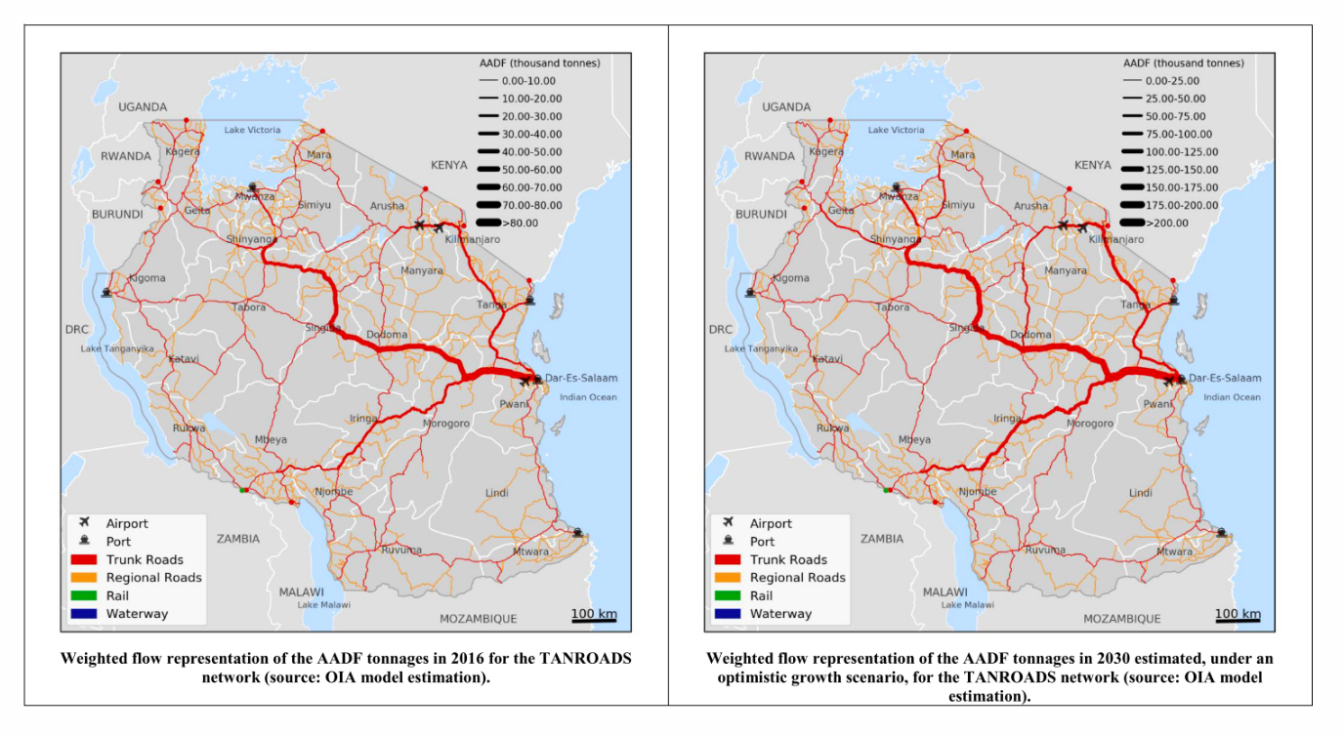
6.2 Projecting future infrastructure networks
(Pant et al. 2018)
Notes:
Figure: Changes in future road use as a result of economic growth and infrastructure upgrades for 2030 (right) relative to 2016 (left)

Slide 19
6.2 Projecting future infrastructure networks
Summary
Different ways future socio-economic scenarios can inform projections of infrastructure needs
New infrastructure development also means more infrastructure potentially at risk
Increased resilience needs to be embedded into new infrastructure development projects

Slide 20
6.2 Projecting future infrastructure networks
Bibliography
Conway, Declan, Carole Dalin, Willem A. Landman, and Timothy J. Osborn. 2017. “Hydropower plans in eastern and southern Africa increase risk of concurrent climate-related electricity supply disruption.” Nature Energy 2 (12): 946–53. https://doi.org/10.1038/s41560-017-0037-4.
Hanson, Susan E., and Robert J. Nicholls. 2020. “Demand for Ports to 2050: Climate Policy, Growing Trade and the Impacts of Sea‐Level Rise.” Earth’s Future 8 (8). https://doi.org/10.1029/2020EF001543.
ITF. 2019. ITF Transport Outlook 2019. ITF Transport Outlook. OECD. https://doi.org/10.1787/transp_outlook-en-2019-en.
Meijer, Johan R., Mark A. J. Huijbregts, Kees C. G. J. Schotten, and Aafke M. Schipper. 2018. “Global patterns of current and future road infrastructure.” Environmental Research Letters 13 (6). https://doi.org/10.1088/1748-9326/aabd42.
Pant, R., E. E. Koks, T. Russell, and J. W. Hall. 2018. “Transport Risk Analysis for The United Republic of Tanzania.” April. Oxford Infrastructure Analytics.
Zarfl, Christiane, Alexander E. Lumsdon, Jürgen Berlekamp, Laura Tydecks, and Klement Tockner. 2015. “A global boom in hydropower dam construction.” Aquatic Sciences 77 (1): 161–70. https://doi.org/10.1007/s00027-014-0377-0.

Slide 21
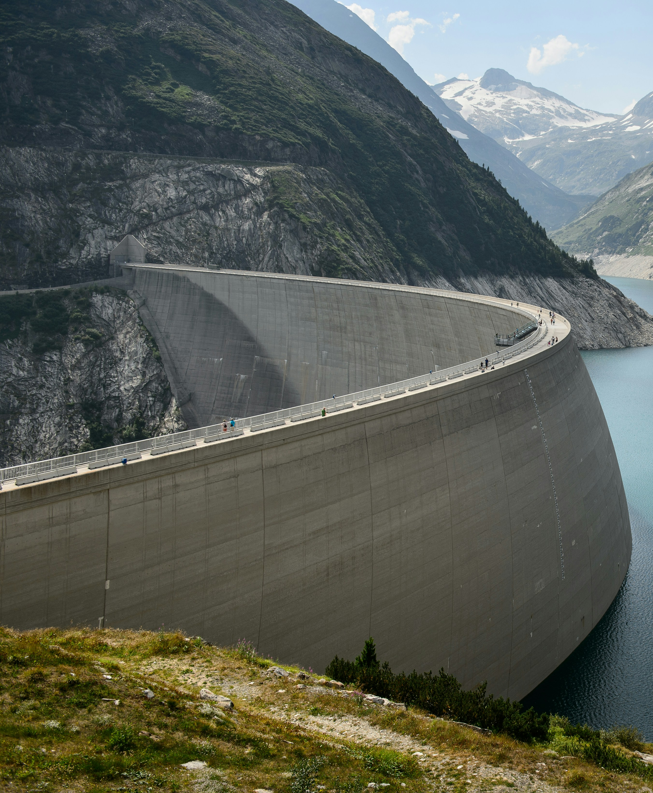
6.3 Changes in infrastructure dependencies
Learning objectives
Analyse the additional critical factors that need to be considered for infrastructure planning
Evaluate how societal changes might change how infrastructure is being used
Identify possible infrastructure pathways and complementary infrastructure investment needs

Slide 22
6.3 Changes in infrastructure dependencies
Introduction
Three critical factors are considered in this lecture:
Societal norms might change, which can change the use of infrastructure. For instance, the transition towards renewable energy changes the electricity networks. Moreover, COVID-19 has shown that societal norms might change (e.g. working from home), which change the way infrastructure is being used
There are important feedback loops and infrastructure lock-ins, which need to be considered. For instance, improved infrastructure systems that connect rural to urban areas might initiate migration to urban centres
There are different ways that infrastructure can be provided in the future (e.g. construct one big road versus a couple of smaller ones), which change the underlying network structure and hence use

Slide 23
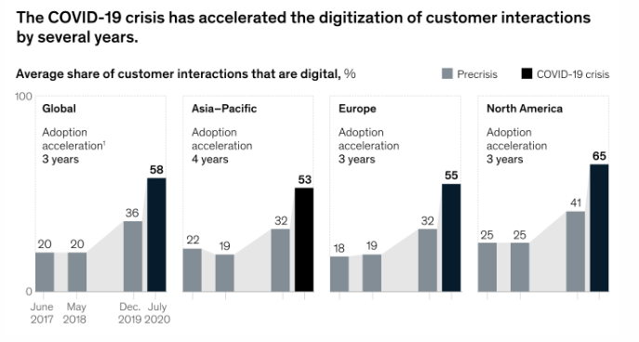
6.3 Changes in infrastructure dependencies
Changes in societal norms
The COVID-19 pandemic has tested the resilience of infrastructure systems, primarily impacting how services are used rather than causing physical damage
Infrastructure development projects have been altered, with airport expansions and public transport usage affected due to changing travel patterns
Many governments intervened financially to support train operators and airports facing crises due to decreased ridership and travel
A surge in digital communication reliance has occurred, accelerating the digitization of business practices as more people work from home
The pandemic has increased appreciation for walking, cycling, and green spaces, influencing urban design and rehabilitation
There is an anticipated focus on green infrastructure projects as part of ‘green recovery’ plans, promoting sustainability in post-pandemic recovery efforts
(McKinsey & Company 2020)
Notes:
Figure: An illustration of the rapid increase in digitisation of customer interactions due to the COVID-19 pandemic
There are now several open-source hazard products at global scales which are being used widely for vulnerability and risk analysis. A few resources include:
Global river and coastal flood maps: Historical and future hazard maps at different return periods (2, 5, 13, 25, 50, 130, 250, 500, 1300 years). All data is available at a 30 arc-seconds resolution (~1km at equator) (Gassert et al. 2015).
Global hazard maps for earthquakes for different return periods (250, 475, 975, 1500, 2475 years) both Peak Ground Acceleration and spectral acceleration. Data is available at 0.072 degrees (~8km at equator).
Global dataset of 13,000 synthetic tropical cyclones paths with cyclone characteristics (e.g., wind speed, pressure) on a global scale. Wind speed probabilities are derived globally (13 metre, 13 minutes sustained speed) for different return periods (13 to 13,000 years) at 13km resolution (Bloemendaal et al. 2019).

Slide 24
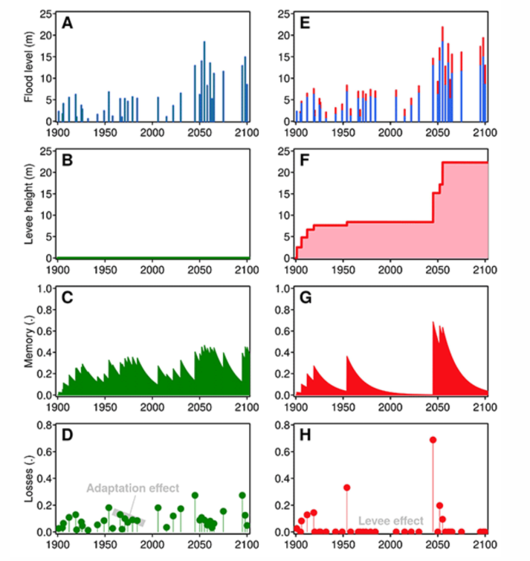
6.3 Changes in infrastructure dependencies
Societal feedbacks with infrastructure
Infrastructure and Development Lock-in
The Levee Effect (White 1942)
Cycle of Risk and Memory Loss
Infrastructure-Induced Migration
Feedback Processes Matter
(Di Baldassarre et al. 2015)
Notes:
Infrastructure and Development Lock-in:
Infrastructure can drive urban expansion into hazard-prone areas or newly connected regions, potentially increasing vulnerability
The Levee Effect (White 1942):
Flood protection works, like levees and reservoirs, can create a false sense of safety, encouraging settlement in at-risk area
This can lead to cyclical investments in levees after catastrophic flood events
Cycle of Risk and Memory Loss:
Increasing levee heights reduces immediate losses but fosters memory loss of prior floods, leading to greater settlement and heightened risk over time
Without levees, more frequent small losses occur, enabling societies to adapt and avoid large-scale disasters
Infrastructure-Induced Migration:
New roads or infrastructure can stimulate economic growth in previously unconnected areas but may also drive migration from rural to urban regions, changing social dynamics
Feedback Processes Matter:
Effective planning requires understanding the feedback loops between infrastructure development and societal behavior to avoid unintended long-term consequences
Figure: An illustration of the levee effect on the right-hand side, showing how the construction of levees can result in low risk compared to the situation without levees, but can cause very extreme losses if the levees fail. This loss event will in turn stimulate additional investments. For the normal scenarios, losses will not change much over time due to the adaptation effect of people not settling in these areas

Slide 25
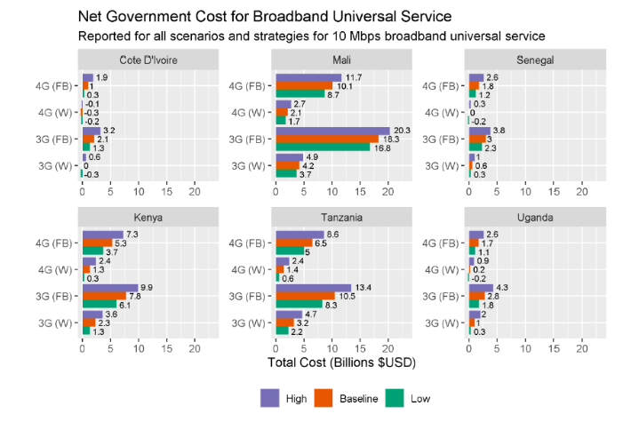
6.3 Changes in infrastructure dependencies
Infrastructure provision pathways
Many potential pathways to meet infrastructure needs in the future, which all have inherent benefits and drawbacks
For rapidly developing regions exploration of various pathways is essential to prevent lock-in patterns of unsustainable infrastructure provision
(Oughton 2021)
Notes:
Figure: The costs of achieving broadband universal services in six countries in Africa for four infrastructure provision pathways (3G vs 4G and fixed vs wireless)
EXAMPLE
E.G. objective to provide universal access to broadband internet in Africa at a service of 10Mbps, aim set by the UN Broadband Commission:
Directly leapfrogging into 4G+wireless backhaul is the most cost-efficient strategy instead of going from 3G to 4G, in particular to connect rural areas
The number of people that can be connected differs per country, from half the population in Uganda to almost 100% in Cote d’Ivoire
Infrastructure sharing (infrastructure shared between operators) can significantly decrease cost, especially in reaching rural areas

Slide 26
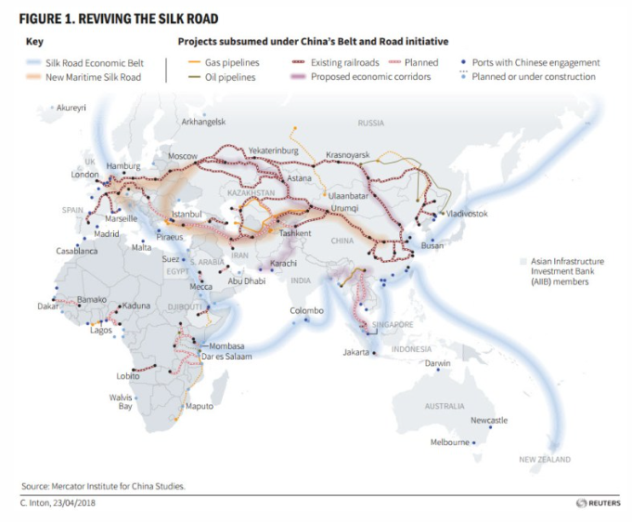
6.3 Changes in infrastructure dependencies
Complementary infrastructure needs
Sketching out what type of societal and infrastructure feedbacks are to be expected, and how complementary infrastructure investment can be made, help to roll out infrastructure services in a more efficient way
The extension of telecommunications infrastructure needs to be accompanied by the expansion of electricity networks
For port infrastructure access to roads and railways in both the port and the hinterland area are critical to make the investment a success
Feedbacks can therefore be local, regional or even global
(Brookings 2019)
Notes:
Figure: The portfolio of planned projects under the Belt and Road Initiative
EXAMPLE
Belt and Road Initiative:
Better connect China with the rest of the world
Land and maritime transport and energy infrastructure, in China and many other countries, expanded to facilitate this increasing connectivity
This shows the true interconnected nature of infrastructure expansions
These interactions need to be kept in mind when planning for infrastructure expansion

Slide 27
6.3 Changes in infrastructure dependencies
Summary
Additional critical factors for sustainable and efficient future infrastructure development
Taking into consideration societal norms and feedbacks, and possible infrastructure pathways and complementary infrastructure needs
These factors need to be identified before infrastructure plans are made

Slide 28
6.3 Changes in infrastructure dependencies
Bibliography
Alam, Muneeza, Matias Herrera Dappe, Martin Melecky, and Ran Goldblatt. 2019. Wider Economic Benefits of Transport Corridors: Evidence from International Development Organizations. November. World Bank, Washington, DC. https://doi.org/10.1596/1813-9450-9057.
Brookings. 2019. “Charts of the Week: China’s Belt and Road Initiative.” https://www.brookings.edu/blog/brookings-now/2019/05/17/charts-of-the-week-chinas-belt-and-road-initiative/.
Di Baldassarre, Giuliano, Alberto Viglione, Gemma Carr, Linda Kuil, Kun Yan, Luigia Brandimarte, and Günter Blöschl. 2015. “Debates-Perspectives on socio-hydrology: Capturing feedbacks between physical and social processes.” Water Resources Research 51 (6): 4770–81. https://doi.org/10.1002/2014WR016416.
McKinsey & Company. 2020. “How COVID-19 has pushed companies over the technology tipping point—and transformed business forever.” https://www.mckinsey.com/business-functions/strategy-and-corporate-finance/our-insights/how-covid-19-has-pushed-companies-over-the-technology-tipping-point-and-transformed-business-forever.
Oughton, Edward. 2021. “Policy Options for Digital Infrastructure Strategies: A Simulation Model for Broadband Universal Service in Africa.” http://arxiv.org/abs/2102.03561.
White, Gilbert Fowler. 1942. “Human Ajustment to floods: A Geographical aproach to the flood problem in the United States.” PhD, Chicago: University of Chicago. http://arxiv.org/abs/arXiv:1011.1669v3.

Slide 29
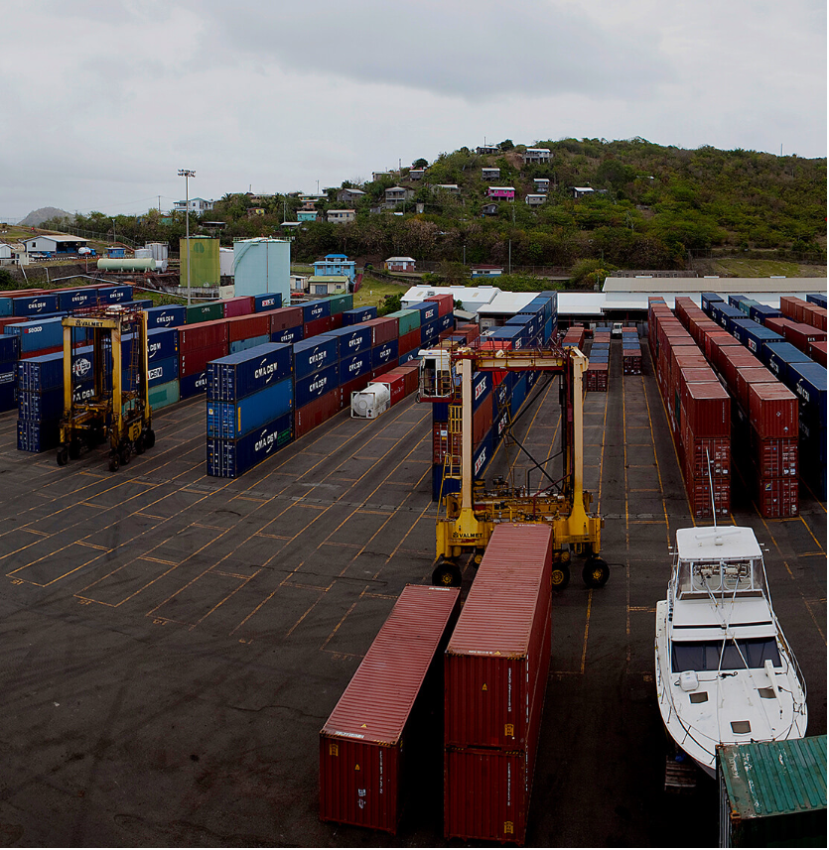
6.4 Future infrastructure needs in practice
Learning objectives
Recall an example of how population and tourism scenarios are used to project future infrastructure demand
Describe how a worst-case climate scenario can be used to identify changes in infrastructure use
Explain how future infrastructure exposure for one asset can been calculated
https://www.slaspa.com/index.php/seaports/facilities/port-vieux-fort

Slide 30
6.4 Future infrastructure needs in practice
Introduction to case study examples on future infrastructure needs
Examples from practical applications of methods explained in the previous sections at the national scale
Small Island Developing States (SIDS) Curaçao and Saint Lucia
Focus on sectoral, and cross-sectoral examples and exemplify the different methods of predicting future infrastructure needs:
Future changes in infrastructure demand: population, tourism, economic growth
Changes in the use of infrastructure due to climate change (using an example of how future climate projections in the dry season reduce river flow and thereby reduce the capacity of existing and future planned treatment plants)
Location-specific future infrastructure assets and related infrastructure needs
Location-specific future infrastructure assets and their exposure to future hazards

Slide 31
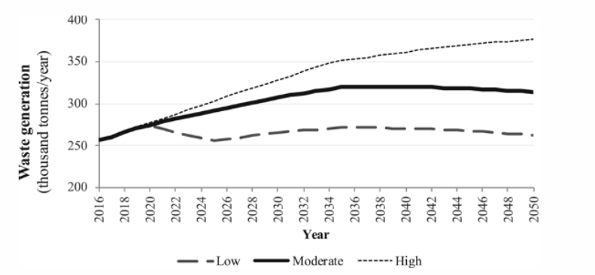
6.4 Future infrastructure needs in practice
Estimating future infrastructure needs using population and tourism projections in practice
Curaçao waste sector
Data collected using existing national documents and through interviews
Population, tourism and economic growth were all identified as the main drivers for future waste generation
Population and tourism growth-related waste factors utilised in order to create a low, moderate, and high growth scenario capturing future uncertainty
Various infrastructure strategies were then created, including an inaction, circular economy and a technology-led scenario, in order to evaluate the performance of these strategies under the various population and economic growth scenarios
Notes:
Figure: Curaçao’s future waste scenarios until 2050 (Fuldauer et al. 2019). Calculations were based on waste generation factors for SIDS (Mohee et al. 2015; World Bank 2012), residential growth scenarios (Bals 2014) and tourism growth scenarios.

Slide 32
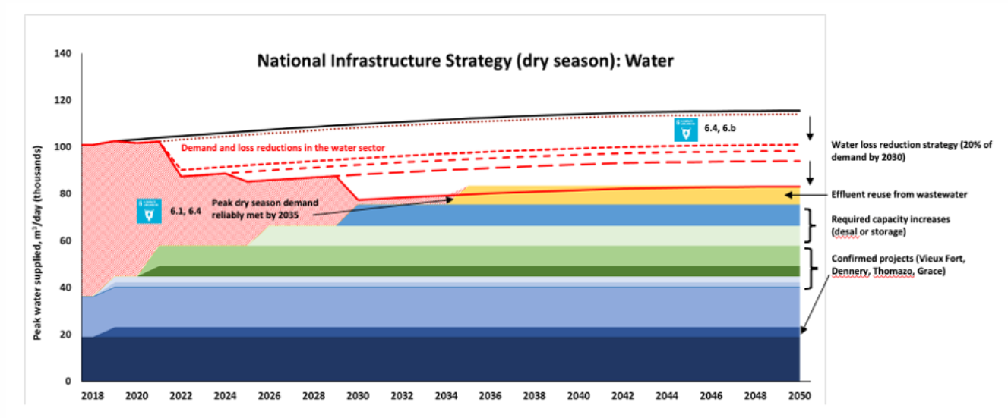
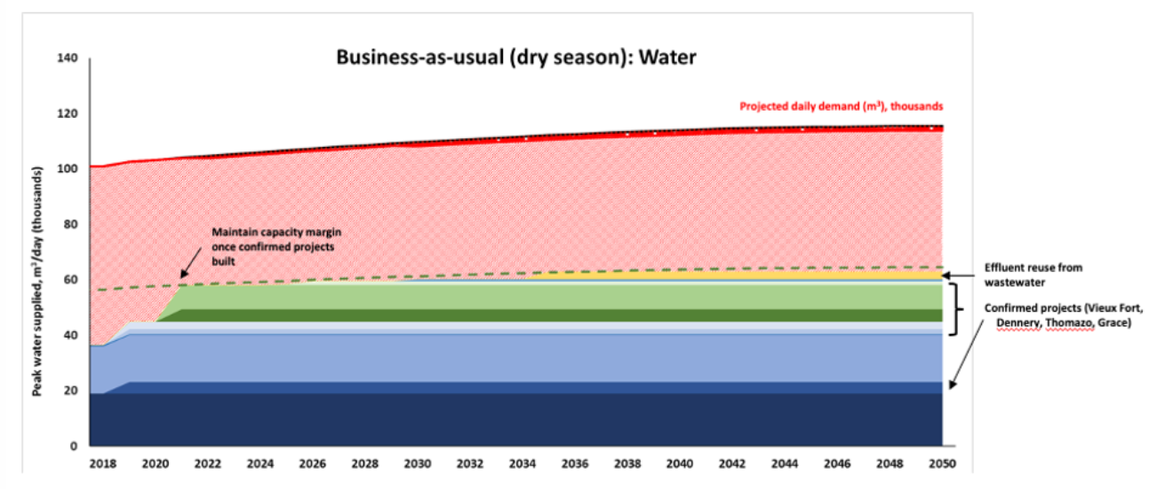
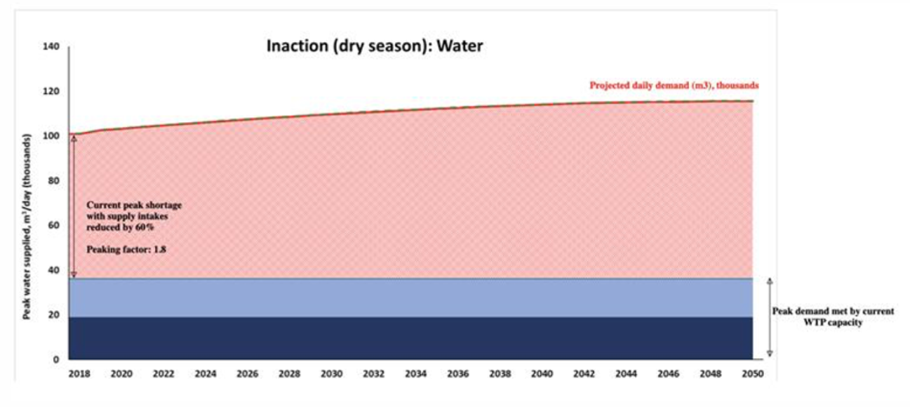
6.4 Future infrastructure needs in practice
Sain Lucia water sector
Water treatment capacity at a national level was shown to be sufficient to meet annual water demand,
Chronic impacts of climate change on river flows during the dry season leave many communities with major water shortages throughout much of the year
Often, these periods correspond with peak holiday periods where many tourists arrive on the island
Estimating future infrastructure usage using climate scenarios in practice
In an inaction scenario, this disparity is projected to increase as
population and tourism increases
drying trends intensify due to climate change
Under a business-as-usual strategy, which includes the implementation of confirmed projects, this shortage in peak water supply is only slightly improved
In contrast, the national infrastructure strategy, which includes adaptation to chronic river runoff, can help eliminate the shortage and ensure continuous water supply, including in the dry season
A national infrastructure strategy, including water loss reductions and infrastructure investments, can be a useful strategy to adapt to reduced chronic river runoff and associated reduced wastewater treatment capacity
Inaction with respect to water infrastructure into the future
Business-as-usual investment in infrastructure into the future leaves peak shortage in the dry season

Slide 33
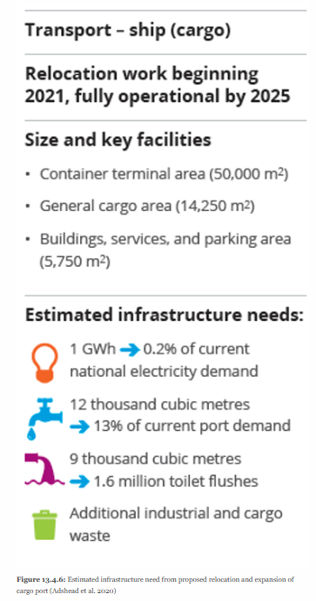
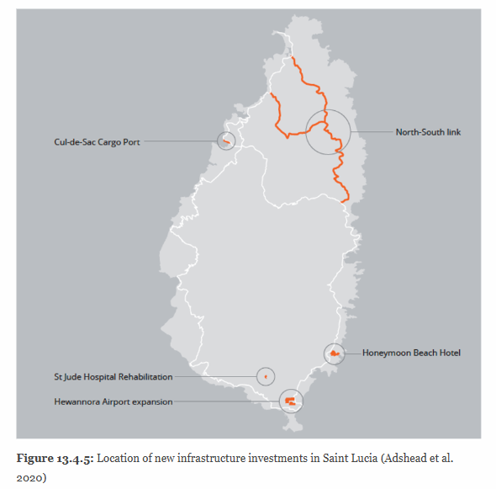
6.4 Future infrastructure needs in practice
Estimating future infrastructure needs from proposed assets in practice
Existing databases of planned infrastructure projects at the national scale for Saint Lucia used to calculate the associated infrastructure needs and climate-related risk
A database of five large infrastructure investments, which are to be constructed in the coming years, was provided by the Government of Saint Lucia
This location for cargo handling allows reduced conflicts of resources and space with the cruise ship arrivals port in the capital Castries
The analysis calculates infrastructure needs of the port
The relocated cargo port will contribute to increased trade and enhance agricultural productive capacity by expanding access to international markets
Critical to plan for increased infrastructure needs from the electricity, water, wastewater and water sectors resulting from the relocation and expansion of the cargo port
We showcase the future hazard risk for two of these new infrastructure projects, including a major port and a major new road
First, a large new infrastructure project involves the relocation of the cargo services of the Port in the capital city to the Cul de Sac port
Location of new infrastructure investments in Saint Lucia (Adshead et al. 2020)
Estimated infrastructure need from proposed relocation and expansion of cargo port (Adshead et al. 2020)

Slide 34
6.4 Future infrastructure needs in practice
Estimating future hazard exposure from proposed infrastructure assets
We superimpose the future proposed infrastructure assets with future hazard data to identify potential hazard exposure
A fraction of the new port is located in a hazard-prone area, and is exposed to a storm surge and a flash flood scenario
Both these hazards are associated with tropical storms, projected to increase in intensity with climate change
The roads which lead to the port are also exposed to these hazards, suggesting that accessibility to the port and the critical services it provides for more than 70 Sustainable Development Goal (SDG) targets are potentially exposed
Another key new infrastructure project is the construction of a new road linking the north and the south of the island
Superimposing the future proposed road data with the hazard information, we find that in terms of metres and percentage of the total road length exposed:
1% of total km exposed to storm surge (4-metre)
6% exposed to flash floods
4% exposed to landslides
These results highlight the importance of integrating future climate risk into infrastructure design at the outset of the planning process
Given that it is estimated that more than USD80 trillion of investment in new and existing infrastructure is required worldwide over the next 15 years (UNFCCC 2017), it is critical to ensure that climate risk is appropriately considered
A comprehensive approach to adaptation of infrastructure systems as part of the overall goal of achieving sustainability will be essential
(Adshead et al. 2020)
Notes:
Figure left: New proposed port in Saint Lucia exposed to storm surge, flash flood and landslides (Adshead et al. 2020)
Figure right: Proposed north-south road (red) potentially exposed to storm surges, flash floods and landslides (Adshead et al. 2020)

Slide 35
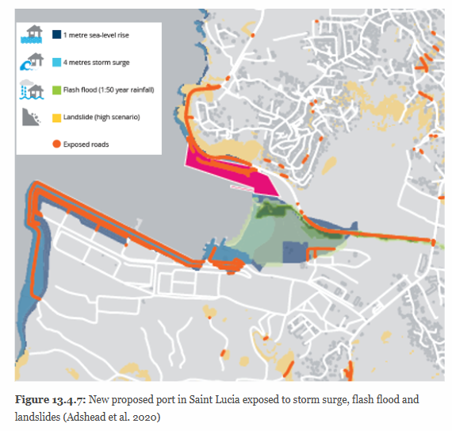
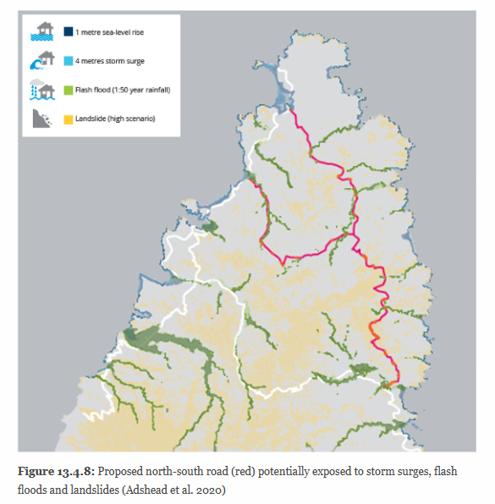
6.4 Future infrastructure needs in practice
(Adshead et al. 2020)
Notes:
Figure left: New proposed port in Saint Lucia exposed to storm surge, flash flood and landslides (Adshead et al. 2020)
Figure right: Proposed north-south road (red) potentially exposed to storm surges, flash floods and landslides (Adshead et al. 2020)

Slide 36
6.4 Future infrastructure needs in practice
Summary
Overview of practical examples of identifying future infrastructure needs, based on population growth, tourism growth and climate scenarios
These showcase how the content introduced in mini-lectures 6.1 and 6.3 can be put into practice, informing national scale decision-making

Slide 37
6.4 Future infrastructure needs in practice
Bibliography
Adshead, Daniel, O. Roman, S. Thacker, F. Felix, and L. I. Fuldauer. 2020. “Long-term strategic infrastructure planning model for Saint Lucia.” Oxford, UK: University of Oxford; United Nations Office for Project Services.
Bals, M. ter. 2014. “Demography of Curaçao Census 2011.” Willemstad, Curacao: Central Bureau of Statistics Curacao. http://www.cbs.cw/website/2011-census{\_}3226/item/demography-of- curacao-publication-series-census-2011{\_}757.html.
Fuldauer, Lena, Matthew C. Ives, Daniel Adshead, Scott Thacker, and Jim W. Hall. 2019. “Participatory planning of the future of waste management in small island developing states to deliver on the Sustainable Development Goals.” Journal of Cleaner Production 223 (June): 147–62. https://doi.org/10.1016/j.jclepro.2019.02.269.
Fuldauer, Lena, S. Thacker, and J. Hall. 2021. “Spatially assessing the impacts of climate change hazards on sustainable development to inform national adaptation.” In Preparation.
Government of Saint Lucia. 2017. “Third National Communication on Climate Change for Saint Lucia.” Castries, Saint Lucia.
Hall, J. W., M. Tran, A. Hickford, and R. Nicholls. 2016. The future of national infrastructure: A systems-of-systems approach. Cambridge: Cambridge University Press.
Ives, M., S. Thacker, D. Adshead, J. W. Hall, A. Hickford, and R. Nicholls. 2017. “A Fast Track Analysis of Infrastructure Provision in Palestine.” Oxford, UK: Environmental Change Institute. https://www.itrc.org.uk/wp-content/PDFs/PalestineFTA{\_}online. pdf.
Mohee, R., S. Mauthoor, Z. Bundhoo, G. Somaroo, N. Soobhany, and S. Gunasee. 2015. “Current status of solid waste management in small island developing states: A review.” Waste Management 43: 539–49. https://doi.org/10.1016/j.wasman.2015.06.012.
Otto, A., J. W. Hall, A. Hickford, R. Nicholls, D. Alderson, and S. Barr. 2016. “A quantified system-of systems modeling framework for robust national infrastructure planning.” IEEE Systems Journal 10 (2): 11. https://doi.org/10.1109/JSYST.2014.2361157.
UNFCCC. 2017. “C40 Infrastructure Interdependencies and Climate Risks Report.” Bonn: UNFCCC. https://unfccc.int/sites/default/files/report{\_}c40{\_}interdependencies{\_}.pdf.
World Bank. 2012. “Waste Generation.” Urban Development Series-Knowledge Papers 3 (1): 8–12.

Slide 38
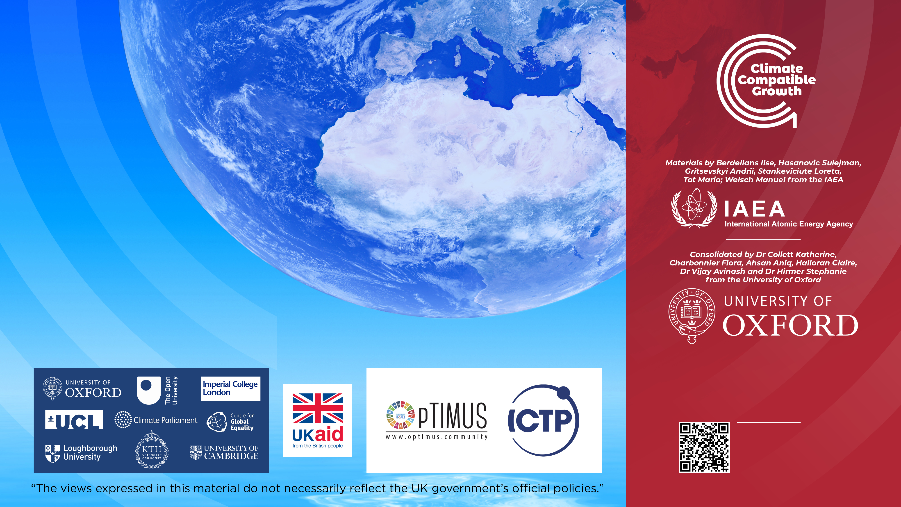
Cannone, C., Collett, K.A., Charbonnier F., Ahsan A., Halloran C., Vijay,A.,Berdellans I., Hasanovic S., Gritsevskyi A,Stankeviciute L., Tot M.; Welsch M., Hirmer S., 2023. Lecture 1: "COURSE INTRODUCTION TO MAED" , Energy Demands Projections with MAED (Model for Analysis of Energy Demand). Release Version 2.0. [online presentation]. Climate Compatible Growth & Programme and International Atomic Energy Agency.
CCG courses (this will take
you to the website link http://www.ClimateCompatibleGrowth.com/teachingmaterials)

