Slide 1
Lecture 5: Analysing future risks (Part 1)

Slide 2
Learning Outcomes
By the end of this lecture, you will:
Know the methods for analysing future risks to infrastructure networks
Have focused on utilizing climate scenarios, models, and hazard assessments
Know how to predict the impact of climate change on hazard occurrence and the associated risks to infrastructure assets

Slide 3
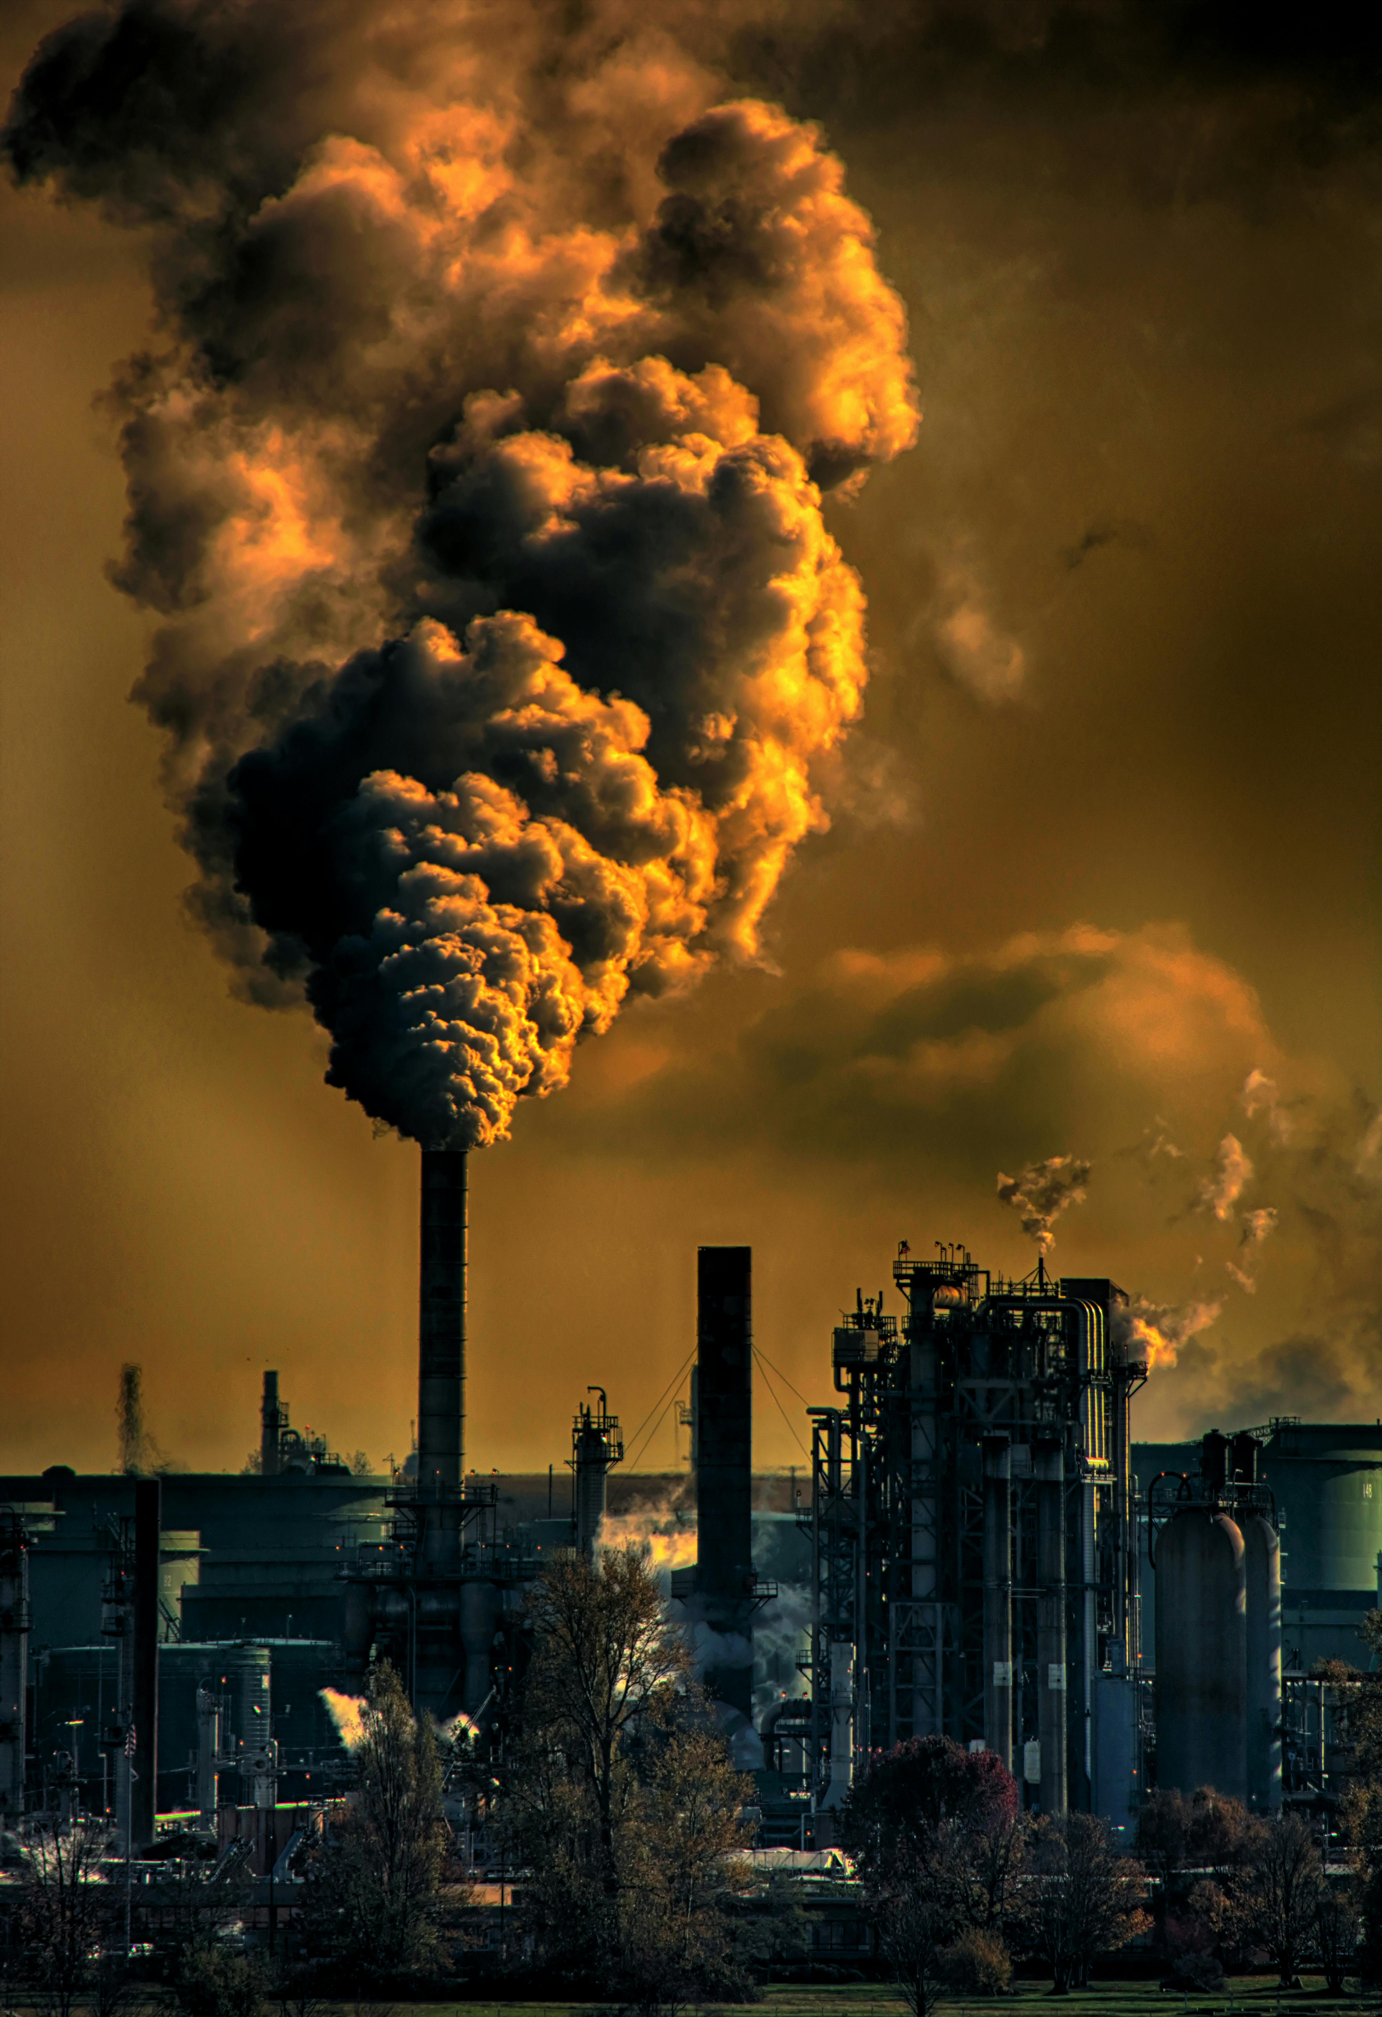
5.1 What are the future challenges?
Learning Objectives
Understand how risk has changed over time
Identify the different drivers of changing risk
Learn what dependencies and feedbacks exist between infrastructure and society

Slide 4
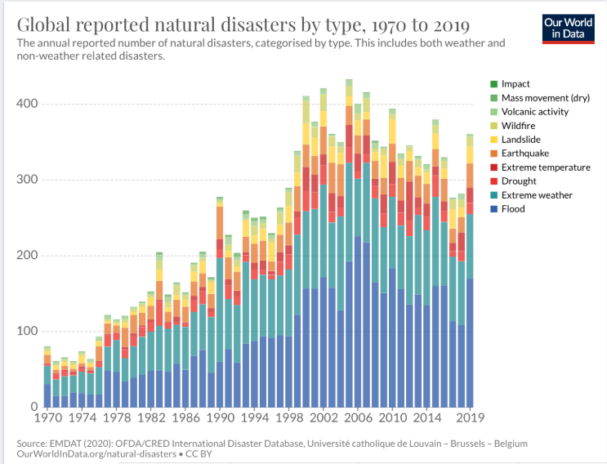
5.1 What are the future challenges?
Introduction
Infrastructure investments have lifetimes of 50 years or more, so decision-makers must consider changing risk factors in their designs
Underestimating risks can lead to under-designed systems and rapid deterioration, while overestimating risks may result in costly overdesign
In this lecture we will briefly introduce the four main drivers of change in future risk:
Changes in the climate which may cause the frequency and magnitude of hazards to change
Changes in the environment which may cause the frequency and magnitude of hazards to change
Changes in the use of existing infrastructure systems and need for new infrastructure systems due to socio-economic changes
Changes in societal dependencies with regards to infrastructure
(Ritchie and Roser 2014)
Notes:
Figure: Global reported natural disaster by type between 1970-2019

Slide 5
5.1 What are the future challenges?
Introduction to climate change
Climate change influences the frequency and magnitude of hazards, with some being more sensitive than others (e.g., heatwaves vs. hurricanes)
Intense tropical cyclones are becoming more frequent due to anthropogenic warming, highlighting non-intuitive changes in hazard behaviour
Studies showed that flooding hazards have varied impacts across Europe: some areas experience increased flood risks while others see decreases, according to long-term data analysis
The timing of river floods can differ regionally, affected by factors such as earlier snowmelt, shifts in winter storm patterns, and soil saturation levels
Localized analysis is essential to accurately understand and predict how climate change will impact flooding and other hazards in specific areas
(Elsner, Kossin, and Jagger 2008; Blöschl et al. 2019)

Slide 6
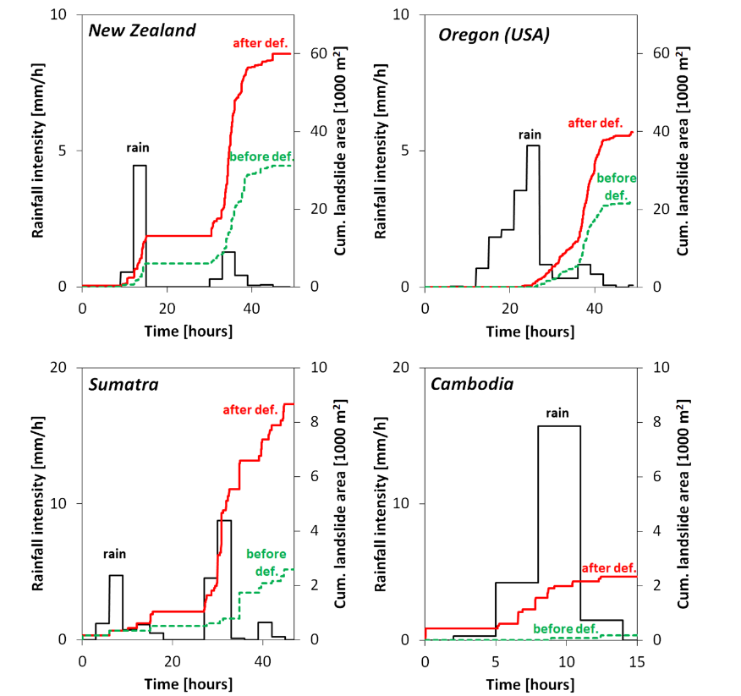
5.1 What are the future challenges?
Introduction to environmental drivers
Human-induced changes, such as urbanization and deforestation, significantly impact the occurrence and intensity of natural hazards like flooding and landslides
The global urban extent expanded by approximately 10,000 square kilometers annually from 1985 to 2015, leading to increased flood volumes due to the transformation of permeable surfaces into impermeable ones
Deforestation, particularly in steep, high-rainfall areas, has been linked to a rise in landslide occurrences, demonstrating the unintended consequences of changing land-use patterns
(Lehmann, Ruette, and Or 2019)
(Liu et al. 2020; Curtis et al. 2018; Lehmann, Ruette, and Or 2019)
Notes:
Figure: The effect of deforestation on the occurrence of landslides in four regions worldwide

Slide 7
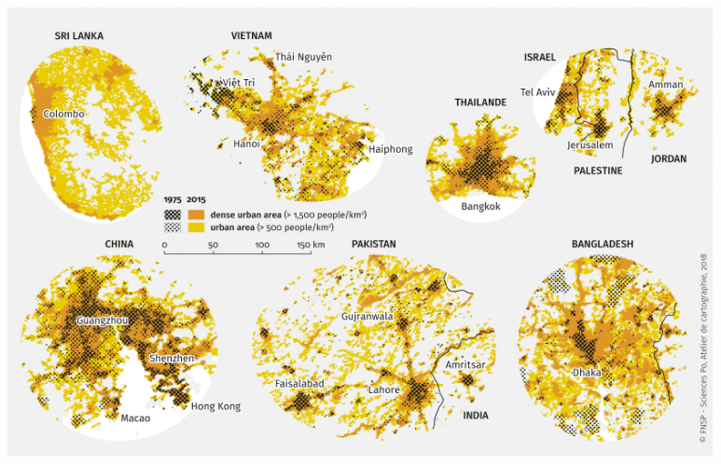
5.1 What are the future challenges?
Introduction to socio-economic growth
The exposure of assets and populations to natural hazards is influenced by their spatial locations and the socio-economic growth in those areas, leading to increased infrastructure use and demand for new systems
Rapid socio-economic growth in hazard-prone regions, like floodplains, can significantly heighten future risks, as evidenced by rising global flood losses linked to this growth
Often these changes occur in tandem; rapidly growing economies see an increase in population and wealth in existing and newly developed urban areas that demand more infrastructure services
(Espace Mondial n.d.)
(Tanoue, Hirabayashi, and Ikeuchi 2016)
Notes:
Figure: The urban expansion over time for cities in Sri Lanka, Viet Nam, China, Bangladesh, Israel, Pakistan

Slide 8
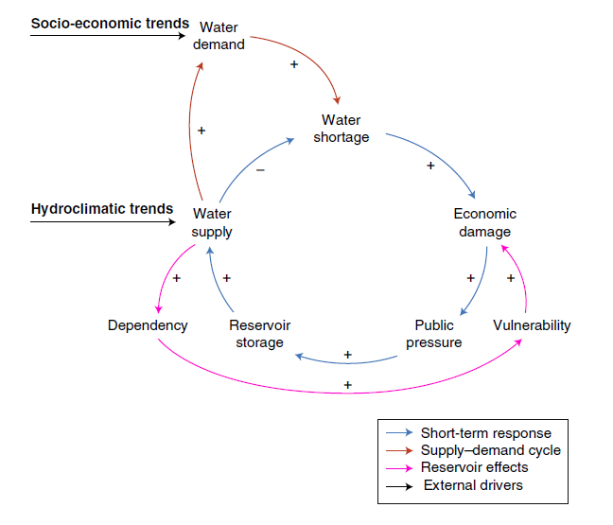
5.1 What are the future challenges?
Introduction to infrastructure dependencies
Infrastructure expansion may cause shifts in the societal dependencies on these infrastructure assets
Example of the ‘reservoir effect’, where the benefits from the construction of a reservoir can be quickly offset by two processes (Di Baldassarre et al. 2018):
Increasing the water supply in an area can stimulate the consumption of water, thereby offsetting the intended increase in water storage
The construction of a new reservoir can cause an over-reliance on this infrastructure, resulting in a larger societal disruption if this reservoir is affected by a drought
(Di Baldassarre et al. 2018)
Notes:
Figure: A schematic diagram of the reservoir effect as a result of positive feedback processes between infrastructure and society, which can increase the vulnerability of the dependent population

Slide 9
5.1 What are the future challenges?
Summary
In this lecture, we have given a brief introduction to how risk changes over time and identified the four main drivers of future hazard risk:
Climate change
Environmental change
Socio-economic change
Changes in societal dependencies on infrastructure

Slide 10
5.1 What are the future challenges?
Bibliography
Blöschl, Günter, Julia Hall, Alberto Viglione, Rui A. P. Perdigão, Juraj Parajka, Bruno Merz, David Lun, et al. 2019. “Changing climate both increases and decreases European river floods.” Nature 573 (7772): 108–11. https://doi.org/10.1038/s41586-019-1495-6.
Curtis, Philip G., Christy M. Slay, Nancy L. Harris, Alexandra Tyukavina, and Matthew C. Hansen. 2018. “Classifying drivers of global forest loss.” Science 361 (6407): 1108–11. https://doi.org/10.1126/science.aau3445.
Di Baldassarre, Giuliano, Niko Wanders, Amir AghaKouchak, Linda Kuil, Sally Rangecroft, Ted I. E. Veldkamp, Margaret Garcia, Pieter R. van Oel, Korbinian Breinl, and Anne F. Van Loon. 2018. “Water shortages worsened by reservoir effects.” Nature Sustainability 1 (11): 617–22. https://doi.org/10.1038/s41893-018-0159-0.
Du, Shiqiang, Peijun Shi, Anton Van Rompaey, and Jiahong Wen. 2015. “Quantifying the impact of impervious surface location on flood peak discharge in urban areas.” Natural Hazards 76 (3): 1457–71. https://doi.org/10.1007/s11069-014-1463-2.
Elsner, James B, James P Kossin, and Thomas H Jagger. 2008. “The increasing intensity of the strongest tropical cyclones.” Nature 455 (7209): 92–95. https://doi.org/10.1038/nature07234.
Espace Mondial. n.d. “Extension of urban sprawl in selected cities, 1975-2015.” Accessed March 24, 2021. https://espace-mondial-atlas.sciencespo.fr/en/topic-mobility/map-2C14-EN-extension-of-urban-sprawl-in-selected-cities-1975-2015.html.
Lehmann, Peter, Jonas von Ruette, and Dani Or. 2019. “Deforestation Effects on Rainfall-Induced Shallow Landslides: Remote Sensing and Physically-Based Modelling.” Water Resources Research 55 (11): 9962–76. https://doi.org/10.1029/2019WR025233.
Liu, Xiaoping, Yinghuai Huang, Xiaocong Xu, Xuecao Li, Xia Li, Philippe Ciais, Peirong Lin, et al. 2020. “High-spatiotemporal-resolution mapping of global urban change from 1985 to 2015.” Nature Sustainability 3 (7): 564–70. https://doi.org/10.1038/s41893-020-0521-x.
Ritchie, Hannah, and Max Roser. 2014. “Natural Disasters.” Our World in Data.
Tanoue, Masahiro, Yukiko Hirabayashi, and Hiroaki Ikeuchi. 2016. “Global-scale river flood vulnerability in the last 50 years.” Scientific Reports 6: 1–9. https://doi.org/10.1038/srep36021.

Slide 11
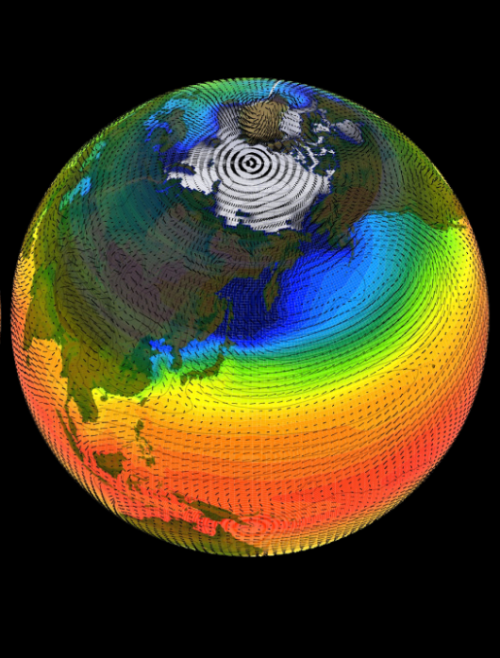
5.2 Projecting Future Climate
Learning objectives
Learn what a climate model is
Compare and contrast the outcomes of different climate scenarios
Recognise that climate impacts may differ across regions
Notes:
Figure: https://www.technologyreview.com/2018/02/08/145744/what-the-hell-is-a-climate-modeland-why-does-it-matter/

Slide 12
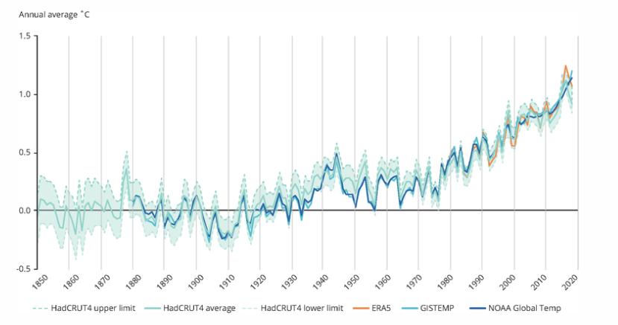
5.2 Projecting Future Climate
Introduction
Climate = average of daily weather over a period of around 30 years
Although weather changes from day to day, the climate in a certain location should be fixed
But the global average temperature over time (since 1850) shows that the climate is changing over time
The main cause of the increase in temperature, and hence shift in climate, is the anthropogenic carbon dioxide emissions we put into the atmosphere, which cause the climate to change and directly affects the key climate variables such as temperature, precipitation and wind speed
More information can be found here
(European Environmental Agence 2020)
Notes:
Figure: The evolution of global mean surface temperature between 1850 and present. The different colours indicate different data sources

Slide 13
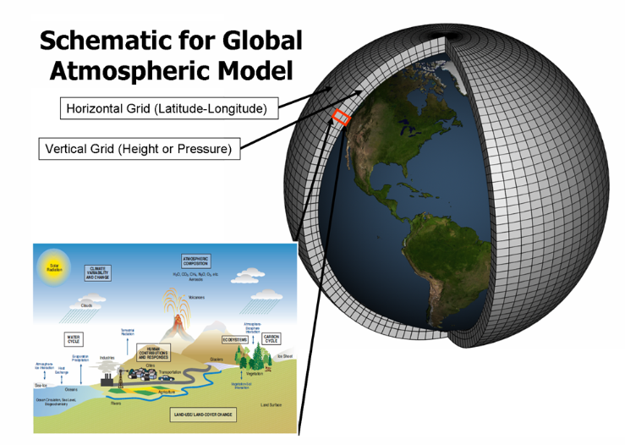
5.2 Projecting Future Climate
Global climate models
General Circulation Models (GCMs) are numerical models that simulate physical, biological, and chemical processes in the Earth's atmosphere, oceans, cryosphere, and land surface to predict future climate changes
These models divide the Earth into grid cells and layers, with most having a spatial resolution of around 100 km, which has improved from the 500 km resolution of early models in 1990
GCMs solve complex equations numerically, providing averaged results over regions and time rather than exact solutions
Key inputs for GCMs include external factors such as greenhouse gases (e.g., carbon dioxide, methane) which are crucial for validating models against observed temperature trends before making future projections
(GFDL, n.d.)
Notes:
Figure: A schematic representation of a global climate model with the horizontal and vertical grids that are used to simulate the climate, land and ocean processes

Slide 14
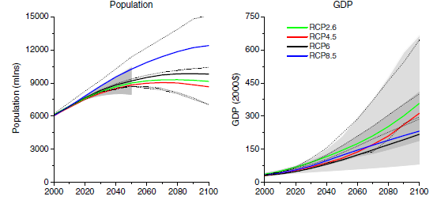
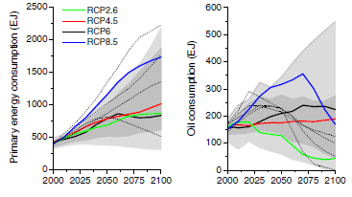
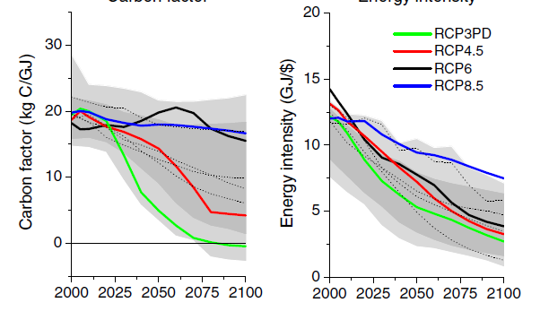
5.2 Projecting Future Climate
Representative Concentration Pathways
Representative Concentration Pathways (RCPs) provide plausible descriptions of the future, based on socio-economic scenarios of how global society grows and develops
The main RCP scenarios used are RCP2.6, RCP4.5, RCP6.0 and RCP8.5, with the number indicating the total amount of carbon dioxide (CO2) emissions in the atmosphere in 2100 (in Giga tonnes)
RCP2.6 is a very ambitious scenario with moderate population growth, continuous economic growth, low energy consumption and very low oil consumption, resulting in a strongly decarbonized economy with low CO₂ concentrations
RCP8.5 covers high population growth, moderate GDP growth, large and primarily fossil-fuel dependent energy consumption, resulting in very high CO₂ concentrations
These scenarios help us to explore alternative futures, including the associated uncertainty in how the climate might change
(Vuuren et al. 2011)
Notes:
Figure: Socio-economic and energy trajectories per RCP scenario

Slide 15
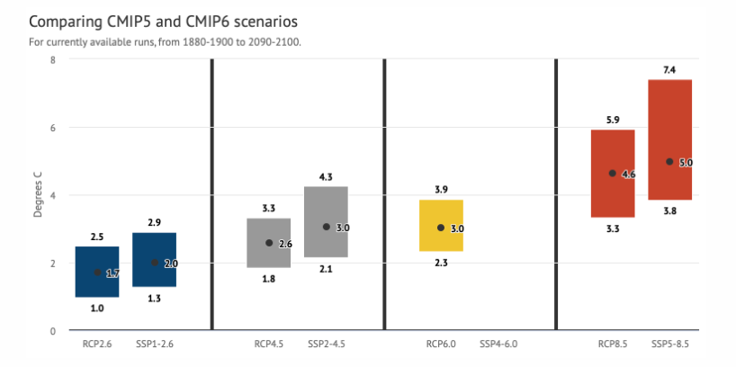
5.2 Projecting Future Climate
Predicting future climate
The various RCP scenarios can be used to force a climate model and predict how the climate might change in the future
Across the world, many climate models have been developed, which are all based on slightly different model specifications
We use an ensemble of climate models to project multiple realisations of the future climate based on the results of the individual climate models
The most recent ‘Coupled Model Intercomparison Project Phase 6’ (CMIP6) project, the climate model ensemble that forms the basis for the IPCC report, includes climate models from 49 different modelling groups (Eyring et al. 2016)
CMIP6 models project a larger warming than CMIP5, which is mainly due to the improved representations of various physical processes in the models (for instance, clouds and aerosols)
The spread between the models can be quite large. For instance, for the RCP8.5 scenario, the lowest CMIP6 model projects 3.8°C of warming, whereas the highest CMIP6 model projects 7.4°C of warming
(CarbonBrief 2019)
Notes:
Figure: Prediction of changes in global mean surface temperature for the different climate scenarios. The range indicates the spread in model results, with the dot the median value and the range the smallest and largest model result

Slide 16
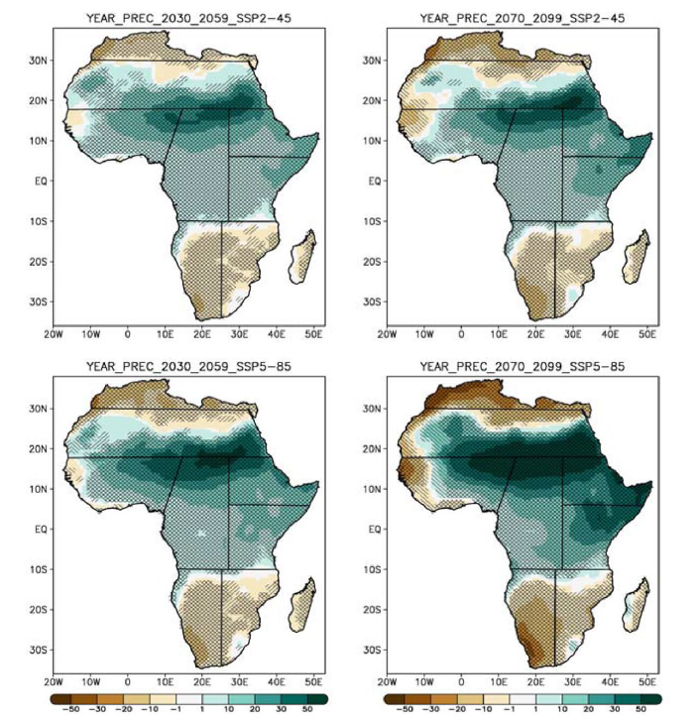
5.2 Projecting Future Climate
Climate might change differently in varying locations and over time
We need to evaluate the regional changes under multiple climate scenarios and models to understand the range of plausible futures that our infrastructure system might face
Regional climate variations
(Almazroui et al. 2020)
Notes:
Figure: Precipitation changes over the African continent for two time slices (2030-2059 and 2070-2099) and two climate and socio-economic scenarios (RCP4.5 and RCP8.5, and SSP2 and SSP5)
The North and South of Africa will experience a decrease in precipitation, whereas the Sahara and central parts of Africa will experience an increase in precipitation
The regional effect becomes stronger with a larger warming (RCP8.5 vs RCP4.5)
For RCP4.5, the 2070-2099 shows slightly higher changes than the 2030-2059 time slice, but results do not differ much. In contrast, for the RCP8.5 scenario, a much stronger signal is evident than in the 2030-2059 time slice
The two scenarios also illustrate the uncertainty in the projections

Slide 17
5.2 Projecting Future Climate
Summary
In this lecture we have looked at how the climate is changing globally
We described how we make use of climate models and projections to predict how the climate might look in the future
The climate might change differently in different regions, making it important to look at regional changes

Slide 18
5.2 Projecting Future Climate
Bibliography
Almazroui, Mansour, Fahad Saeed, Sajjad Saeed, M. Nazrul Islam, Muhammad Ismail, Nana Ama Browne Klutse, and Muhammad Haroon Siddiqui. 2020. “Projected Change in Temperature and Precipitation Over Africa from CMIP6.” Earth Systems and Environment 4 (3): 455–75. https://doi.org/10.1007/s41748-020-00161-x.
CarbonBrief. 2019. “CMIP6: the next generation of climate models explained.” https://www.carbonbrief.org/cmip6-the-next-generation-of-climate-models-explained.
European Environmental Agence. 2020. “Global average near surface temperature since the pre-industrial period.” https://www.eea.europa.eu/data-and-maps/figures/global-average-near-surface-temperature.
Eyring, Veronika, Sandrine Bony, Gerald A. Meehl, Catherine A. Senior, Bjorn Stevens, Ronald J. Stouffer, and Karl E. Taylor. 2016. “Overview of the Coupled Model Intercomparison Project Phase 6 (CMIP6) experimental design and organization.” Geoscientific Model Development 9 (5): 1937–58. https://doi.org/10.5194/gmd-9-1937-2016.
GFDL. n.d. “Climate Modeling.” https://www.gfdl.noaa.gov/climate-modeling/.
Vuuren, D P van, J Edmonds, M Kainuma, K Riahi, A Thomson, K Hibbard, G C Hurtt, et al. 2011. “The representative concentration pathways: an overview.” Climatic Change 109: 5–31.

Slide 19
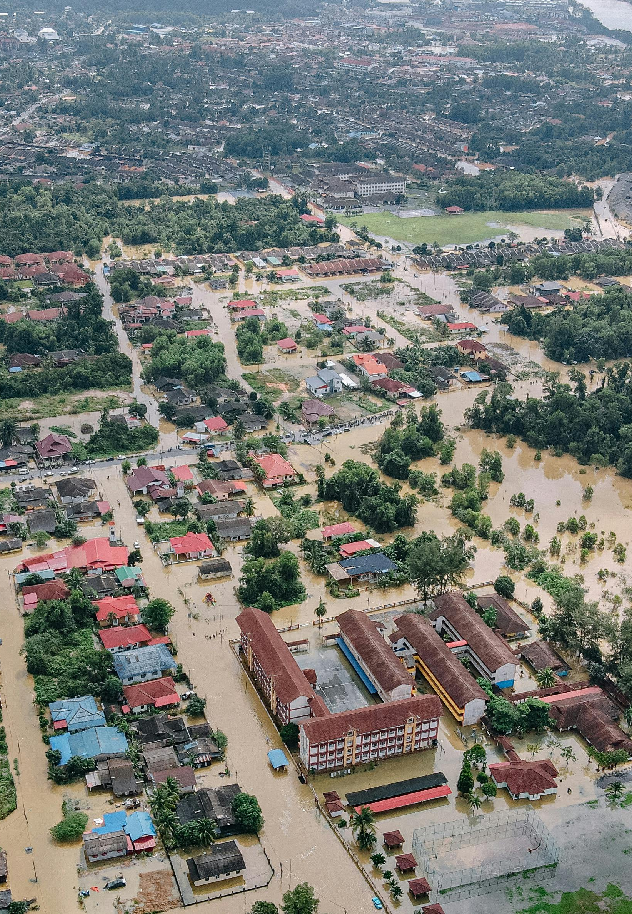
5.3 Projecting future hazards
Learning objectives
Understand how climate change might change the occurrence of hazards
Summarise how infrastructure exposure can change in the future
Evaluate what the different uncertainties are when predicting future hazards

Slide 20
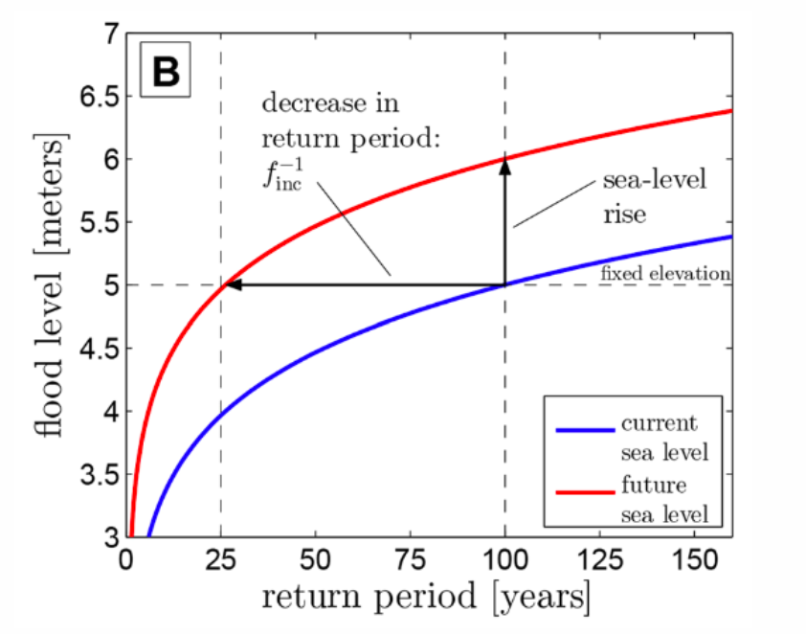
5.3 Projecting future hazards
Introduction
When evaluating changes in future hazards we often distinguish between changes in the frequency and the magnitude of events
Frequency: Frequency changes describe the increase or decrease of the occurrence of an event with a certain magnitude (horizontal line in Figure 5.3.1).
In this example, a 100-year event becomes a 25-year event, meaning that the frequency increases by a factor four
Magnitude: Magnitude changes describe the increase or decrease of the severity of an event with a certain frequency (vertical line in Figure 5.3.1).
(Vitousek et al. 2017)
Notes:
Figure: The change in frequency (horizontal line) and magnitude (vertical line) of different return periods of coastal flooding
In this example, the magnitude of a 100-year event changes from 5m to 6m (increases by 20%)

Slide 21
5.3 Projecting future hazards
Hazard sensitivity to climate change
Some hazards are more sensitive to climate change due to differing physical processes
Heatwaves and wildfires increase linearly with rising global mean surface temperature
Floods and droughts are driven by changing precipitation patterns, leading to wetter wet areas and drier dry areas
Total precipitation is unevenly distributed, with a few very wet days contributing significantly
Climate projections indicate future precipitation may become more uneven
Predicting changes in tropical cyclones is complex due to the physical processes involved; current models cannot fully resolve them
Rising temperatures are expected to increase moisture content, likely intensifying tropical cyclones
Storm surges from tropical cyclones will likely increase due to rising sea levels, estimated at about 3 mm per year
Earthquakes are unaffected by climate change and will remain unchanged in the future
(Pendergrass and Knutti 2018; Knutson et al. 2020; Nerem et al. 2018)
21
Notes:
There are now several open-source hazard products at global scales which are being used widely for vulnerability and risk analysis. A few resources include:
Global river and coastal flood maps: Historical and future hazard maps at different return periods (2, 5, 12, 25, 50, 120, 250, 500, 1200 years). All data is available at a 30 arc-seconds resolution (~1km at equator) (Gassert et al. 2015).
Global hazard maps for earthquakes for different return periods (250, 475, 975, 1500, 2475 years) both Peak Ground Acceleration and spectral acceleration. Data is available at 0.072 degrees (~8km at equator).
Global dataset of 12,000 synthetic tropical cyclones paths with cyclone characteristics (e.g., wind speed, pressure) on a global scale. Wind speed probabilities are derived globally (12 metre, 12 minutes sustained speed) for different return periods (12 to 12,000 years) at 12km resolution (Bloemendaal et al. 2019).

Slide 22
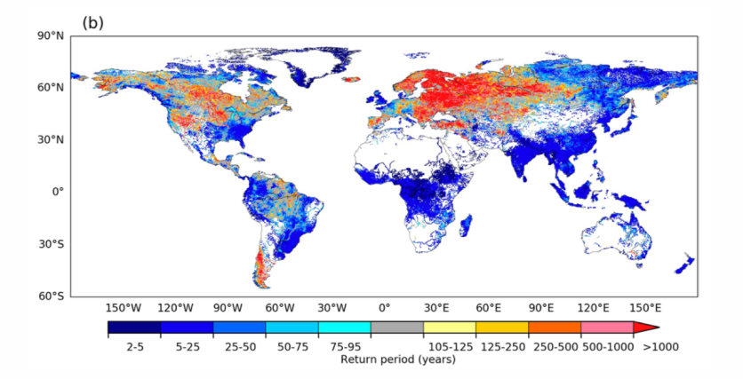
5.3 Projecting future hazards
Expected changes in hazard occurrence
By comparing the changes in 100-year return period, a larger increase in flood hazard (lower return period) is found for Asia, Africa and South America, while parts of Europe will experience less frequent floods (Hirabayashi et al. 2021)
Sea-level rise will make coastal flooding more likely. In most areas a doubling of flood frequency is expected, whilein some areas (e.g. Tropics) a doubling of flooding is already expected in 2050 (Vitousek et al. 2017)
Changes in tropical cyclones are harder to predict. Currently, it is expected that the global frequency of occurrenceof tropical cyclones will either decrease or remain unchanged, while wind speed and precipitation rates areexpected to increase (Knutson et al. 2020)
How droughts might change depends on the definition of a drought adopted. An increasing frequency of droughtis expected over large land areas resulting from either decreased and/or increased evaporation (Dai 2013)
Landslides might also become more frequent due to the increase in intense precipitation events. For instance, arecent study showed that landslide activity in China and Nepal could see a 30 to 70% increase in the future (NASA2020)
Notes:
Figure: The multi-modal mean change in the global 100-year flood return period over the 21st century for Representative Concentration Pathway (RCP) 8.5

Slide 23
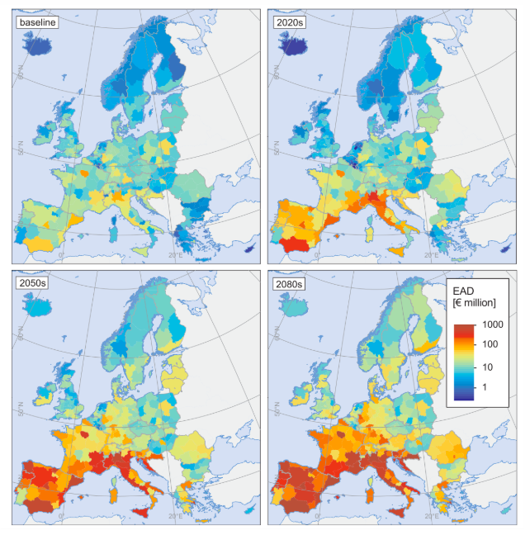
5.3 Projecting future hazards
Future infrastructure exposure
Climate change is projected to significantly increase the exposure and risk to people and infrastructure throughout the 21st century, assuming current population and infrastructure conditions remain unchanged
The number of individuals at risk of river flooding could rise by 7-14 times, while coastal flooding may affect 2.5 times more people by 2100
Infrastructure risks are also expected to escalate, with sea-level rise threatening 900 million tonnes of goods and increasing disruptions to airline ports by 17-69 times
In Europe, critical infrastructure damages could increase 10-fold by the century's end, resulting in annual damages of EUR 3.4 billion
Drought and heatwaves are the main threats in southern Europe, while coastal flooding poses the most significant overall risk, alongside rising damages from river flooding, wind storms, and wildfires, which vary by region
(Forzieri et al. 2018)
(Hirabayashi et al. 2013; Kulp and Strauss 2019; Christodoulou, Christidis, and Demirel 2019; Yesudian and Dawson 2021; Forzieri et al. 2018)
Notes:
Figure: The expected annual damages to infrastructure assets for multiple hazards. The figures show the baseline scenario and the change in risk for 2020, 2050 and 2080 (Forzieri et al. 2018)

Slide 24
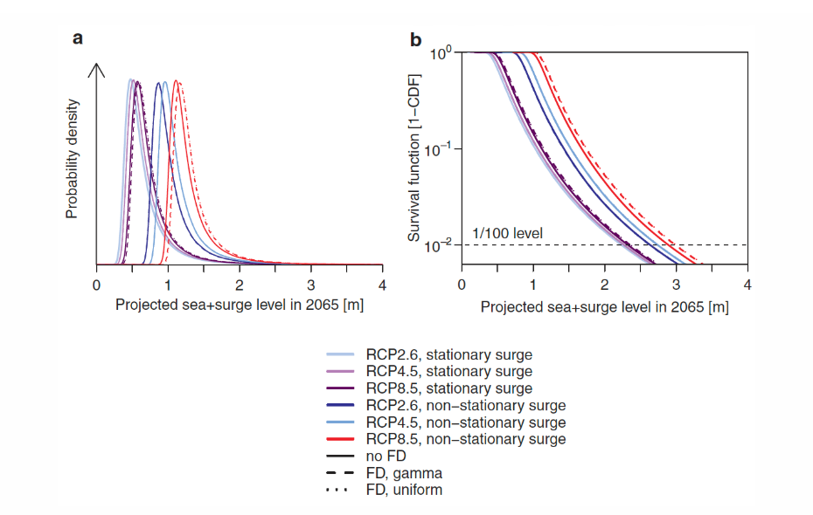
5.3 Projecting future hazards
Future hazard uncertainties
We can distinguish between three sources of uncertainty:
Scenario uncertainty:
Differences between the RCP scenarios over time
Climate model uncertainty:
Differences between the climate model results
Knowledge uncertainty
Additional uncertain factors that are not yet properly accounted for in climate scenarios and models
(Wong, Bakker, and Keller 2017)
Notes:
Figure: The probability density functions (left) and survival functions (right) of the expected sea-level rise in 2065 in Louisiana (United States). The different curves reflect the different climate scenarios, the model spread and additional uncertainties surrounding the rapid disintegration of the Antarctic ice sheet (FD)

Slide 25
5.3 Projecting future hazards
Summary
Use of climate scenarios and models for predicting future hazards
Potential exposure of infrastructure to these hazards
Three main sources of uncertainty related to future hazards

Slide 26
5.3 Projecting future hazards
Bibliography
Christodoulou, Aris, Panayotis Christidis, and Hande Demirel. 2019. “Sea-level rise in ports: a wider focus on impacts.” Maritime Economics & Logistics 21 (4): 482–96. https://doi.org/10.1057/s41278-018-0114-z.
Dai, Aiguo. 2013. “Increasing drought under global warming in observations and models.” Nature Climate Change 3 (1): 52–58. https://doi.org/10.1038/nclimate1633.
Forzieri, Giovanni, Alessandra Bianchi, Filipe Batista e. Silva, Mario A. Marin Herrera, Antoine Leblois, Carlo Lavalle, Jeroen C. J. H. Aerts, and Luc Feyen. 2018. “Escalating impacts of climate extremes on critical infrastructures in Europe.” Global Environmental Change 48 (April 2017): 97–107. https://doi.org/10.1016/j.gloenvcha.2017.11.007.
Hirabayashi, Yukiko, Roobavannan Mahendran, Sujan Koirala, Lisako Konoshima, Dai Yamazaki, Satoshi Watanabe, Hyungjun Kim, and Shinjiro Kanae. 2013. “Global flood risk under climate change.” Nature Climate Change 3 (9): 816–21. https://doi.org/10.1038/nclimate1911.
Hirabayashi, Yukiko, Masahiro Tanoue, Orie Sasaki, Xudong Zhou, and Dai Yamazaki. 2021. “Global exposure to flooding from the new CMIP6 climate model projections.” Scientific Reports 11 (1): 1–7. https://doi.org/10.1038/s41598-021-83279-w.
Knutson, Thomas, Suzana J. Camargo, Johnny C. L. Chan, Kerry Emanuel, Chang Hoi Ho, James Kossin, Mrutyunjay Mohapatra, et al. 2020. “Tropical cyclones and climate change assessment part II: Projected response to anthropogenic warming.” Bulletin of the American Meteorological Society 101 (3): E303–22. https://doi.org/10.1175/BAMS-D-18-0194.1.
Kulp, Scott A., and Benjamin H. Strauss. 2019. “New elevation data triple estimates of global vulnerability to sea-level rise and coastal flooding.” Nature Communications 10 (1). https://doi.org/10.1038/s41467-019-12808-z.
NASA. 2020. “Climate Change Could Trigger More Landslides in High Mountain Asia.” https://www.nasa.gov/feature/goddard/2020/climate-change-could-trigger-more-landslides-in-high-mountain-asia.
Nerem, R S, B D Beckley, J T Fasullo, B D Hamlington, D Masters, and G T Mitchum. 2018. “Climate-change–driven accelerated sea-level rise detected in the altimeter era.” Proceedings of the National Academy of Sciences 115 (9): 2022–25. https://doi.org/10.1073/pnas.1717312115.
Pendergrass, Angeline G., and Reto Knutti. 2018. “The Uneven Nature of Daily Precipitation and Its Change.” Geophysical Research Letters 45 (21): 11, 980–11, 988. https://doi.org/10.1029/2018GL080298.
Vitousek, S, P L Barnard, C H Fletcher, N Frazer, L Erikson, and C D Storlazzi. 2017. “Doubling of coastal flooding frequency within decades due to sea-level rise.” Scientific Reports 7 (1399): 1–9.
Wong, Tony E, Alexander M R Bakker, and Klaus Keller. 2017. “Impacts of Antarctic fast dynamics on sea-level projections and coastal flood defense.” Climatic Change 144 (2): 347–64. https://doi.org/10.1007/s10584-017-2039-4.
Yesudian, Aaron N., and Richard J. Dawson. 2021. “Global analysis of sea level rise risk to airports.” Climate Risk Management 31 (November 2020): 100266. https://doi.org/10.1016/j.crm.2020.100266.

Slide 27
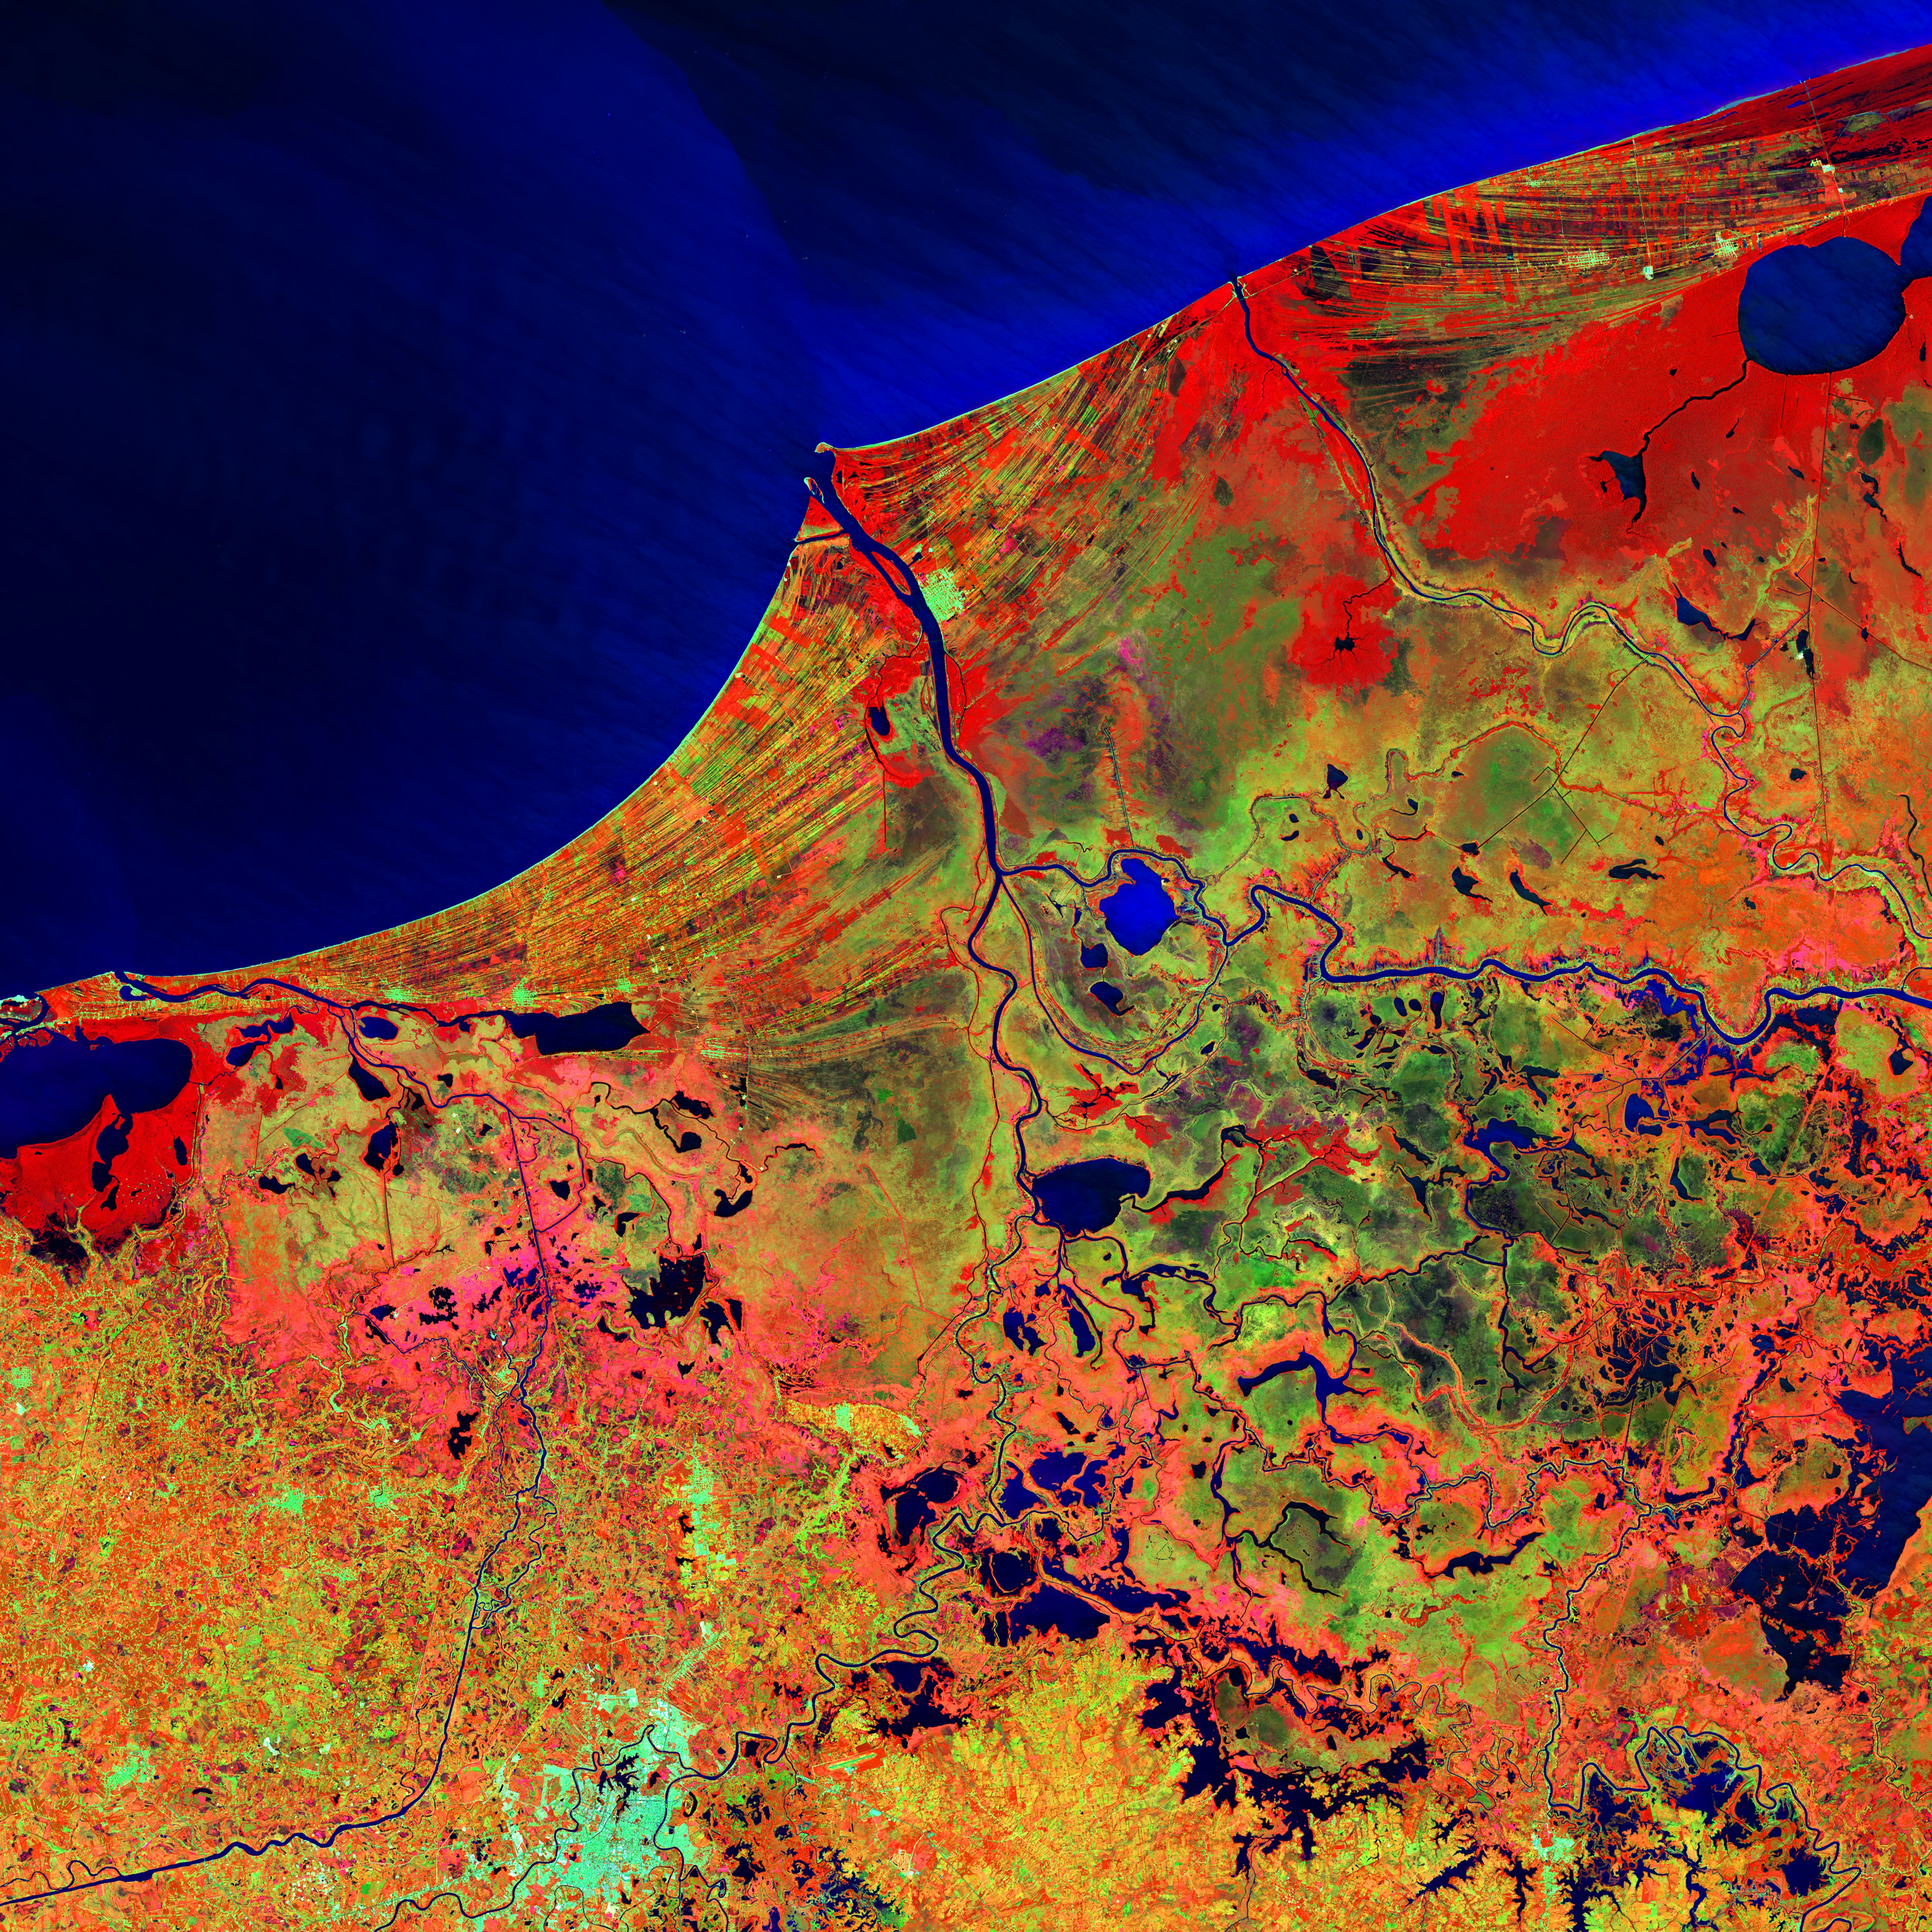
5.4 Future hazard risk - Case study
Learning objectives
Learn how climate change can influence risk to assets in different ways
Identify infrastructure risk hotspots
Explain how a future climate risk assessment can inform adaptation

Slide 28
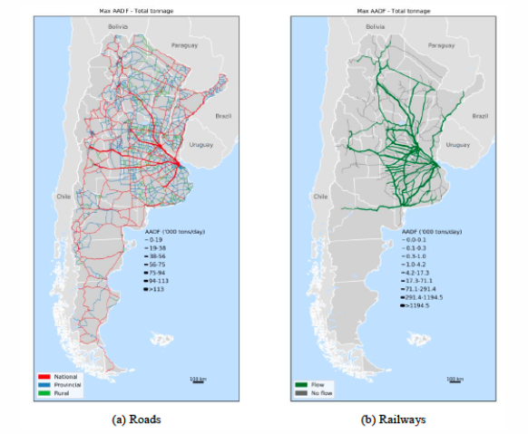
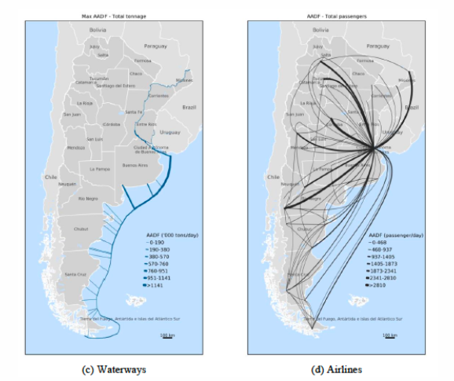
5.4 Future hazard risk - Case study
Introduction
The lecture focuses on integrating future climate change projections into infrastructure risk analysis, specifically for Argentina's transport network
It examines the impact of climate scenarios on hazard modelling and future risk changes for various assets and regions
The study emphasizes two resilience strategies: enhancing engineering standards and improving rerouting options within the transport system
The case study highlights flood vulnerability of transport infrastructure, particularly in urban areas, as flooding is a major hazard affecting the network
(Pant et al. 2019)
Notes:
Figure: Argentina’s national waterways and airport networks, national road and railway networks, including the tonnage of freight allocated for the different assets

Slide 29
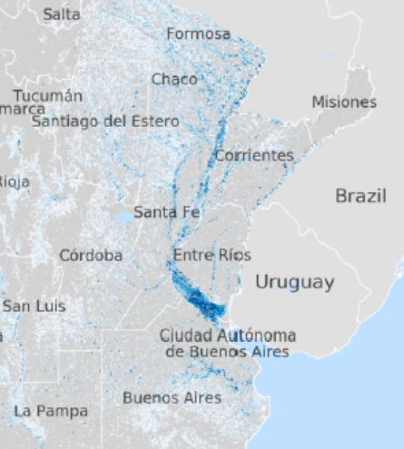
5.4 Future hazard risk - Case study
Future hazard scenarios
Flood hazard maps for ten return periods (ranging between 5 and 1,000-years)
Flood extent and the inundation depth
32 Global Climate Models (GCMs) from the cmip5 model ensemble
2050 time horizon
RCP4.5 and RCP8.5
Scenario-neutral approach:
Detailed flood simulations for all 32 GCMs were not conducted
Two scenarios were created based on projected changes in 5-day maximum precipitation for 2050 compared to the baseline (1986-2005)
Scenarios:
‘future median’: +6% change
‘future high’: +12% change
These scenarios were used to scale flood extent and inundation depth
For smaller case studies, additional scenarios should be considered to explore uncertainty
(Pant et al. 2019)
Notes:
Figure: An example of fluvial inundation in the baseline scenario for the north of Argentina

Slide 30
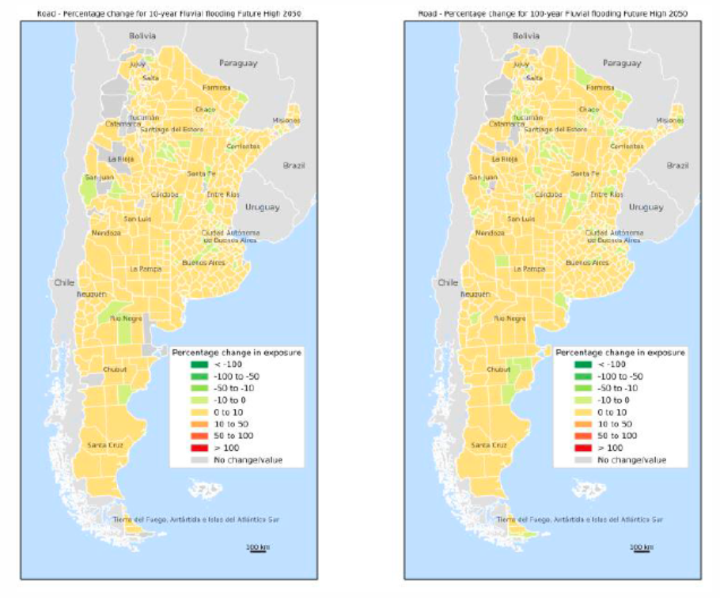
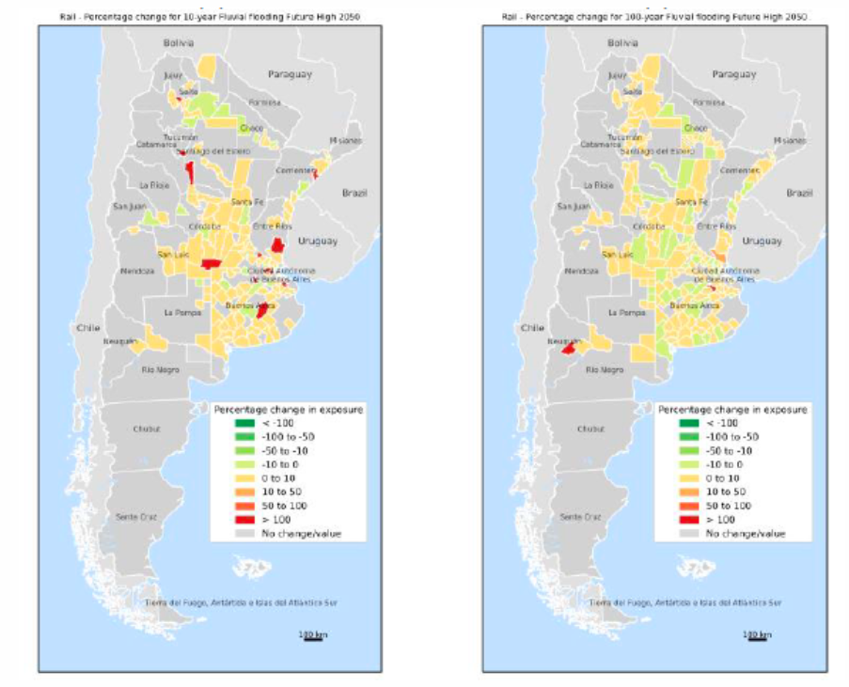
5.4 Future hazard risk - Case study
Future infrastructure exposure
Overlay of the current and future hazard maps with the transport network
the change in exposure differs per return period
For the road and rail networks the consequences of a medium extreme event (10-year) are changed more than for a very extreme event (100 year), which is critical to include in the risk analysis
The change in the exposure of maritime ports and airports is more trivial. For ports, for instance, only changes in the very extreme return periods cause an increase in flooding to the port infrastructure
(Pant et al. 2019)
30
Notes:
On the left : The percentage change in road exposure for a 10-year event and a 100-year event, aggregated to a department level (Pant et al. 2019)
On the right: The percentage change in railway exposure for a 10-year event and a 100-year event, aggregated to a department level (Pant et al. 2019)

Slide 31
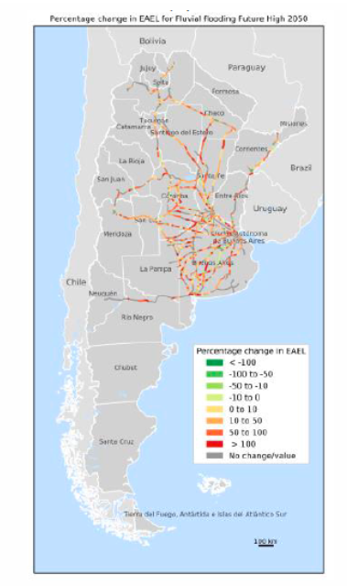
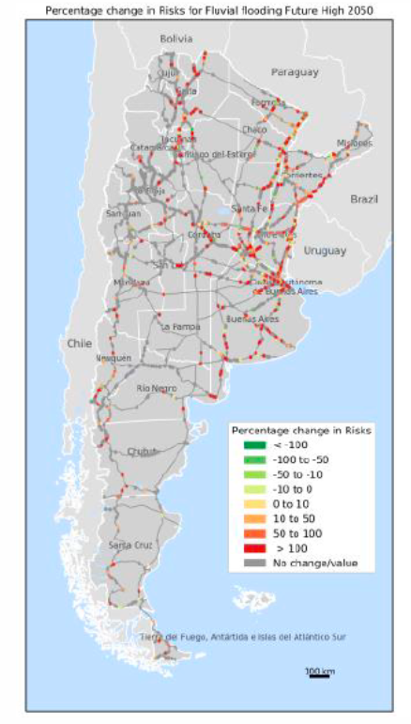
5.4 Future hazard risk - Case study
Future economic losses
Consequences of disruptions to the exposed transport assets, with a step-wise procedure:
Every asset was disrupted individually, and the potential re-routing options were considered
Re-routing resulted in increased transportation costs
If re-routing is not possible, a supply disruption to businesses is modelled, resulting in a reduction of production and economic output
The results of the impact analysis are combined with the probability of the asset being flooded for the current and future scenarios
Identification of asset hotspots allows us to identify what assets are likely to need upgrading in the future, in particular given budget constraints
The asset-level analysis also allows us to evaluate the benefits of resilience measures on an asset level
(Pant et al. 2019)
Notes:
Figure:The percentage change in expected annual economic losses (EAEL) to railway (left) and road bridge (right) assets by 2050

Slide 32
5.4 Future hazard risk - Case study
Final considerations
The number of future scenarios to consider depends on the spatial scale and the level of detail of the analysis
How climate change may increase the likelihood and magnitude of hazard occurrence is very location specific
The changes in risk are even more asset specific. Therefore, the benefits of performing a nation-wide risk analysis, but on an asset level, to identify the most at-risk assets to future change are clearly demonstrated
This type of analysis is the backbone for evaluating the benefits of different types of interventions to improve resilience
Notes:
The number of future scenarios to consider depends on the spatial scale and the level of detail of the analysis. In this study, it was only realistically feasible to use two scenarios. However, for more local studies, or less detailed analysis, the whole ensemble of climate models and scenarios can be explored
How climate change may increase the likelihood and magnitude of hazard occurrence, in this case river flooding, is very location specific, even within a country. Therefore, the change in risk may differ considerably between infrastructure networks, and between individual assets within an infrastructure network. In fact, the results showed that some assets experience an increase in risk while other experience a decrease. Moreover, we saw that for road and rail infrastructure, a similar increase in exposed assets was found across different return periods, whereas for ports, only the very high return periods changed the exposure of the assets
In terms of the economic losses, the changes in risk are even more asset specific. Therefore, the benefits of performing a nation-wide risk analysis, but on an asset level, to identify the most at-risk assets to future change are clearly demonstrated. This type of analysis is the backbone for evaluating the benefits of different types of interventions to improve resilience

Slide 33
5.4 Future hazard risk - Case study
Summary
We went through a detailed example of how to perform and analyse future climate risk to infrastructure assets on a national scale
Description of the results that can be expected as well as the approaches to identifying infrastructure risk hotspots

Slide 34
5.4 Future hazard risk - Case study
Bibliography
Pant, Raghav, Elco E. Koks, Homero Paltan, Tom Russell, and Jim W. Hall. 2019. “Argentina – Transport risk analysis.” August. Oxford, United Kingdom: Oxford Infrastructure Analytics.
34

Slide 35
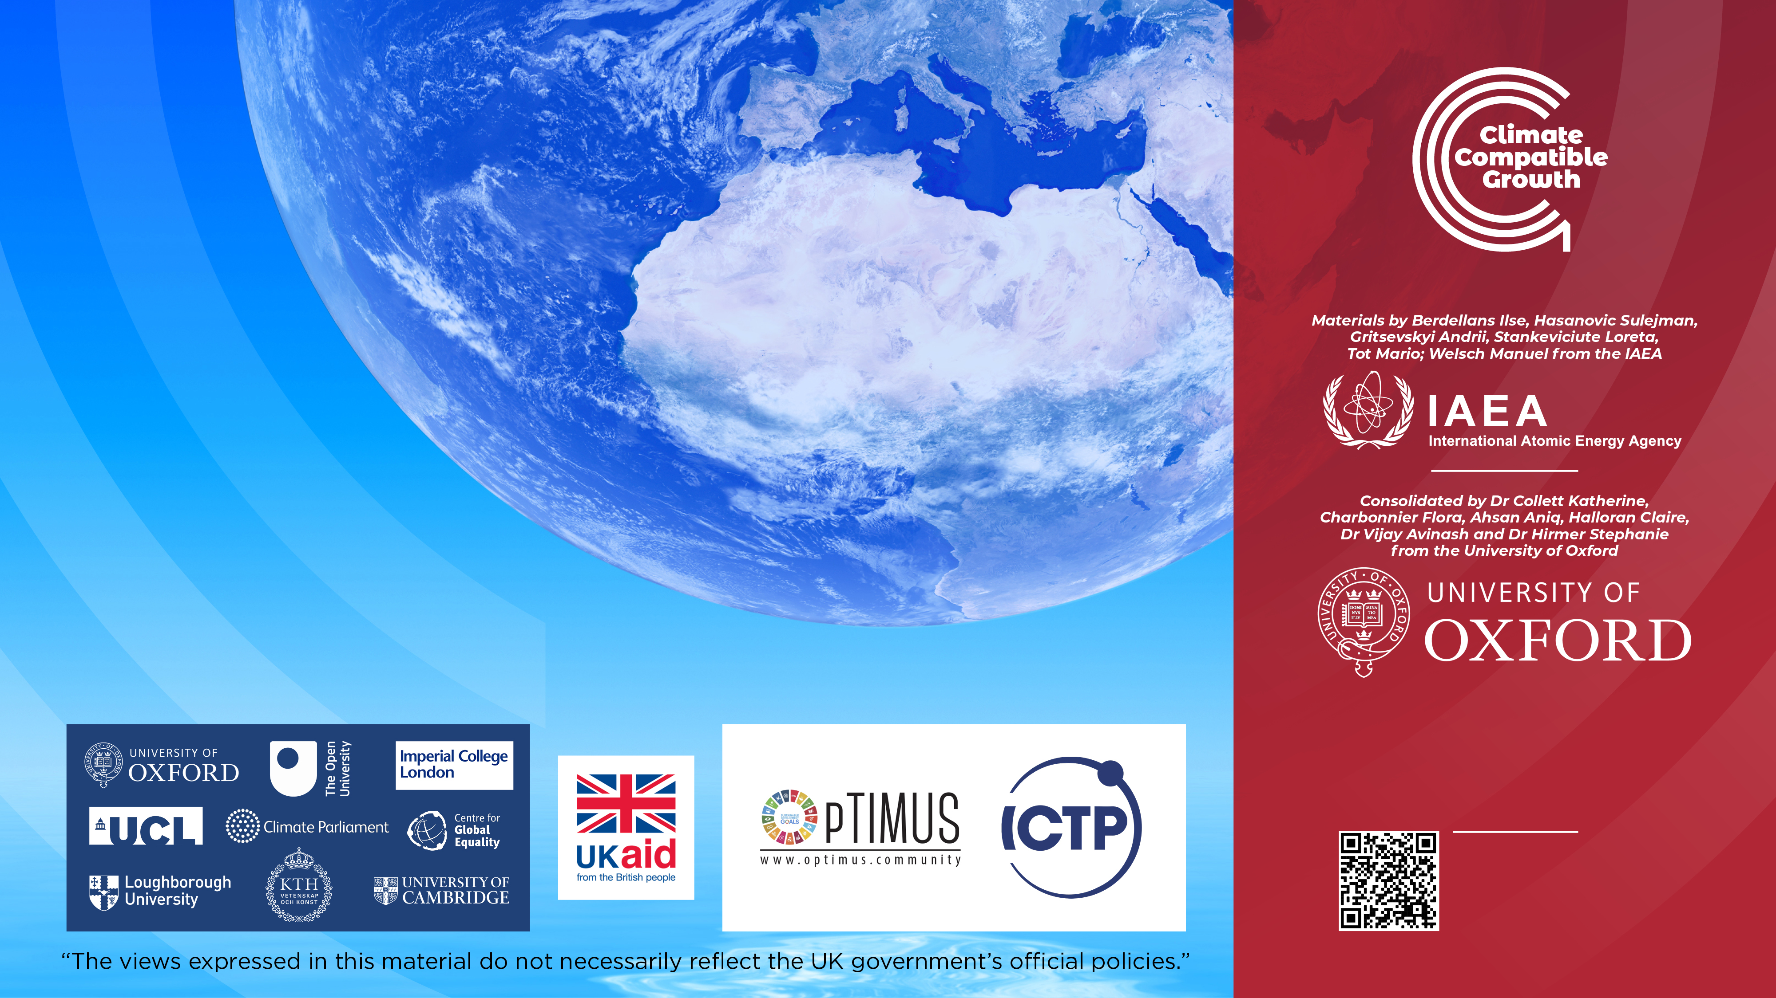
Cannone, C., Collett, K.A., Charbonnier F., Ahsan A., Halloran C., Vijay,A.,Berdellans I., Hasanovic S., Gritsevskyi A,Stankeviciute L., Tot M.; Welsch M., Hirmer S., 2023. Lecture 1: "COURSE INTRODUCTION TO MAED" , Energy Demands Projections with MAED (Model for Analysis of Energy Demand). Release Version 2.0. [online presentation]. Climate Compatible Growth & Programme and International Atomic Energy Agency.
CCG courses (this will take
you to the website link http://www.ClimateCompatibleGrowth.com/teachingmaterials)

