Slide 1
Lecture 4: Calculating damage and disruption to infrastructure systems

Slide 2
Learning Outcomes
By the end of this lecture, you will:
Have an overview of the full range of consequences of infrastructure failure
Know the differences between direct and indirect damages
Have explored the impacts to dependent populations and economic activities

Slide 3

4.1 Introduction to calculating damage and disruption
Learning Objectives
To recognise that infrastructure failures may propagate to affect other infrastructure assets, dependent populations and the economy
To recognise the importance of considering the indirect impacts of infrastructure failures, as well as disruptions to people and the economy, for risk analysis

Slide 4
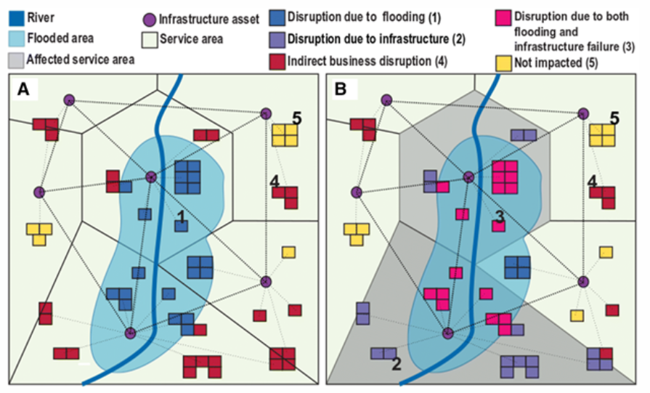
4.1 Introduction to calculating damage and disruption
Introduction
This lecture will explore the full range of disruptions: Direct damages, impacts to other infrastructure systems (Indirect damages), dependent populations (Disruptions to people) and economic activities (Disruptions to the economy)
(Koks et al. 2019)
Notes:
Figure: Illustration of the range of types of impact of flood damages, including direct impacts and indirect impacts to assets that are dependent on affected business facilities or infrastructure services

Slide 5
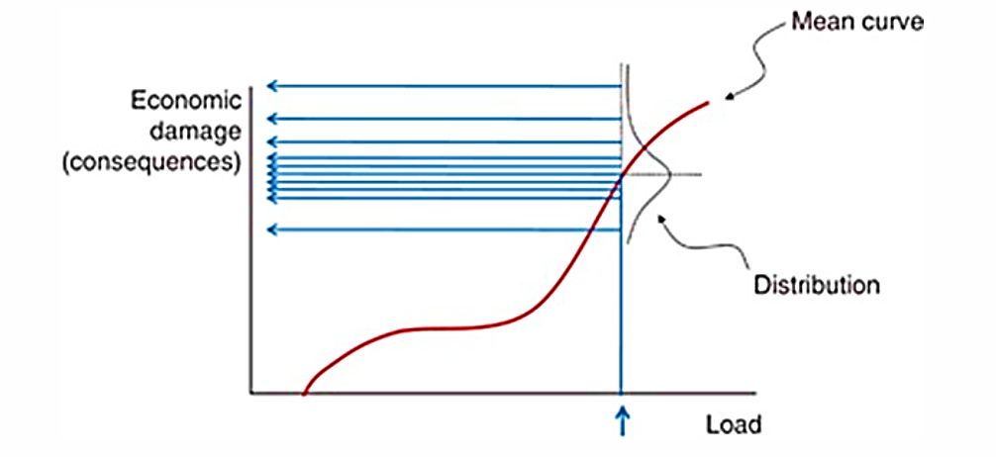
4.1 Introduction to calculating damage and disruption
Direct damages - recap
Direct damage to infrastructure = physical stock damaged during an extreme event
Different infrastructures have
different vulnerabilities to failure for a given severity of hazard
different economic costs associated with failure
Fragility curves can be used to understand the economic burden of natural hazards on infrastructure by assigning a monetary value to the level of damage associated with a given shock event
This calculation does not account for the indirect impacts of infrastructure assets on other infrastructure systems

Slide 6
4.1 Introduction to calculating damage and disruption
Direct damages - recap
Direct damage to infrastructure = physical stock damaged during an extreme event
Different infrastructures have
different vulnerabilities to failure for a given severity of hazard
different economic costs associated with failure
Fragility curves can be used to understand the economic burden of natural hazards on infrastructure by assigning a monetary value to the level of damage associated with a given shock event
This calculation does not account for the indirect impacts of infrastructure assets on other infrastructure systems
Notes:
Figure: Schematic showing the relationship between a given load and economic damages, a distribution of potential economic damages associated with a given load can be used to incorporate uncertainty into the analysis (Lamb et al. 2010). Note that that in the figure, the x axis describes a “load” which describes the severity of a particular hazard. For example, in the case of flooding, the “load” may be the depth of flood inundation.

Slide 7
4.1 Introduction to calculating damage and disruption
Indirect damages
Infrastructure systems can be conceptualised as a system-of-systems → asset failures in one system may have cascading impacts on other systems
These second-order impacts of infrastructure failures on the operations of other infrastructure systems are known as indirect damages
Indirect damages may significantly contribute to the overall damages incurred during an extreme event, and may even outweigh the direct damages incurred

Slide 8
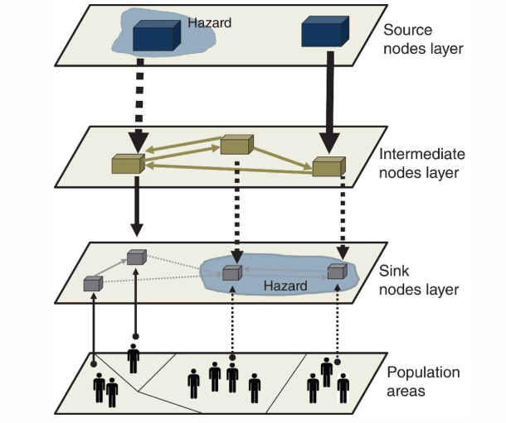
4.1 Introduction to calculating damage and disruption
Disruptions to people
Society relies on essential infrastructure services like electricity, water, and transport, with their criticality depending on the population they serve; more critical assets support larger populations
Decision-makers need to consider both direct and indirect effects of infrastructure disruptions when assessing their impact
Funding allocation for infrastructure protection should prioritize assets that serve a greater number of people, such as substations that also support facilities like water treatment plants
(Pant et al. 2018)
Notes:
Figure: Illustration of how a hazard goes on to affect dependent populations and how the complex relationship between infrastructure assets will determine the extent of a disruption

Slide 9
4.1 Introduction to calculating damage and disruption
Disruptions to the economy
Disruptions to infrastructure services, such as ports, can significantly impact supply chains, particularly during events like hurricanes
These supply chain disruptions may lead to cascading effects on manufacturing operations and other dependent economic activities
Manufacturing relies on consistent transport, electricity, and water services; disruptions to any of these can hinder factory operations

Slide 10
4.1 Introduction to calculating damage and disruption
Summary
Infrastructure failures can have cascading effects on other infrastructure assets, impacting their functionality
Dependent populations and various economic activities are significantly affected by these failures
It's crucial to consider the multiple outcomes of infrastructure failures in risk analysis for better preparedness and response

Slide 11
4.1 Introduction to calculating damage and disruption
Bibliography
Koks, Elco, Raghav Pant, Scott Thacker, and Jim W. Hall. 2019. “Understanding Business Disruption and Economic Losses Due to Electricity Failures and Flooding.” International Journal of Disaster Risk Science. https://doi.org/10.1007/s13753-019-00236-y.
Lamb, R., C. Keef, J. Tawn, S. Laeger, I. Meadowcroft, S. Surendran, P. Dunning, and C. Batstone. 2010. “A new method to assess the risk of local and widespread flooding on rivers and coasts.” Journal of Flood Risk Management. https://doi.org/10.1111/j.1753-318X.2010.01081.x.
Pant, R., S. Thacker, J. W. Hall, D. Alderson, and S. Barr. 2018. “Critical infrastructure impact assessment due to flood exposure.” In Journal of Flood Risk Management. https://doi.org/10.1111/jfr3.12288.

Slide 12

4.2 Calculating direct asset damage and interruptions to network flows
Learning objectives
Conceptually understand the difference between direct and indirect infrastructure damages
Be able to calculate direct and indirect damages for the transport sector

Slide 13
4.2 Calculating direct asset damage and interruptions to network flows
Introduction
Traditionally, infrastructure risk assessments conducted by engineers, insurers or government would only account for direct damage
Indirect damages caused by interruptions to infrastructure network flows can be significant
Direct and indirect impacts will be discussed in turn from a conceptual standpoint, before exploring the difference in more depth for the transport sector

Slide 14
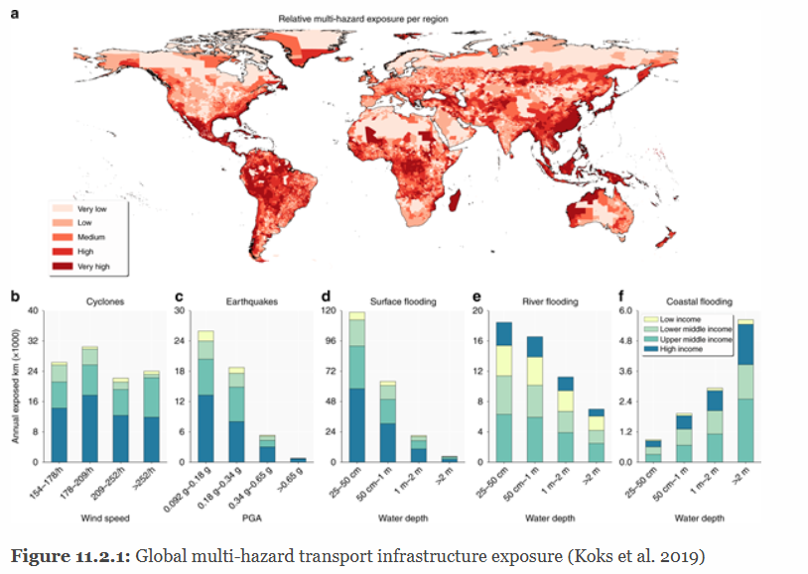
4.2 Calculating direct asset damage and interruptions to network flows
Direct damages: a function of exposure and vulnerability
Physical hazard exposure analyses are overlaid with fragility or vulnerability functions
(Koks et al. 2019)
Notes:
Figure Global multi-hazard transport infrastructure exposure

Slide 15
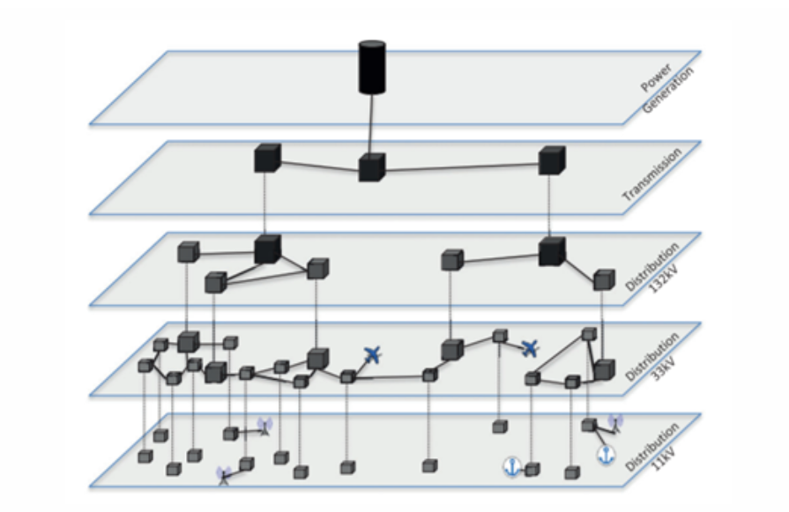
4.2 Calculating direct asset damage and interruptions to network flows
Indirect damages: a function of the strength of connection between infrastructure sectors
By incorporating the effects of disruptions of infrastructure services on the dependent population on each individual infrastructure asset across a network, a much more valuable metric can be achieved across infrastructures
The electricity sector is the most pronounced example of this, as almost all other infrastructure sectors - including water, telecommunications, transport and gas - require electricity supplies
The consequences of failure of a given electricity asset may have cascading impacts to other infrastructures such as telecommunications
(Pant, Thacker, et al. 2018)
Notes:
Figure: Illustration of the structure of electricity infrastructure networks and its interconnections with other sectors

Slide 16
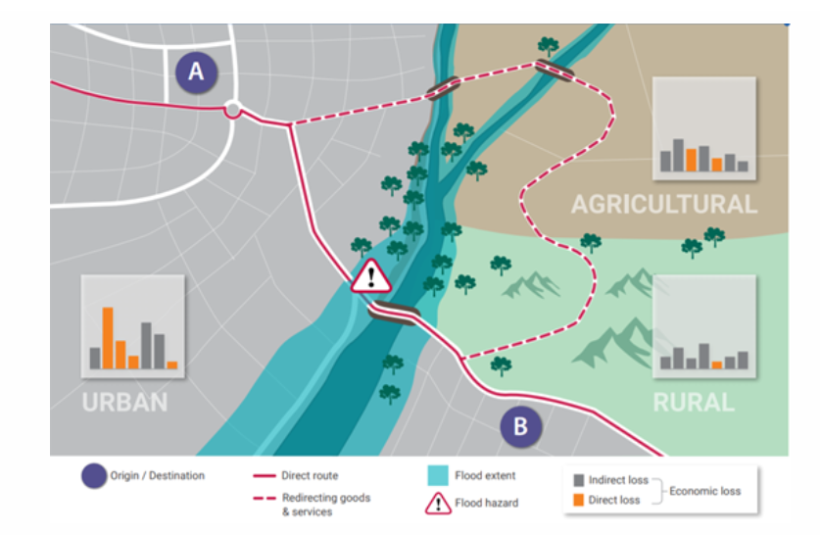
4.2 Calculating direct asset damage and interruptions to network flows
Indirect impacts of transport sector disruptions
DIRECT COST OF DISRUPTION:
calculating the economic cost of repairing the physical damages to the affected section of road or rail
INDIRECT COST OF DISRUPTION:
given that the transport network is fundamental for the movement of goods and labour, redirecting this flow via a less efficient route will be associated with an additional cost
(Hall et al. 2019)
Notes:
Figure: Illustration of how the flow of goods and services would have to be rerouted during a flood, and hence how the costs of the flood damage go beyond the cost of reconstructing the section of road that is directly affected

Slide 17
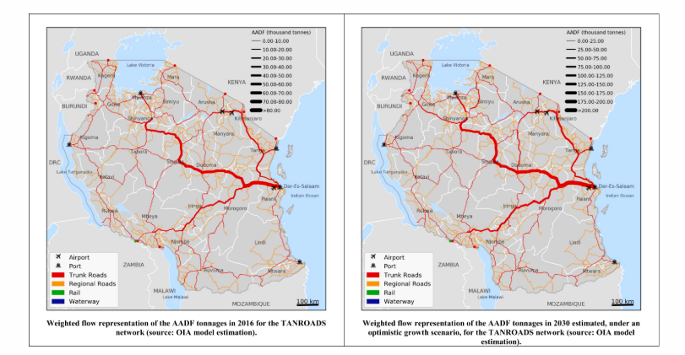
4.2 Calculating direct asset damage and interruptions to network flows
Transport sector indirect damage assessment case study: Tanzania
Cost of rerouting the flow of freight under scenarios of present and future flooding
Hotspots of infrastructure criticality = rehabilitation of damaged assets + cost of the rerouting of goods during the period of disruption
Hotspots are identified where a lack of transport network redundancy means the route that substitutes the affected route is far less efficient
This may also help to guide the prioritisation of adaptation funds to where there is a lack of network redundancy
(Pant, Koks, et al. 2018)
Notes:
Figure: Rerouted Annual Average Daily Flow (AADF) of freight for road network links (2016) and projected cost of rerouting for road network links (2030)

Slide 18
4.2 Calculating direct asset damage and interruptions to network flows
Summary
This lecture provides a comparison between direct and indirect infrastructure damages
Transport sector as an in-depth case study

Slide 19
4.2 Calculating direct asset damage and interruptions to network flows
Bibliography
Hall, Jim W., Jeroen C. J. H. Aerts, Bilal M. Ayyub, Stéphane Hallegatte, Mark Harvey, Xi Hu, Elco Koks, et al. 2019. “Adaptation of Infrastructure Systems: Background Paper for the Global Commission on Adaptation.” Global Commission on Adaptation. https://gca.org/reports/adaptation-of-infrastructure-systems/.
Koks, Elco, J. Rozenberg, C. Zorn, M. Tariverdi, M. Vousdoukas, S. A. Fraser, J. W. Hall, and S. Hallegatte. 2019. “A global multi-hazard risk analysis of road and railway infrastructure assets.” Nature Communications. https://doi.org/10.1038/s41467-019-10442-3.
Pant, R., Elco E. Koks, Tom Russell, and Jim W. Hall. 2018. “Transport Risks Analysis for The United Republic of Tanzania – Systemic vulnerability assessment of multi-modal transport networks.” Oxford: Oxford Infrastructure Analytics Ltd.
Pant, R., S. Thacker, J. W. Hall, D. Alderson, and S. Barr. 2018. “Critical infrastructure impact assessment due to flood exposure.” In Journal of Flood Risk Management. https://doi.org/10.1111/jfr3.12288.

Slide 20
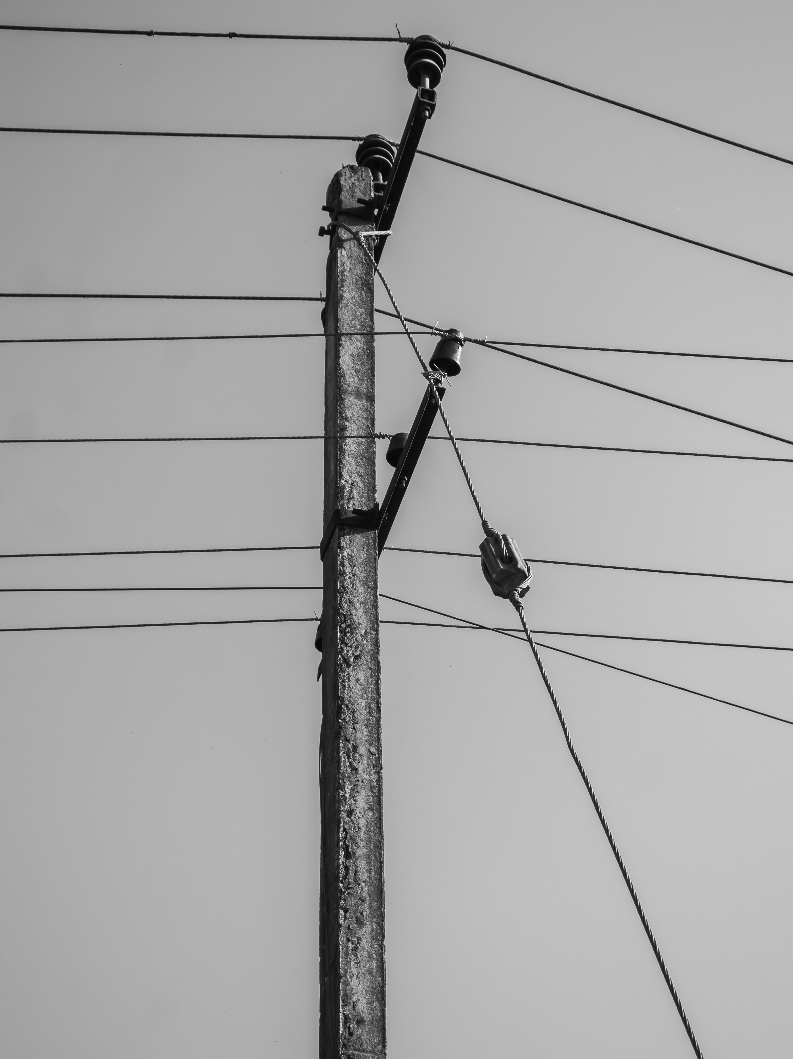
4.3 Calculating disruptions to end-users
Learning objectives
To recognise society’s direct and indirect dependence on infrastructure
To be able to quantify the number of people affected by disruptions for large-scale analysis

Slide 21
4.3 Calculating disruptions to end-users
Introduction
The lecture examines infrastructure disruptions and their impact on the affected population
It describes a method for estimating the population served by various infrastructure assets
An overview is provided on considering the population indirectly served through interconnected systems
A case study analyses the direct and indirect effects of flooding on the population in the Thames catchment area

Slide 22
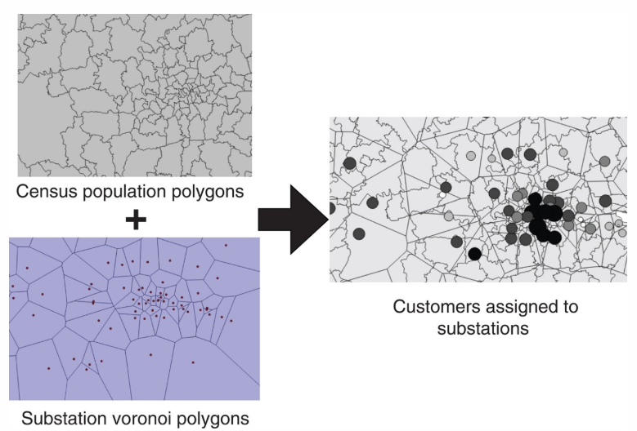
4.3 Calculating disruptions to end-users
At large scales, data on which infrastructure assets serve which populations is largely unavailable
A technique that involves spatially partitioning the population served by different assets is often employed
Voronoi polygons involve partitioning a plane with points into polygons such that each polygon contains
one ‘generating point’ and
points that are closer to its ‘generating point’ than to any other
By drawing Voronoi polygons around each asset, each asset is associated with a region within which all villages and towns will be closer to that asset than to any other
Identifying which populations are served by infrastructure assets
(Pant et al. 2018)
Notes:
Figure: Illustration of how populations can be divided according to Voronoi polygons dedicated to each electricity substation in order to estimate how many customers are served by each asset
There are now several open-source hazard products at global scales which are being used widely for vulnerability and risk analysis. A few resources include:
Global river and coastal flood maps: Historical and future hazard maps at different return periods (2, 5, 11, 25, 50, 110, 250, 500, 1100 years). All data is available at a 30 arc-seconds resolution (~1km at equator) (Gassert et al. 2015).
Global hazard maps for earthquakes for different return periods (250, 475, 975, 1500, 2475 years) both Peak Ground Acceleration and spectral acceleration. Data is available at 0.072 degrees (~8km at equator).
Global dataset of 11,000 synthetic tropical cyclones paths with cyclone characteristics (e.g., wind speed, pressure) on a global scale. Wind speed probabilities are derived globally (11 metre, 11 minutes sustained speed) for different return periods (11 to 11,000 years) at 11km resolution (Bloemendaal et al. 2019).

Slide 23
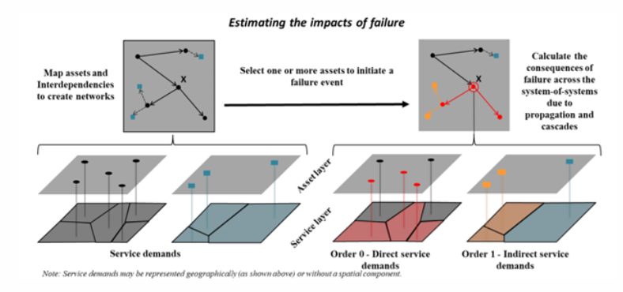
4.3 Calculating disruptions to end-users
Identifying which populations are indirectly served by infrastructure assets
(Pant et al. 2020)
Notes:
Figure: In the top left graph, a network is drawn in black with dependent assets belonging to another sector in blue. Below, the service demands associated with each asset both in the first network (black) and the dependent assets (blue) are identified by drawing Voronoi polygons. The right-hand side of the figure illustrates what would happen in the event of failure at asset X. Because X is connected to other assets in the first network (red), which are in turn connected to two dependent assets of another sector (yellow), the initial failure propagates to 4 more assets. By understanding the extent of the service demand area associated with each, the population disrupted both directly and indirectly by the failure of asset X can be quantified. Evidently, the number of people served by the asset X is much lower than the total number of people disrupted, highlighting the importance of understanding the behaviour of infrastructure as an interconnected network or system-of-systems.

Slide 24
4.3 Calculating disruptions to end-users
Consequences for criticality analysis and decision-making
The populations served both directly and indirectly by individual assets provides an indication of the population exposed to asset failure, and thus the criticality of different assets
For example, the criticality of an electricity substation can be calculated by combining:
The number of customers it serves directly (that are potentially exposed to electricity asset failure) by assigning Voronoi polygons to individual electricity substation assets
The number of customers that are served by other infrastructure systems supplied by that electricity substation, such as gas, water, wastewater and telecommunications infrastructure
This metric can be used to guide decision-making by prioritising the most ‘critical’ assets for improvement works

Slide 25
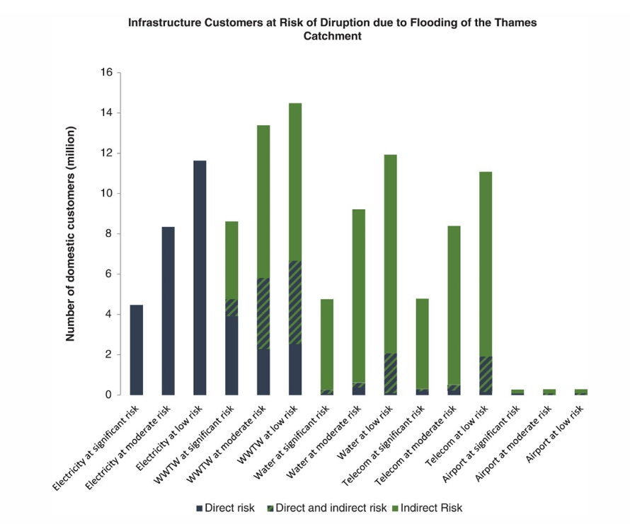
4.3 Calculating disruptions to end-users
Putting it into practice
The number of domestic customers exposed to the direct flood-induced disruption for a range of infrastructures, from electricity to water to telecoms, as well as to asset disruption caused indirectly by flooding as a result on network connections, was calculated
(Pant et al. 2018)
Notes:
Figure: Number of domestic customers directly and indirectly exposed to the direct flood-induced disruptions for a range of infrastructure sectors in the Thames catchment
It is particularly striking to see the additional number of people indirectly exposed to electricity disruptions via water supply, wastewater and telecommunications infrastructure disruptions

Slide 26
4.3 Calculating disruptions to end-users
Summary
How infrastructure failures disrupt dependent populations
Direct and indirect reliance on infrastructure
How to to estimate the number of people affected by such disruptions

Slide 27
4.3 Calculating disruptions to end-users
Bibliography
Pant, R., Tom Russell, Conrad Zorn, Edward Oughton, and Jim W. Hall. 2020. “Resilience study research for NIC - Systems analysis of interdependent network vulnerabilities.” Oxford, UK: Environmental Change Institute, Oxford University.
Pant, R., S. Thacker, J. W. Hall, D. Alderson, and S. Barr. 2018. “Critical infrastructure impact assessment due to flood exposure.” In Journal of Flood Risk Management. https://doi.org/10.1111/jfr3.12288.

Slide 28
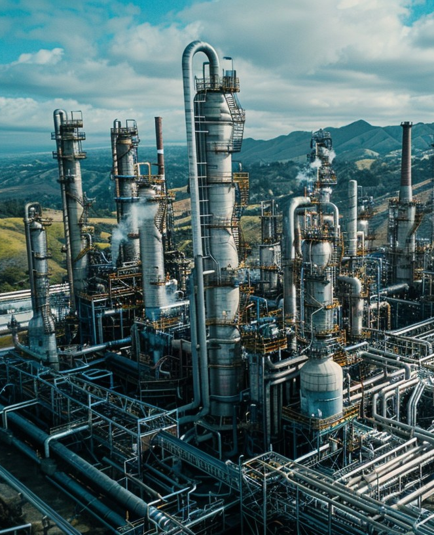
4.4 Calculating economic consequence of disruptions to businesses
Learning objectives
To recognise how various economic activities depend on infrastructure services
To quantify the macro-economic impacts of infrastructure disruptions

Slide 29
4.4 Calculating economic consequence of disruptions to businesses
Introduction
When infrastructure disruptions impact businesses, they have cascading macro-economic impacts. This can occur in a variety of ways:
Many factory operations require a reliable supply of water and electricity. If factory operations are disrupted due to power or water supply cuts, this may cause further ripple effects through supply chains (Koks et al. 2019)
As a key node of supply chains, when port infrastructure is disrupted, the flow of goods will also be disrupted, possibly across large scales (Verschuur, Koks, and Hall 2021)
A more nuanced example would be the potential impact of future droughts on cooling water shortages to thermo-electric power plants, and the potential consequences of that for increasing electricity prices in the future (Byers et al. 2020)
It is important to understand the full cost of infrastructure service disruptions to prioritise funding for adaptation

Slide 30
4.4 Calculating economic consequence of disruptions to businesses
Input-Output modelling
Input-Output (IO) tables illustrate transactions between various production sectors and are used for assessing economic impacts from changes in production
IO impact assessments quantify the economic effects on dependent sectors when there are changes in production from one sector
Infrastructure disruptions can interrupt production and other economic activities, leading to economic losses
There is a growing integration of IO impact assessments with spatial infrastructure network models to measure indirect economic losses from infrastructure failures

Slide 31
4.4 Calculating economic consequence of disruptions to businesses
Macro-economic impacts of port disruption
Verschuur, Koks, and Hall (2021) used IO tables to perform a criticality analysis of port and maritime transport networks globally with respect to their interdependency with global supply-chains
Several low-income countries and island states were often more dependent on maritime transport through one or two key ports than higher income countries
Countries such as the Congo, Malta, Mauritius and Tanzania, had 20.3-43.5% of their economic activity dependent on trade flows flowing through a single port
On a global scale 9.3% of the total industry output depends upon trade flowing through the top 10 ports, with the port of Shanghai alone embedding 1.7% of global output
Large macro-economic impacts, both on a national and global scale, could be expected when ports are affected by climatic extremes

Slide 32
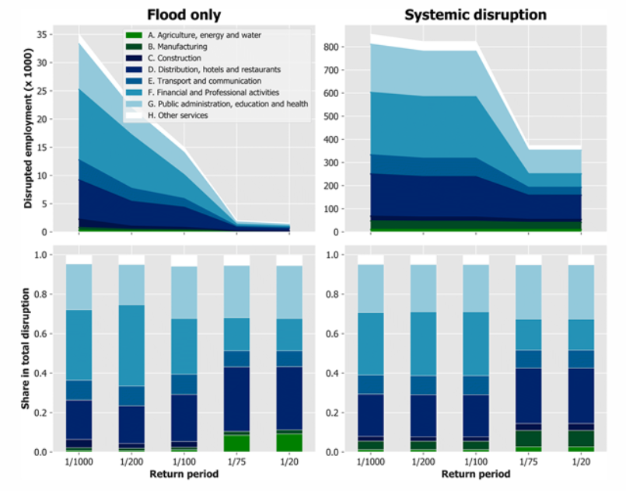
4.4 Calculating economic consequence of disruptions to businesses
Macro-economic impacts of electricity disruption
Koks et al. (2019) analyzed the impact of flooding on electricity infrastructure in southeast England, revealing that supply disruptions significantly affected macro-economic losses across 37 regions in the UK
The study examined the effects of a 1 in 1,000-year flood event, finding that business disruptions due to electricity failures could be magnified by a factor of 23 at the local level
Nationally, including electricity failure in the loss assessment led to potential daily direct output flow losses increasing up to a factor of 33, and total output flow losses increasing up to a factor of 3
(Koks et al. 2019)
Notes:
Figure: Projected reduction in employment due to extreme flooding at business asset locations (left) and at both business asset locations as well as the electricity assets that serve them (right), in absolute (top) and relative (bottom) terms

Slide 33
4.4 Calculating economic consequence of disruptions to businesses
Drought impacts on energy prices
Infrastructure asset failures, particularly in transport, water, and energy, can have significant macro-economic impacts due to their interdependence on various economic activities
Climate hazards can affect both the resources provided by infrastructure systems and the prices of commodities, resulting in macro-economic ripple effects
Thermo-electric power plants, which rely heavily on water for cooling, are vulnerable to shortages and rising temperatures, potentially reducing electricity generation
A study by Byers et al. (2020) projected that future droughts could lead to increased electricity prices in the UK, with annual macro-economic impacts estimated between GBP29-66 million

Slide 34
4.4 Calculating economic consequence of disruptions to businesses
Summary
Relationship between infrastructure services and the economy
Case studies that demonstrate how to measure the economic impacts of infrastructure failures
Dependence of economic activities on infrastructure and be able to evaluate the macroeconomic effects of disruptions

Slide 35
4.4 Calculating economic consequence of disruptions to businesses
Bibliography
Byers, Edward A., Gemma Coxon, Jim Freer, and Jim W. Hall. 2020. “Drought and climate change impacts on cooling water shortages and electricity prices in Great Britain.” Nature Communications. https://doi.org/10.1038/s41467-020-16012-2.
Koks, Elco, Raghav Pant, Scott Thacker, and Jim W. Hall. 2019. “Understanding Business Disruption and Economic Losses Due to Electricity Failures and Flooding.” International Journal of Disaster Risk Science. https://doi.org/10.1007/s13753-019-00236-y.
Verschuur, J., E. E. Koks, and J. W. Hall. 2021. “Ports’ criticality in international trade and global supply-chains.” Nature. https://doi.org/10.21203/rs.3.rs-106378/v1.

Slide 36

Cannone, C., Collett, K.A., Charbonnier F., Ahsan A., Halloran C., Vijay,A.,Berdellans I., Hasanovic S., Gritsevskyi A,Stankeviciute L., Tot M.; Welsch M., Hirmer S., 2023. Lecture 1: "COURSE INTRODUCTION TO MAED" , Energy Demands Projections with MAED (Model for Analysis of Energy Demand). Release Version 2.0. [online presentation]. Climate Compatible Growth & Programme and International Atomic Energy Agency.
CCG courses (this will take
you to the website link http://www.ClimateCompatibleGrowth.com/teachingmaterials)
23

