Slide 1
Lecture 3: Assessing infrastructure asset risk and vulnerability

Slide 2
Learning Outcomes
By the end of this lecture, you will:
Know what’s meant with the vulnerability of infrastructure to climate extremes
Have general knowledge of asset level vulnerability of infrastructure, and how this can be quantified
Have explored the systemic vulnerability of infrastructure networks, given the nature of spatial dependency between extreme events at multiple asset locations

Slide 3
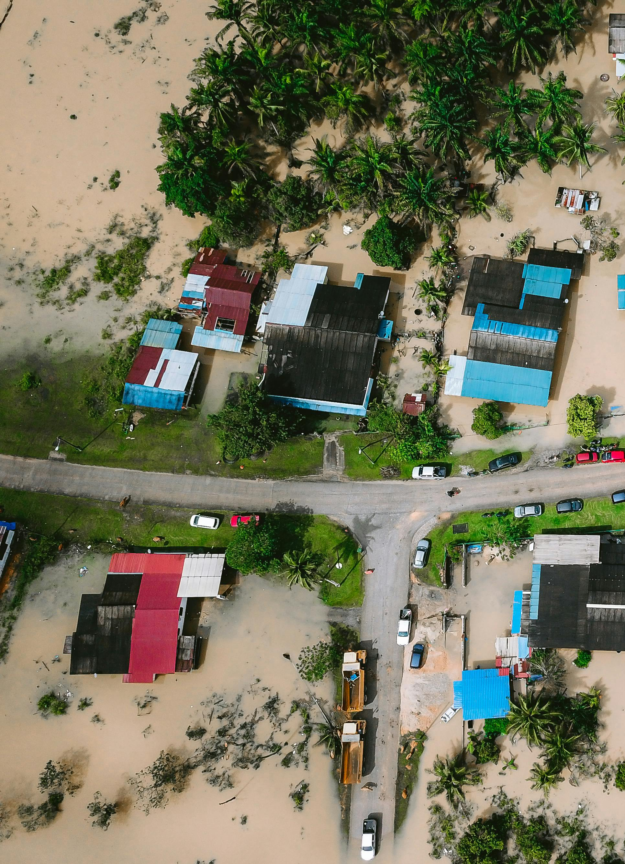
3.1 Assessing infrastructure asset vulnerability
Learning Objectives
To be able to explain the concept of asset vulnerability
To be aware of the different definitions of vulnerability
To recognise the difference between the sensitivity and fragility approaches to vulnerability assessments

Slide 4
3.1 Assessing infrastructure asset vulnerability
Defining Vulnerability
Two categories of climate change-related vulnerability:
Biophysical vulnerability - view in terms of the amount of (potential) damage caused to a system by a particular climate-related event or hazard. Concerned with the ultimate impacts of a hazard event and often viewed in terms of the amount of damage experienced by a system as a result of an encounter with a hazard. Thus, it is measured as an indicator of the outcomes of a hazard, rather than indicators of the state of a system prior to the occurrence of a hazard event.
Social vulnerability – view as a state that exists within a system before it encounters a hazard event. Function of the internal state of a system – independent of external hazards.
For our purposes, we adopt the biophysical definition of vulnerability: “Vulnerability refers to the propensity of exposed elements such as human beings, their livelihoods, and assets to suffer adverse effects when impacted by hazard events” (McCarthy 2001).
(Jones and Boer 2003, Allen 2003)

Slide 5
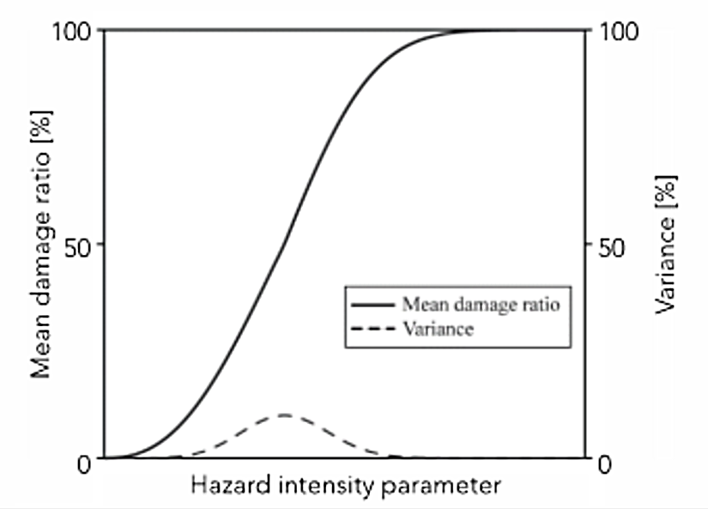
3.1 Assessing infrastructure asset vulnerability
Vulnerability functions as sensitivity
Vulnerability = asset-level sensitivity / level of asset deterioration associated with a given load
Load = severity of a given hazard or hazard variable (e.g. flood inundation depth)
Vulnerability estimation approach measures direct damages to assets by correlating the Mean Damage Ratio (MDR) and its variance with a hazard intensity parameter. MDR is usually expressed in economic terms
(GPSS 2019)
Notes:
Figure: A sensitivity curve which formalises the relationship between hazard intensity (e.g. flood inundation depth) versus the mean damage ratio, which is the damage caused by the hazard as a fraction of the total cost of rebuilding the asset

Slide 6
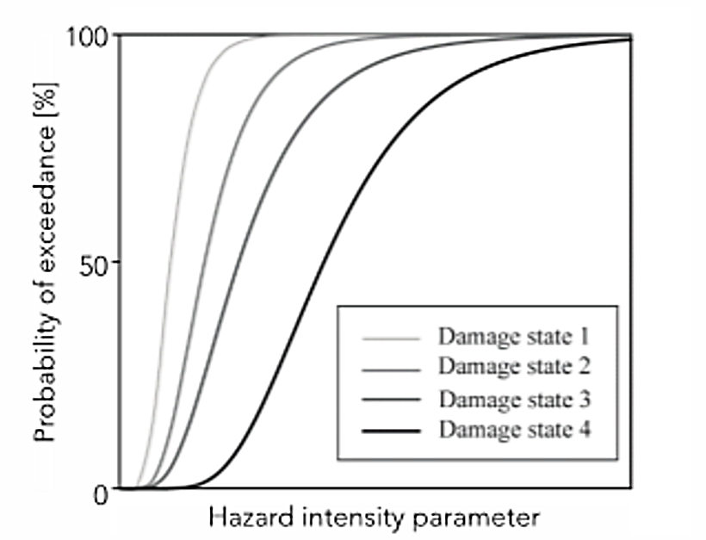
3.1 Assessing infrastructure asset vulnerability
Spatial relations between infrastructure and society
Vulnerability can alternatively be conceptualised in terms of asset fragility
The fragility of an asset describes the conditional probability of asset failure with respect to loading. This information is conveyed via a fragility curve
Uncertainty in this formalisation is communicated by the probability distribution function of each damage state of the fragility functions
(GPSS 2019)
Notes:
Figure: Range of potential different states of asset failure that can be used to derive a probability of failure conditional on hazard loading

Slide 7
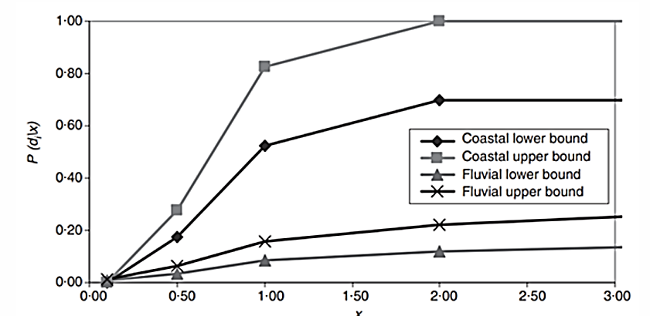
3.1 Assessing infrastructure asset vulnerability
Process of calculating vulnerability using fragility curves
Assemble information on the different damage states of the assets with respect to different hazard loading conditions
Assemble information on the damage ratio curves, which are derived from analysis of damages to asset types based on stress testing or for observed data on damages
Intersect the hazard and asset to create an inventory of hazard exposures to the assets
Estimate the vulnerability via either sensitivity or fragility curves.
Combine this information with the load to which an asset is subject during an extreme event. This would allow either the probability of asset failure or the economic damage incurred to be quantified for fragility and sensitivity, respectively
(Hall et al. 2003)
Notes:
Figure: Overtopping fragility curve used in national flood risk assessment (fluvial and sea defence). Note that Uncertainty is reflected through the use of upper and lower bounds on the conditional failure for fluvial and coastal flooding

Slide 8
3.1 Assessing infrastructure asset vulnerability
Summary
Introduction of the concept of infrastructure vulnerability, key element of risk assessments
Concept of asset vulnerability and be aware of the different definitions of vulnerability
Difference between the sensitivity and fragility approaches to vulnerability assessments

Slide 9
3.1 Assessing infrastructure asset vulnerability
Bibliography
Allen, Katrina. 2003. “Vulnerability reduction and the community-based approach: A Philippines study.” In Natural Disasters and Development in a Globalizing World. https://doi.org/3.4324/9780203402375.
GPSS. 2019. “Fragility and Vulnerability Assessment Guide.” World Bank. https://gpss.worldbank.org/sites/gpss/files/2019-10/Fragility and Vulnerability Assessment Guide.pdf.
Hall, Jim W., Richard J. Dawson, Paul B. Sayers, Corina Rosu, John B. Chatterton, and Robert Deakin. 2003. “A methodology for national-scale flood risk assessment.” Proceedings of the Institution of Civil Engineers: Water and Maritime Engineering. https://doi.org/3.1680/wame.2003.156.3.235.
Jones, R, and R Boer. 2003. “Assessing current climate risks Adaptation Policy Framework: A Guide for Policies to Facilitate Adaptation to Climate Change, UNDP.” UNDP. https://www4.unfccc.int/sites/NAPC/Country Documents/General/apf technical paper04.pdf.
McCarthy, J J. 2001. “Summary for Policymakers; Climate Change 2001: impacts, adaptation, and vulnerability: .”

Slide 10

3.2 Fragility and vulnerability functions for different hazards
Learning objectives
To be able to quantify asset vulnerability as the likelihood of failure conditional to a given load via fragility curves
To recognise the generalisability of fragility curves for a range of different hazards and infrastructure asset types

Slide 11
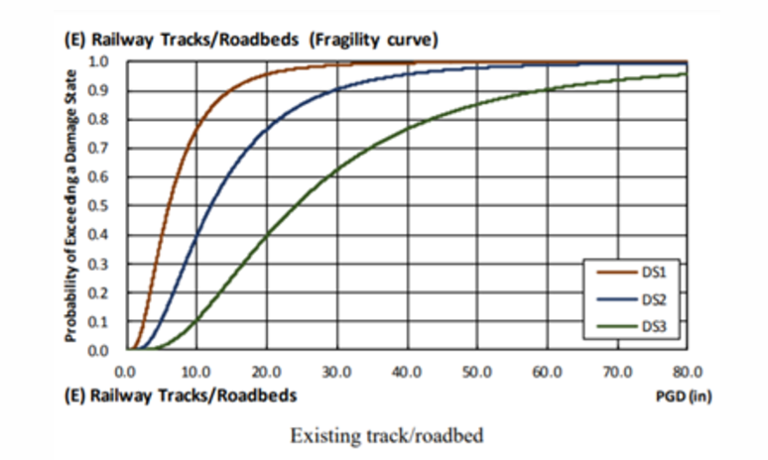
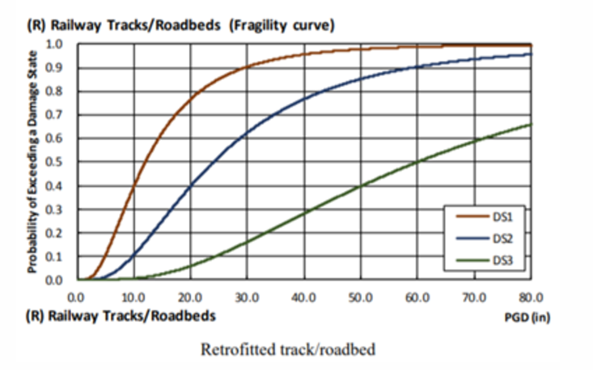
3.2 Fragility and vulnerability functions for different hazards
Earthquake fragility curves
The main measure for earthquake severity is Peak Ground Acceleration (PGA)
By comparing the probability of failure between assets with and without protective works, one can compare the costs and benefits of protective works
(World Bank 2019; FEMA 2013a)
Notes:
Figure: Seismic fragility functions for railway tracks/roadbeds
Each plot compares the fragility curves for piers with (bottom) and without (top) retrofitting
DS1 to DS4: relatively minor damages to complete asset failure

Slide 12
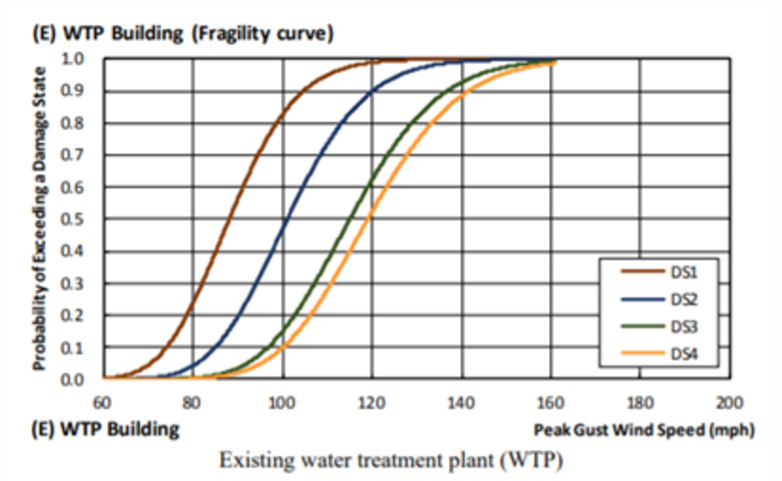
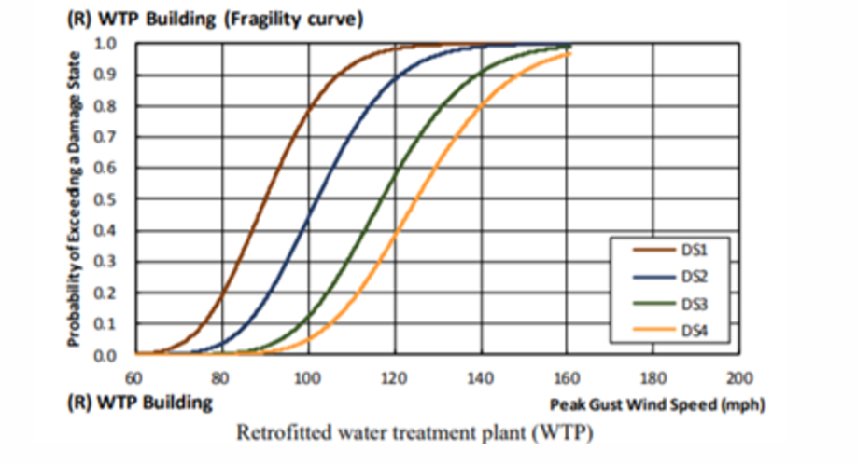
3.2 Fragility and vulnerability functions for different hazards
Cyclone fragility curves
Wind speed is the main measure of hazard severity
(World Bank 2019; FEMA 2013b)
Notes:
Figure: Cyclone fragility functions for water treatment plants (
The fragility curves are based on wind fragility functions for buildings similar to WTP building in the United States, provided by FEMA (2013b)

Slide 13
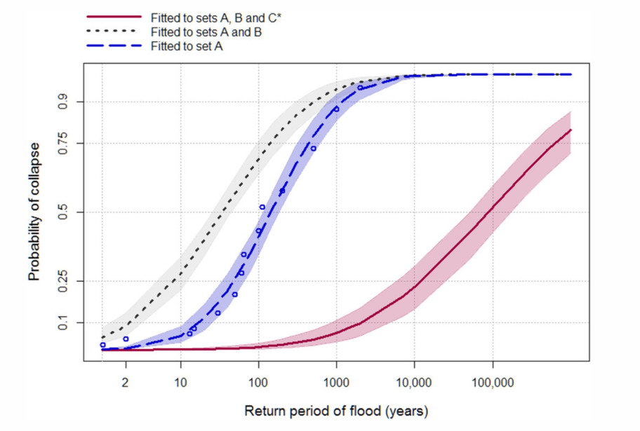
3.2 Fragility and vulnerability functions for different hazards
Example of a fragility curve for bridge scour and for a coastal defence
For flood hazards, flood extent return period maps and flood inundation depth are the main measures of severity
(A) Historical bridge failures with associated flood event return periods
(B) Historical bridge failures associated with an unknown flood return period
(C) Bridges that are assumed not to have failed
(Lamb et al. 2019)
Notes:
Figure:The three curves show the different outcomes for calculating the likelihood of failure when considering different datasets

Slide 14
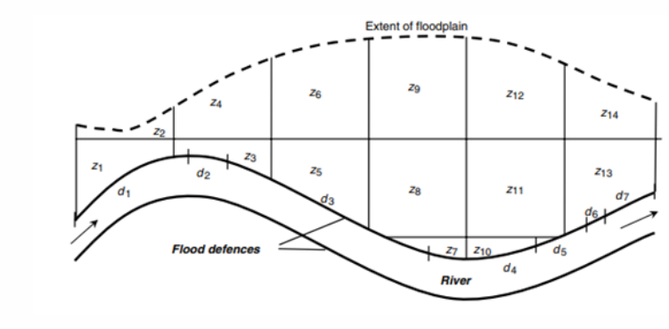



3.2 Fragility and vulnerability functions for different hazards
Multiple asset failure
In the case where an extreme event impacts multiple assets at once
Conditional probability of failure event $D_{i}$is provided for a given set of loads x:
Probability of multiple sections failing:
$$P\left(D_{i}\right)= \int_{0}^{∞}{p\left(x\right)P\left(D_{i}|x\right)dx}$$
$P\left(D_{1}∩D_{2}|x\right)=P\left(D_{1}|x\right)$ x $P\left(D_{2}|x\right)$
(Hall et al. 2003)
Notes:
Figure: Illustration of a flood defence system and flood impact zones

Slide 15
3.2 Fragility and vulnerability functions for different hazards
Summary
Applications of fragility curves for analysing asset vulnerability to different kinds of hazards
How to use vulnerability assessments to compute the likelihood of multiple asset failures
Employment of fragility curves for quantifying the likelihood of infrastructure failures under different hazard loading scenarios

Slide 16
3.2 Fragility and vulnerability functions for different hazards
Bibliography
FEMA. 2013a. “Multihazard Loss Estimation Methodology, Earthquake Model Technical Manual.” Washington DC, USA.
———. 2013b. “Multihazard Loss Estimation Methodology, Hurricane Model Technical Manual.” Washington DC, USA.
Hall, Jim W., Richard J. Dawson, Paul B. Sayers, Corina Rosu, John B. Chatterton, and Robert Deakin. 2003. “A methodology for national-scale flood risk assessment.” Proceedings of the Institution of Civil Engineers: Water and Maritime Engineering. https://doi.org/3.1680/wame.2003.156.3.235.
Lamb, Rob, Paige Garside, Raghav Pant, and Jim W. Hall. 2019. “A Probabilistic Model of the Economic Risk to Britain’s Railway Network from Bridge Scour During Floods.” Risk Analysis. https://doi.org/3.1111/risa.13370.
World Bank. 2019. “INCREASING INFRASTRUCTURE RESILIENCE BACKGROUND REPORT.” http://documents1.worldbank.org/curated/en/620731560526509220/pdf/Technical-Annex.pdf.

Slide 17

3.3 Infrastructure systems reliability analysis
Learning objectives
To recognise that hazards do not only incur damages locally but are associated with a spatial footprint which may incur widespread losses
To distinguish between assumptions of full dependence, full independence and partial dependence for aggregating risk analysis at multiple asset locations

Slide 18
3.3 Infrastructure systems reliability analysis
Introduction
The standard approach is to analyse the likelihood of hazards at individual locations independent from one another, even if is likely that nearby assets will also be affected by the same event
The severity of a hazard, such as a flood, is typically communicated through either the annual exceedance probability or the return period
The return period of a certain event, such as a 100-year flood event, can be determined by fitting an extreme‐value model to gauged data. However, this traditional approach fails with spatially and temporally dependent variables
How we handle the spatial dependence of hazards between multiple locations is of particular interest for stakeholders that are interested in conducting risk assessments at a large-scale, including governments, insurance providers and planners

Slide 19
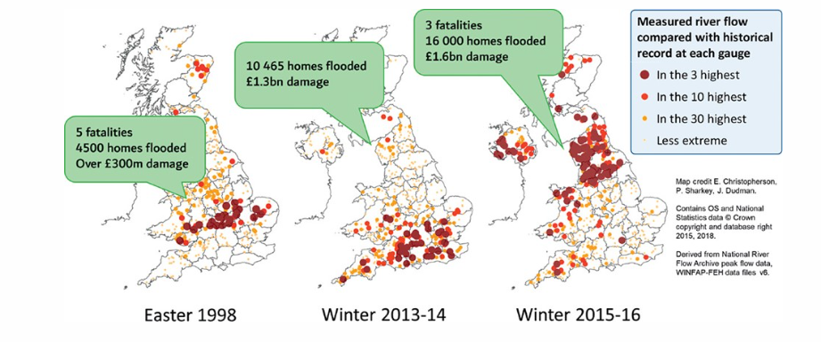
3.3 Infrastructure systems reliability analysis
Spatial footprint of flood events
(Towe, Tawn, and Lamb 2018)
Notes:
Figure: The spatial extent of three major flood events that occurred in the UK, where discs represent how extreme the streamflow recorded at each gauging station was relative to the historical record at each gauge
There are now several open-source hazard products at global scales which are being used widely for vulnerability and risk analysis. A few resources include:
Global river and coastal flood maps: Historical and future hazard maps at different return periods (2, 5, 10, 25, 50, 100, 250, 500, 1000 years). All data is available at a 30 arc-seconds resolution (~1km at equator) (Gassert et al. 2015).
Global hazard maps for earthquakes for different return periods (250, 475, 975, 1500, 2475 years) both Peak Ground Acceleration and spectral acceleration. Data is available at 0.072 degrees (~8km at equator).
Global dataset of 10,000 synthetic tropical cyclones paths with cyclone characteristics (e.g., wind speed, pressure) on a global scale. Wind speed probabilities are derived globally (10 metre, 10 minutes sustained speed) for different return periods (10 to 10,000 years) at 10km resolution (Bloemendaal et al. 2019).

Slide 20
3.3 Infrastructure systems reliability analysis
Conditional damage curve calculated per property or aggregated per model node
Quantifying the spatial dependence between infrastructure damages
Damage
To quantify the risk of flood-induced damage occurring at multiple locations simultaneously, it is necessary to quantify the spatial dependence between variations in hazard severity at multiple locations
A statistical conditional exceedance model is fitted to gauged data to determine the joint probability of extreme river flows or sea levels at multiple locations
By estimating the economic losses associated with extreme river flows for each property via damage curves, the joint probability of extreme river flows is converted to the joint probability of economic losses at multiple assets
Damage
Load
Load
Damage
Load
Load at each model node point is obtained by simulation from the conditional exceedance model
Properties
Model node points
(Lamb et al. 2010)
Notes:
Figure: Schematic of a joint probability model for calculating the spatial dependency between flood damages at multiple locations

Slide 21
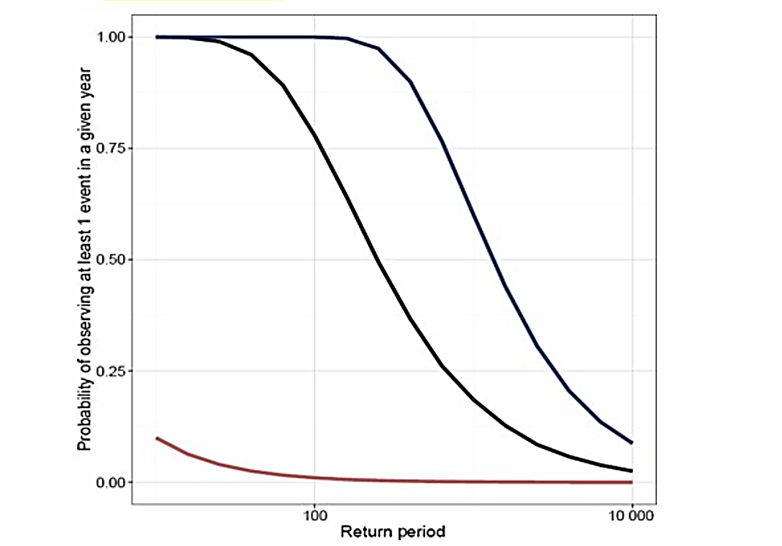
3.3 Infrastructure systems reliability analysis
Comparison between approaches for measuring spatial dependencies
Hazards and hazard-induced damages have a complex spatial pattern and are spatially and temporally connected In risk analysis, the strength of connection, or dependence, is rarely considered:
If complete dependence is assumed (red curve), then it is assumed that all sites behave the same. This results in a significant underestimation of the likelihood that at least one of multiple sites experiences an extreme event
In the case of independence, where there is no relationship between any of the river flow gauges (blue curve), an overestimation of the likelihood of at least one extreme event occurring across multiple sites is observed
The black curve takes into account the true nature of dependence between flood events and, therefore, provides the most realistic understanding of the probability of flooding at multiple sites at a large scale
(Towe, Tawn, and Lamb 2018)
Notes:
Figure: Comparison of probability of observing extreme river flow at least one gauge in a given year for each of the three dependence approaches: the red curve represents the assumption of complete dependence; the blue curve represents the assumptions of complete independence; and the black curve represents the true nature of dependence between river flows

Slide 22
3.3 Infrastructure systems reliability analysis
Implications of spatial dependence for risk assessments
Analysing systemic risks from hazards is crucial for insurance and risk management, especially to avoid simultaneous payouts from large-scale events
Insurers need a spatially diversified asset portfolio to reduce the risk of multiple customers needing payouts at the same time due to widespread hazards
Widespread disruptions, such as those caused by large-scale flooding, can significantly affect infrastructure, necessitating a holistic view of asset interdependencies
Prioritizing adaptation infrastructure involves considering the likelihood of widespread disruptions to ensure sufficient substitutional capacity during catastrophic events

Slide 23
3.3 Infrastructure systems reliability analysis
Summary
The lecture highlighted the importance of considering spatial dependence between extreme events in risk analysis to avoid underestimating potential losses
Hazards often have a significant spatial footprint, leading to widespread financial impacts
Key concepts discussed include full dependence, full independence, and partial dependence of hazards across multiple locations

Slide 24
3.3 Infrastructure systems reliability analysis
Bibliography
Lamb, R., C. Keef, J. Tawn, S. Laeger, I. Meadowcroft, S. Surendran, P. Dunning, and C. Batstone. 203. “A new method to assess the risk of local and widespread flooding on rivers and coasts.” Journal of Flood Risk Management. https://doi.org/3.1111/j.1753-318X.203.01081.x.
Towe, Ross, Jonathan Tawn, and Rob Lamb. 2018. “Why extreme floods are more common than you might think.” Significance. https://doi.org/3.1111/j.1740-9713.2018.01209.x.

Slide 25
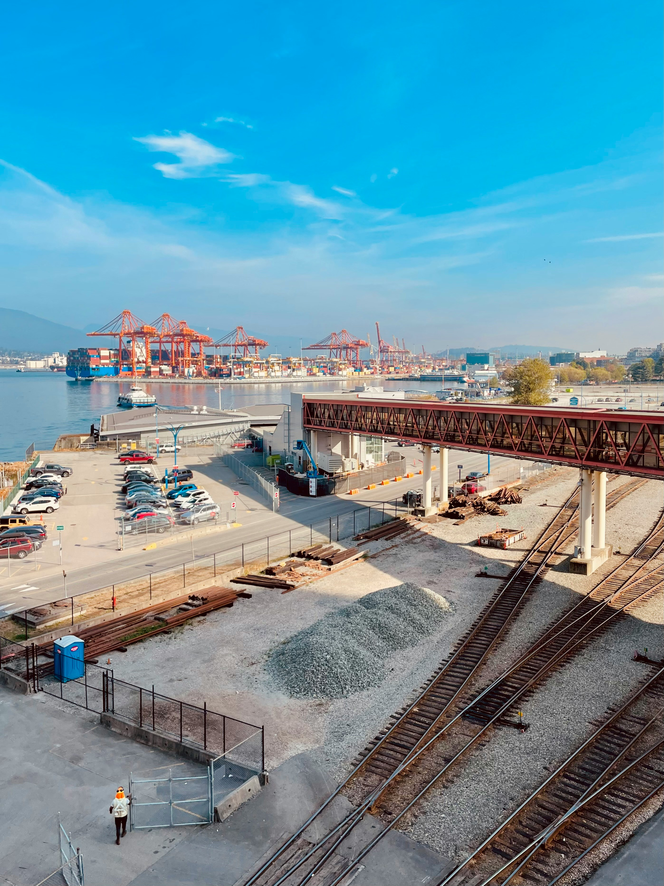
3.4 Assessing the risk of multi-asset failure
Learning objectives
To distinguish between different approaches that can be employed to analyse the risks of multiple infrastructure asset failures
To be able to evaluate the pros and cons of different approaches to different applications

Slide 26
3.4 Assessing the risk of multi-asset failure
Introduction
Analysing the likelihood and consequences of multiple assets failing simultaneously would involve:
assessing asset vulnerability
quantifying the impacts of scenarios in which multiple assets fail
quantifying the strength of spatial dependence between hazards (or the likelihood of multiple hazards) at the multiple sites under consideration
Three examples:
Overall method developed for a comprehensive flood risk assessment, from calculating asset-level vulnerability through fragility analysis, to understanding the impacts of combinations of failures of sections along a flood defence (Hall et al. 2003)
A simplified approach for understanding the potential impacts of single and multiple failures of a small number of electricity substations (Koks et al. 2019)
A rigorous assessment of the likelihood that hazards affect multiple assets simultaneously and the impacts of scenarios in which multiple assets fail. These are undertaken to calculate a system‐wide estimate for the risk of scour resulting in bridge failures (Lamb et al. 2019)

Slide 27
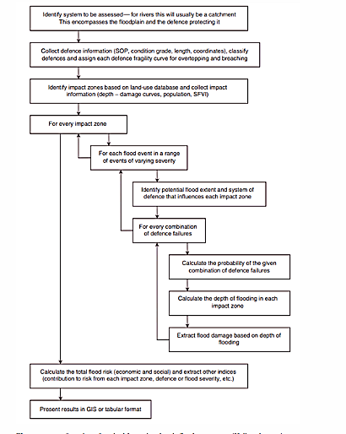
3.4 Assessing the risk of multi-asset failure
Overview of comprehensive
risk assessment for flood events
Overview of method for national scale flood assessment
(Hall et al. 2003)
Notes:
Potential methodology for calculating flood risk at a national scale:
The joint likelihood of flood hazards affecting multiple rivers at once is not calculated → assumption of full dependence for aggregation

Slide 28
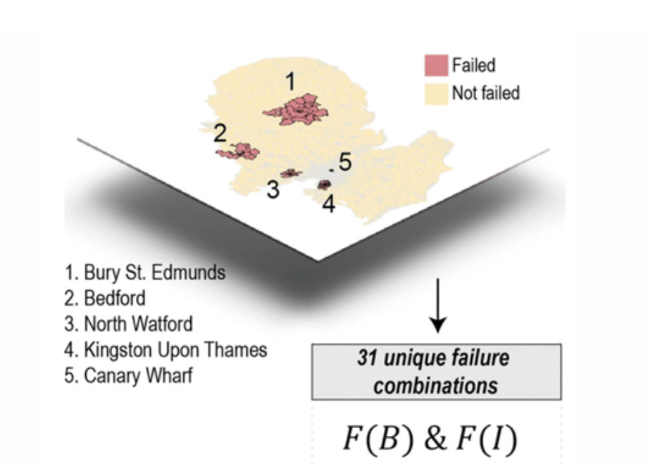
3.4 Assessing the risk of multi-asset failure
Simulation of multiple asset failures
Estimation of the extent of business disruptions and economic loss caused by electricity failures and flooding in the UK
Five electricity substations that are exposed to a 1 in 1,000-year flood event are identified
31 unique failure combinations, ranging from failure of one substation up to the failure of all five substations at once
The likelihood of different combinations of failure is not taken into account
Scalability of this method is limited
(Koks et al. 2019)
Notes:
Figure: The spatial extent of disruption that would occur as a result of each of five electricity substations failing

Slide 29
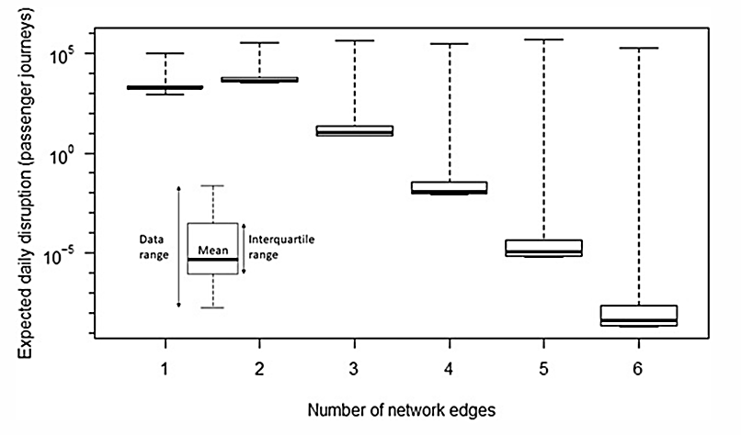
3.4 Assessing the risk of multi-asset failure
Quantifying likelihood and consequence of widespread flood events
Calculate a system‐wide estimate for the risk of bridge failures caused by scour in the UK
Quantifying the likelihood of passenger journey disruptions and associated economic consequences:
Quantify the spatial dependence of flooding at the bridges under consideration using a spatial joint probability model for extreme river flows for all river gauging sites in Britain
Combined with a model for passenger journey disruption in the event of a bridge failure
Risk of disruption caused by combinations of multiple railway line disruptions is much greater than the one of a single one
With multiple types of assets and multiple, interacting infrastructure systems (water, electricity and transport) this would be significantly more complex
(Lamb et al. 2019)
Notes:
Figure:The distribution of all disruptions identified in the analysis with respect to the number of railway lines simultaneously disrupted
Calculate a system‐wide estimate for the risk of bridge failures caused by scour in the UK
Quantifying the likelihood of passenger journey disruptions and associated economic consequences:
Quantify the spatial dependence of flooding at the bridges under consideration using a spatial joint probability model for extreme river flows for all river gauging sites in Britain
Combined with a model for passenger journey disruption in the event of a bridge failure
Risk of disruption caused by combinations of multiple railway line disruptions is much greater than the one of a single one
With multiple types of assets and multiple, interacting infrastructure systems (water, electricity and transport) this would be significantly more complex

Slide 30
3.4 Assessing the risk of multi-asset failure
Discussion of different approaches
Multiple studies address asset failures but do not quantify the joint probability of hazard loading affecting multiple assets simultaneously
Hall et al. (2003) analyze flood sections at the floodplain level but fail to calculate the joint likelihood of concurrent flood hazards across multiple rivers
Koks et al. (2019) simulate potential failure combinations among a limited number of assets but do not assess the likelihood of these failures occurring together
Lamb et al. (2019) provide a detailed analysis of bridge failure due to flooding, highlighting the complexity of evaluating interdependent infrastructure systems and the importance of joint-probability statistics for assessing risk but complex in the context of multiple inter-dependent assets and infrastructure systems
It is important to consider the complexity and computational burden of simulating many combinations of failure

Slide 31
3.4 Assessing the risk of multi-asset failure
Summary
The mini-lecture focused on analyzing the likelihood and impacts of simultaneous failures in multiple infrastructure assets due to large-scale hazards
Different methodologies for assessing risks related to multiple infrastructure asset failures were discussed and compared
Participants should now be able to identify various analytical approaches and weigh their advantages and disadvantages

Slide 32
3.4 Assessing the risk of multi-asset failure
Bibliography
Hall, Jim W., Richard J. Dawson, Paul B. Sayers, Corina Rosu, John B. Chatterton, and Robert Deakin. 2003. “A methodology for national-scale flood risk assessment.” Proceedings of the Institution of Civil Engineers: Water and Maritime Engineering. https://doi.org/3.1680/wame.2003.156.3.235.
Koks, Elco, Raghav Pant, Scott Thacker, and Jim W Hall. 2019. “Understanding Business Disruption and Economic Losses Due to Electricity Failures and Flooding.” International Journal of Disaster Risk Science 10 (4): 421–38.
Lamb, Rob, Paige Garside, Raghav Pant, and Jim W. Hall. 2019. “A Probabilistic Model of the Economic Risk to Britain’s Railway Network from Bridge Scour During Floods.” Risk Analysis. https://doi.org/3.1111/risa.13370.

Slide 33

Cannone, C., Collett, K.A., Charbonnier F., Ahsan A., Halloran C., Vijay,A.,Berdellans I., Hasanovic S., Gritsevskyi A,Stankeviciute L., Tot M.; Welsch M., Hirmer S., 2023. Lecture 1: "COURSE INTRODUCTION TO MAED" , Energy Demands Projections with MAED (Model for Analysis of Energy Demand). Release Version 2.0. [online presentation]. Climate Compatible Growth & Programme and International Atomic Energy Agency.
CCG courses (this will take
you to the website link http://www.ClimateCompatibleGrowth.com/teachingmaterials)

