Slide 1
Lecture 2: Modelling infrastructure assets

Slide 2
Learning Outcomes
By the end of this lecture, you will:
Have general knowledge of the spatial aspects of infrastructure service provision, and a short introductory idea of infrastructure specific spatial data
Have fundamentals of spatial mapping and flow simulation modelling of transport systems and of the disruption metrics created from such models
Understand water infrastructure network and the disruptions that affect water supplies, from asset-related failures to source-related failures
Knowledge of spatial and simulation modelling of flows and impacts of climate hazards on energy systems

Slide 3

2.1 Introduction to infrastructure services and infrastructure modelling
Learning Objectives
To be able to explain why we model infrastructure
To understand which services infrastructure provides and what their spatial relation to society is
To have a basic understanding on what geospatial data is and where datasets for infrastructure modelling can be found

Slide 4
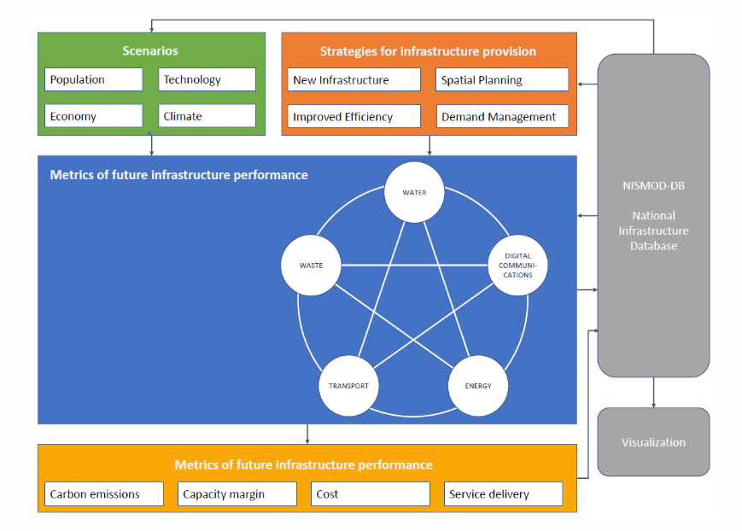
2.1 Introduction to infrastructure services and infrastructure modelling
Introduction to infrastructure modelling
Modelling infrastructure is used in infrastructure planning to make projections of future demand as well as for exploring possible future scenarios to support informed decision-making
Additionally, it can be used to assess infrastructure vulnerability and enable the development of more resilient infrastructure in the future
It can help to identify risks such as climate hazards and calculate potential damages or economic and social consequences from service disruptions
(based on Hall et al., 2017)
Notes:
Figure: Schematic overview of the National Infrastructure Model (NISMOD). It shows the “National Infrastructure Systems Model” (NISMOD) which was designed by the UK Infrastructure Transitions Research Consortium (ITRC) to inform infrastructure assessment on a national level

Slide 5
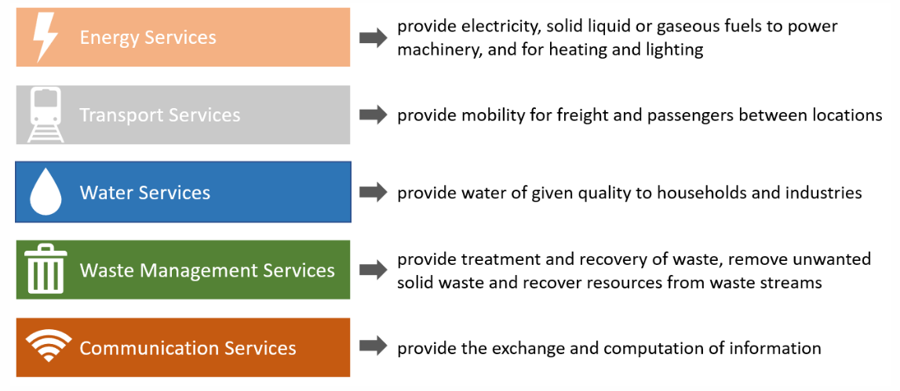
2.1 Introduction to infrastructure services and infrastructure modelling
Infrastructure services
Taking a service perspective instead of just looking at the assets allows us to consider the possibility of substitution of services between networks
(based on Hall et al. (2016)
Notes:
Figure: Services from infrastructure assets

Slide 6
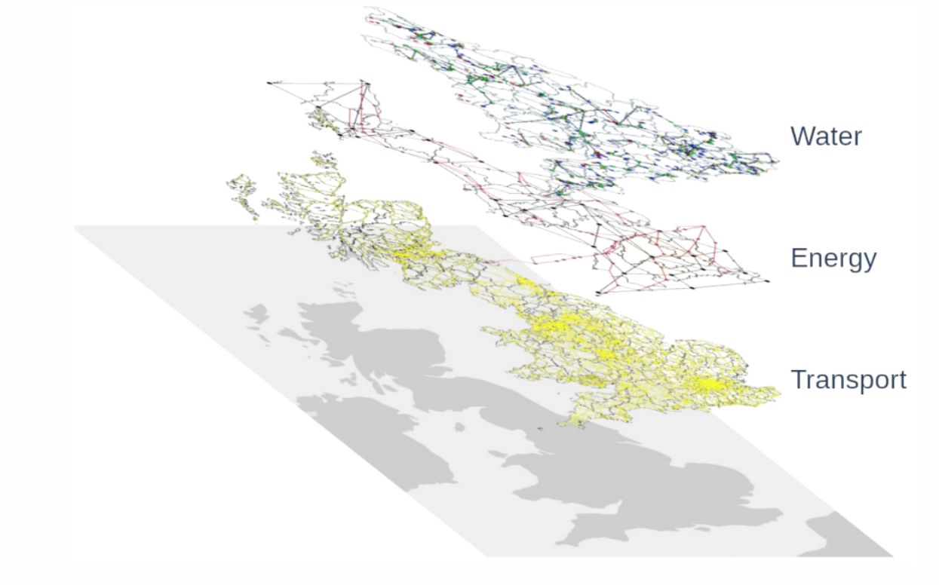
2.1 Introduction to infrastructure services and infrastructure modelling
Spatial relations between infrastructure and society
Water, energy and transport networks have branch network structure
Energy and water supply systems connect the different levels of service supply:
Production or source level
Transport (water) or transmission (energy)
Distribution
Consumer
The extent or density of the infrastructure networks helps determining how well rural areas are developed and if people in those areas are provided with infrastructure services
Supply areas determine how many people are supplied by one part of the network or depend on one specific infrastructure asset
Crucial for infrastructure planning and risk assessment
(Russell et al. 2020)
Notes:
Figure: The water, energy and transport infrastructure networks in Great Britain

Slide 7
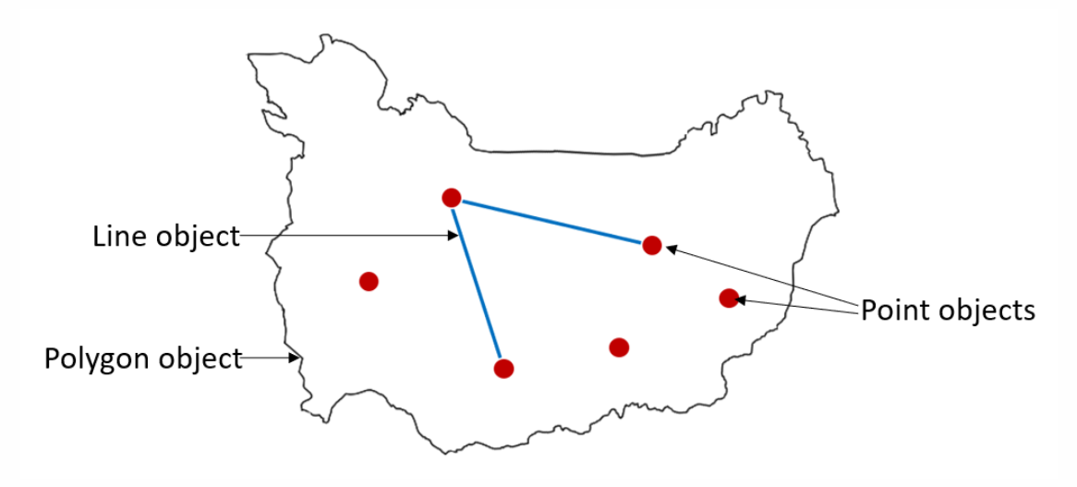
2.1 Introduction to infrastructure services and infrastructure modelling
Introduction to geospatial data for infrastructure modelling
A lot of infrastructure modelling is done using geospatial data
The “vector data” (point, line or polygon shape) is the most useful to be used to represent infrastructure assets or networks. Each of those objects can store additional information (e.g. name, size, capacity, etc.)
ArcGIS (license) or QGIS (open-source) softwares used to look at spatial data, explore it, analyse or process it and visualise the results
For more complex analysis and modelling usually programming languages are used – (Python for this class, with GDAL and GeoPandas packages)
Data are on infrastructure assets, climate hazards or the population living in an area are essential:
Local: Many countries have official websites where all kinds of datasets including geospatial data is available (e.g. data.gov.uk. for the UK)
Global: Open Street Map (infrastructures), World Bank Data Catalog (section “geospatial data”)
Notes:
Figure: Point, line and polygon object types in geospatial data. The points can represent infrastructure assets, or other points in the network such as households. The lines can represent pipes or transmission lines and the polygon can be a district or a supply area

Slide 8
2.1 Introduction to infrastructure services and infrastructure modelling
Summary
Service provision of infrastructure networks and its spatial component
How to represent spatial information in data frames and got to know the different kinds of software you can use to work with geospatial data
Softwares and websites to manipulate and analyse geospatial data and download it
Great foundation to dive deeper into infrastructure modelling

Slide 9
2.1 Introduction to infrastructure services and infrastructure modelling
Bibliography
Hall, Jim W., Scott Thacker, Matt C. Ives, Yue Cao, Modassar Chaudry, Simon P. Blainey, and Edward J. Oughton. 2017. “Strategic analysis of the future of national infrastructure.”
Proceedings of the Institution of Civil Engineers: Civil Engineering 170 (1): 39–47. https://doi.org/10.1680/jcien.16.00018.
Hall, Jim W., Martino Tran, Adrian J Hickford, and Robert Nicholls, eds. 2016. The Future of National Infrastructure: A System-of-Systems Approach. Cambridge University Press. https://eprints.soton.ac.uk/388149/.
Russell, T., C. Zorn, A. Majid, and R. Pant. 2020. “Snkit: A Spatial Networks Data Cleaning Toolkit.” In. https://doi.org/https://doi.org/10.5281/zenodo.3269512.
9

Slide 10

2.2 Modelling of transport network flows and service disruptions
Learning objectives
Identify the critical components of transport systems
Define the general principles of a transport flow model in terms of its spatial and temporal dimensions
Show how to do disruption analysis for transport networks

Slide 11
2.2 Modelling of transport network flows and service disruptions
Understanding critical components of transport networks
Transport networks: roads, railways, waterways (inland and maritime) and airline networks
Key service provided: mobility of goods, services and people. Their role is to provide connectivity for easier mobility
Each of these networks is referred to as a transport mode, and the overall transport ‘system-of-system’ is the collection of all modes, called a multi-modal network
The critical components for each transport mode include:
Roads: Junctions (points), bridges (points or lines), road section links connecting junctions (lines)
Railways: Stations and junctions (points), track section links connecting points (lines)
Waterways: Ports (points) and water courses and shipping channels connecting ports (lines)
Airlines: Airports (points) and airline routes between airports (lines)

Slide 12
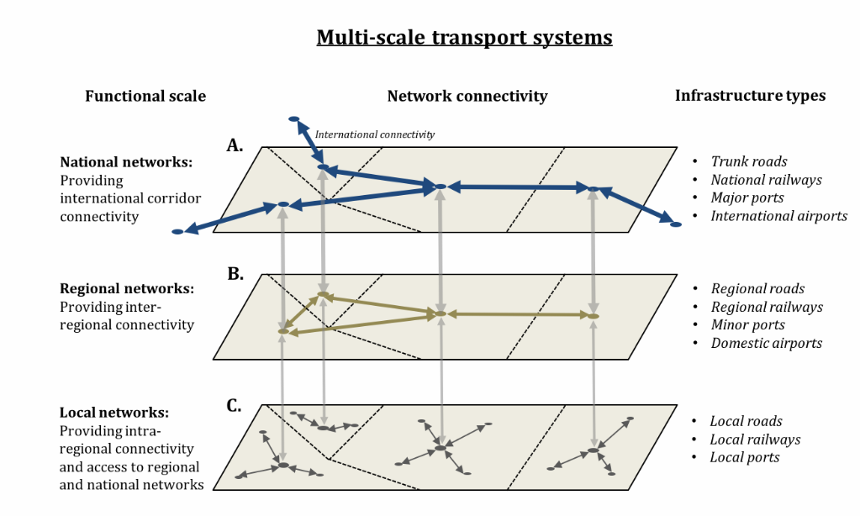
2.2 Modelling of transport network flows and service disruptions
Understanding critical components of transport networks

Slide 13
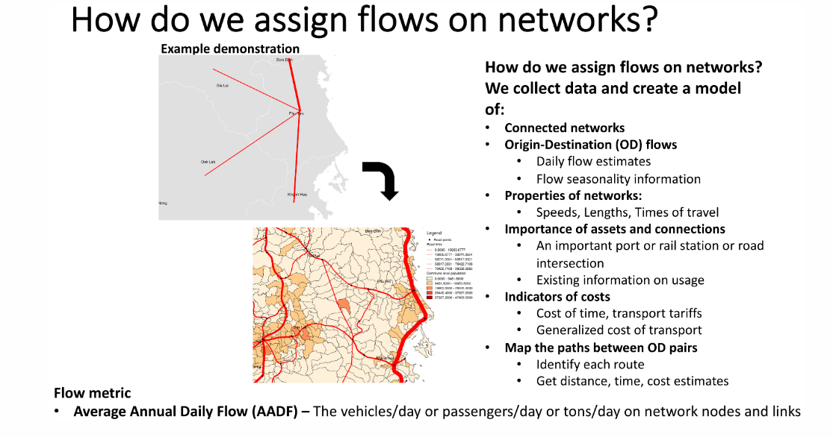
2.2 Modelling of transport network flows and service disruptions
Multi-modal transport flows
(Oh et al. 2019)
Notes:
Figure: Illustrative process and steps for building a transport flow assignment model. Applied in a transport risks analysis study in Viet Nam

Slide 14
2.2 Modelling of transport network flows and service disruptions
Flow disruption modelling
Choosing network nodes and links that are affected by some external shock event – for example, identifying roads that are flooded or ports that face a man-made attack
Understanding how the chosen nodes and links cannot still function as before – they might be completely damaged or shut down, or they might be able to operate at reduced speeds and/or capacities
Recalibrating the transport network depending upon the effects on disrupted nodes and links – if nodes and links are considered completely damaged or shut down then they can be removed from the network, or if they still provide reduced mobility then the speeds, costs, capacities assigned to them are changed
Recalculating all OD flows along the disrupted network sections and seeing how flows are redistributed (rerouted) along new routes that can provide the next-best least cost route (after the original route is disrupted)
Estimating disruption losses in terms of:
Increases in transport costs (or journey distances, times) when traffic is rerouted
Volumes of traffic (vehicles/people/freight) that cannot be rerouted because there is no other alternative route if the existing one is damaged or shut down
Notes:
Steps in a disruption model:

Slide 15
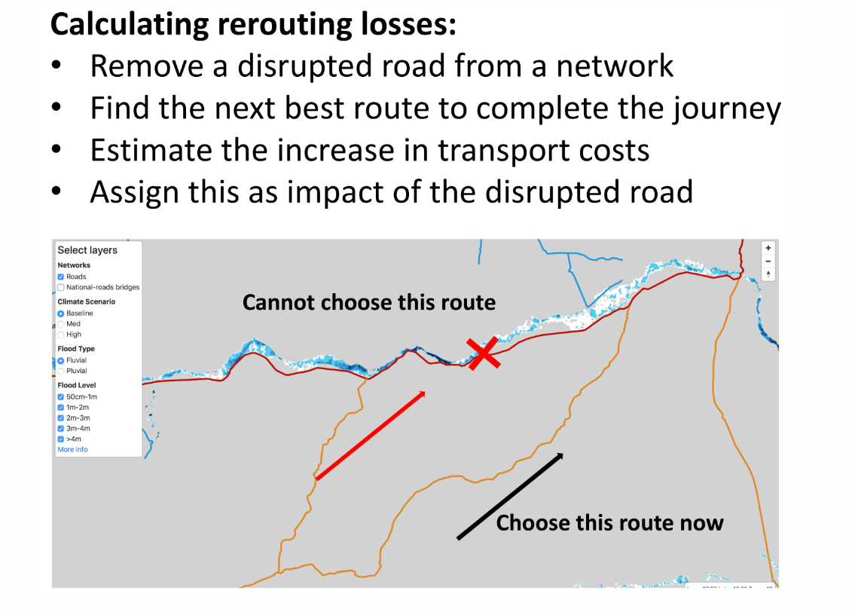
2.2 Modelling of transport network flows and service disruptions
Flow disruption modelling – Example
Notes:
Figure: Representation of the steps and example of transport flow disruption modelling for a road network that is flooded

Slide 16
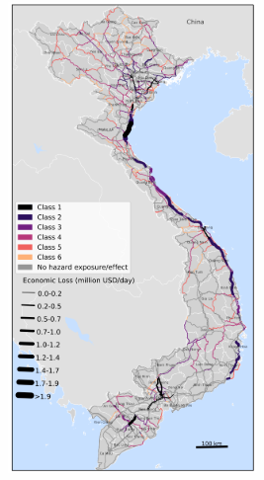
2.2 Modelling of transport network flows and service disruptions
Criticality assessment of transport networks
Criticality is defined as a measure of the of transport asset’s (node or link) importance and disruptive impact on the rest of the transport infrastructure. Some transport criticality measures include:
Vehicles disrupted
Freight disrupted
Freight redistribution losses – increase in transport costs due to rerouting
Economic flow losses – macroeconomic supply chain losses due to flow isolation
Affected population with no or limited transport access
Criticality is assigned to the individual asset that is disrupted. For example, a port might be disrupted, and we estimate some (or all) of the above metrics and assign the values to the port
(Oh et al. 2019)
Notes:
Figure: Road network criticality map showing economic losses in US$ per day associated with roads disrupted by natural hazards in Viet Nam

Slide 17
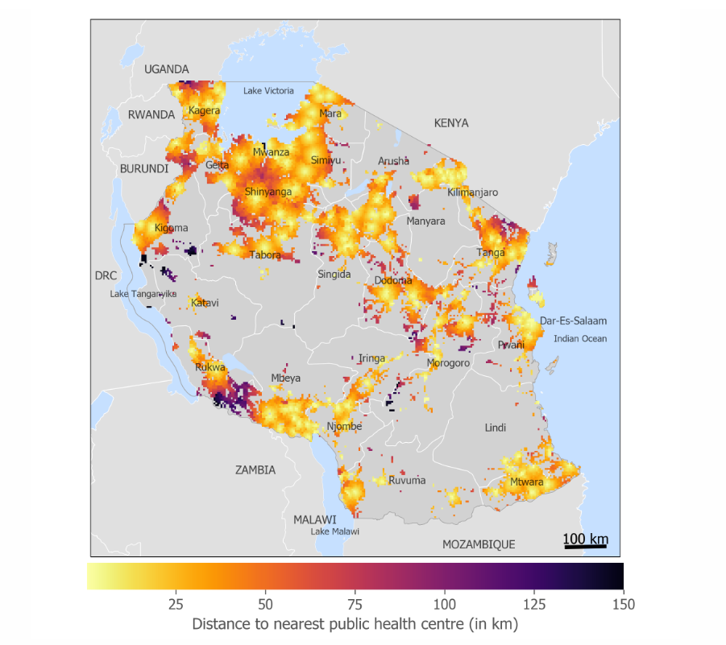
2.2 Modelling of transport network flows and service disruptions
Transport accessibility analysis
Transport accessibility analysis helps us understand how easy (or difficult) it is for people to travel to their nearest important locations (e.g. health centre, job market)
The metric of measuring ease of access could be in terms of travel distances or time or costs associated with population concentrations using a particular transport network
Such analysis is particularly important in developing countries, where large parts of the population might not have access to services within a small distance from their houses
(Pant et al. 2018)
Notes:
Figure: Accessibility mapping analysis in Tanzania showing locations of populations with their distances to nearest health centres via the road network in the country. The darkest colours show the population concentrations that have the poorest connectivity to health centres, making them the most vulnerable during disasters

Slide 18
2.2 Modelling of transport network flows and service disruptions
Summary
Introduction of multi-modal transport systems and how these networks are modelled
How transport systems are spatially represented and what the critical components of these systems are
How to model flows on transport networks using a general set of datatypes and modelling principles + how transport disruption analysis is done, and what kinds of disruption metrics are produced from such analyses
Concepts applicable to transport network analysis at multiple scales (local, national, global). Valuable tools for measuring transport vulnerabilities and risks, and also to identify critical network locations (nodes and links) which could be targeted for resilience planning

Slide 19
2.2 Modelling of transport network flows and service disruptions
Bibliography
Archondo-Callao, Rodrigo S, and Asif Faiz. 1994. “Estimating Vehicle Operating Costs.”
Baier, Scott L, and Jeffrey H Bergstrand. 2001. “The Growth of World Trade: Tariffs, Transport Costs, and Income Similarity.” Journal of International Economics 53 (1): 1–27.
Bera, Sharminda, and KV Rao. 2011. “Estimation of Origin-Destination Matrix from Traffic Counts: The State of the Art.”
Dijkstra, Edsger W, and others. 1952. “A Note on Two Problems in Connexion with Graphs.” Numerische Mathematik 1 (1): 269–71.
Jiang, Jincheng, Nico Dellaert, Tom Van Woensel, and Lixin Wu. 2012. “Modelling Traffic Flows and Estimating Road Travel Times in Transportation Network Under Dynamic Disturbances.” Transportation, 1–30.
Oh, Jung Eun, Xavier Espinet Alegre, Raghav Pant, Elco E Koks, Tom Russell, Roald Schoenmakers, and Jim W Hall. 2012. “Addressing Climate Change in Transport: Volume 2: Pathway to Resilient Transport.” World Bank.
Ouma, P, EA Okiro, and RW Snow. 2018. “Sub-Saharan Public Hospitals Geo-Coded Database.” Harvard Dataverse 1: 2018.
Pant, Raghav, Elco E. Koks, Tom Russell, and Jim W. Hall. 2018. “Transport Risks Analysis for The United Republic of Tanzania – Systemic vulnerability assessment of multi-modal transport networks.” Oxford: Oxford Infrastructure Analytics Ltd.
Patriksson, Michael. 2015. The Traffic Assignment Problem: Models and Methods. Courier Dover Publications.
Tatem, Andrew J. 2017. “WorldPop, Open Data for Spatial Demography.” Scientific Data 4 (1): 1–4.

Slide 20
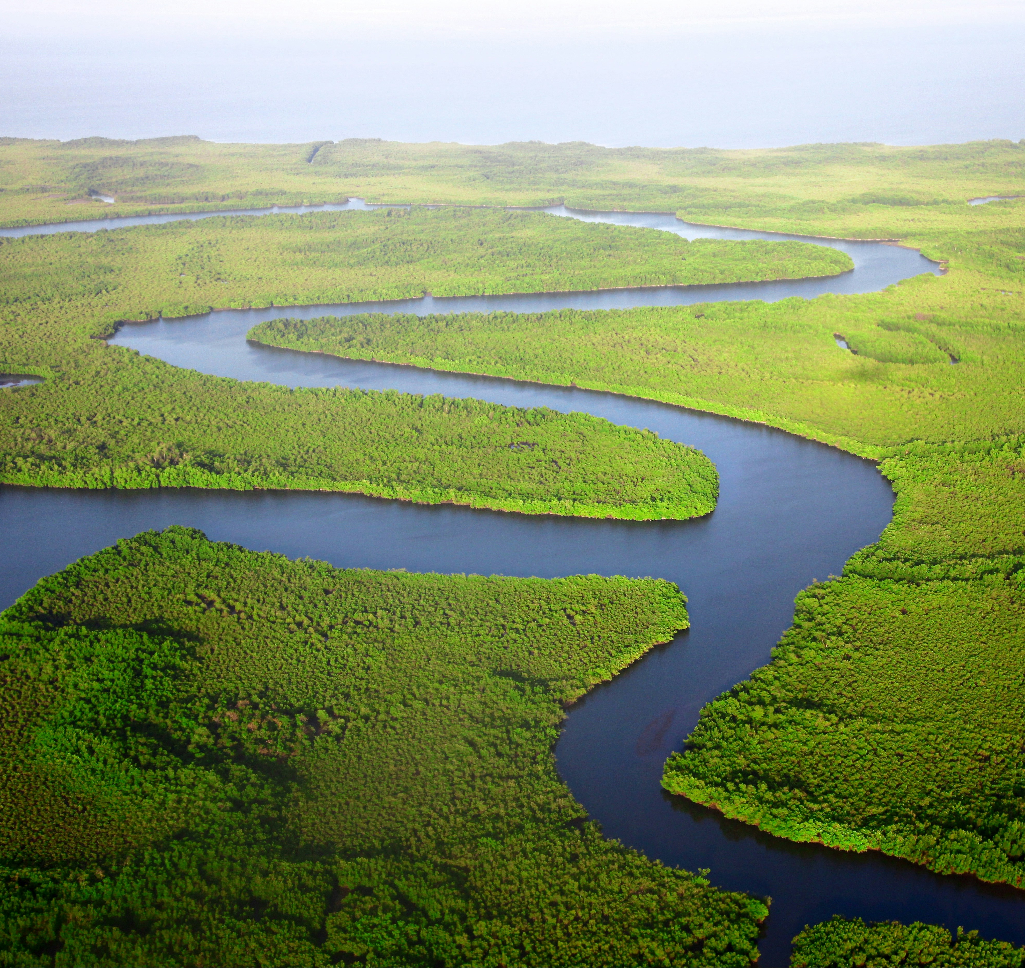
2.3 Modelling of water infrastructure networks and service delivery
Learning objectives
Be able to identify the components of water infrastructure systems
To recognise the characteristics that make water infrastructure stand-out compared to other infrastructure systems
To be able to explain the full range of water infrastructure disruptions and how they can be modelled

Slide 21
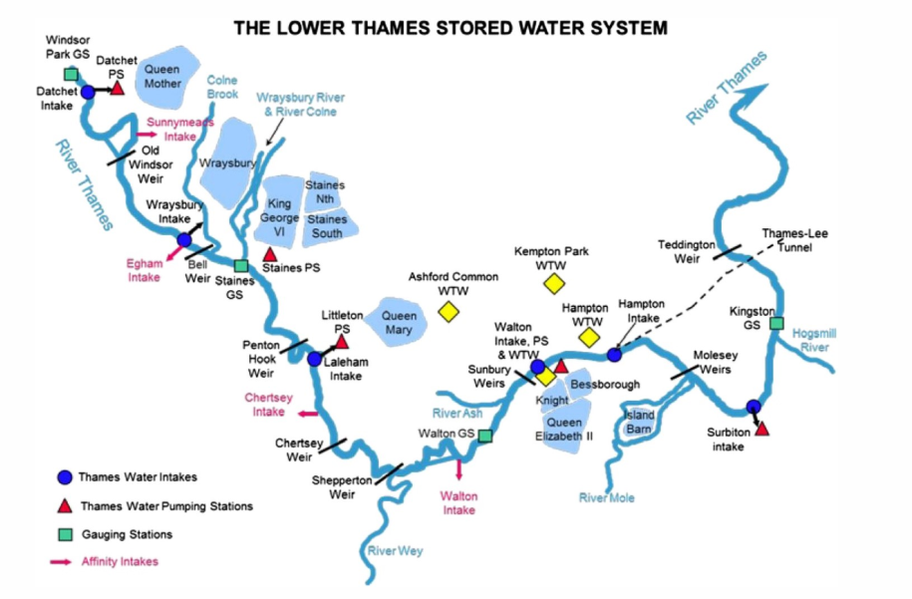
2.3 Modelling of water infrastructure networks and service delivery
Introduction
Water infrastructure systems: assets that abstract (intakes), treat (water treatment plants), pump (pumping stations), convey (pipes) and store water (reservoirs/storage tanks) to supply municipal and sometimes commercial/industrial demand
Wastewater infrastructure systems: assets that transport (sewer), treat (wastewater treatment plant) and discharge wastewater back to the natural environment
(Mortazavi-Naeini et al. 2019)
Notes:
Figure: Locations of water infrastructure asset along a section of the river Thames
Raw water may be stored in reservoirs or dams before being treated at a treatment plant
Treated water may be stored in tanks before or after being pumped to communities via a network of pipes
Wastewater is then transported from communities via a sewer network to be treated by wastewater treatment plants, before being returned to the rivers and the natural system
Electricity supply nodes which serve water assets are also an important element of the water infrastructure system to consider

Slide 22
2.3 Modelling of water infrastructure networks and service delivery
Global datasets on water
Datasets | Source
Reservoirs and dams | Global Dam Watch
Rivers | HydroSHEDS
Runoff | ISI-MIP
Connections to piped water supply and sewer systems | Joint Monitoring Programme
Water use | FAO, AquaSTAT
Notes:
Table: Overview of some examples of global data sources for water infrastructure
There are now several open-source hazard products at global scales which are being used widely for vulnerability and risk analysis. A few resources include:
Global river and coastal flood maps: Historical and future hazard maps at different return periods (2, 5, 10, 25, 50, 100, 250, 500, 1000 years). All data is available at a 30 arc-seconds resolution (~1km at equator) (Gassert et al. 2015).
Global hazard maps for earthquakes for different return periods (250, 475, 975, 1500, 2475 years) both Peak Ground Acceleration and spectral acceleration. Data is available at 0.072 degrees (~8km at equator).
Global dataset of 10,000 synthetic tropical cyclones paths with cyclone characteristics (e.g., wind speed, pressure) on a global scale. Wind speed probabilities are derived globally (10 metre, 10 minutes sustained speed) for different return periods (10 to 10,000 years) at 10km resolution (Bloemendaal et al. 2019).

Slide 23
2.3 Modelling of water infrastructure networks and service delivery
Hazard interactions with water infrastructure
Sub-sector | Asset | Flood (pluvial/ river/coastal) | Landslide | Hurricane | Earthquake | Drought
Water | Sources (springs, wells, rivers) | N | N | N | N | Y
Water | Dams and reservoir | N | N | N | Y | Y
 | Water treatment plants | Y | Y | N | Y | Y
 | Pumping stations | Y | Y | N | Y | N
 | Potable storage tanks | N | N | N | N | Y
 | Pipelines | N | Y | N | N | N
Wastewater | Wastewater treatment plants | Y | Y | N | Y | N
 | Sewers | N | Y | N | Y | N

Slide 24
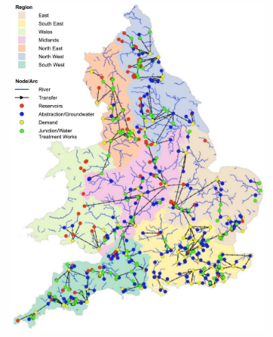
2.3 Modelling of water infrastructure networks and service delivery
Risks to water network infrastructure
Water supply disruptions can be caused by flood damage to water infrastructure assets or dependent electricity supply infrastructure
These network models can be used to understand which demand centres could be disrupted by the failure of certain assets
The likelihood of certain assets being disrupted by climate extremes, such as flooding, can be determined by overlaying flood return period maps
The intersection between probability and consequence provides an indication of risk
(Dobson et al. 2020)
Notes:
Figure: Network model of water infrastructure, comprising water infrastructure assets, such as water treatment plants and network connections to demand centres, in England and Wale

Slide 25
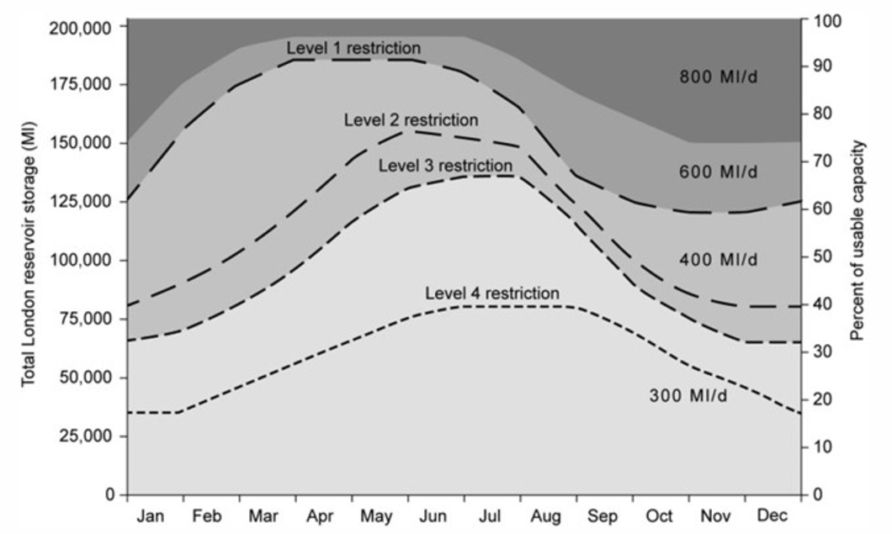
2.3 Modelling of water infrastructure networks and service delivery
Risks to water resources
Water resources variations - such as water shortages and harmful water quality events - also pose a major risk to water supplies. Water shortages are often measured according to deviations in the volume of water stored in reservoirs
The risk of water shortages can be determined by analysing the probability of water shortages of varying severity or untreatable water quality and associated consequences for dependent populations
(Borgomeo et al. 2014)
Notes:
Figure: Thresholds of reservoir storage over a given year that are associated with water use restrictions of different levels of severity in the Thames catchment, UK
Example point 1: during droughts that result in the volume of stored water dropping to, say, 50% of their normal levels, utilities will put measures in place to ensure that water supplies will be able to outlast the drought
Example point 2: Level of Service is used as a risk metric, quantifying the probability of exceeding planned frequencies of water shortages of varying severity

Slide 26
2.3 Modelling of water infrastructure networks and service delivery
Summary
Overview of the components of water infrastructure systems, how systems are affected by hazards and how the risks of different kinds of disruption can be analysed
Range of assets that make up systems of water infrastructure
Distinction of water infrastructure from other types of infrastructure
Different types of disruptions and hazards that affect water infrastructure

Slide 27
2.3 Modelling of water infrastructure networks and service delivery
Bibliography
Borgomeo, Edoardo, Jim W. Hall, Fai Fung, Glenn Watts, Keith Colquhoun, and Chris Lambert. 2014. “Risk-based water resources planning: Incorporating probabilistic nonstationary climate uncertainties.” Water Resources Research. https://doi.org/10.1002/2014WR015558.
Davie, J. C. S., P. D. Falloon, R. Kahana, R. Dankers, R. Betts, F. T. Portmann, D. Wisser, et al. 2013. “Comparing projections of future changes in runoff from hydrological and biome models in ISI-MIP.” Earth System Dynamics. https://doi.org/10.5194/esd-4-359-2013.
Dobson, Barnaby, Gemma Coxon, Jim Freer, Helen Gavin, Mohammad Mortazavi-Naeini, and Jim W. Hall. 2020. “The Spatial Dynamics of Droughts and Water Scarcity in England and Wales.” Water Resources Research. https://doi.org/10.1029/2020WR027187.
Doeffinger, Tess, Edoardo Borgomeo, William J. Young, Claudia Sadoff, and Jim W. Hall. 2020. “A diagnostic dashboard to evaluate country water security.” Water Policy. https://doi.org/10.2166/wp.2020.235.
Gaupp, Franziska, Jim Hall, and Simon Dadson. 2015. “The role of storage capacity in coping with intra- and inter-annual water variability in large river basins.” Environmental Research Letters. https://doi.org/10.1088/1748-9326/10/12/125001.
Hall, Jim W., D. Grey, D. Garrick, F. Fung, C. Brown, S. J. Dadson, and C. W. Sadoff. 2014. “Coping with the curse of freshwater variability.” Science. https://doi.org/10.1126/science.1257890.
Mortazavi-Naeini, Mohammad, Gianbattista Bussi, J. Alex Elliott, Jim W. Hall, and Paul G. Whitehead. 2012. “Assessment of Risks to Public Water Supply From Low Flows and Harmful Water Quality in a Changing Climate.” Water Resources Research. https://doi.org/10.1029/2018WR022865.

Slide 28

2.4 Modelling energy networks and simulating service delivery
Learning objectives
Identify the critical processes within energy infrastructure systems
Define an energy system simulation model in terms of its spatial and temporal dimensions
Illustrate the quantification of climate risks in energy systems through simulation modelling

Slide 29
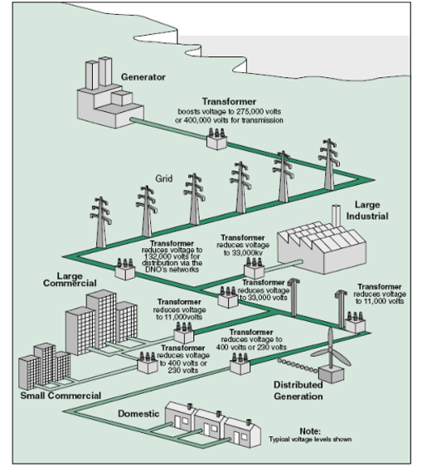
2.4 Modelling energy networks and simulating service delivery
Introduction to energy networks
Electricity is generated from various sources, primarily thermal power and increasing renewable energy
It is generated at 22,000 volts, then boosted to at least 275 kV for transmission, reducing heat losses
High voltage is reduced to 132 kV for large users and 230-400 volts for domestic consumers
Electricity networks are susceptible to climate-related issues, posing risks of cascading failures across dependent infrastructure
Schematic illustration of an energy system (DECC 2010)

Slide 30
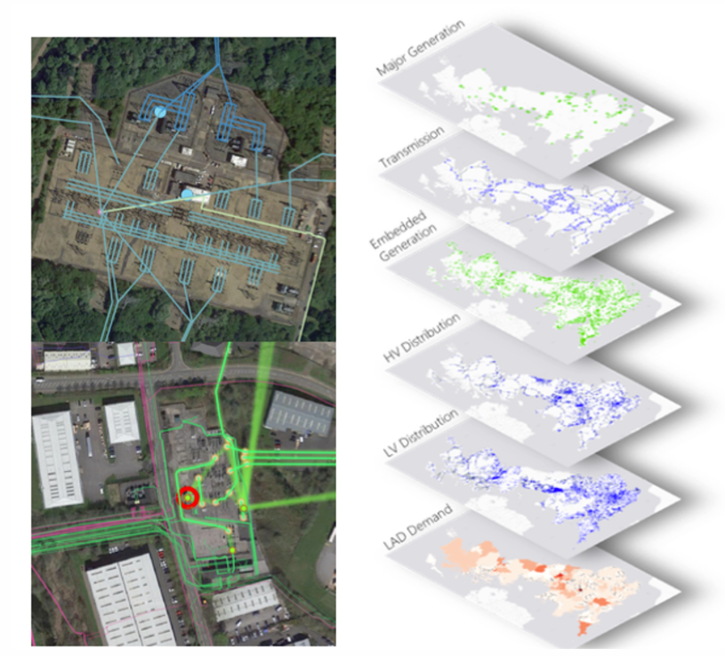
2.4 Modelling energy networks and simulating service delivery
Modelling: Creating a spatial representation
The first step in modelling energy networks usually entails creating a spatial representation of the system
At this stage, we map critical assets within the network as nodes, as well as the connections between nodes as edges. This leads to the creation of a spatial representation of the network topology
The amount of spatial detail to capture is dependent upon the purpose
Network models can be created using Geographical Information Systems (GIS) software, usually QGIS (Graser 2013)
(Russell et al. 2020).
Notes:
Figure: An illustration of a spatial energy system model from the United Kingdom

Slide 31
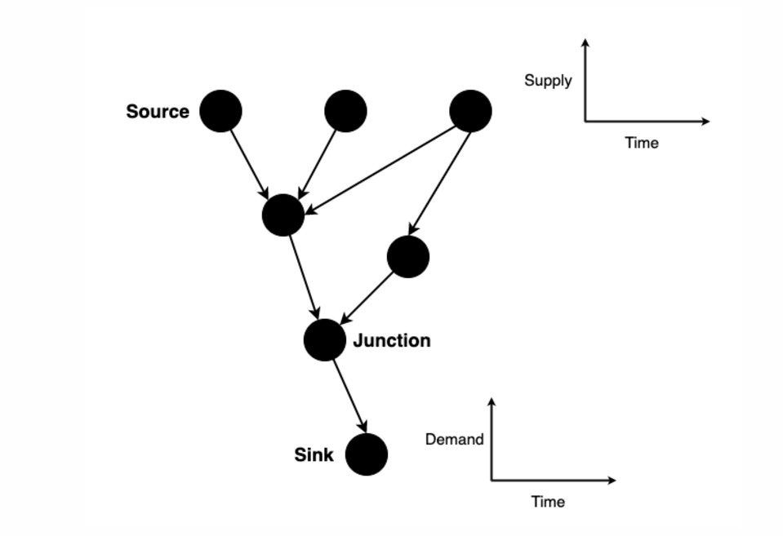
2.4 Modelling energy networks and simulating service delivery
Modelling: Creating a temporal representation
Mapping a spatial network topology requires categorizing nodes as sources, sinks, or junctions, with sources supplying energy, sinks consuming energy, and junctions facilitating flow without supply or demand
Source and sink nodes are associated with time series data that reflect their respective supply and demand curves and temporal characteristics, such as a solar farm's energy output variability and household energy demand patterns
Temporal data collection for an energy network can be data-intensive, often necessitating stochastic modelling to account for random variables in the system, like wind energy output
Stochastic processes represent variables that change over time based on probabilistic laws, such as fluctuations in wind speed affecting energy generation
Notes:
Figure: Schematic of a directed graph (network) model with temporal dimensions

Slide 32
2.4 Modelling energy networks and simulating service delivery
Modelling: Simulating the system
Simulation models are a digital representation of a real-world system, which allow us to explore ‘what-if’ scenarios. In the context of energy networks, such models enable us to simulate the effects of building new infrastructure and policy interventions, as well as understand the impacts of potential climatic hazards. They could facilitate us to answer the following questions:
How might a proposed operations management policy influence the operation of the network?
How might a specific set of climatic hazards impact a regional energy system?
  Is there a disruption in supply?
  What is the spatial and temporal scale of the disruption?
  How resilient is the system to these hazards?
  Which are the most vulnerable assets in the network to these hazards?
  How widely might the damage spread?
Energy system simulation models include high-level energy balance models and AC/DC optimal power flow models. The former simplifies energy balances dynamically, while the latter captures complex power flows and short-circuit calculations. High-level models are preferred for large-scale analyses due to their efficiency and tractability
(Thurner et al. 2018)

Slide 33
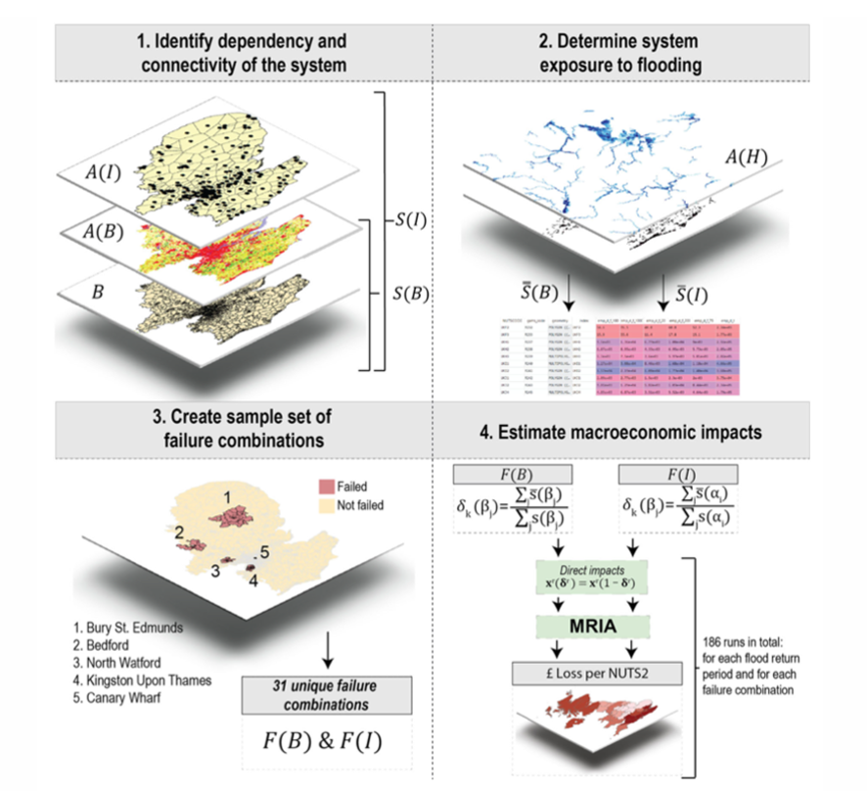
2.4 Modelling energy networks and simulating service delivery
Risk analysis: Simulating climate hazards
A commonly used approach is to overlay mapped climate hazard data onto the geospatial network and to stress-test nodes and arcs that fall within the most hazardous zones
By simulating disruptions in the function of the most vulnerable assets within the network, we can quantify:
The redundancy in the network
The relationship between number of customers affected and the number of assets exposed
The spatial exposure of the network
The resilience of the system
(Koks et al. 2019)
Notes:
Figure: Methodological setup to quantify climate risks across an energy system

Slide 34
2.4 Modelling energy networks and simulating service delivery
Summary
Introduction of the basic functions of energy systems and how these networks are modelled
How spatial representations of energy networks are constructed, as well as how dynamic simulations are conducted
How the influence of climatic hazards on energy networks can be simulated

Slide 35
2.4 Modelling energy networks and simulating service delivery
Bibliography
DECC. 2010. “The Future of Britain’s Electricity Networks.” Department of Energy; Climate Change.
Graser, Anita. 2013. Learning QGIS 2.0. Packt Publishing Ltd.
Koks, Elco, Raghav Pant, Scott Thacker, and Jim W Hall. 2012. “Understanding Business Disruption and Economic Losses Due to Electricity Failures and Flooding.” International Journal of Disaster Risk Science 10 (4): 421–38.
Russell, T., C. Zorn, A. Majid, and R. Pant. 2020. “Snkit: A Spatial Networks Data Cleaning Toolkit.” In. https://doi.org/https://doi.org/10.5281/zenodo.3269512.
Thurner, Leon, Alexander Scheidler, Florian Schäfer, Jan-Hendrik Menke, Julian Dollichon, Friederike Meier, Steffen Meinecke, and Martin Braun. 2018. “Pandapower—an Open-Source Python Tool for Convenient Modeling, Analysis, and Optimization of Electric Power Systems.” IEEE Transactions on Power Systems 33 (6): 6510–21.

Slide 36

Cannone, C., Collett, K.A., Charbonnier F., Ahsan A., Halloran C., Vijay,A.,Berdellans I., Hasanovic S., Gritsevskyi A,Stankeviciute L., Tot M.; Welsch M., Hirmer S., 2023. Lecture 1: "COURSE INTRODUCTION TO MAED" , Energy Demands Projections with MAED (Model for Analysis of Energy Demand). Release Version 2.0. [online presentation]. Climate Compatible Growth & Programme and International Atomic Energy Agency.
CCG courses (this will take
you to the website link http://www.ClimateCompatibleGrowth.com/teachingmaterials)
23

