Slide 1
Lecture 1: Introduction to climate hazard impacts on infrastructure systems

Slide 2
Learning Outcomes
By the end of this lecture, you will:
Have general knowledge of infrastructure networks, hazards, and the theory of spatial risk analysis
Know the key concepts of: infrastructures, hazards, exposures, vulnerabilities, and infrastructure resilience
Have explored the quantifying hazards and understanding loss-probability curves for risk analysis

Slide 3
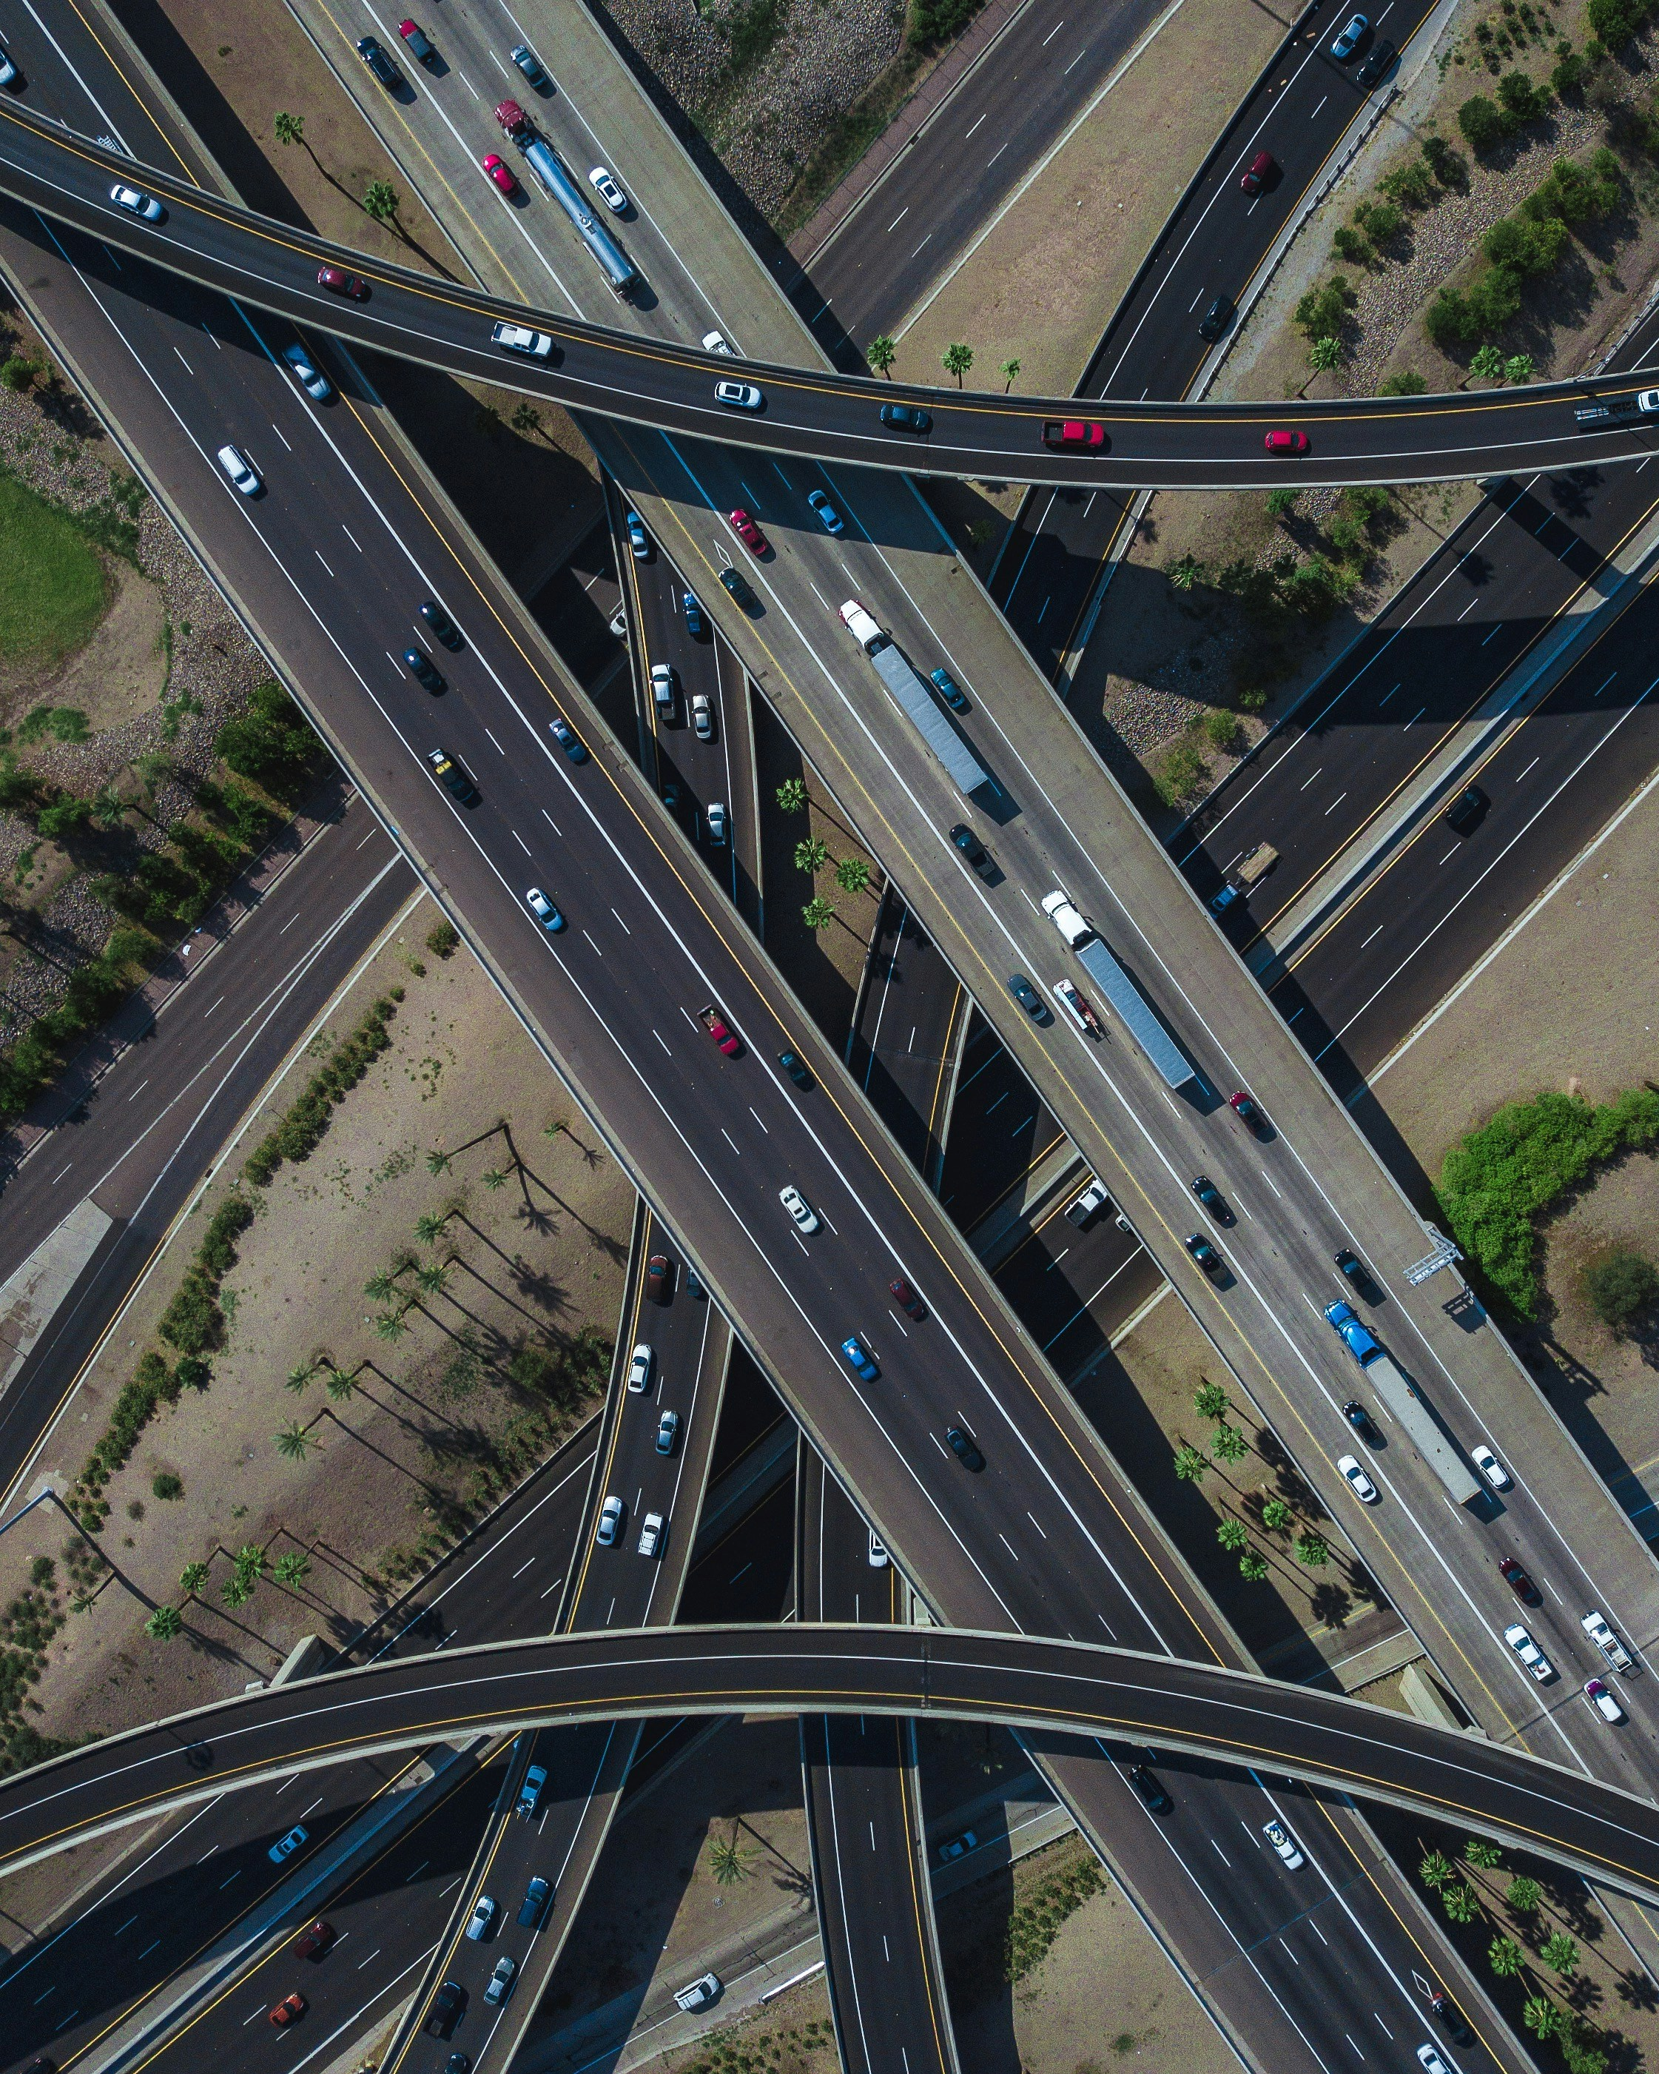
1.1 Introduction to infrastructure risk and resilience
Learning Objectives
Gain an understanding of climate risks to infrastructure systems
Recall options for adapting infrastructure systems in the context of a changing climate
Explain how risk analysis fits into adaptation decision-making

Slide 4
1.1 Introduction to infrastructure risk and resilience
Introduction
Infrastructure systems: energy, transport, digital communications, water and waste management
Many of these systems are vulnerable to the impacts of climate change: sea level rise, river and surface water flooding, landslides, wildfires, permafrost melt, droughts and other extreme events
Expansion and modernisation of infrastructure systems → economic development
US$80 trillion of investment in new and existing infrastructure required worldwide over the next 15 years
Adaptation and resilience need to be embedded throughout the life cycle of infrastructure planning, project preparation, finance, design, delivery, operation and maintenance
(Hall et al. 2019; Koks et al. 2019; Thacker et al. 2019)

Slide 5
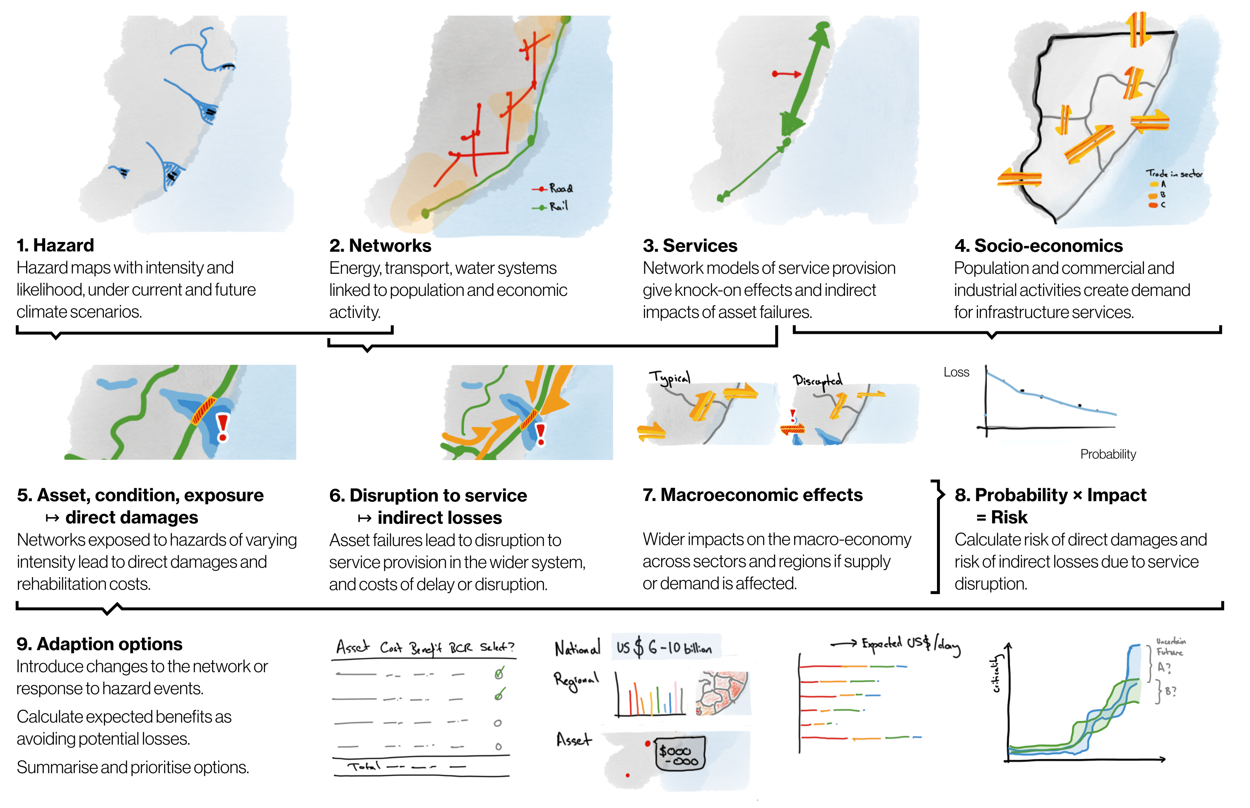

Slide 6
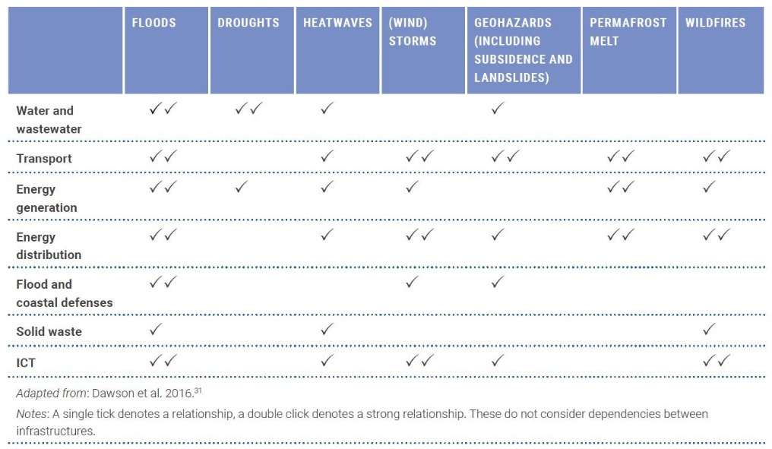
1.1 Introduction to infrastructure risk and resilience
Types of climate risks to infrastructure systems
Direct climate damage to infrastructure assets
Climate disruption to the operation of infrastructure networks
Infrastructure-induced exposure to climate hazards
Examples of climate hazards to infrastructure sectors (Hall et al. 2019; Dawson et al. 2016)

Slide 7
1.1 Introduction to infrastructure risk and resilience
Priorities for adapting infrastructure systems
Decisions on adapting infrastructure must consider projected future climatic conditions across various scales, addressing risks such as increased flooding and wind damage from extreme weather events
There is always a residual risk of extreme climatic events exceeding the design conditions of infrastructure, given the uncertainty of future climate scenarios
Adaptation efforts must be context-specific, striving to incorporate climate change considerations in the design and management of all infrastructure assets while prioritizing flexible solutions
The enforcement of engineering standards and codes, alongside nature-based solutions, can help reduce risks and promote resilience while providing multiple co-benefits
(Hall et al. 2019)

Slide 8
1.1 Introduction to infrastructure risk and resilience
Energy sub-sector | Technology and structural measures | Management and siting measures
Thermal and nuclear power | Adopt alternative cooling technologies such as closed loop and dry cooling | Site plants based on water access and away from high-risk areas Use alternative water sources, including grey water or seawater
Hydropower | Enhance reservoir capacity Improve design and location of spillways to manage changing water levels Culvert and drainage sizing revised for hydrological uncertainty Development of upstream sediment control facilities or sediment bypass tunnels/facilities Reassessment of dam type to allow overtopping (i.e. concrete dam) Adapt concrete mix design to withstand more temperature variations Additional slope protection and stabilisation measures Installation of variable speed turbines or turbines with higher efficiency for a wide range of discharges | Modify management procedures for water storage Site plants based on projections of hydrological conditions Enhance debris removal Demand-side management to reduce water consumption and enhance water re-use Creation of regulatory bodies that are mandated to develop and apply improved operating strategies
Solar energy | Modify surface material for PV panels for improved light diffusion Adapt material durability to extreme wind and precipitation | Site solar PV panels based on projected changes in cloud cover and air temperature Site CSP based on water availability Adjust design of buildings with passive and active solar heating Demand-side flexibility – enhance the installation of rooftop solar PV
(Hall et al. 2019)

Slide 9
1.1 Introduction to infrastructure risk and resilience
Energy sub-sector | Technology and structural measures | Management and siting measures
Wind power | Alter turbine design to withstand high winds Improve material durability Fortify off-shore potential for wind energy Taller and larger wind turbines to improve efficiency | Site turbines based on projected changes in wind speed and direction, and exposure to extreme weather events
Transportation, transmission and distribution (T&D) | Increase T&D line capacity and ability to withstand higher snow and ice load Modify pipeline materials to be waterproof and able to withstand freeze-thaw cycles Replace wooden utility poles with steel poles | Place T&D lines underground Improve vegetation management around wires Site pipelines away from areas of high flood risk, extreme freeze-thaw cycles, and melting permafrost
Ocean energy | Combination of offshore wind power plants with wave or tidal energy production Continuous development of wave, ocean current and ocean thermal energy production potential Development of offshore tidal lagoons Turbine efficiency improvements in bi-directional flows for tidal energy production Installation of variable speed turbines or turbines with higher efficiency for a wide range of flows | A comprehensive set of policies is required to encourage investments in ocean energy
Hydrogen production | Link together with other energy sources, to compensate when energy production is low | A comprehensive set of policies is required to encourage private investments in hydrogen Large scale storage requirements in salt caverns or storage tanks
(Hall et al. 2019)

Slide 10
1.1 Introduction to infrastructure risk and resilience
Systemic resilience across infrastructure networks
Enhancing system resilience
Development and operation of forecasting, warning and emergency management systems
Diversified supply chains with stocks
Managing demand for water and energy
Financial instruments (direct payments, well-designed insurance, etc.)
Planning for sustainable infrastructure development
Questions of climate risk and adaptation need to become mainstreamed in development policies and plans
A broad spatial scale will open up more resilient options and help to avoid locking in vulnerability
Systems thinking for the long-term and exploring diverse options in a range of possible futures
(Hall et al. 2019)

Slide 11
1.1 Introduction to infrastructure risk and resilience
Summary
Climate risks to infrastructure systems and various adaptation strategies, importance of considering the scale, timing, and location of interventions
Effective decision-making relies on quantifying climate risks both before and after adaptation measures are implemented, to understand the residual risk
The analysis of risk reduction benefits versus costs is essential for selecting appropriate adaptation options and planning effectively

Slide 12
1.1 Introduction to infrastructure risk and resilience
Bibliography
Dawson, R. J., D. Thompson, D. Johns, S. Gosling, L. Chapman, G. Darch, G. Watson, et al. 2016. “UK Climate Change Risk Assessment Evidence Report: Chapter 4: Infrastructure.” Adaptation Sub-Committee for the Committee on Climate Change; Paul Hughes.
Hall, Jim W., Jeroen C. J. H. Aerts, Bilal M. Ayyub, Stephane Hallegatte, Mark Harvey, Xi Hu, Elco Koks, et al. 2019. “Adaptation of Infrastructure Systems.” Global Commission on Adapatation. https://gca.org/reports/adaptation-of-infrastructure-systems/.
Hall, Jim W., Frans Berkhout, and Rowan Douglas. 2015. “Responding to Adaptation Emergencies.” Nature Climate Change. Nature Publishing Group. https://doi.org/10.1038/nclimate2467.
Koks, E. E., J. Rozenberg, C. Zorn, M. Tariverdi, M. Vousdoukas, S. A. Fraser, J. W. Hall, and S. Hallegatte. 2019. “A Global Multi-Hazard Risk Analysis of Road and Railway Infrastructure Assets.” Nature Communications 10 (December): 1–11. https://doi.org/10.1038/s41467-019-10442-3.
Loew, Petra. 2019. “The Natural Disasters of 2018 in Figures | Munich Re Topics Online.” https://www.munichre.com/topics-online/en/climate-change-and-natural-disasters/natural-disasters/the-natural-disasters-of-2018-in-figures.html.
Steinbuks, J., and V. Foster. 2010. “When Do Firms Generate? Evidence on in-House Electricity Supply in Africa.” Energy Economics 32 (May): 505–14. https://doi.org/10.1016/j.eneco.2009.10.012.
Thacker, Scott, Daniel Adshead, Marianne Fay, Stéphane Hallegatte, Mark Harvey, Hendrik Meller, Nicholas O’Regan, Julie Rozenberg, Graham Watkins, and Jim W. Hall. 2019. “Infrastructure for Sustainable Development.” Nature Sustainability 2 (April): 324–31. https://doi.org/10.1038/s41893-019-0256-1.

Slide 13
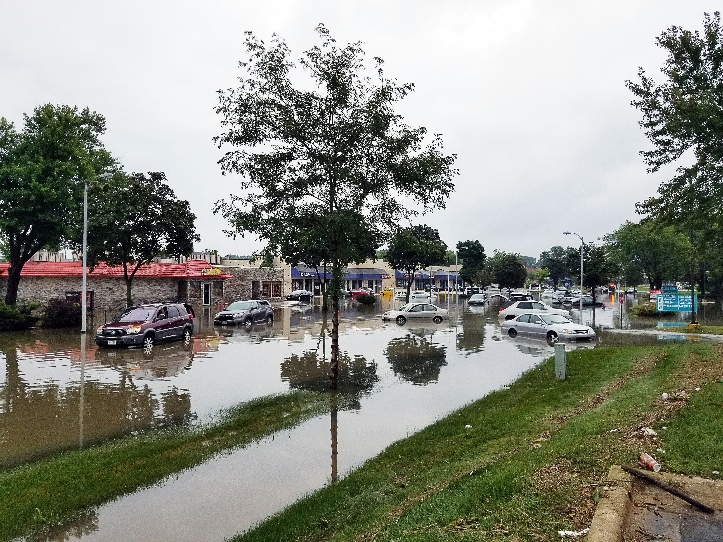
1.2 Key concepts and definitions
Learning objectives
Explain the definition and concept of an infrastructure
Define and conceptualise infrastructure risk as a combination of hazard, vulnerability and exposure, showing the role of networks in risk propagations
Explain the relevant definitions in understanding infrastructure resilience

Slide 14
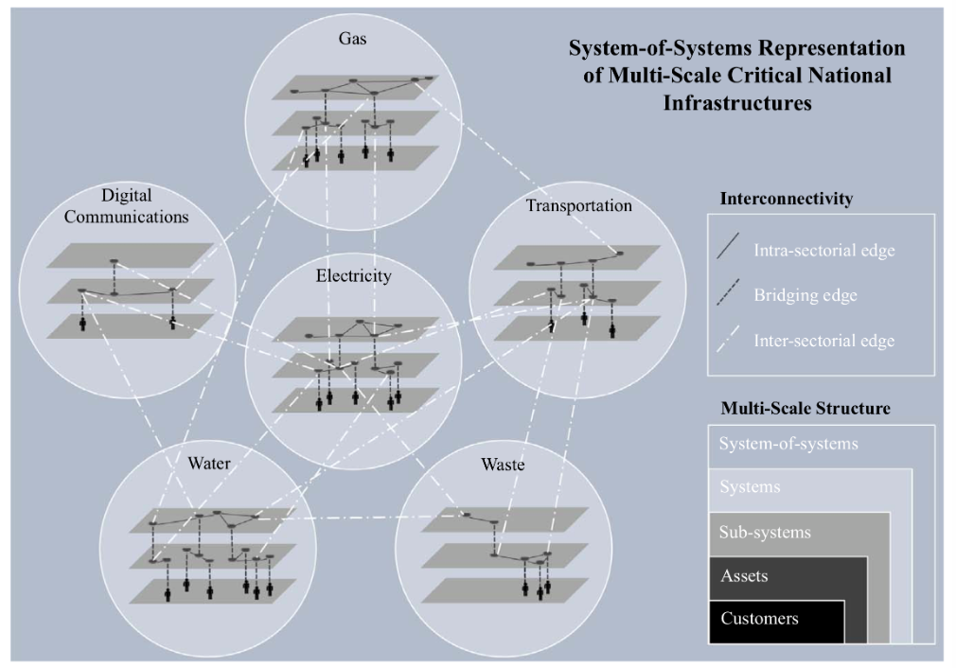
1.2 Key concepts and definitions
Understanding infrastructure networks
Collection and interconnection of all physical assets and human systems that are operated in a coordinated way to provide a particular infrastructure service
Large spatially distributed networks that generally exhibit multi-scale hierarchical structures
Interdependent ‘system-of-systems’
(Thacker, Pant, and Hall 2017)
(Hall et al. 2016; Thacker, Pant, and Hall 2017; Mann 2009; Rinaldi, Peerenboom, and Kelly 2001)

Slide 15
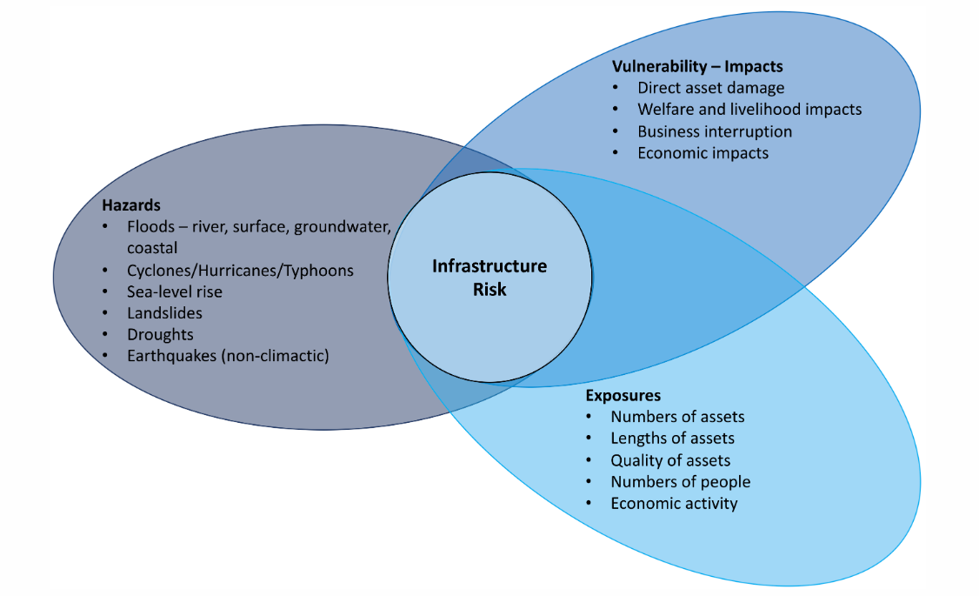
1.2 Key concepts and definitions
The notion of hazard exposures, vulnerabilities and risks
Hazard: possible future occurrence of natural or human-induced physical events that may have adverse effects on vulnerable and exposed elements
Exposure: inventory of elements in an area in which hazard events may occur
Vulnerability: propensity of exposed elements such as human beings, their livelihoods, and assets to suffer adverse effects when impacted by hazard events
Risk: combination of the hazard, exposure, and vulnerability: probability of occurrence of hazardous events or trends multiplied by the consequences of impacts to vulnerable systems if these events or trends occur
(Field and Barros 2014; Oppenheimer et al. 2015)

Slide 16
1.2 Key concepts and definitions
Conceptualising infrastructure layers
Source layers: Where resources are generated
Intermediate layers: Where resources are stored and (or) converted to be delivered further downstream
Sink layers: Which resources are connected to the final customers (people, businesses, systems) who receive the infrastructure service
(Thacker, Pant, and Hall 2017; Pant et al. 2018)
Notes:
Source layers: Where resources are generated - for example, power generation sites, rivers and reservoirs for water
Intermediate layers: Where resources are stored and (or) converted to be delivered further downstream - for example, electricity transmission substations and cables, ports, water treatment plants
Sink layers: Which resources are connected to the final customers (people, businesses, systems) who receive the infrastructure service - for example, electricity, gas and water distributions systems connected to homes, local roads.

Slide 17
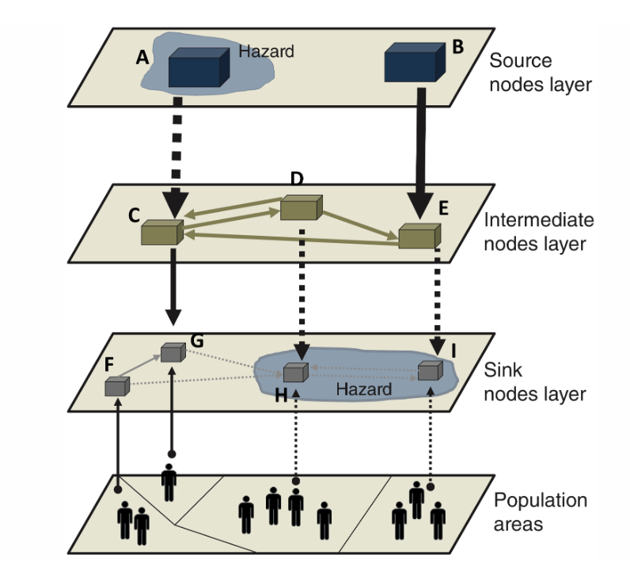
1.2 Key concepts and definitions
Cascading risks through the infrastructure network
(Pant et al. 2018)
Notes:
Cascading effect: small initial failures manifest into larger events
Example: the hazard affecting the source layer asset (A) breaks the flow of service (A->C) to the intermediate layer. But there is another flow of service (B->E->C) that keeps the service going. This prevents the disruption from proceeding further in the network towards customers.
But for another hazard affecting the sink layer assets (H and I) there are no alternative flows and all flow linkages (shown in dotted lines are all ineffective), so the customers become vulnerable.

Slide 18
1.2 Key concepts and definitions
Climate risk to infrastructure systems
Technology and structural measures
Direct climate damage to infrastructure assets
Management and siting measures
Asset adaptation measures
Climate disruption to the operation of infrastructure networks
Infrastructure-induced exposure to climate hazards
Systemic resilience across infrastructure networks
Enhancing system resilience
Planning for sustainable infrastructure development

Slide 19
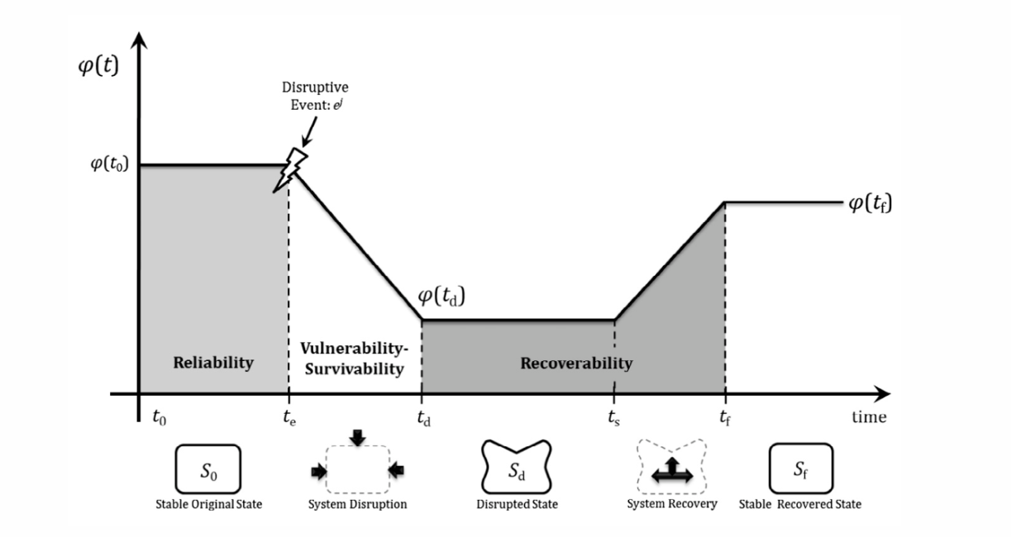
1.2 Key concepts and definitions
Infrastructure resilience
The ability of an infrastructure to anticipate external hazard shocks is built into its reliability. For example, making a road flood-proof in advance of knowing the severity of floods that could affect it
(Hosseini, Barker, and Ramirez-Marquez 2016; Hickford et al. 2018; Pant et al. 2014)

Slide 20
1.2 Key concepts and definitions
Infrastructure resilience
The ability to absorb shocks is reflected in the decrease of level of services while some function is still possible, which is also a measure of the vulnerability or survivability.
(Hosseini, Barker, and Ramirez-Marquez 2016; Hickford et al. 2018; Pant et al. 2014)

Slide 21
1.2 Key concepts and definitions
Infrastructure resilience
The abilities to adapt and recover are reflected in the recoverability of the infrastructure systems, which are the results of combinations of actions and plans put in place to get the system back to its pre-shock failure levels of service.
(Hosseini, Barker, and Ramirez-Marquez 2016; Hickford et al. 2018; Pant et al. 2014)

Slide 22
1.2 Key concepts and definitions
Infrastructure resilience
In the context of a network, two mechanisms by which all these aspects of resilience are enhanced include:
Robustness: When the network assets are built to absorb shocks and maintain function
Redundancies: When the networks have alternative routes within or connections with other networks to continue the services. For example, alternative routes can be used in road networks to bypass a damaged road, or electricity backup supply can be provided for networks that rely on a continuous supply of electricity.
(Hosseini, Barker, and Ramirez-Marquez 2016; Hickford et al. 2018; Pant et al. 2014)

Slide 23
1.2 Key concepts and definitions
Summary
Infrastructure networks are interdependent multi-scale systems that deliver essential goods and services to various population segments, including households and businesses.
Concepts of hazard, exposure, and vulnerability in relation to infrastructure and how hierarchical structures contribute to risk propagation and cascading effects.
Definition and importance of resilience in quantifying failures and enhancing preparedness for risks.

Slide 24
1.2 Key concepts and definitions
Bibliography
Field, Christopher B, and Vicente R Barros. 2014. Climate Change 2014–Impacts, Adaptation and Vulnerability: Regional Aspects. Cambridge University Press.
Hall, J. W., M. Tran, A. Hickford, and R. Nicholls. 2016. The future of national infrastructure: A systems-of-systems approach. Cambridge: Cambridge University Press.
Hickford, Adrian J, Simon P Blainey, Alejandro Ortega Hortelano, and Raghav Pant. 2011. “Resilience Engineering: Theory and Practice in Interdependent Infrastructure Systems.” Environment Systems and Decisions 38 (3): 278–91.
Hosseini, Seyedmohsen, Kash Barker, and Jose E. Ramirez-Marquez. 2016. “A Review of Definitions and Measures of System Resilience.” Reliability Engineering & System Safety 145: 47–61. https://doi.org/https://doi.org/10.1016/j.ress.2015.01.006.
Mann, B. 2009. “Strategic Framework and Policy Statement on Improving the Resilience of Critical Infrastructure to Disruption from Natural Hazards.” Cabinet Office, London< Http://Www.cabinetoffice.gov.uk/Media/308367/Sfps-Consultation.pdf.
Oppenheimer, Michael, Maximiliano Campos, Rachel Warren, Joern Birkmann, George Luber, Brian O’Neill, Kiyoshi Takahashi, et al. 2015. “Emergent Risks and Key Vulnerabilities.” In Climate Change 2014 Impacts, Adaptation and Vulnerability: Part a: Global and Sectoral Aspects, 1039–1100. Cambridge University Press.
Pant, Raghav, Kash Barker, Jose Emmanuel Ramirez-Marquez, and Claudio M. Rocco. 2014. “Stochastic Measures of Resilience and Their Application to Container Terminals.” Computers & Industrial Engineering 70: 183–94. https://doi.org/https://doi.org/10.1016/j.cie.2014.01.017.
Pant, Raghav, Scott Thacker, Jim W Hall, David Alderson, and Stuart Barr. 2011. “Critical Infrastructure Impact Assessment Due to Flood Exposure.” Journal of Flood Risk Management 11 (1): 22–33.
Rinaldi, S. M., J. P. Peerenboom, and T. K. Kelly. 2001. “Identifying, Understanding, and Analyzing Critical Infrastructure Interdependencies.” IEEE Control Systems Magazine 21 (6): 11–25. https://doi.org/10.1109/37.969131.
Thacker, Scott, Raghav Pant, and Jim W. Hall. 2017. “System-of-Systems Formulation and Disruption Analysis for Multi-Scale Critical National Infrastructures.” Reliability Engineering & System Safety 167: 30–41. https://doi.org/https://doi.org/10.1016/j.ress.2017.04.023.
Watts, Duncan J. 2002. “A Simple Model of Global Cascades on Random Networks.” Proceedings of the National Academy of Sciences 99 (9): 5766–71.

Slide 25

1.3 Characterising hazards and risk calculations for infrastructure networks
Learning objectives
How to represent and model different hazards
Introduce the concept of hazard exceedance probabilities
Discuss the process of generating loss-probability curves
Show how to calculate expected risks for discrete probabilities and losses

Slide 26
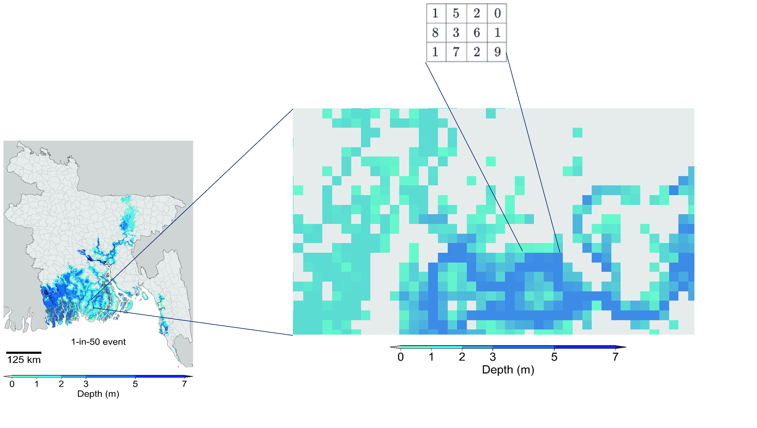
1.3 Characterising hazards and risk calculations for infrastructure networks
Hazards representation
Raster format - a 2D grid where each grid cell has a value
For floods this is often maximum flood depth (in meters)
For storms could be maximum sustained wind speed (or maximum 30s gust) at 10m above the ground (in meters/second)

Slide 27
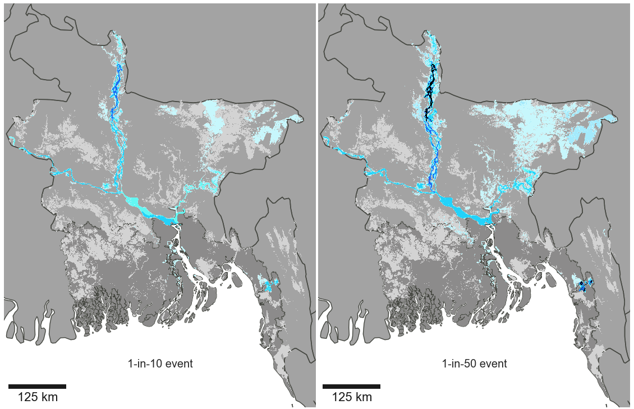
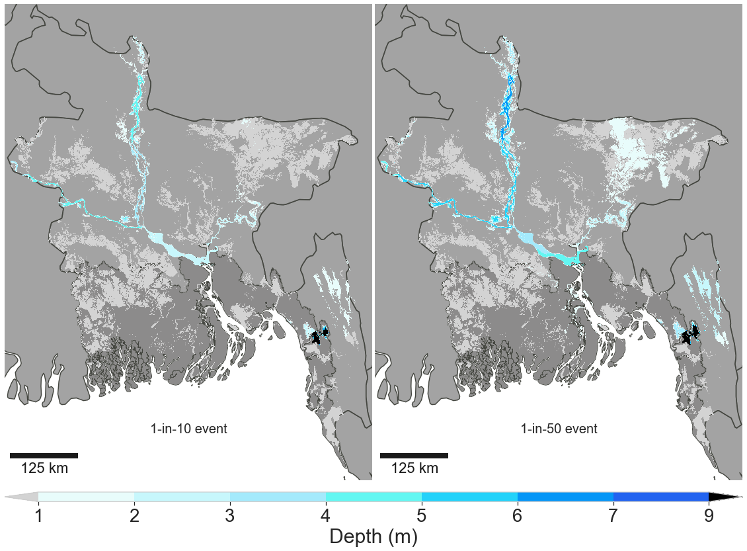
1.3 Characterising hazards and risk calculations for infrastructure networks
Return periods and events
Severity of a hazard scenario, such as a flood, is typically communicated through either the annual exceedance probability or the return period
"Commonly referenced return periods when assessing flood risk include:
1 in 30 year (3.33% annual exceedance probability)
1 in 100 year (1% annual exceedance probability)
1 in 1000 year (0.1% annual exceedance probability)
Unfortunately, many people are under the impression if they experience a 1-in-100-year flood, they will not experience another one like it for the next 99 years. However, this is not the case! In reality, the chance of being flooded by a 1-in-100-year flood event is the same in any given year: 1%"
https://fpsenvironmental.co.uk/what-are-flood-return-periods/
Return period maps show the intensity of a hazard that will be exceeded with the given probability in each grid cell, independently of neighbouring or distant cells: the whole map does not represent a realistic event.
1-in-10 year
1-in-50 year
27

Slide 28
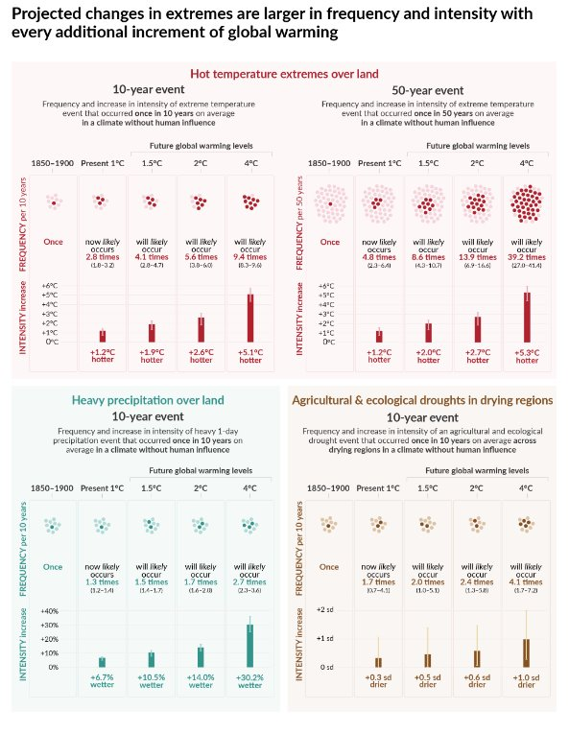
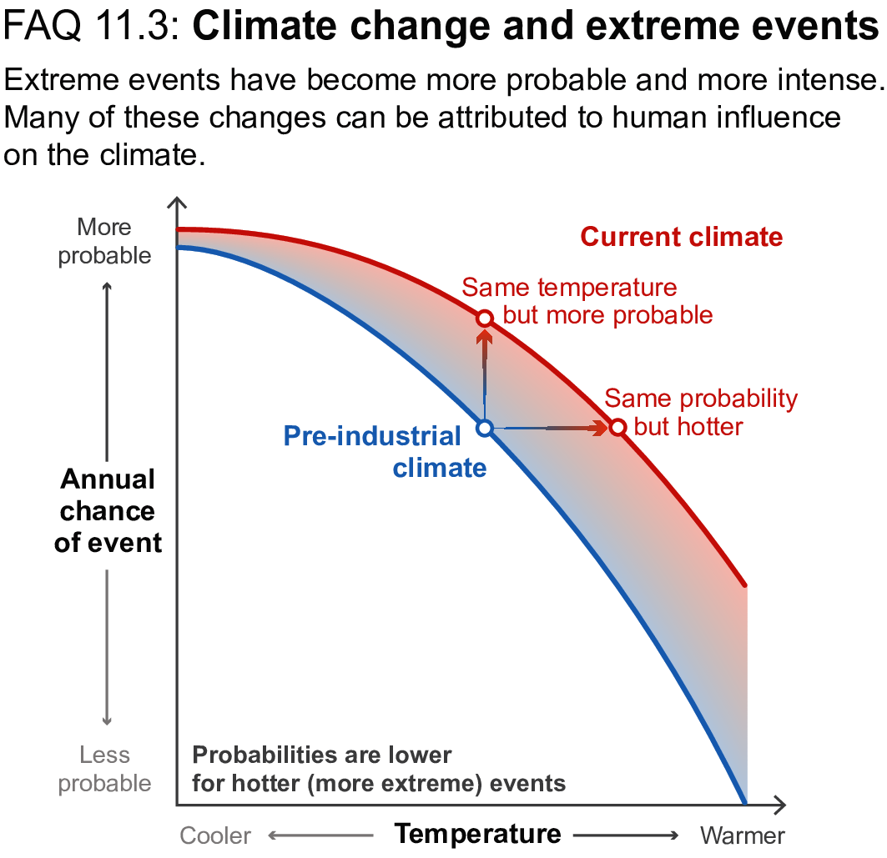
1.3 Characterising hazards and risk calculations for infrastructure networks
Return periods and climate
Historical return periods may no longer reflect the current or future probability of extreme events
As the climate is changing, extreme events are occurring more frequently and with greater intensity.
Figures from IPCC, 2021: Summary for Policymakers. In: Climate Change 2021: The Physical Science Basis. Contribution of Working Group I to the Sixth Assessment Report of the Intergovernmental Panel on Climate Change [Masson-Delmotte, V., P. Zhai, A. Pirani, S.L. Connors, C. Péan, S. Berger, N. Caud, Y. Chen, L. Goldfarb, M.I. Gomis, M. Huang, K. Leitzell, E. Lonnoy, J.B.R. Matthews, T.K. Maycock, T. Waterfield, O. Yelekçi, R. Yu, and B. Zhou (eds.)]. Cambridge University Press, Cambridge, UK and New York, NY,USA, pp. 3−32, doi: 10.1017/9781009157896.001 .]
28
28
Notes:
Figures from IPCC, 2021: Summary for Policymakers. In: Climate Change 2021: The Physical Science Basis. Contribution of Working Group I to the Sixth Assessment Report of the Intergovernmental Panel on Climate Change [Masson-Delmotte, V., P. Zhai, A. Pirani, S.L. Connors, C. Péan, S. Berger, N. Caud, Y. Chen, L. Goldfarb, M.I. Gomis, M. Huang, K. Leitzell, E. Lonnoy, J.B.R. Matthews, T.K. Maycock, T. Waterfield, O. Yelekçi, R. Yu, and B. Zhou (eds.)]. Cambridge University Press, Cambridge, UK and New York, NY,USA, pp. 3−32, doi: 10.1017/9781009157896.001 .]

Slide 29
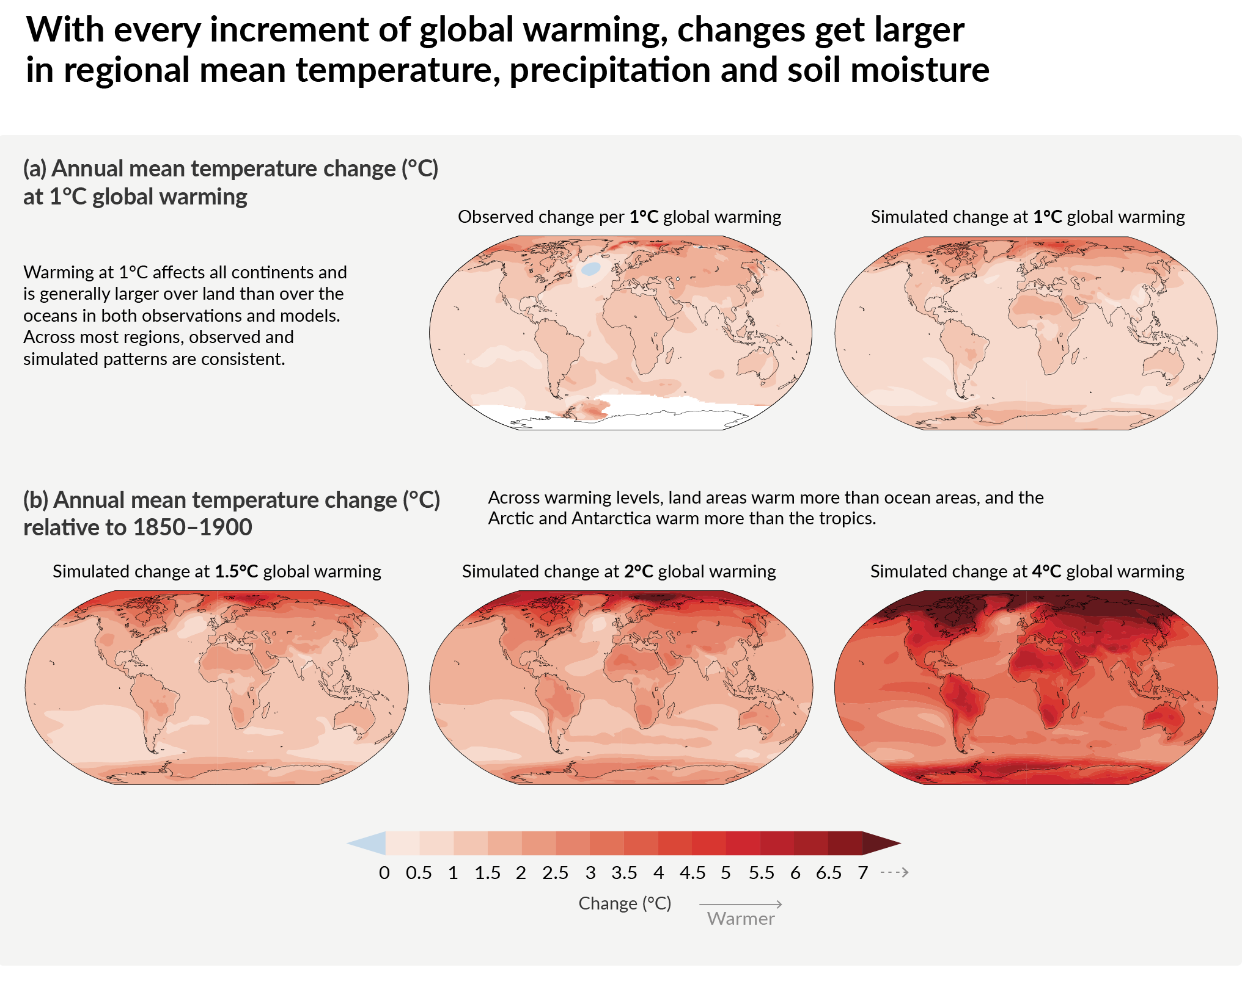
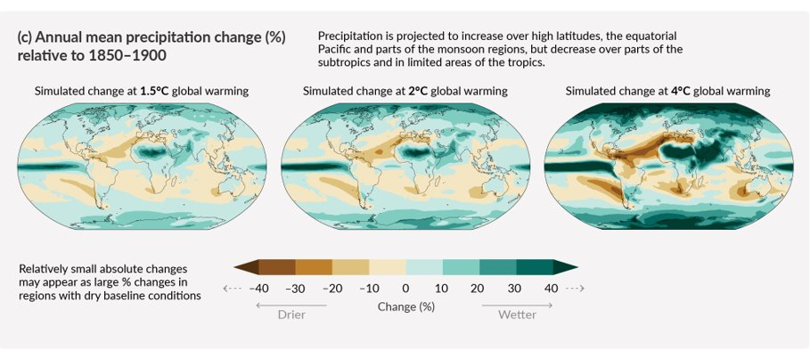
1.3 Characterising hazards and risk calculations for infrastructure networks
Climate change and acute hazards
Climate change projections are developed using global circulation models (GCMs) that simulate temperature, precipitation, and other variables
GCMs are not able to represent granular atmospheric features (such as cloud cover, tropical cyclone formation, or local processes)
Downscaling of climate models attempts to bridge the gap between global and local effects by layering local-level data over larger-scale climate models
Climate variables (possibly downscaled) are used to force or parameterise changes in the various hydro-meteorological models that represent acute hazard processes: coastal storm surges, river flooding, tropical cyclones, and so on
Figures from IPCC, 2021: Summary for Policymakers. In: Climate Change 2021: The Physical Science Basis. Contribution of Working Group I to the Sixth Assessment Report of the Intergovernmental Panel on Climate Change [Masson-Delmotte, V., P. Zhai, A. Pirani, S.L. Connors, C. Péan, S. Berger, N. Caud, Y. Chen, L. Goldfarb, M.I. Gomis, M. Huang, K. Leitzell, E. Lonnoy, J.B.R. Matthews, T.K. Maycock, T. Waterfield, O. Yelekçi, R. Yu, and B. Zhou (eds.)]. Cambridge University Press, Cambridge, UK and New York, NY,USA, pp. 3−32, doi: 10.1017/9781009157896.001 .]
29
29

Slide 30
1.3 Characterising hazards and risk calculations for infrastructure networks
Hazard data selection
Raster format
Range of scenarios (RPs, RCPs, future projections)
Resolution
Discrete categories vs. continuous data
Global data vs data based on regional models
Return period maps, historical events, synthetic event sets
Acceptance
NB: Trade offs!
30
30

Slide 31
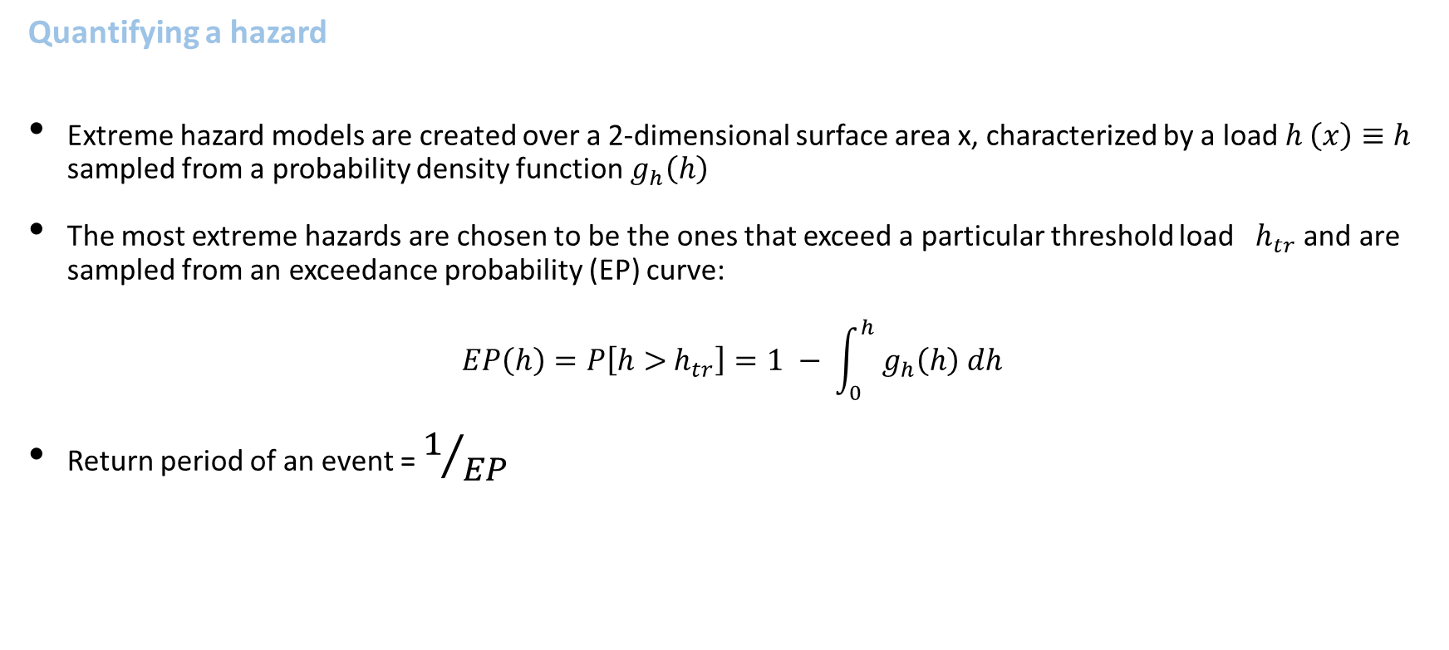
1.3 Characterising hazards and risk calculations for infrastructure networks
Quantifying a hazard
Extreme hazard models are created over a 2-dimensional surface area x, characterized by a load $h \left(x\right)≡$ $h$ sampled from a probability density function${ g}_{h}\left(h\right)$
The most extreme hazards are chosen to be the ones that exceed a particular threshold load ${ h}_{tr}$ and are sampled from an exceedance probability (EP) curve:
$$EP\left(h\right)=P\left[h>{ h}_{tr}\right]=1 − \int_{0}^{h}{{ g}_{h}\left(h\right) dh}$$
Return period of an event = $1/{EP}$
cumulative density function of hazard loading
Notes:
Flooding example:
5 cm of flood depth might be okay, but 1metre of flood depth might be catastrophic→ $h>{ h}_{tr}$= 1 m
The exceedance probability is a good indicator for selecting events – an event that has 0.001 probability of being exceeded (i.e. EP(h)=0.001) would be a rare event and possibly a hazard. This is a 1 in 1000-year return period flood event

Slide 32
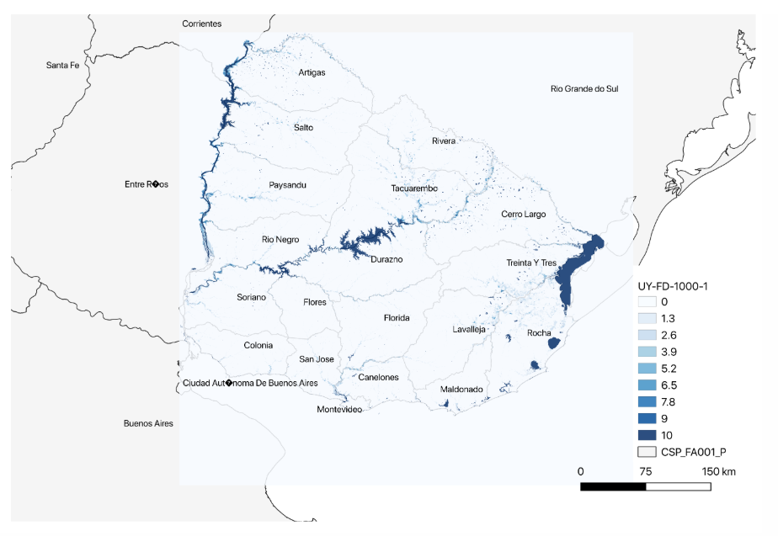
1.3 Characterising hazards and risk calculations for infrastructure networks
Hazard information used in practice
The river flood hazard here is defined as an event for which the river flows at every location have 0.001 exceedance probability values: at every location the selected flow is the one that has a 1 in 1000 chance of being exceeded
The flood depths in metres are the hazard loads here. Very high flood depths at specific locations (in darkest shades of blue) would make potential areas vulnerable to flooding
A 1 in 1000 exceedance probability river flood map for Uruguay showing areas with different flood depths in metres. Created from FATHOM data (Wing et al. 2020)
Notes:
There are now several open-source hazard products at global scales which are being used widely for vulnerability and risk analysis. A few resources include:
Global river and coastal flood maps: Historical and future hazard maps at different return periods (2, 5, 10, 25, 50, 100, 250, 500, 1000 years). All data is available at a 30 arc-seconds resolution (~1km at equator) (Gassert et al. 2015).
Global hazard maps for earthquakes for different return periods (250, 475, 975, 1500, 2475 years) both Peak Ground Acceleration and spectral acceleration. Data is available at 0.072 degrees (~8km at equator).
Global dataset of 10,000 synthetic tropical cyclones paths with cyclone characteristics (e.g., wind speed, pressure) on a global scale. Wind speed probabilities are derived globally (10 metre, 10 minutes sustained speed) for different return periods (10 to 10,000 years) at 10km resolution (Bloemendaal et al. 2019).

Slide 33
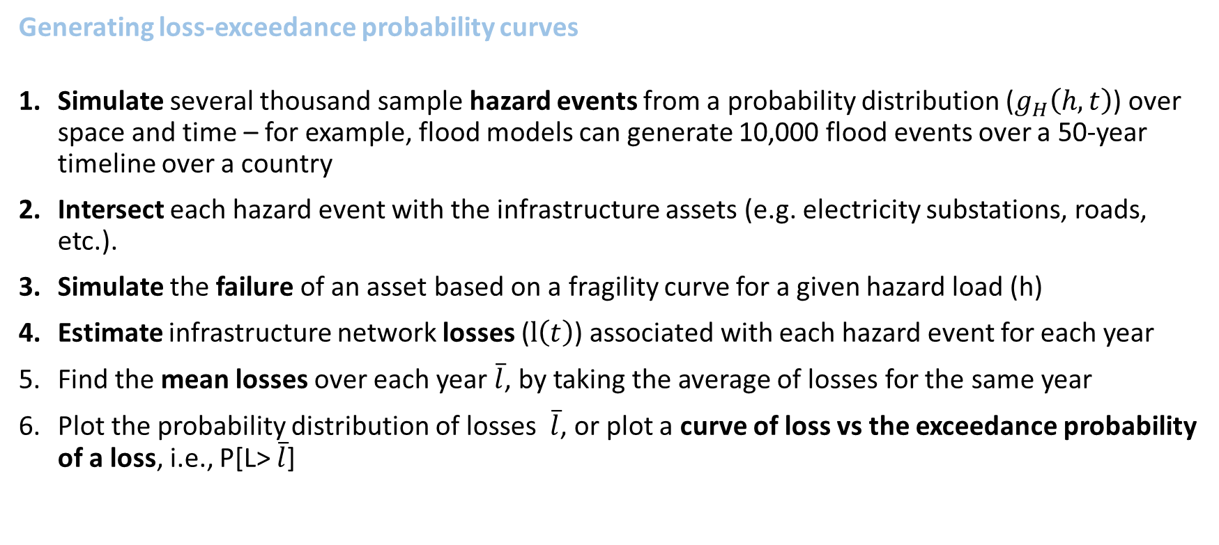
1.3 Characterising hazards and risk calculations for infrastructure networks
Generating loss-exceedance probability curves
Simulate several thousand sample hazard events from a probability distribution ($g_{H}\left(h,t\right)$) over space and time – for example, flood models can generate 10,000 flood events over a 50-year timeline over a country
Intersect each hazard event with the infrastructure assets (e.g. electricity substations, roads, etc.).
Simulate the failure of an asset based on a fragility curve for a given hazard load (h)
Estimate infrastructure network losses ($l\left(t\right)$) associated with each hazard event for each year
Find the mean losses over each year $\overline{l}$, by taking the average of losses for the same year
Plot the probability distribution of losses $\overline{l}$, or plot a curve of loss vs the exceedance probability of a loss, i.e., P[L> $\overline{l}$]
Notes:
A key result in risk analysis is the distribution of the vulnerability outcomes (losses) for different hazard events sampled from a probability distribution. A comprehensive approach to generating such curves includes the following steps:

Slide 34
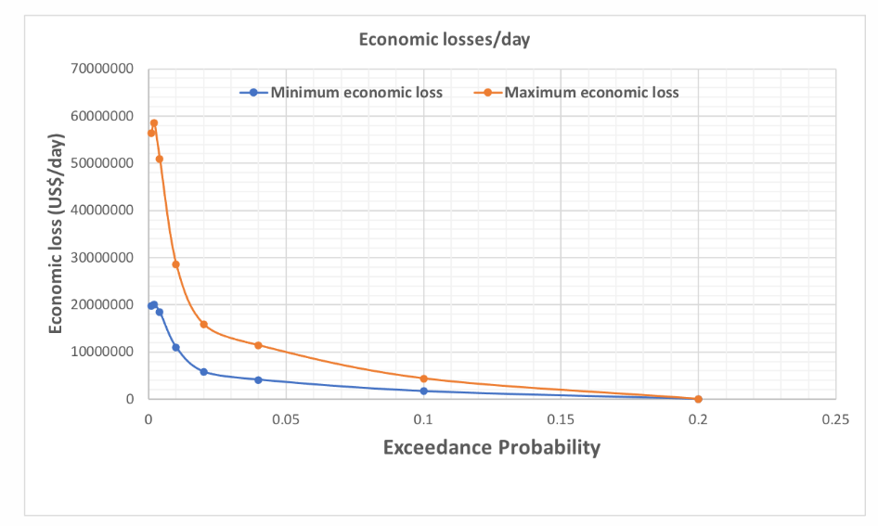
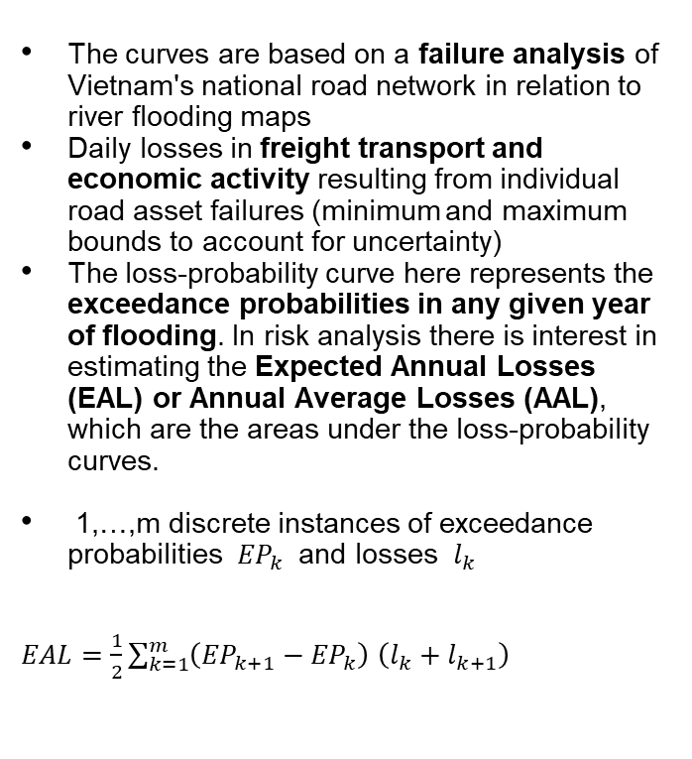
1.3 Characterising hazards and risk calculations for infrastructure networks
Risk calculations from loss-probability curves
The curves are based on a failure analysis of Vietnam's national road network in relation to river flooding maps
Daily losses in freight transport and economic activity resulting from individual road asset failures (minimum and maximum bounds to account for uncertainty)
The loss-probability curve here represents the exceedance probabilities in any given year of flooding. In risk analysis there is interest in estimating the Expected Annual Losses (EAL) or Annual Average Losses (AAL), which are the areas under the loss-probability curves.
1,…,m discrete instances of exceedance probabilities ${EP}_{k}$ and losses $l_{k}$
$EAL=\frac{1}{2}\sum_{k=1}^{m}{\left({EP}_{k+1}−{EP}_{k}\right)}$ $\left(l_{k}+l_{k+1}\right)$
(Oh et al. 2019)
Notes:
Figure: Minimum and maximum daily loss vs exceedance probability curves for river flooding of the national road network. From a climate risk analysis study in Viet Nam

Slide 35
1.3 Characterising hazards and risk calculations for infrastructure networks
Nuances in infrastructure risk assessments
In general, infrastructure losses are a combination of the monetary value of asset damages that need to be replaced (direct damages) and the economic losses accrued due to disruption of network services (indirect losses)
While the principles of finding direct damages might be the same across all types of infrastructure assets, the process of estimating indirect losses are very network specific
For example, electricity and telecoms network failure result in instantaneous loss of service (electricity), which might result in losses and risks within a matter of a few minutes. On the other hand, transport network failures might result in a gradual build-up of losses over several days or months until commodity supplies run out
In infrastructure risk analysis often the quantification of the losses (l) is not a straightforward process. It often depends on creating good network flow models
35

Slide 36
1.3 Characterising hazards and risk calculations for infrastructure networks
Summary
General theory of sampling hazard events from hazard models
Introduction of the concept of exceedance probabilities as applied to spatial hazard event sets
Theoretical steps in the process of generating a comprehensive loss-probability curve for hazards and network losses
Loss-probability curve from a real-world study and how to estimate the expected annual risks
36
Notes:
The different theoretical formulations and concepts introduced in this lecture provide over-arching concepts that apply to every type of network and hazard combination that we could analyse. But we note that there are network-specific nuances that need to be considered in infrastructure loss calculations

Slide 37
1.3 Characterising hazards and risk calculations for infrastructure networks
Bibliography
Bloemendaal, Nadia, Ivan Haigh, Hans de Moel, S. Muis, Reindert Haarsma, and Jeroen Aerts. 2019. “STORM IBTrACS present climate synthetic tropical cyclone tracks,” November. https://doi.org/10.4121/uuid:82c1dc0d-5485-43d8-901a-ce7f26cda35d.
Gassert, Francis, Paul Reig, Tien Shiao, Matt Landis, Matt Luck, and others. 2015. “Aqueduct Global Maps 2.1.”
Oh, Jung Eun, Xavier Espinet Alegre, Raghav Pant, Elco E Koks, Tom Russell, Roald Schoenmakers, and Jim W Hall. 2019. “Addressing Climate Change in Transport: Volume 2: Pathway to Resilient Transport.” World Bank.
Wing, Oliver EJ, Niall Quinn, Paul D Bates, Jeffrey C Neal, Andrew M Smith, Christopher C Sampson, Gemma Coxon, Dai Yamazaki, Edwin H Sutanudjaja, and Lorenzo Alfieri. 2020. “Toward Global Stochastic River Flood Modeling.” Water Resources Research 56 (8): e2020WR027692.

Slide 38

1.4 Hazard exposure and vulnerability analysis in practice for high-level decision-making
Learning objectives
Exposure analysis in practice
Show exposure analysis with a road network layer and a flood hazard layer
Measure network vulnerabilities
Highlight vulnerable network locations (hotspots) at the national scale

Slide 39
1.4 Hazard exposure and vulnerability analysis in practice for high-level decision-making
Assets, location and attributes
Aim to collect sufficient asset information to support the risk analysis.
Damage assessment
Location of the asset
Condition? Design standard? Generic type?
Replacement or rehabilitation cost
Disruption assessment
Functional attributes (capacity, usage, restrictions, constraints)
Connection to wider system (network links, dependency connections)

Slide 40
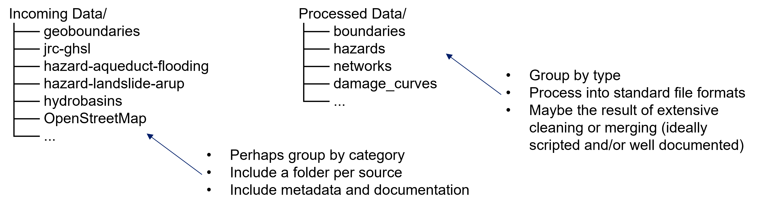
1.4 Hazard exposure and vulnerability analysis in practice for high-level decision-making
make a list of datasets required for the study collect potentially useful datasets review the collected datasets, selecting the most useful ones to input into the analysis process and clean/extract/enrich the datasets into analysis-ready form do the modelling and analysis report and share results with clear reference to all input datasets Organise and archive incoming data as received; separate processed analysis-ready data:
Data collection process

Slide 41
1.4 Hazard exposure and vulnerability analysis in practice for high-level decision-making
Sector | Sub-sector | Short description
Energy | Power | Generation sites (location, fuel, capacity)
Energy | Power | Transmission lines
Energy | Power | Substations
Energy | Power | Distribution lines
Energy | Power | Load curves
Energy | Power | Demand centres / service areas
Energy | Oil and Gas | FPSOs
Energy | Oil and Gas | Offshore platforms
Energy | Oil and Gas | Pipelines
Transport | Road | Road junctions and road links, including major, minor and local
Transport | Road | Road usage statistics (AADT)
Transport | Road | Travel/trip statistics (travel survey)
Transport | Road | Future (proposed/planned) roads
Social | Education | School and university locations
Social | Health | Health centre and hospital locations
All | All | Maintenance, build, rehabilitation costs
Economic | Markets or local hubs | Populated places - village/town/city centres
Demographic | Population | Population density
Demographic | Population | Census population
Economic | Trade | International trade statistics
Boundaries |  | Census regions
Boundaries |  | National boundaries
Boundaries |  | Regional boundaries
Boundaries |  | River basins
Data collection spreadsheet example
Column | Description
System | Top-level category (infrastructure/socio-economic/hazard/vulnerability/other)
Sector | Dataset sector (energy/transport/water/...)
Sub-sector | Dataset subsector (power/road/rail/...)
Short description | Short description of the dataset sought/collected
Dataset name | Short name of the specific dataset collected
Status of evaluation | Status of the dataset in the collection process: first list datasets "to collect"; then as they are collected, mark them "to review"; then either select them for use or not.
Notes on data collection & evaluation | Add notes on collection and review
Source/Contact/Link | Add details on the dataset source: citation, dataset URL, contact name and institution
Usage restrictions/License | Add details on the dataset usage: is it for internal use only, commercially restricted, for academic or government use only, or is it openly licensed (CC-BY-SA, ODbL or similar)
Notes | Space for more notes!
Resolution/Granularity | Spatial resolution or granularity (30m, 1km raster; regional/national; point/line)
Date/last updated | Dates covered by a timeseries, and/or date last updated
Storage location | Reference to your own storage location for this dataset as collected (folder/drive/bucket/database...)

Slide 42
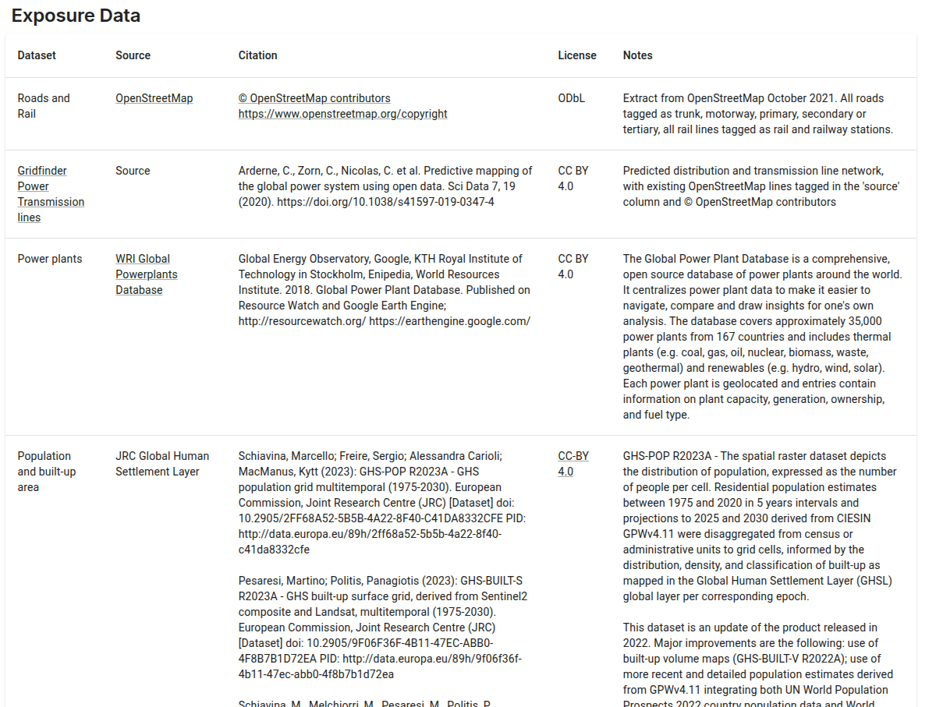
1.4 Hazard exposure and vulnerability analysis in practice for high-level decision-making
Global open data sources
Search Zenodo:
https://zenodo.org/communities/ccg/records?q=%22Infrastructure%20Climate%20Resilience%20Assessment%20Data%20Starter%20Kit%22&l=list&p=1&s=10&sort=newest
CSV list of records:
https://github.com/nismod/irv-datapkg/blob/main/records.csv
https://global.infrastructureresilience.org/data#exposure

Slide 43
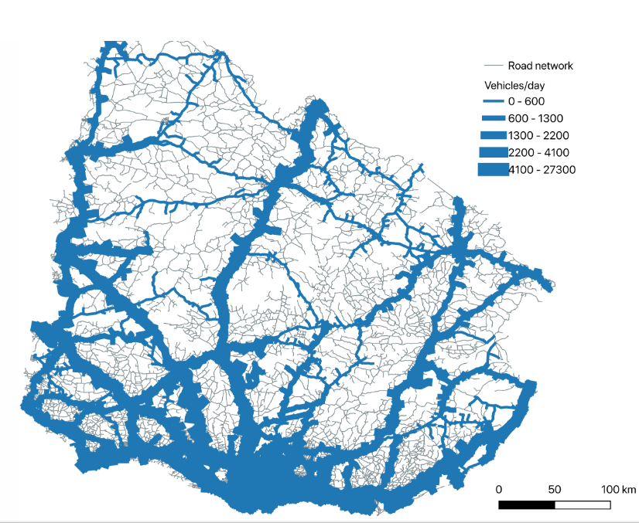
1.4 Hazard exposure and vulnerability analysis in practice for high-level decision-making
Road network exposure analysis
How an exceedance probability hazard layer is overlaid and combined with a road network to produce exposure and vulnerability outcomes useful for decision-making
Simplified exposure and vulnerability assessment for the national scale road network in Uruguay, for which we know the average daily traffic count of vehicles along different road sections
Notes:
Figure: Spatial representation of the national road network in Uruguay showing the average daily vehicle counts along different roads

Slide 44
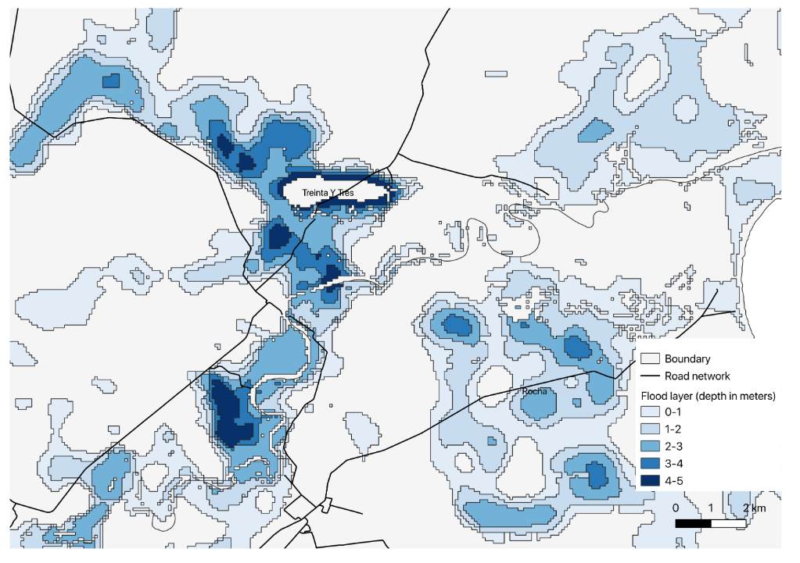
1.4 Hazard exposure and vulnerability analysis in practice for high-level decision-making
Hazards and network overlays
We infer the potential exposure and vulnerability of infrastructure networks by spatially intersecting them with hazard maps
Example of a river flood map with a 1 in 1000 exceedance probability overlaid with a road network in Uruguay, from which the potential locations of roads exposed to high flood depths (> 1metre) can be identified
The type of outcomes of such analyses include estimating the exact geometry, flooded lengths and flood depths along sections of roads
The intersection analysis can be done with a software package such as QGIS (QGIS Development Team 2021) or using spatial functions in Python programming language
Notes:
Figure: Overlaying a 1 in 1000 flood hazard map with a road network and identifying locations of flood exposures

Slide 45
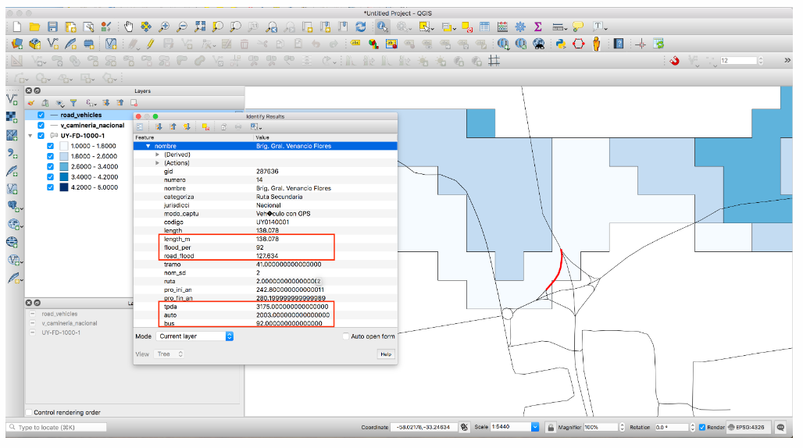
1.4 Hazard exposure and vulnerability analysis in practice for high-level decision-making
Exposures and vulnerability metrics
As a single road could be exposed to flooding over several sections and many flood depths, we can estimate the total length of flooding and minimum and maximum flood depths for each road
Since we know the traffic counts along the road, we can get an estimate of the potential traffic that could be disrupted due to flooding, which is a measure of the level of vulnerability associated with the road
(QGIS Development Team 2021)
Notes:
Figure Result of overlaying a road with the flood outline. Here we see the length of the road flooded (road_flood), and flood depth (between 1m – 1.8m), and the potential traffic disrupted per day on this road (daily total traffic – tpda, numbers of automobiles – auto, numbers of buses – bus) (Figure generated in QGIS software

Slide 46
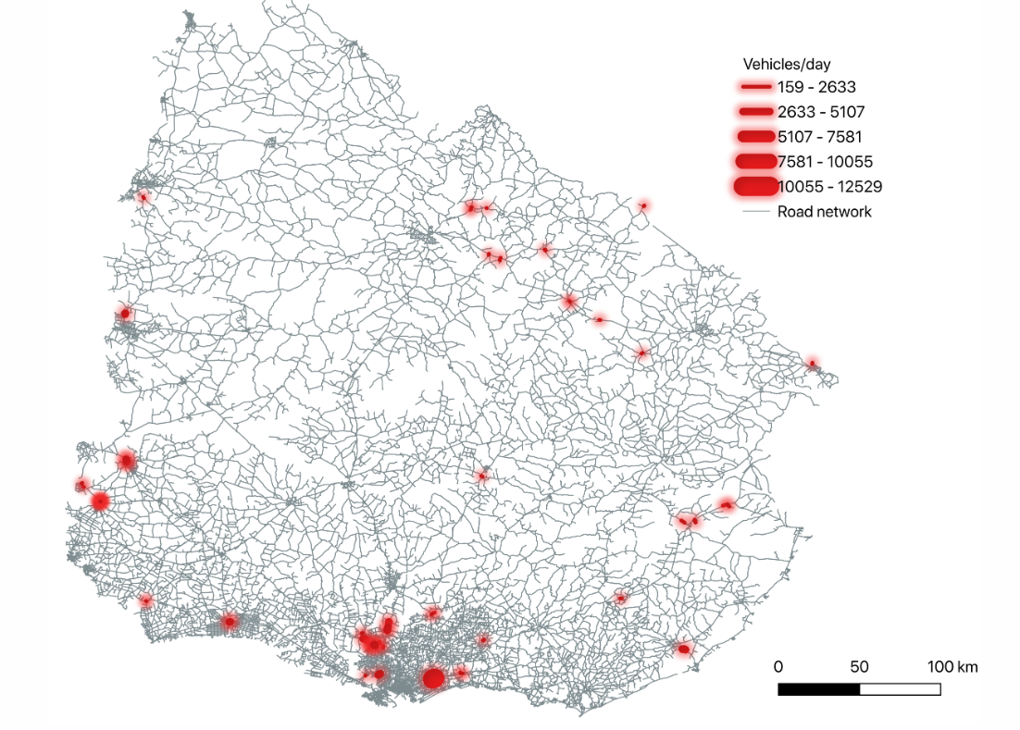
1.4 Hazard exposure and vulnerability analysis in practice for high-level decision-making
Identifying locations of vulnerabilities at national scales
A simple way of identifying the most critical roads in the country is to look at the roads with the highest lengths or percentages of flood exposures and the highest impacted traffic flows
The figure highlights vulnerable locations in the Uruguay road network at risk of severe flooding, impacting traffic
Criticality assessments rank road links based on their importance and potential disruption to the infrastructure
Initial analyses to help prioritize high-risk areas for more detailed studies, aiding efficient resource allocation for disaster resilience

Slide 47
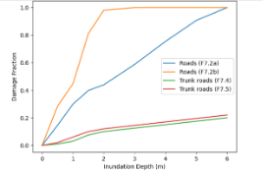
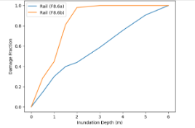
1.4 Hazard exposure and vulnerability analysis in practice for high-level decision-making
Vulnerability and damage curves
Relate hazard intensity to damage fraction
e.g. Flood depth in metres on the x-axis
Fraction of asset damage on the y-axis
Different curves for different asset types
Often desirable to test multiple curves or some bounds of sensitivity
Can be interpreted as a "probability of destruction"
Related concept of fragility curves, which relate hazard intensity to probability of being in one of several qualitative damage states
Generated empirically, from recorded events, or as the result of modelling of structures and loads
Flood depth-damage curves plotted from Nirandjan et al 2024
Notes:
Some references:
FEMA (Federal Emergency Management Agency). 2013. “Multi-hazard Loss Estimation Methodology: Flood Model.” Department of Homeland Security and Federal Emergency Management Agency, Washington, DC.
Huizinga, J., H. de Moel and W. Szewczyk. 2017. “Global Flood Depth-Damage Functions”. Publications Office of the European Union: Luxembourg. https://doi.org/10.2760/16510.
Nirandjan, S., E. Koks, M. Ye, R. Pant, K C. H. van Ginkel, J. C. J. H. Aerts, and P. J. Ward. 2024. “Review Article: Physical Vulnerability Database for Critical Infrastructure Multi-hazard Risk Assessments—A Systematic Review and Data Collection.” Preprint, Natural Hazards and Earth Systems Sciences Discussion, January 23, 2024. https://doi.org/10.5194/nhess-2023-208.
van Ginkel, K. C. H., F. Dottori, L. Alfieri, L. Feyen, and E. E. Koks. 2021. “Flood Risk Assessment of the European Road Network.” Natural Hazards and Earth System Sciences 21, no. 3: 1011–27. https://doi.org/10.5194/nhess-21-1011-2021.

Slide 48
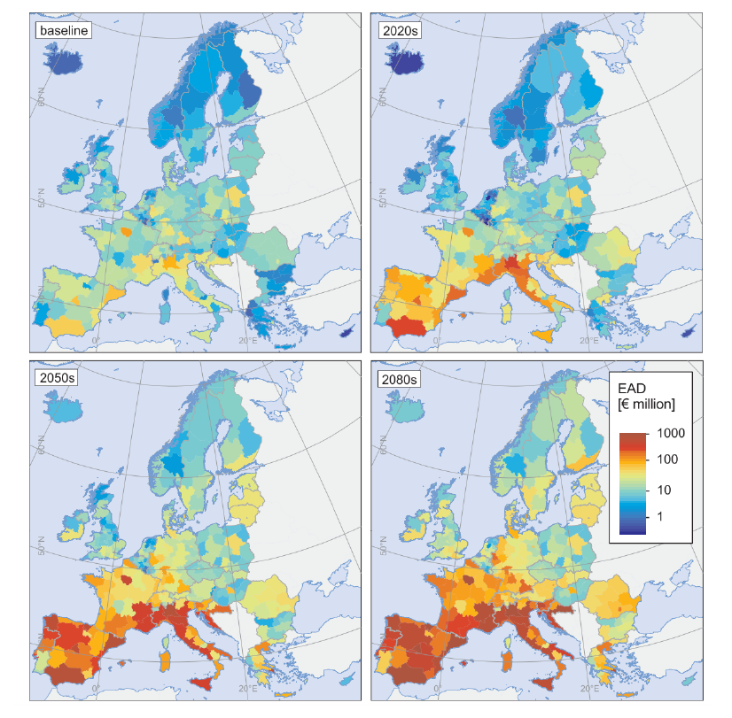
1.4 Hazard exposure and vulnerability analysis in practice for high-level decision-making
Expected annual damage
Having the hazard exposure, the vulnerability curves, construction costs:
Apply the damage functions to the exposed infrastructure asset
Calculate expected annual damages for historical and future scenarios, integrating under the expected damage curve over return period
Enables estimation of economic burden by assigning monetary values to damage levels
Economic damage is based on the asset’s reconstruction costs

Slide 49
1.4 Hazard exposure and vulnerability analysis in practice for high-level decision-making
Limitations and further analysis steps
There are further analysis steps that should be included in such analyses to get more realistic risk outcomes:
The vulnerability or failure of an asset (road section here) is not a deterministic quantity, but rather a probabilistic estimate derived from fragility curves
The damages associated with hazards are not limited to specific point locations, but rather have wider spatially dependent footprints
The vulnerable impacts (traffic counts here) to networks are estimated through more complex network flow models which account for how the disruption will propagate through the rest of the network.
If several such hazard maps or actual simulations of hazard event sets were available, then the calculations should be repeated over several hazards and network failure scenarios to get a more complete picture of vulnerabilities and risks.

Slide 50
1.4 Hazard exposure and vulnerability analysis in practice for high-level decision-making
Summary
A basic hazard exposure and vulnerability analysis was conducted using a river flooding map and Uruguay's national road network to identify flooded road segments and their traffic impacts
The results were visualized in a criticality map, highlighting hotspots of affected roads and disrupted traffic counts
This analysis serves as a preliminary tool for prioritizing vulnerable locations, aiding resource allocation in countries with limited disaster risk planning budgets

Slide 51
1.4 Hazard exposure and vulnerability analysis in practice for high-level decision-making
Bibliography
Jafino, Bramka Arga, Jan Kwakkel, and Alexander Verbraeck. 2020. “Transport Network Criticality Metrics: A Comparative Analysis and a Guideline for Selection.” Transport Reviews 40 (2): 241–64.
Pant, Raghav, Jim W Hall, and Simon P Blainey. 2016. “Vulnerability Assessment Framework for Interdependent Critical Infrastructures: Case-Study for Great Britain’s Rail Network.” European Journal of Transport and Infrastructure Research 16 (1).
QGIS Development Team. 2021. QGIS Geographic Information System. QGIS Association. https://www.qgis.org.
Wing, Oliver EJ, Niall Quinn, Paul D Bates, Jeffrey C Neal, Andrew M Smith, Christopher C Sampson, Gemma Coxon, Dai Yamazaki, Edwin H Sutanudjaja, and Lorenzo Alfieri. 2020. “Toward Global Stochastic River Flood Modeling.” Water Resources Research 56 (8): e2020WR027692.

Slide 52

Cannone, C., Collett, K.A., Charbonnier F., Ahsan A., Halloran C., Vijay,A.,Berdellans I., Hasanovic S., Gritsevskyi A,Stankeviciute L., Tot M.; Welsch M., Hirmer S., 2023. Lecture 1: "COURSE INTRODUCTION TO MAED" , Energy Demands Projections with MAED (Model for Analysis of Energy Demand). Release Version 2.0. [online presentation]. Climate Compatible Growth & Programme and International Atomic Energy Agency.
CCG courses (this will take you to the website link http://www.ClimateCompatibleGrowth.com/teachingmaterials)

