Slide 1


Maximum 32 point Arial in white
LECTURE 6
DATA GOVERNANCE AND SUSTAINABILITY
Supported by and in collaboration with World Resources Institute
Notes:
License:
This work is licensed under the Creative Commons Attribution 4.0 International License (CC BY 4.0). To view a copy of this license, visit https://creativecommons.org/licenses/by/4.0/.
Attribution:
Please cite as: Woldeamanuel, A. A., Khalid, A., Anand, S., Sahar, T., Saklani, A., Sinclair-Lecaros, S., Mentis, D., Ronoh, D., & Stockman, J., 2026. Data Driven, Integrated and Inclusive Energy Planning with Energy Access Explorer. Version 1. Climate Compatible Growth Teaching Kit Website, Climate Compatible Growth.

Slide 2
Learning Outcomes
By the end of this lecture, you will:
ILO1: Understand the meaning and importance of data governance
ILO 2: Describe how to design and implement effective data governance system in the energy sector
ILO 3: Explain the mechanisms of data governance and management in EAE
ILO 3: Identify the various sustainability plans for adopting EAE in a country
2
Notes:
This lecture has four Intended Learning Outcomes. After this lecture you will:
​
Understand the meaning and importance of data governance
Describe how to design and implement effective data governance system in the energy sector
Explain the mechanisms of data governance and management in EAE
Identify the various sustainability plans for adopting EAE in a country
​
These learning outcomes will be important to understand the data governance and sustainability plan of an energy system including EAE.

Slide 3
6.1 Data Governance and Data Management
What is Data Governance?
Data governance has many definitions
Data governance can be defined as a strategy for the overall management of the usability, availability, integrity, quality, and security of data to ensure their maximum potential
The Data Management Association (DAMA) defines data governance as the exercise of authority, control, and shared decision making (planning, monitoring, and enforcement) over the management of data assets
SOURCE: Solà-Morales et.al., 2023; Al-Ruithe et.al, 2019
3
Notes:
Data governance

Slide 4
6.1 Data Governance and Data Management
What is Data Governance?
Data governance helps answer the following questions
Who has ownership of the data?
Who can access what data?
What security measures are in place to protect data and privacy?
How much of our data is compliant with new regulations?
Which data sources are approved to use?
SOURCE: https://www.tableau.com/learn/articles/data-management-vs-data-governance
4
Notes:
Data governance

Slide 5
6.1 Data Governance and Data Management
Difference between Data Governance and Data Management?
The Data Management Association (DAMA) defines data management as the development, execution, and supervision of plans, policies, programs, and practices that control, protect, deliver, and enhance the value of data and information assets.
Data governance establishes policies and procedures around data, while data management enacts those policies and procedures to compile and use that data for decision-making
SOURCE: Al-Ruithe et.al, 2019; https://www.tableau.com/learn/articles/data-management-vs-data-governance
5
Notes:
Data governance

Slide 6
6.1 Data Governance and Data Management
Importance of Data Governance
Effective data governance is important for the following reasons:
  Ensure that appropriate users have system access
  Protect data that may be sensitive or proprietary in nature
  Create processes for data validation and standardization
  Develop process for recurring data updates
Data governance ensures quality, security, reliability, transparency and accountability.
SOURCE: Al-Ruithe et.al, 2019; https://www.tableau.com/learn/articles/data-management-vs-data-governance
6

Slide 7
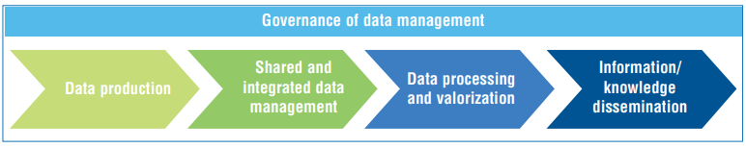
6.1 Data governance and data management
Examples of data governance in other sectors
Can we adapt data governance system from other sectors?
e.g., water data governance system includes legislative texts, strategies and procedures for inter-institutional coordination and organization of a steering committee and specific working groups
SOURCE: INBO/UNESCO, 2018
7

Slide 8
Lecture 6.1 References
Solà-Morales, O., Sigurðardóttir, K., Akehurst, R., Murphy, L.A., Mestre-Ferrandiz, J., Cunningham, D., de Pouvourville, G., 2023. Data Governance for Real-World Data Management: A Proposal for a Checklist to Support Decision Making. Value Health 26(4S):32–42 https://doi.org/10.1016/j.jval.2023.02.012
Al-Ruithe, M., Elhadj Benkhelifa, Khawar Hameed., 2019. A Conceptual Framework for Designing Data Governance for Cloud Computing. Procedia Computer Science 94, 160-167 https://doi.org/10.1016/j.procs.2016.08.025
Tableau, 2023. Data Management vs. Data Governance: The Difference Explained
https://www.tableau.com/learn/articles/data-management-vs-data-governance
INBO/UNESCO, 2018. Handbook of Water Information Systems: Administration, Processing and Exploitation of Water-Related Data https://www.riob.org/en/documents/handbook-water-information-systems-administration-processing-and-exploitation-water
Mini Lecture Learning Objective
8

Slide 9
6.2 Data Governance in the Energy Sector
Designing an Effective Data Governance Strategy
The precise data governance structure in place can vary considerably according to context, but the following principles should guide the strategy:
  Strategy should match intended use of data
  Executive leadership should be involved in process, and data governance strategy should be integrated across projects
  Data governance should reflect the availability capacity of the organization, with subject experts involved in validation
  Data governance should include consultation with data providers
  Detailed metadata should be recorded for each dataset
  Data should be open-access by default, with exceptions where explicitly justified
9

Slide 10
6.2 Data Governance in the Energy Sector
Designing an Effective Data Governance Strategy
Aspects of data governance which should be included in the strategy are:
  Data sourcing/scoping
  Validation of datasets
  Frequency of data updates
  Security and access levels of different datasets
  Attribution and documentation of metadata
10

Slide 11
6.2 Data Governance in the Energy Sector
Designing an Effective Data Governance Strategy
Data governance should involve all relevant stakeholders:
  Data users
  Data providers
  Data administrators/support team
  Executive leadership
  Subject area experts
11

Slide 12
6.2 Data Governance in the Energy Sector
Implementing an Effective Data Governance Strategy
A data management strategy is only as effective as its implementation
Best practices for implementing data governance:
  Identify qualified managers for data governance
  Hold recurring meetings and/or audits to ensure that strategy remains effective and on track
  Central repository for storing data and metadata
  Continued engagement with data users to ensure data align with use cases and needs
  Continued engagement with data providers to track new data releases and updates
12

Slide 13





6.2 Data Governance in the Energy Sector
Key Components of Energy Data Governance
 | 1. Data Availability Ensuring that relevant energy data is collected, maintained and made openly accessible to relevant stakeholders. Open access policies, alongside interoperable data platforms, can enhance availability and reduce institutional silos, enabling decision-makers to plan, finance, implement and monitor energy interventions more effectively.
 | 2. Data Quality The accuracy, consistency and completeness of energy data are critical for sound decision-making. Standardized data collection methodologies, robust validation protocols and periodic updates ensure that data remains reliable, providing an accurate representation and reflecting or capturing evolving energy needs and solutions.
 | 3. Data Ownership and Stewardship Energy data is generated by multiple stakeholders, including utilities, regulatory bodies, private sector actors and NGOs, raising complex questions around ownership and access rights. Lack of or ambiguities in data governance frameworks can impede cross-sector collaboration and lead to data hoarding. Clearly defining ownership roles — such as ministries overseeing national energy data repositories or utilities managing grid performance data — and establishing transparent stewardship mechanisms, can prevent such barriers and ensure equitable data access.
 | 4. Data Sharing and Collaboration Strong data governance enables integration across sectors, allowing energy strategies to align with broader development objectives, such as those in health, education and agriculture. In many countries, however, energy data remains siloed within government agencies or private entities due to regulatory constraints or commercial sensitivities. Establishing clear data-sharing agreements, interoperability standards and cross-sectoral working groups can mitigate these issues, ensuring that stakeholders coordinate and share insights effectively.
 | 5. Data Privacy and Security Protecting sensitive information, such as personal information and household-level energy consumption data, is crucial for maintaining public trust and complying with privacy regulations. A comprehensive data governance framework should incorporate encryption, anonymization and controlled-access measures to balance transparency with the need for security.
SOURCE: Mentis et.al, 2025
13

Slide 14
Lecture 6.2 References
Mentis, D., Ronoh, D., Saklani, A., Lecaros, S.S., Alemayehu, A., Khalid, A., and Anand, S. 2025. “Energy Access Explorer: Lessons Learned on Data Governance”. Washington, DC: World Resources Institute. Available online at: https://www.wri.org/technical-perspectives/energy-access-explorer-data-governance
Mini Lecture Learning Objective
14

Slide 15
6.3 Data Governance in Energy Access Explorer: Foundations
Data Governance in EAE – Guiding Principles
While specific approaches may vary by geography, the following principles always guide the development of the governance strategy:
  Impact: EAE should be developed to best support the country’s electrification/clean cooking strategy and development goals
  Quality: Data in EAE should undergo rigorous evaluation, include detailed documentation, and present data in an easy-to-use format
  Ownership: local ownership is critical for ensuring long-term sustainability, integration with national policy goals, and engaging key stakeholders in each country
  Adaptability: there is no one-size-fits-all solution, and both the data included and data governance strategies should reflect local needs
15

Slide 16
6.3 Data Governance in Energy Access Explorer: Foundations
EAE Data Standards
In our technical note, we outline standards for ensuring data quality and documentation in EAE:
  Credibility: data should come from a credible source (peer reviewed and/or comprehensively cited) with clearly defined methodology
  Metadata: dataset should include detailed metadata documentation
  Accessibility: data are in a usable format for GIS applications
  Spatial Coverage: data offer complete coverage for target geography
  Spatial Resolution: data are in the highest available resolution for the data type
  Timeliness: data are recent enough for reliable use—ideally no more than 5 years old
  Public License: data are released to the public, can be shared, and are available for download according to a Creative Commons (3.0 or 4.0) or Open License
16

Slide 17
6.4 Data Governance in Energy Access Explorer: Implementation
Data Lifecycle in EAE
Before covering specific approaches to data governance in EAE, let’s review the lifecycle of data integration into the platform:
  Identify key stakeholders and their strategic objectives
  Scope relevant datasets and tools available to support goals
  Validate dataset contents to ensure quality and completeness
  Present prospective data list to stakeholders for feedback
  Modify and format dataset as needed
  Upload to EAE backend data repository
  Document complete metadata
  Configure settings to support use cases in EAE
  Update as new data become available, or user needs evolve
17

Slide 18
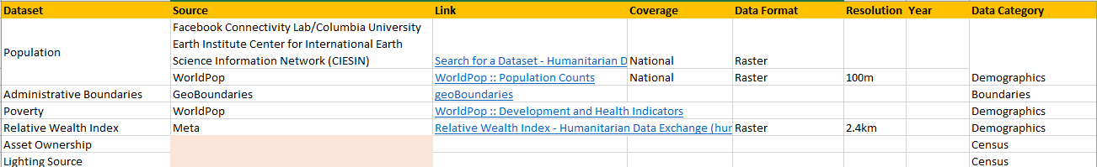
6.4 Data Governance in Energy Access Explorer: Implementation
Data Governance in EAE – Data Wish List
The first phase of the data governance strategy for EAE involves creating a data wish list. The wish list is intended to:
  List high-priority datasets for inclusion on the EAE platform
  Review existing data sources for quality and completeness
  Document potential sources and record detailed metadata
  Track progress of data uploads in EAE
  Identify data gaps where important data are missing or incomplete
18

Slide 19
6.4 Data Governance in Energy Access Explorer: Implementation
Data Governance in EAE – Working Groups
A focal point of long-term data governance is the formation of EAE Working Groups, which are organized for the following purposes:
  Convene relevant stakeholders: data users, providers, administrators, and subject area experts
  Coordinate long-term partnerships with key stakeholders to support long-term engagement and optimization to suit their needs
  Communicate progress to date and upcoming updates
  Gather feedback on the platform to date and prioritize data requests
  Engage in peer learning to integrate successful practice from other EAE geographies to maximize impact and improve user experience
  Leverage participant expertise in non-energy sectors to link energy initiatives to broader socio-economic development goals
  Inform the design of relevant energy strategies
19

Slide 20
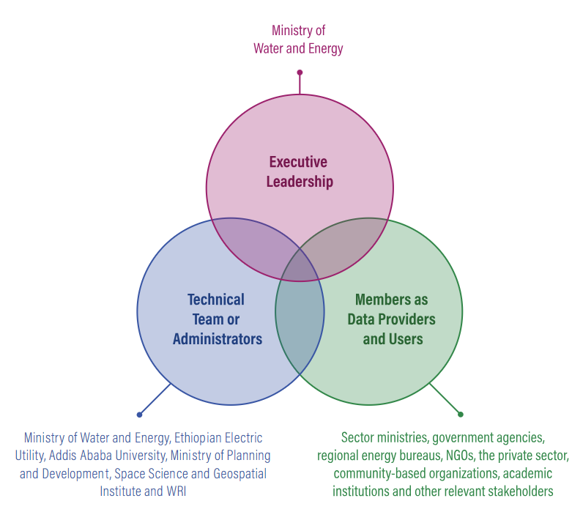
6.4 Data Governance in Energy Access Explorer: Implementation
Example of EAE Working Group from Ethiopia
Shown for the purpose of facilitating the activities of the working group, does not reflect any existing organizational or administrative structures
SOURCE: Mentis et.al, 2025
20

Slide 21
6.4 Data Governance in Energy Access Explorer: Implementation
Data Governance in EAE – Capacity Building
Effective data governance requires technical capacity among data administrators. EAE features a robust capacity building strategy among its governance priorities.
  Review key objectives and relationships between EAE and broader planning objectives
  Reinforce critical GIS concepts and workflows for processing EAE data
  Introduce EAE front-end and back-end infrastructure
  Practice with hands-on exercises to ensure readiness
21

Slide 22
6.4 Data Governance in Energy Access Explorer: Implementation
Data Governance in EAE – User Access, Roles, and Security
While Energy Access Explorer takes pride in being an open-source solution, we understand that datasets may be sensitive or proprietary in nature.
  To accommodate this, EAE includes a user management system in the backend of the application.
  User management is an integral part of the data governance strategy
22

Slide 23
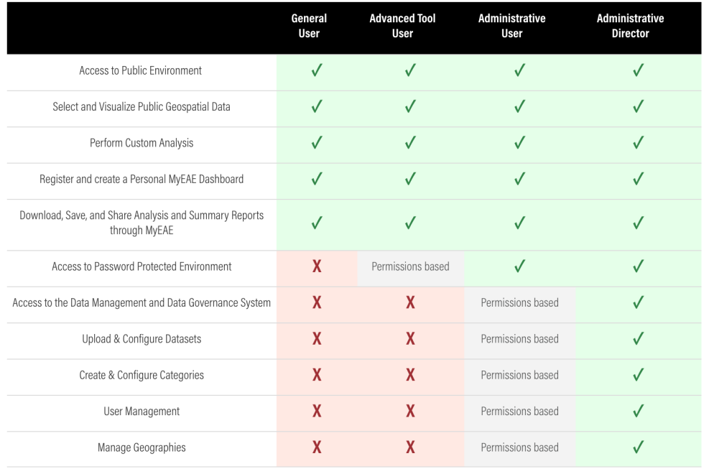
6.4 Data Governance in Energy Access Explorer: Implementation
Data Governance in EAE – User Access, Roles, and Security
SOURCE: Mentis et.al, 2025
23

Slide 24
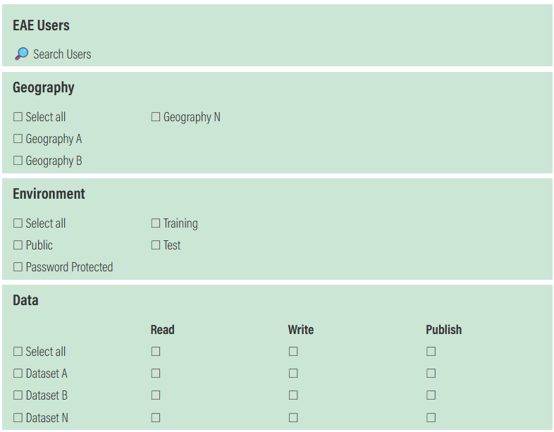
6.4 Data Governance in Energy Access Explorer: Implementation
EAE Data Governance Flow
SOURCE: Mentis et.al, 2025
24

Slide 25
Lecture 6.4 References
Mentis, D., Ronoh, D., Saklani, A., Lecaros, S.S., Alemayehu, A., Khalid, A., and Anand, S. 2025. “Energy Access Explorer: Lessons Learned on Data Governance”. Washington, DC: World Resources Institute. Available online at: https://www.wri.org/technical-perspectives/energy-access-explorer-data-governance
Mini Lecture Learning Objective
25

Slide 26
Thank you
www.climatecompatiblegrowth.com
Supported by and in collaboration with
World Resources Institute
Consolidated by Alemayehu Agizew Woldeamanuel, Abdul Khalid, Shikha Anand, Tarannum Sahar, Akansha Saklani, Santiago Sinclair-Lecaros, Dimitris Mentis, Douglas Ronoh and Jake Stockman from the World Resources Institute
Woldeamanuel, A. A., Khalid, A., Anand, S., Sahar, T., Saklani, A., Sinclair-Lecaros, S., Mentis, D., Ronoh, D., & Stockman, J., 2026.
Lecture 6: Data Governance and Sustainability. Release Version 3.0
[online presentation]. Climate Compatible Growth Programme, World Resource Institute

