Slide 1


Maximum 32 point Arial in white
LECTURE 5
ENERGY ACCESS EXPLORER BACK-END
Supported by and in collaboration with World Resources Institute
Notes:
License:
This work is licensed under the Creative Commons Attribution 4.0 International License (CC BY 4.0). To view a copy of this license, visit https://creativecommons.org/licenses/by/4.0/.
Attribution:
Please cite as: Woldeamanuel, A. A., Khalid, A., Anand, S., Sahar, T., Saklani, A., Sinclair-Lecaros, S., Mentis, D., Ronoh, D., & Stockman, J., 2026. Data Driven, Integrated and Inclusive Energy Planning with Energy Access Explorer. Version 1. Climate Compatible Growth Teaching Kit Website, Climate Compatible Growth.

Slide 2
Learning Outcomes
By the end of this lecture, you will:
ILO1: Understand the structure of EAE’s backend
ILO2: List the key functionalities of EAE’s backend
ILO3: Explore the Content Management System
ILO4: Integrate and configure data in the Content Management System
2
Notes:
This lecture has four Intended Learning Outcomes. After this lecture you will:
Understand the structure of EAE’s backend
List the key functionalities of EAE’s backend
Explore the Content Management System
Integrate and configure data in the Content Management System

Slide 3
5.1 Component of EAE’s back-end architecture
Introduction
EAE is a dynamic geographic information system, with an open source, adaptable web-architecture.
Its unique backend infrastructure comes with an easy to navigate Content Management System and allows administrative users with limited or no GIS and programming expertise to add data and metadata in a simple manner.
SOURCE: EAE
3
Notes:
Beyond its visualization and analytical capabilities, EAE functions as a dynamic geographic information system and data repository which reduces software engineering and data transaction costs for both data providers and users. Its unique backend infrastructure comes with an easy to navigate Content Management System and allows administrative users with limited or no GIS and programming expertise to add data and metadata in a simple manner.

Slide 4
5.1 Component of EAE’s back-end architecture
Programming languages used to develop EAE
Repositories​ | Function​ | Languages​
Admin​ | frontend code for the platform's admin panel.​ | Javascript, HTML, CSS​
Tool​ | Source code for the primary visualization/analytics of the platform​ | Javascript, Mustache, HTML, CSS​ ​
Website​ | This repository contains a template/view way of building the EAE website.​ | Javascript, Mustache, HTML, CSS​ ​
Paver​ | Paver is the EAE's backend for processing the geolocated data needed for EAE​ | Go​
Database​ | This is the SQL (PostgreSQL) code for the platform's database.​ | SQL​
API​ | The API is delegated PostgREST.​ | Makefile​
Offroad​ | Offline version of EAE ​ | Go, Shell​
Gdal​ | The gdal.go package provides a go wrapper for GDAL, the Geospatial Data Abstraction Library​ | Go, C ​
4

Slide 5
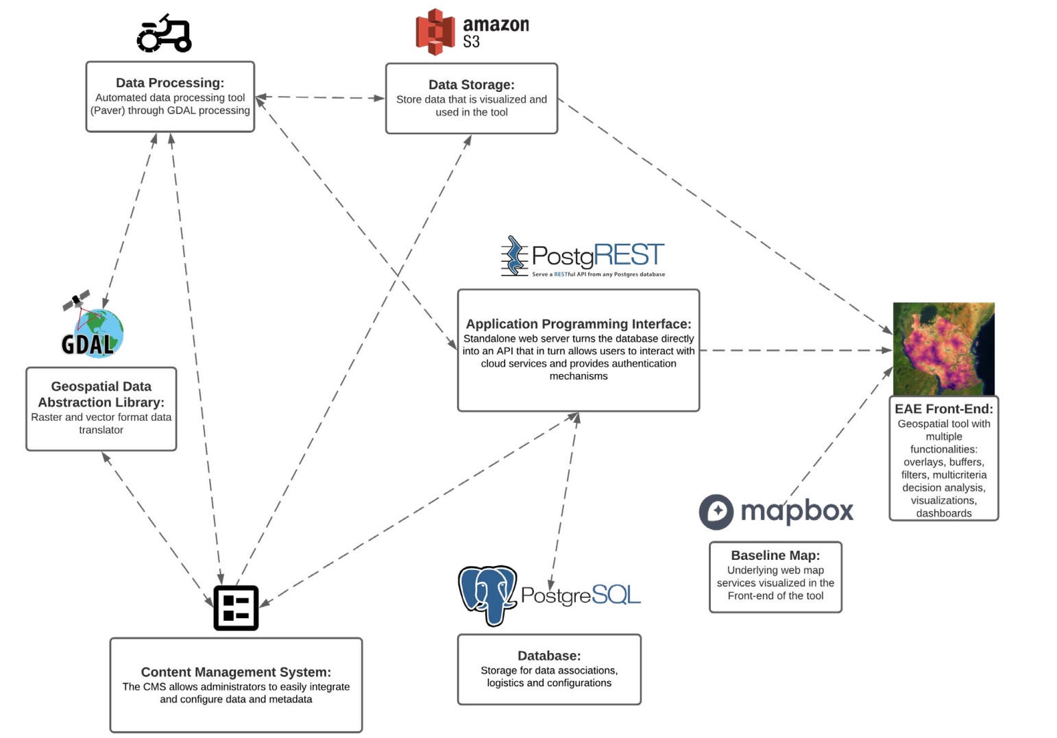
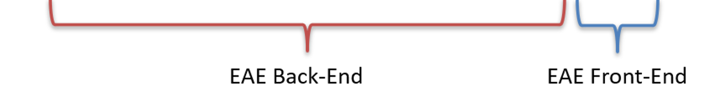
5.1 Component of EAE’s back-end architecture
Automated Data Processing
EAE’s backend infrastructure provides automated data processing to minimizes resource requirements when it comes to harmonizing and integrating new data.
5
Notes:
EAE’s backend infrastructure provides automated data processing to minimizes resource requirements when it comes to harmonizing and integrating new data.

Slide 6
5.1 Component of EAE’s back-end architecture
Data Storage and Dynamic Database
EAE’s backend infrastructure provides dynamic database and efficient data storage to optimize data transaction and configurations.
6
Notes:
EAE’s backend infrastructure provides dynamic database and efficient data storage to optimize data transaction and configurations.

Slide 7
5.1 Component of EAE’s back-end architecture
Customized Content Management System
EAE’s backend infrastructure provides customized content management System which allows admin users to better process, store, manage and
update EAE in a cost-effective manner
7
Notes:
EAE’s backend infrastructure provides customized content management System which allows admin users to better process, store, manage and
update EAE in a cost-effective manner

Slide 8
5.1 Component of EAE’s back-end architecture
Modular Application Programming Interface (API)
EAE’s backend infrastructure provides modular API that connects the backend of the application with the front-end and enables users to generate
rapid, high-resolution visualizations and prioritization analysis on-the-fly.
8
Notes:
EAE’s backend infrastructure provides modular API that connects the backend of the application with the front-end and enables users to generate
rapid, high resolution visualizations and prioritization analysis on-the-fly.

Slide 9
5.1 Component of EAE’s back-end architecture
Baseline Maps
EAE’s backend infrastructure provides a variety of Baseline Maps including names of places, satellite imagery and other.
9
Notes:
EAE’s backend infrastructure provides a variety of Baseline Maps including names of places, satellite imagery and other.

Slide 10
5.2 Functionalities of EAE’s back-end
Key Functionalities:
User friendly interface
Ability to add data in different resolutions, types, formats
Ability to add metadata
Modify visualizations/ symbology
Categorize and organize data
Automated data processing
Enable searchability of data
Sorting of data
Dynamic database
Efficient data storage
Last update feature
Staging site for testing
Link with AWS
Link to other cloud services
A modular API – connects back end and front end
Add new multi-criteria analysis defined by administrators
SOURCE: EAE
10
Notes:
The EAE back-end comprises a range of essential functionalities designed to empower users. Its intuitive interface ensures user-friendliness, while offering the flexibility to incorporate data in various resolutions, types, and formats. The inclusion of metadata enhances data context, while dynamic visualization modification and symbology adjustments cater to individual preferences. Efficient categorization and organization of data are facilitated, along with seamless automated data processing and robust search capabilities. The system enables effortless data sorting, backed by a dynamic database for optimal performance. With efficient data storage and a convenient last update feature, users can track when changes are made. A dedicated staging site supports rigorous testing, while seamless integration with AWS and other cloud services ensures comprehensive functionality. A modular API bridges the gap between the back-end and front-end, facilitating smooth communication. Furthermore, administrators can introduce new multi-criteria analyses to enhance decision-making capabilities.

Slide 11
5.2 Functionalities of EAE’s back-end
EAE Environments
EAE has multiple environments: Public, Protected, Training, and Testing.
Public Environment refers to the public-facing tool that can be accessed by anyone
Protected, Training, and Testing Environments are the password-protected version and only viewable with login credentials.
SOURCE: EAE
11

Slide 12
5.2 Functionalities of EAE’s back-end
Protected, Training, and Testing Environments
The purpose of the Protected Environment is to host sensitive data that cannot be available publicly but are ready to use with login access.
The purpose of the Testing Environment is to test functionality before rolling the features and data out to the public
The purpose of the Training Environment is for EAE back-end capacity building for new data administrators
SOURCE: EAE
12

Slide 13
5.3 Content Management System Interface
Customized Content Management System
Customized Content Management System (CMS) allows admin users to better process, store, manage and update EAE in a cost-effective manner
CMS has three parts:
Category
Geography
Datasets
13

Slide 14
5.3 Content Management System Interface
CMS: Category
Categories contain configuration settings for datasets that are shared across geographies, giving the EAE a consistent look and feel.
An example would be ‘wind speed,’ which comes from the same data source for each geography and shares the same default configuration settings for each. An instance of the ‘wind speed’ category exists in each geography for which that data is available in the EAE
14

Slide 15
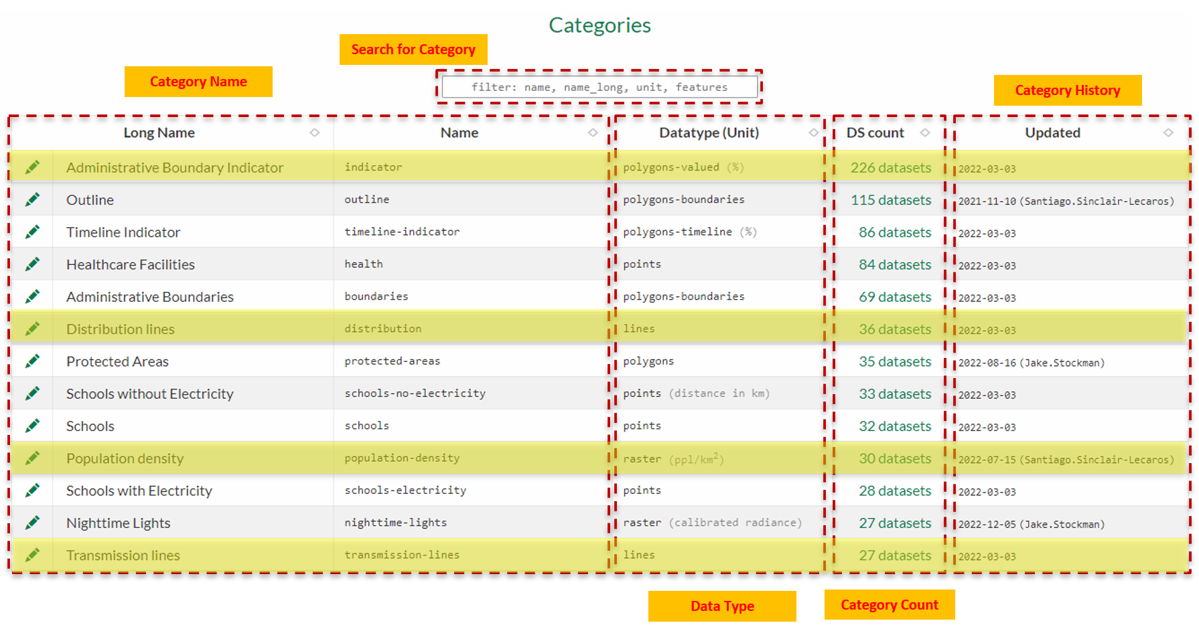
5.3 Content Management System Interface
CMS: Category
15

Slide 16
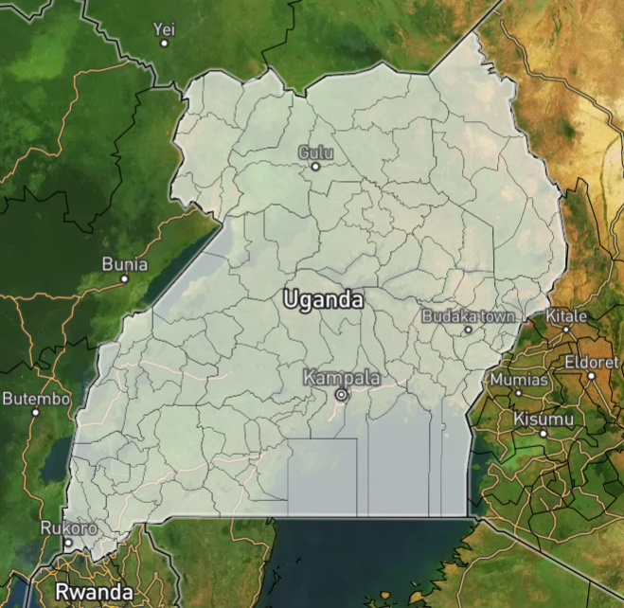
5.3 Content Management System Interface
CMS: Geography
Geographies correspond to national and/or subnational boundaries (i.e. province, county, district, etc.) and contain unique instances of a category record for every dataset displayed in the EAE for that geography.
Country Outline – Admin level 0
Region boundary – Admin level 1
County boundary – Admin level 2
SOURCE: EAE
16

Slide 17
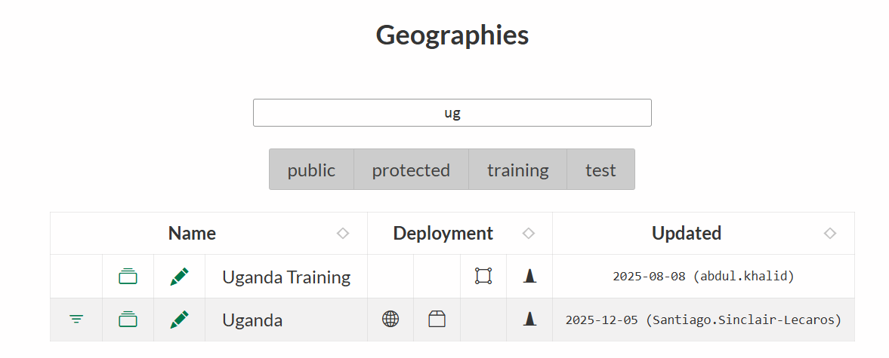
5.3 Content Management System Interface
CMS: Geography
Search for Geography
Geography Name/Code
Environments
Geography History
17

Slide 18
5.3 Content Management System Interface
CMS: Datasets
Each dataset in the EAE is associated with a Geography and a Category record.
EAE aggregates geospatial data related to both energy demand and supply.
Data on demographics and the social and productive uses of electricity are used to represent current and potential demand
Data on energy resource availability and infrastructure are used to visualize current and potential supply.
18

Slide 19
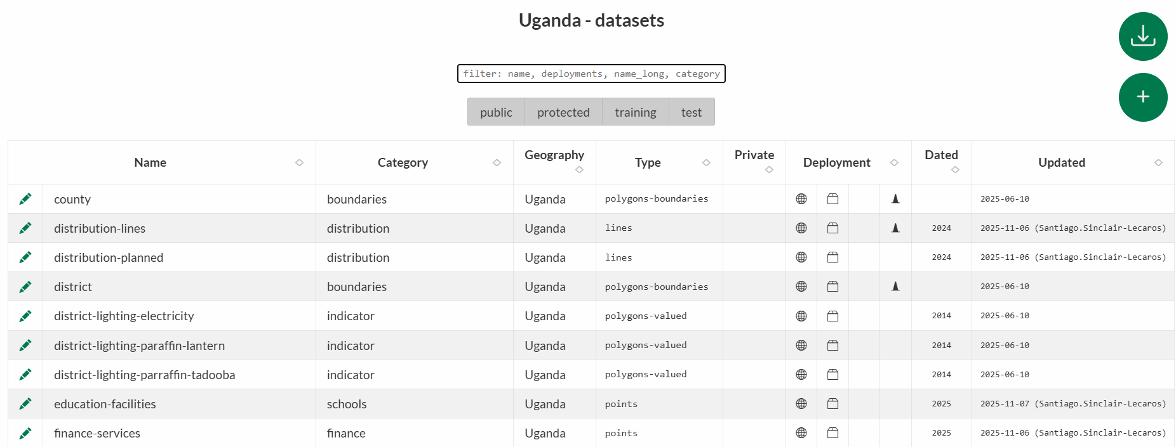
5.3 Content Management System Interface
CMS: Datasets
Search for Dataset
Dataset Name
Dataset Category
Dataset Type
Environment
Dataset History
19

Slide 20
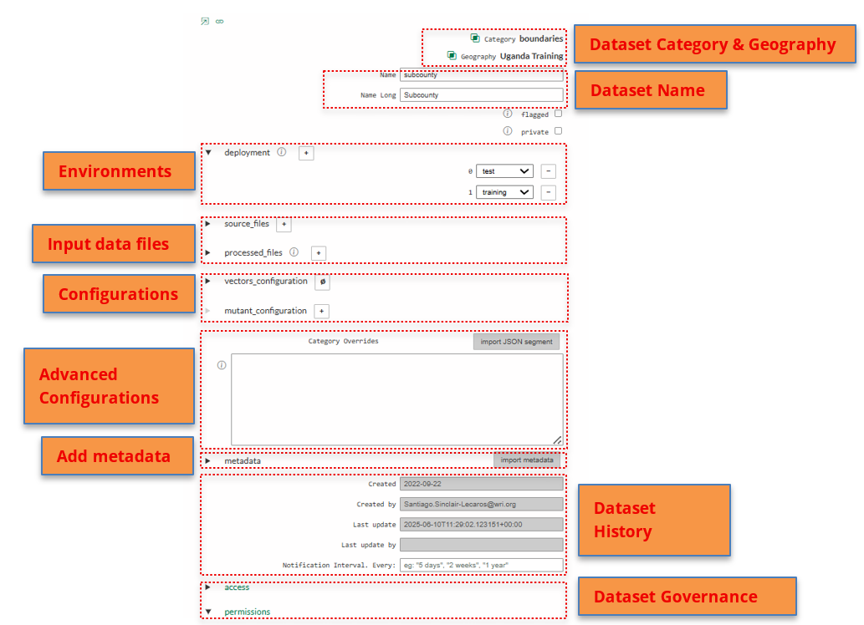
5.3 Content Management System Interface
CMS: Datasets
20

Slide 21
5.3 Content Management System Interface
CMS: Data Storage
Files used in the EAE are stored in a separate S3 cloud location, which is currently hosted through WRI’s Amazon Web Services and can be accessed through the free AWS Cloudberry desktop application.
Though we use the S3 cloud hosting platform at present, EAE is designed to flexibly interact with local servers or other cloud services according to the administrator’s requirements. To access and write files on the S3 platform, users will first require permission to access the shared folders.
Backend users can also opt to upload data directly from their PCs without first storing the data on the Cloudberry platform. But each file size should not exceed 15MB, usually preferable to use a smaller file size.
21

Slide 22
5.4 Integrate and Configure Data in the CMS
Dataset creation in EAE
22

Slide 23


5.4 Integrate and Configure Data in the CMS
Automated data processing: Paver
Paver is a tool that automates several geoprocessing functions to ensure that datasets correctly match EAE data specifications
  Geographic Projections
  Data Extent/Clipping
  Resolution/Unit Conversion
Paver significantly reduces the need for GIS and programming expertise in EAE data administration, making the tool accessible to a wider audience
SOURCE: EAE
23

Slide 24
5.4 Integrate and Configure Data in the CMS
Troubleshooting best practices
Test each dataset in the protected/training environment before proceeding to the next
Note the type of error, when/where it appears, and record the pop-up error message (if applicable)
If the error is fatal (prevents users from accessing the platform), make sure to remove staging deployment until you’ve addressed the problem
SOURCE: EAE
24

Slide 25
Thank you
www.climatecompatiblegrowth.com
Supported by and in collaboration with
World Resources Institute
Consolidated by Alemayehu Agizew Woldeamanuel, Abdul Khalid, Shikha Anand, Tarannum Sahar, Akansha Saklani, Santiago Sinclair-Lecaros, Dimitris Mentis, Douglas Ronoh and Jake Stockman from the World Resources Institute
Woldeamanuel, A. A., Khalid, A., Anand, S., Sahar, T., Saklani, A., Sinclair-Lecaros, S., Mentis, D., Ronoh, D., & Stockman, J., 2026.
Lecture 5: Energy Access Explorer Back-end. Release Version 3.0
[online presentation]. Climate Compatible Growth Programme, World Resource Institute

