Slide 1


Maximum 32 point Arial in white
LECTURE 4
ENERGY ACCESS EXPLORER FRONT-END
Supported by and in collaboration with World Resources Institute
Notes:
License:
This work is licensed under the Creative Commons Attribution 4.0 International License (CC BY 4.0). To view a copy of this license, visit https://creativecommons.org/licenses/by/4.0/.
Attribution:
Please cite as: Woldeamanuel, A. A., Khalid, A., Anand, S., Sahar, T., Saklani, A., Sinclair-Lecaros, S., Mentis, D., Ronoh, D., & Stockman, J., 2026. Data Driven, Integrated and Inclusive Energy Planning with Energy Access Explorer. Version 1. Climate Compatible Growth Teaching Kit Website, Climate Compatible Growth.

Slide 2
Learning Outcomes
By the end of this lecture, you will:
ILO1: Differentiate the key functions of the EAE front-end
ILO2: Explore the categories, layers and features of the data
ILO3: Conduct multi-criteria analysis based on different scenarios
ILO4: Export the analysis results for generating reports and presentations
2
Notes:
This lecture has four Intended Learning Outcomes. By the end of this lecture, you will:
​
Differentiate the key functions of the EAE front-end
Explore the categories, layers and features of the data
Identify the analytical indices and results of EAE
Make multi-criteria analysis based on different scenarios
​
These learning outcomes will be important to understand the context of the course.

Slide 3
4.1 EAE Front-End Interface
Introduction
The EAE front-end interface allows users to visualize and carry out multi-criteria spatial analysis with user-selected datasets on energy demand and supply to generate high priority areas for energy access interventions.
For EAE's front-end applications, users do not require any prior GIS or programming expertise. Anyone can use it!
3
Notes:
Beyond its visualization and analytical capabilities, EAE functions as a dynamic geographic information system and data repository which reduces software engineering and data transaction costs for both data providers and users. Its unique backend infrastructure comes with an easy to navigate Content Management System and allows administrative users with limited or no GIS and programming expertise to add data and metadata in a simple manner.

Slide 4
4.1 EAE Front-End Interface
Key Functionalities:
Select and visualize geospatial data
User friendly interface
Overlay data
Apply queries, filters and buffers
High resolution multi-criteria analysis
Map high-priority areas
View on desktop and mobile phone internet browsers
Customizable base maps (e.g., satellite, light, dark plus labels)
View in a public version
View in a password protected version
Zoom-in feature to select smaller administrative division and see custom versions of the app
Search for and summarize the top 20 locations in terms of the select indicators or the analytical outputs
Develop custom summary reports and dashboards
Search for coordinates or areas of interest
Save and download analysis
Visualize temporal data to track progress
4
Notes:
The EAE front-end comprises a range of essential functionalities designed to allow users ...

Slide 5
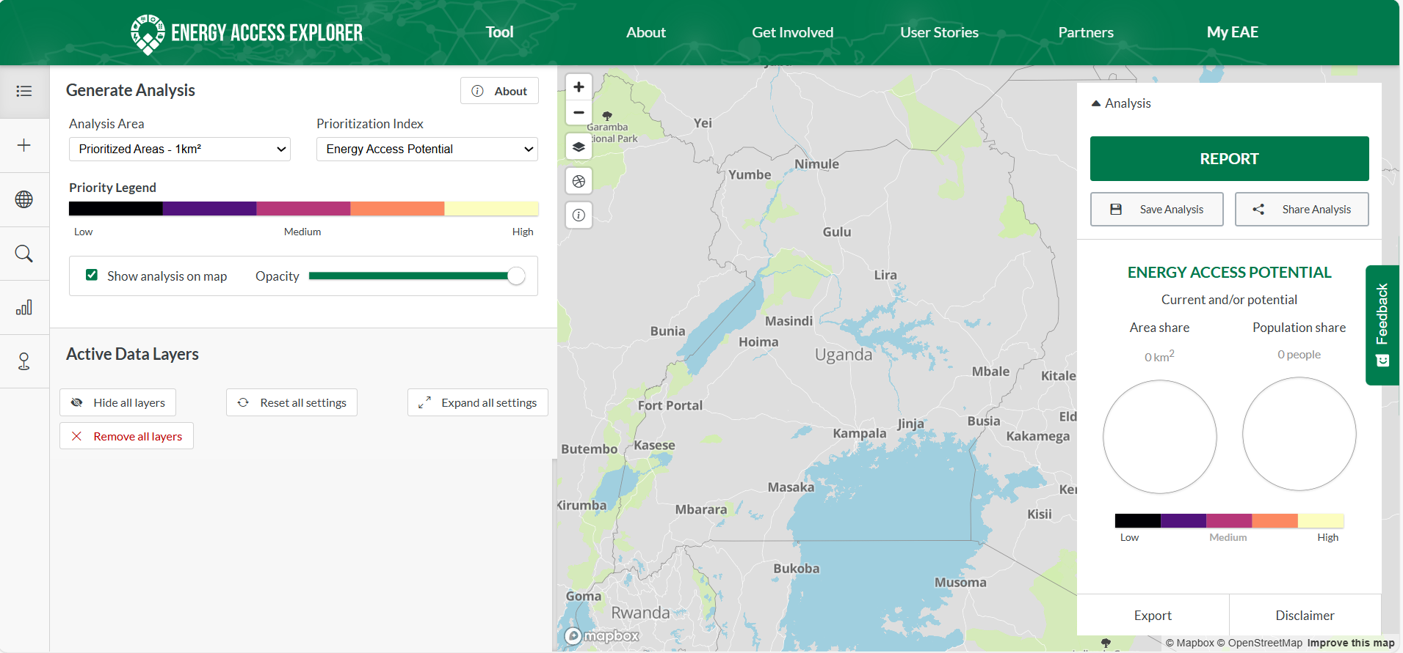

4.1 EAE Front-End Interface
Data & Features Menu
Log in to MyEAE
Map Functions​ Menu
Analysis & Results
5
Notes:
The EAE front-end comprises a range of essential functionalities designed to allow users ...

Slide 6
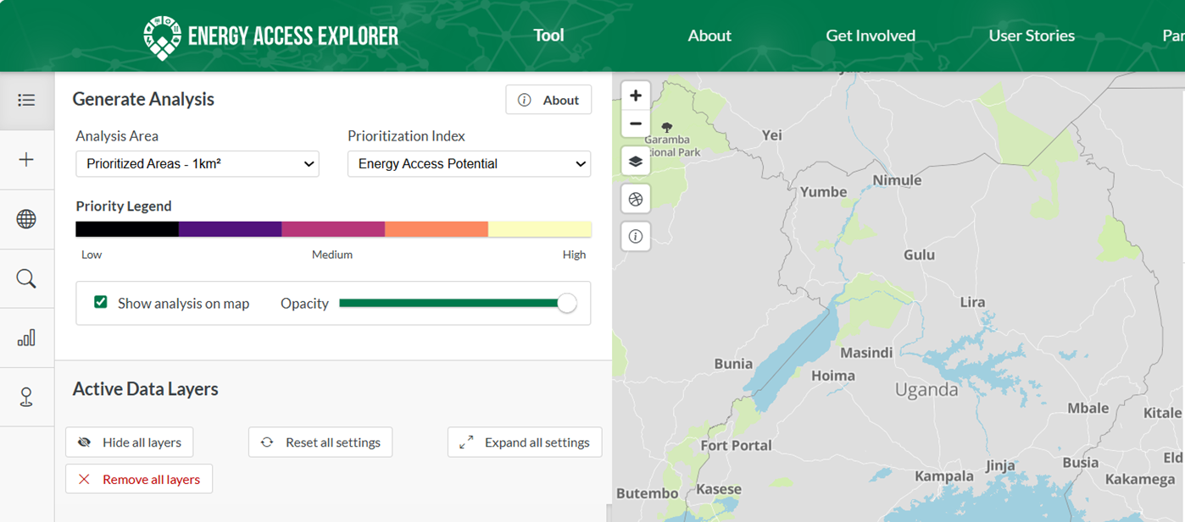
4.2 Data view
Data, features and map functions menu
Active Layers
Zoom in
Zoom out
Add Layers
Base map change
Map projection type
Change geographies
Activate information cursor
Search Features
Map Functions​ Menu
Top Locations
Search POI's
Data & Features Menu
6

Slide 7






4.2 Data view
EAE Features:
Active Layers
  View all currently selected layers; Change the order in which layers are displayed; Filter values & change the dataset’s weight in the analysis; Hide or remove all layers; Reset or expand all settings
Add Layers: select from available datasets in EAE
Change Geographies: select a particular subnational unit to focus your analysis
Search Features: search for a specific feature within a dataset
  Example: ‘Makerere University’ in Schools
  Note: not all datasets are searchable
Top Locations: provides a ranked list of the top 20 locations (sq km pixels) based on user-selected criteria
Search POIs: search for a point of interest (city/town, subnational division, national park) within the country
7
Notes:
The EAE front-end comprises a range of essential functionalities designed to allow users ...

Slide 8
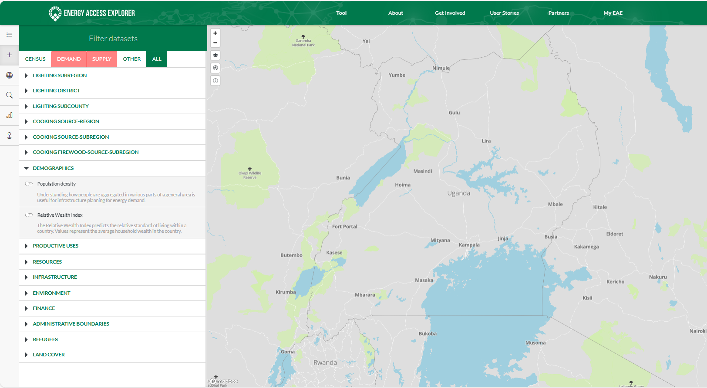
4.2 Data view
Data categories and subcategories
Data categories and subcategories
8
Notes:
The EAE front-end comprises

Slide 9
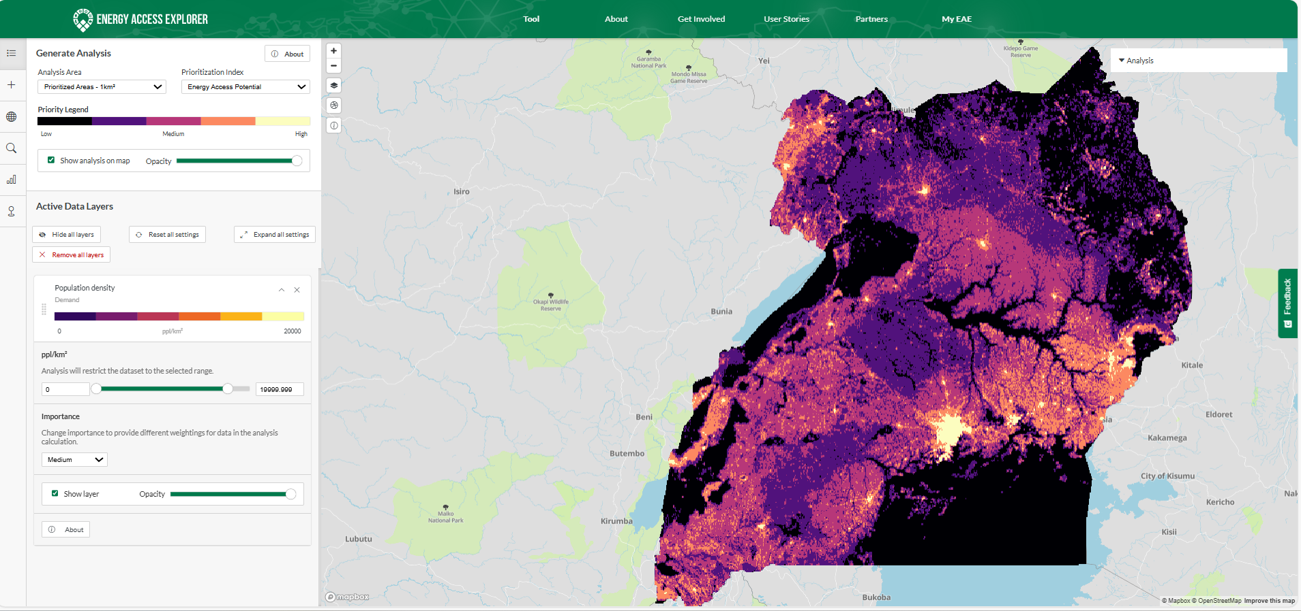
4.2 Data view
Active later
Generate analysis :
By analysis area & prioritization index
Priority area’s legend
Show analysis and adjust opacity
Active data layers:
Apply settings for all active layers
Layer’s legend
Adjust layer values
Adjust weighting
Show layer & adjust Opacity
About the dataset
9
Notes:
The EAE front-end comprises

Slide 10
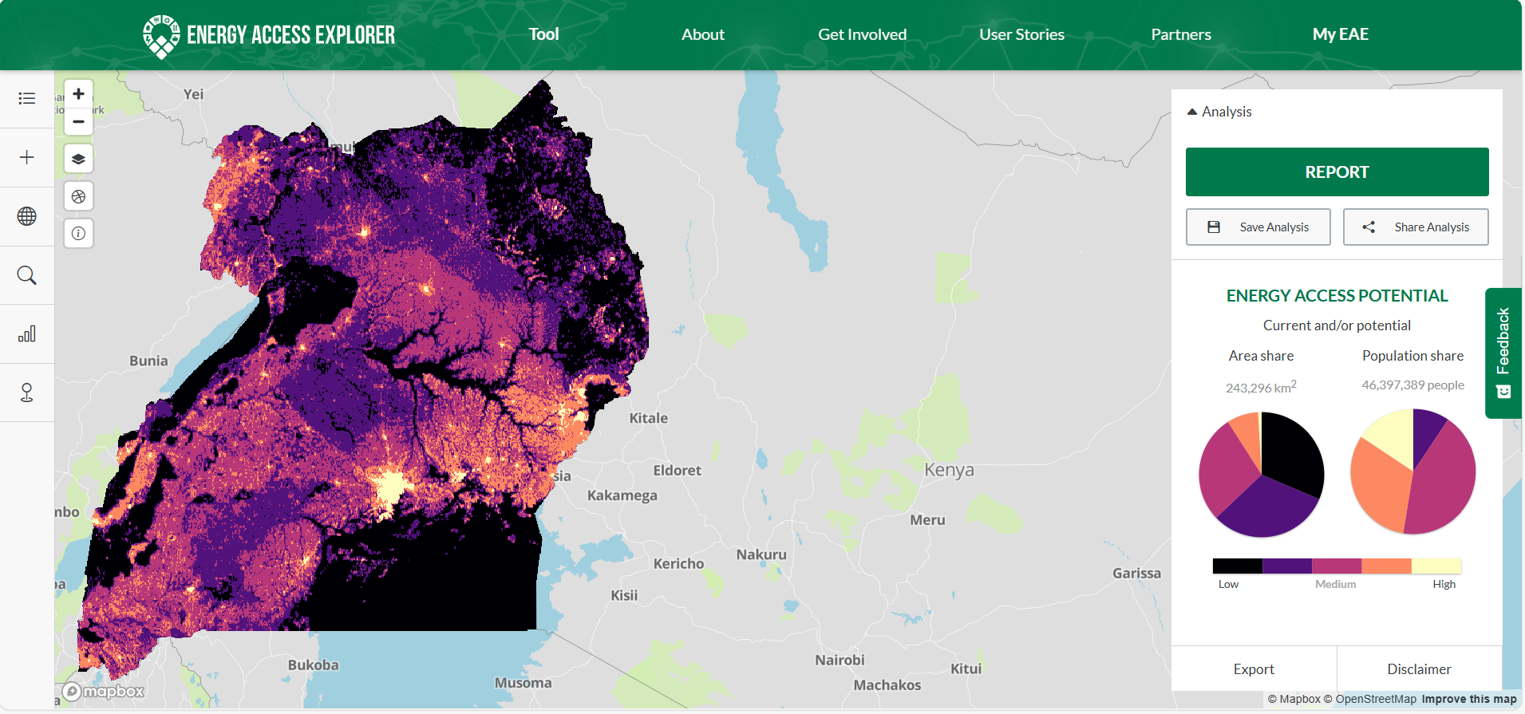
4.3 Analysis View
Analysis View
Generate summary reports
Save and Share the analysis
Analysis dashboard
10

Slide 11
4.3 Analysis View
Analytical Indices
There are 4 indices available in the analysis view:
  Energy Access Potential: areas with highest potential for electrification in the short-term, based on both supply and demand indicators; areas with high values on this index are the ‘low hanging fruits’
  Demand Index: focuses on demand indicators to identify where demand for energy services is highest
  Supply Index: focuses on supply indicators to identify sites with high potential for developing electricity generation
  Assistance Need Index: areas where demand and supply indicators are weaker, but where there is nevertheless an ongoing need for electrification; areas scoring high on the Assistance Need Index may require donor-supported interventions
  For more details on the analytical indices, please refer to Module 2.4
11

Slide 12
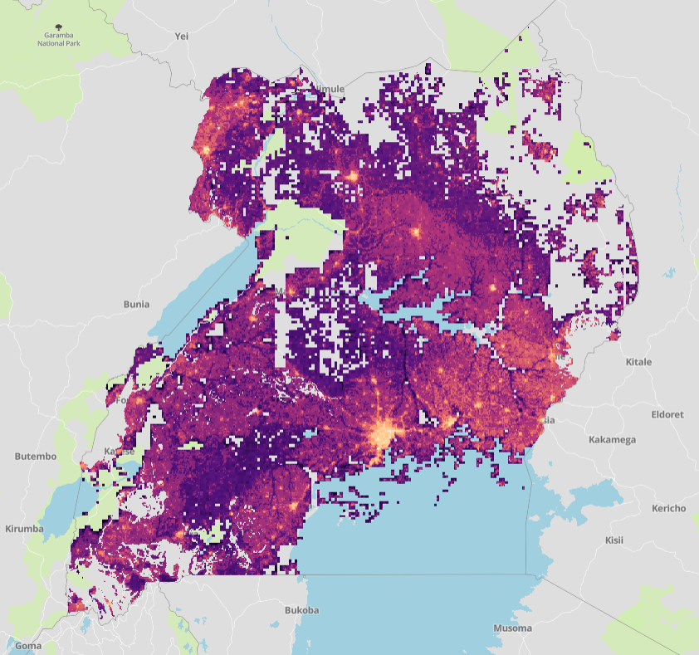
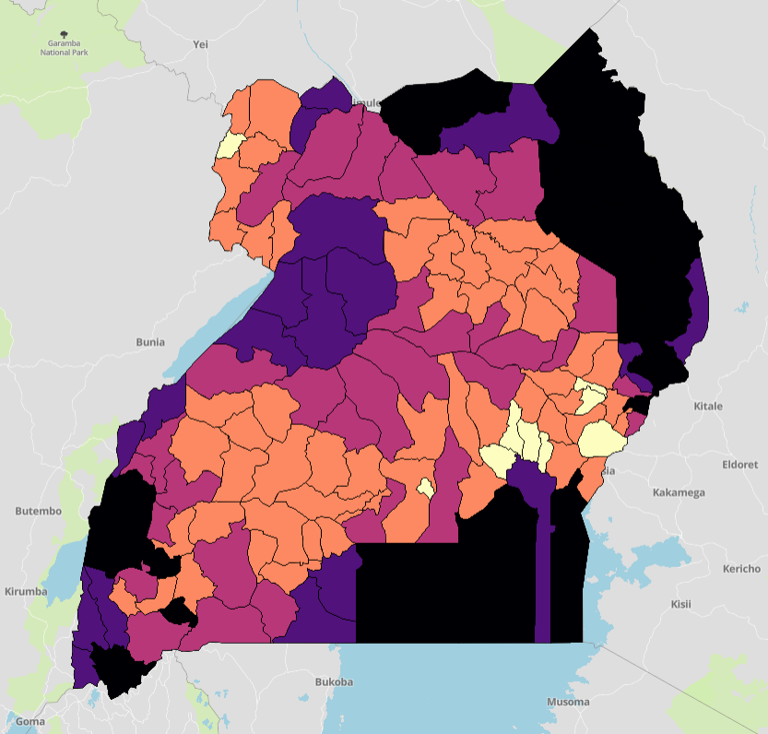
4.3 Analysis View
Unit of Analysis
The index scores generated by EAE can be presented at different scales:
  Raster Analysis: The default unit of analysis in Energy Access Explorer is Raster Analysis, which provides granular analysis down to the pixel level
  Administrative Priority: Summarizes results for subnational administrative divisions; available at different levels/tiers
12

Slide 13
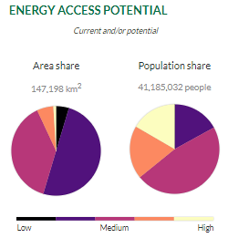
4.4 Applying EAE Analysis Results
High-Level Summaries
In addition to identifying key areas, EAE also calculates the area and population affected in the user’s custom analysis
These values are displayed in summary charts within the analysis view
More detailed results can be found in the Summary Report
13
Notes:
Source raster files may come in a higher resolution (finer pixel size) than what is supported in the Energy Access Explorer
Resampling the raster reduces the file size by adjusting the pixel size.
You may need to install the GRASS plugin to access r.resamp.stats

Slide 14
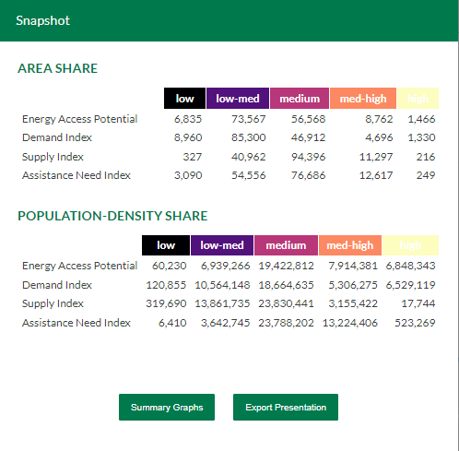
4.4 Applying EAE Analysis Results
Summary Reports
The Summary Report in EAE provides detailed information for all indices in both chart and table format
The report can be exported for use in reports and presentations
14

Slide 15
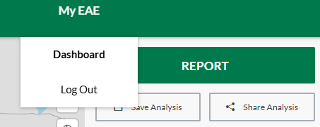
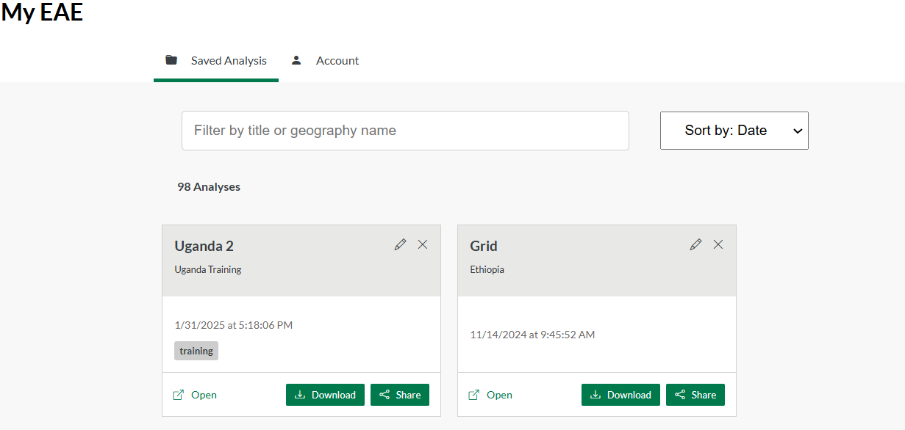
4.5 MyEAE Dashboard
MyEAE dashboard allows users to:
  Save their custom analyses and access these later from the ‘Saved Analysis’ folder
  Filter and sort the analyses by date and geography
  Share their analysis with others simply through the ‘Share’ button
  Download the analysis in other GIS formats (e.g.,JSON format)
  Change their password in the dashboard account setting
  Log Out from the platform
15

Slide 16
Thank you
www.climatecompatiblegrowth.com
Supported by and in collaboration with
World Resources Institute
Consolidated by Alemayehu Agizew Woldeamanuel, Abdul Khalid, Shikha Anand, Tarannum Sahar, Akansha Saklani, Santiago Sinclair-Lecaros, Dimitris Mentis, Douglas Ronoh and Jake Stockman from the World Resources Institute
Woldeamanuel, A. A., Khalid, A., Anand, S., Sahar, T., Saklani, A., Sinclair-Lecaros, S., Mentis, D., Ronoh, D., & Stockman, J., 2026.
Lecture 4: Energy Access Explorer Front-end. Release Version 3.0
[online presentation]. Climate Compatible Growth Programme, World Resource Institute

