Slide 1


Maximum 32 point Arial in white
LECTURE 3
KEY GIS CONCEPTS
Supported by and in collaboration with World Resources Institute
Notes:
License:
This work is licensed under the Creative Commons Attribution 4.0 International License (CC BY 4.0). To view a copy of this license, visit https://creativecommons.org/licenses/by/4.0/.
Attribution:
Please cite as: Woldeamanuel, A. A., Khalid, A., Anand, S., Sahar, T., Saklani, A., Sinclair-Lecaros, S., Mentis, D., Ronoh, D., & Stockman, J., 2026. Data Driven, Integrated and Inclusive Energy Planning with Energy Access Explorer. Version 1. Climate Compatible Growth Teaching Kit Website, Climate Compatible Growth.

Slide 2
Learning Outcomes
By the end of this lecture, you will:
ILO1: Understand the characteristics and uses of vector, raster, and tabular data types
ILO2: View, modify, and clean data attributes
ILO3: Adjust vector datasets to make them suitable for EAE backend uploading
ILO4: Perform pre-processing with raster datasets for easy uploading into EAE
2
Notes:
This lecture has four Intended Learning Outcomes. After this lecture you will:
​
Understand the characteristics and uses of vector, raster, and tabular data types in GIS
Be able to view, modify, and clean data attributes
Adjust coordinate reference systems for different data types
Perform standard geoprocessing functions to reduce upload file size
​
These learning outcomes will be important to understand the context of the course.

Slide 3
3.1 GIS Data Types & Formats
Geospatial Data Overview
Geospatial data captures information in relation to a particular geographic location
  The principal types of geospatial data are vector and raster
  Tabular data (e.g. spreadsheets) can be represented geospatially, if data values are linked to a location
Geospatial data usually includes both geometry and attributes
3
Notes:
Geospatial data refers to any data that is associated with a particular place or geographic feature. The principal types of geospatial data are vector and raster data. Tabular data (e.g. spreadsheets) can sometimes be geospatial, if data values are linked to a location. This might be a coordinate pair (longitude-latitude), or an administrative unit, like a province or municipality. Geospatial data usually includes both geometry (the shape on the map) and attributes (details or characteristics describing the mapped feature).

Slide 4
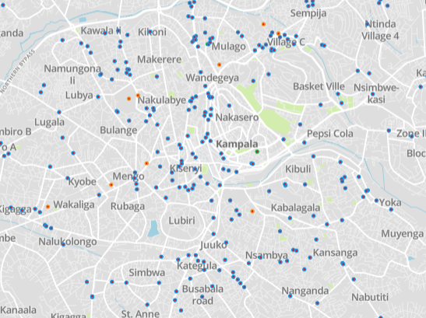
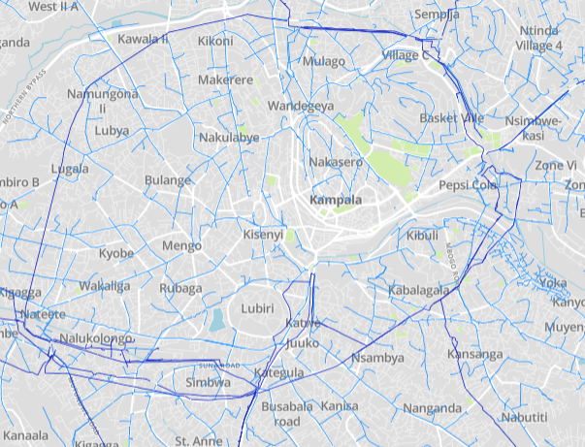
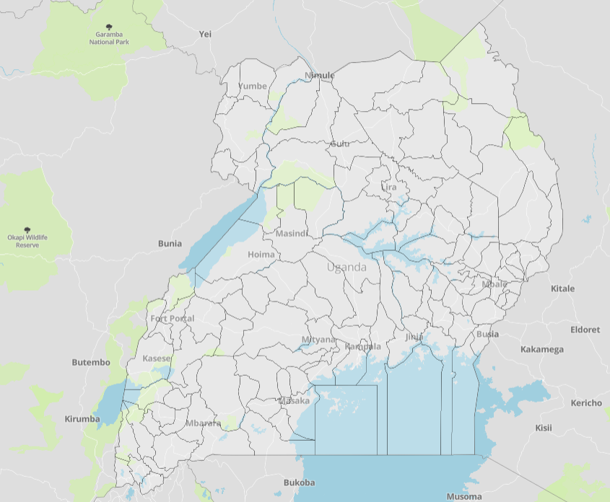
3.1 GIS Data Types & Formats
Vector Data
Vector Data refers to shapes—points, lines, and polygons—that represent discrete real-world features.
There are multiple formats that can be used to store vector data:
  Shapefile: most commonly used, requires additional files in a zip
  GeoJSON: efficient data storage, EAE preferred input format
4
Notes:
Vector Data refers to shapes—points, lines, and polygons—that represent discrete real-world features.
There are multiple formats (or file types) that can be used to store vector data:
Shapefile: probably the most common vector format; to use a shapefile, it will need to be stored in the same folder location with associated files (.shx, .dbf, .prj, .xml, .sbn) which help determine how it functions in GIS software
GeoJSON: GeoJSON is a lighter version that is comprised of a single file (it does not require associated configuration files, like a shapefile does), and offers efficient data storage which takes up less space. For this reason, GeoJSON files are preferred for web mapping applications, and are the required input format for vector data in Energy Access Explorer

Slide 5
3.1 GIS Data Types & Formats
Raster Data
Raster data refers to georeferenced ‘images’ containing pixels arranged in a grid
Each pixel has an associated data value
Pixels are uniform in size, known as the resolution of the raster (e.g. 1 km sq)
Rasters may show discrete or continuous data:
  In discrete rasters, the pixel values correspond with categories
    Example: land cover
  In continuous data rasters, pixels correspond with numerical values
    Example: population density, elevation
Remote sensing (e.g. satellite imaging) data is captured in raster format
It is easy to perform mathematical calculations with raster data
5
Notes:
Raster data refers to georeferenced ‘images’ containing pixels arranged in a grid
Each pixel has an associated data value
Pixels are uniform in size, known as the resolution of the raster (e.g. 1 km sq)
Rasters may show discrete or continuous data:
In discrete rasters, the pixel values correspond with categories
Example: land cover
In continuous data rasters, pixels correspond with numerical values
Example: population density, elevation
Remote sensing (e.g. satellite imaging) data is captured in raster format
It is easy to perform mathematical calculations with raster data

Slide 6
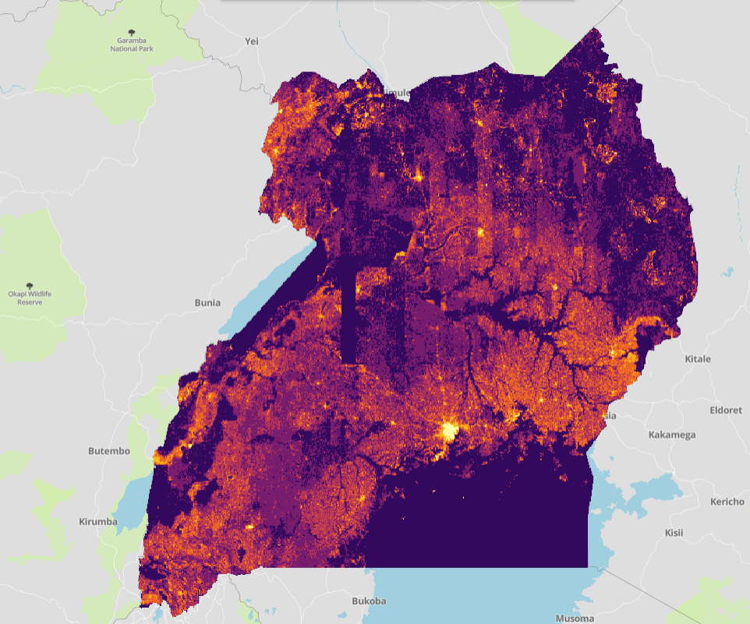
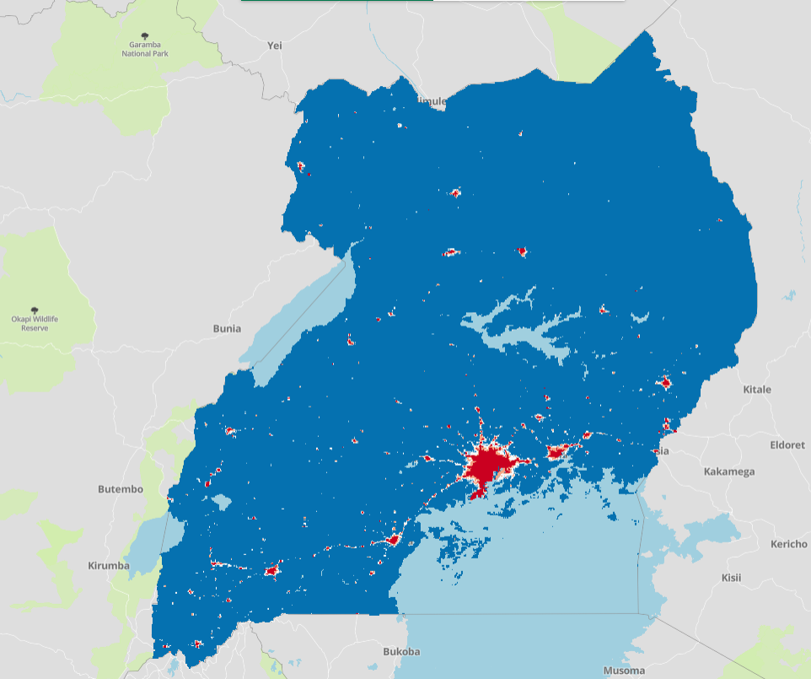
3.1 GIS Data Types & Formats
Raster Data - Examples
Population Density (Continuous) – Source: WorldPop, 2023
Consumption Tier (Discrete) – Source: Falchetta et al, 2018
6
Notes:
Raster data refers to georeferenced ‘images’ containing pixels arranged in a grid
Each pixel has an associated data value
Pixels are uniform in size, known as the resolution of the raster (e.g. 1 km sq)
Rasters may show discrete or continuous data:
In discrete rasters, the pixel values correspond with categories
Example: land cover
In continuous data rasters, pixels correspond with numerical values
Example: population density, elevation
Remote sensing (e.g. satellite imaging) data is captured in raster format
It is easy to perform mathematical calculations with raster data

Slide 7
3.1 GIS Data Types & Formats
Tabular Data Inputs
Tabular data refers to data tables arranged in rows and columns
This data type can be used in GIS if it includes georeferenced data columns
  Tabular data can be used in GIS platforms if it contains geospatial references:
    Coordinates: point data can be georeferenced using longitude-latitude coordinate pairs. Note that coordinates may be in either decimal degree or degree-minute-second format.
    Administrative Units: data values can be associated with national or subnational (province, state, or municipality) administrative units.
Common uses for tabular data in GIS include field observations (recorded as coordinates), and census data (at subnational level)
7
Notes:
Tabular data refers to data tables arranged in rows and columns
This data type can be used in GIS if it includes georeferenced data columns
Tabular data can be used in GIS platforms if it contains geospatial references:
Coordinates: point data can be georeferenced using longitude-latitude coordinate pairs. The latitude and longitude values should be recorded, as precisely as possible (including direction like E or W), and in a consistent format (decimal degrees is preferred), in labelled table columns.
Administrative Units: data values can be associated with national or subnational (province, state, or municipality) administrative units. The unique feature IDs associated with the vector polygons associated with each unit should be recorded in its own column.
Common uses for tabular data in GIS include field observations (recorded as coordinates), and census data (at subnational level)

Slide 8
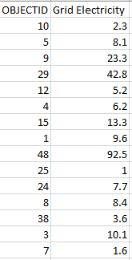
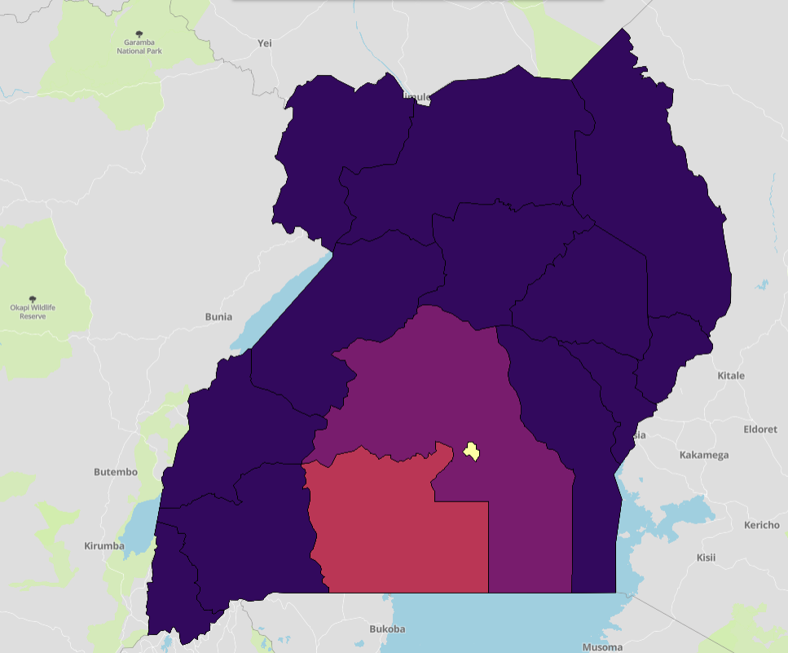
3.1 GIS Data Types & Formats
Tabular Data Example
Data Extract: Electric Lighting percent (Subregion) – Uganda Census
Visualization in Energy Access Explorer
8
Notes:
Tabular data refers to data tables arranged in rows and columns
This data type can be used in GIS if it includes georeferenced data columns
Tabular data can be used in GIS platforms if it contains geospatial references:
Coordinates: point data can be georeferenced using longitude-latitude coordinate pairs. The latitude and longitude values should be recorded, as precisely as possible (including direction like E or W), and in a consistent format (decimal degrees is preferred), in labelled table columns.
Administrative Units: data values can be associated with national or subnational (province, state, or municipality) administrative units. The unique feature IDs associated with the vector polygons associated with each unit should be recorded in its own column.
Common uses for tabular data in GIS include field observations (recorded as coordinates), and census data (at subnational level)

Slide 9
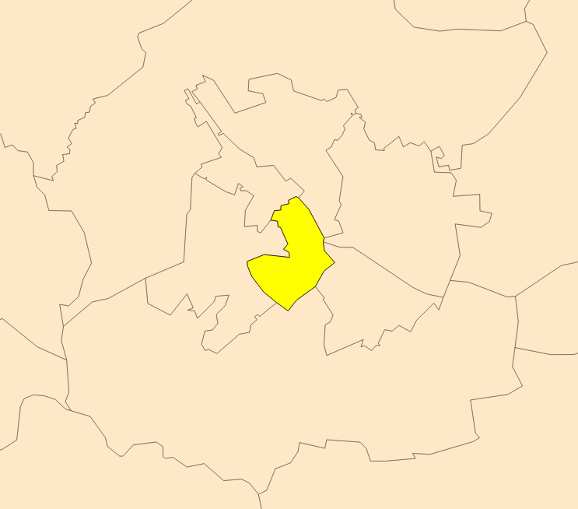
3.1 GIS Data Types & Formats
Geospatial Data Organization
Datasets are a group of features in the same geospatial format and saved to the same file
Features are discrete geospatial units within a dataset
Attributes are descriptive data linked to specific features in a dataset
Selected feature within a dataset
DATASET
(ex. Power Plants)
FEATURE 1
(Power Plant A)
Attribute I (Fuel Source)
Attribute II (Capacity)
Attribute III (Status)
FEATURE 2
(Power Plant B)
Attribute I (Fuel Source)
Attribute II (Capacity)
Attribute III (Status)
FEATURE 3
(Power Plant C)
Attribute I (Fuel Source)
Attribute II (Capacity)
Attribute III (Status)
9
Notes:
Tabular data refers to data tables arranged in rows and columns
This data type can be used in GIS if it includes georeferenced data columns
Tabular data can be used in GIS platforms if it contains geospatial references:
Coordinates: point data can be georeferenced using longitude-latitude coordinate pairs. The latitude and longitude values should be recorded, as precisely as possible (including direction like E or W), and in a consistent format (decimal degrees is preferred), in labelled table columns.
Administrative Units: data values can be associated with national or subnational (province, state, or municipality) administrative units. The unique feature IDs associated with the vector polygons associated with each unit should be recorded in its own column.
Common uses for tabular data in GIS include field observations (recorded as coordinates), and census data (at subnational level)

Slide 10
3.1 GIS Data Types & Formats
Geographic Projections
Map Projection refers to the method used to depict 3-dimension data (the earth’s surface) in a 2-dimensional representation (a map)
Projections are specified in GIS using a coordinate reference system (CRS)
Each CRS has a specified unit:
  Meters: A CRS denominated in meters can be useful for geoprocessing operations that require inputs in metric units
  Degrees: A CRS denominated in degrees provides more intuitive navigation for GIS users
10
Notes:
Map Projection refers to the method used to depict 3-dimension data (the earth’s surface) in a 2-dimensional representation (a map). A projection may preserve shape, or area, or some compromise of the two, however an exact replication of the 3-dimensional shapes in not possible, so the projection chosen will influence how data appears in GIS platforms.
Projections are specified in GIS using a coordinate reference system (CRS)
Each CRS has a specified unit:
Meters: A CRS denominated in meters can be useful for geoprocessing operations that require inputs in metric units
Degrees: A CRS denominated in degrees provides a better user experience in GIS platforms
- You may need to define or convert (reproject) your data to execute certain geoprocessing functions

Slide 11

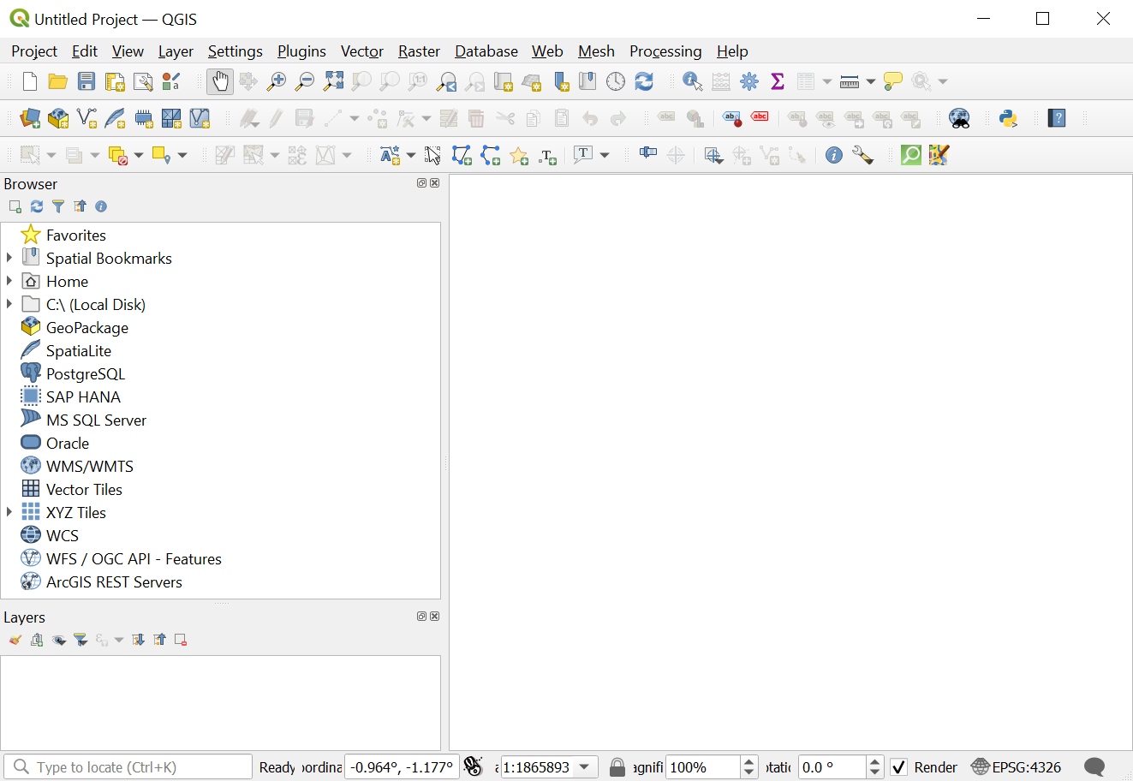
3.1 GIS Data Types & Formats
QGIS – Geographic Information System Software
QGIS is a free, open-source software GIS software used for the creation, analysis, visualization, and management of geographic data and maps.
Geospatial data often requires cleaning, updating, and transformation to ensure clarity and consistency.
QGIS provides essential tools for data preprocessing, including reformatting attributes, aligning coordinate systems, and structuring data to match the desired format and granularity required by EAE.
SOURCE: QGIS
11

Slide 12
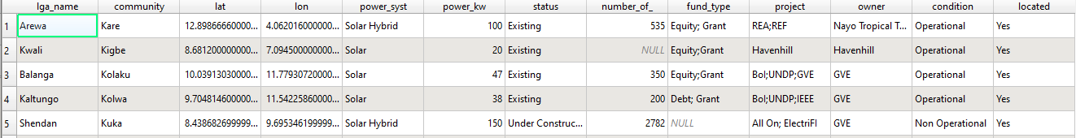
3.2 Working with Data Attributes
Data Attribute Tables
Data attributes are informational values about a geospatial feature
These are stored in the attribute table
  Attributes can be viewed, modified, or added in the attribute table
Attributes can also be added to geospatial features by joining a .csv file
SOURCE: QGIS
12

Slide 13
3.2 Working with Data Attributes
Cleaning & Harmonizing Attributes
It is common to have to clean, reconcile, or harmonize data attributes when using GIS data. Raw data may require:
  Reformatting data (ex. Number, string, etc.)
  Adjusting labels and units
  Removing unnecessary attributes
Data attributes should be recorded consistently, clearly labelled, and relevant to user objectives
SOURCE: QGIS
13
Notes:
It is common to have to clean, reconcile, or harmonize data attributes when using GIS data. Raw data require:
Reformatting data (ex. Number, string, etc.). For example, numbers/percentages stored in text (string) format may not function properly in calculations
Adjusting labels and units. Sometimes data may not be entered in the correct unit or format for end consumption. Misspellings or redundant categories can be reconciled.
Adding attribute columns. You may wish to add addition data for features within a dataset
Removing unnecessary attributes. Additional attributes increase the file size of your dataset. Removing columns that are irrelevant or redundant can streamline your data and improve user experience
Data attributes can be modified in GIS program, or in a spreadsheet editor
Data attributes should be recorded consistently, clearly labelled, and relevant to user objectives

Slide 14
3.2 Working with Data Attributes
Adding & Modifying Data Attributes in QGIS
There are many ways to modify data attributes in QGIS
  Manual Entry: select features to edit (manual selection or select by attribute), and enter values manually
  Function Editor: specify a mathematic or geometric (e.g. area) calculation to apply to an attribute column
  Join Attributes by Location: populate attribute columns with values reflecting relation to other geospatial data
SOURCE: QGIS
14
Notes:
There are many ways to modify data attributes in QGIS
Manual Entry: select features to edit (manual selection or select by attribute), and enter values manually. Remember to use single quotes (‘example’) for text entry.
Field Calculator: specify a mathematic or geometric (e.g. area) calculation to apply to an attribute column. See screenshot on following slides.
Join Attributes by Location: populate attribute columns with values reflecting relation to other geospatial data. See screenshot on following slides.

Slide 15
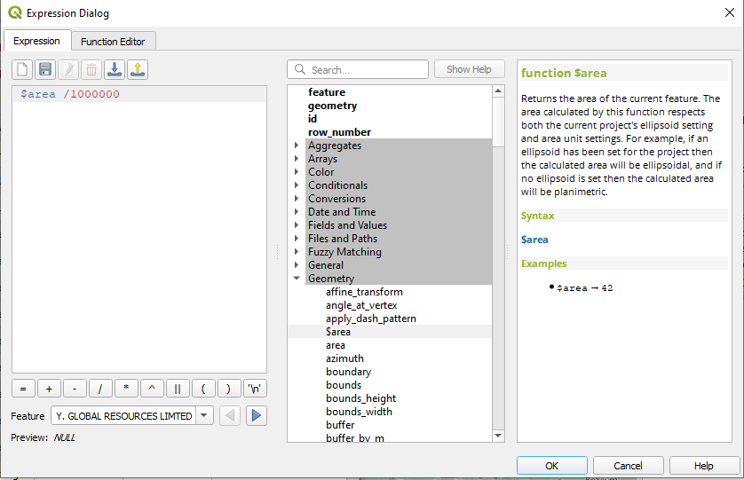
3.2 Working with Data Attributes
Adding & Modifying Data Attributes in QGIS
Open Function Editor from Attribute Table
Expression to be applied to selected attribute column
(example: area in km sq)
Help text and example function
Menu of available mathematical and geometric functions
15
Notes:
Open Function Editor from Attribute Table
Enter expression in the left-hand pane. You can click on functions in the center pane to populate them in the expression dialogue pane. Help text, including an example and descriptions of parameters, can be found in the right pane.

Slide 16
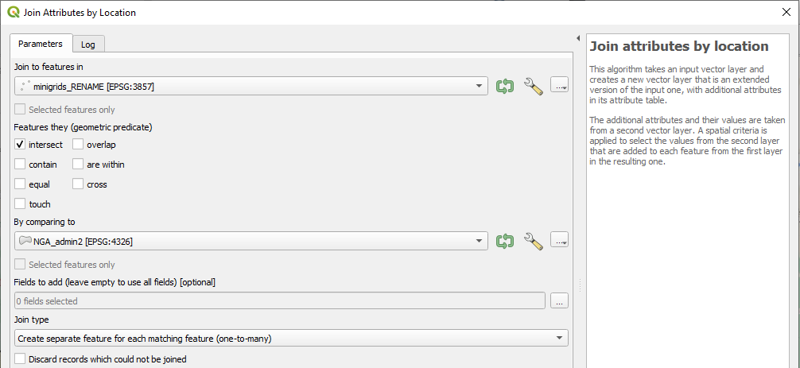
3.2 Working with Data Attributes
Adding & Modifying Data Attributes in QGIS
Select layer to add geographic attributes
Select geometric inclusion criteria
Select layer to source location information
Select join type:
(e.g. one-to-one, one-to-many)
16
Notes:
Join attributes by location can be used to add attribute data that represents the geospatial relation between two data layers. For example, if you wanted a column showing which district a minigrid is located in.
The tool can be accessed in your toolbar: vector > Data Management Tools > Join Attributes by Location
Select the destination and source layers, along with the geometric inclusion criteria and the join type (one-to-one, one-to-many)

Slide 17
3.2 Working with Data Attributes
Adding & Modifying Data Attributes in Spreadsheets
Attribute tables can also be modified in a spreadsheet editor, like Excel
  Export attribute table as a .csv file
  Load .csv file in spreadsheet editor and modify attributes as needed
    The ‘lookup’ function can be useful for matching values with an another spreadsheet
  Reload modified .csv file in GIS program
  Join to data layer
  Save as new layer
SOURCE: QGIS
17
Notes:
Attribute tables can also be modified in a spreadsheet editor, like Excel
Export attribute table as a .csv file
Load .csv file in spreadsheet editor and modify attributes as needed
The ‘lookup’ function can be useful for matching values with an another spreadsheet.
Reload modified .csv file in GIS program
Join to data layer
Save as new layer

Slide 18
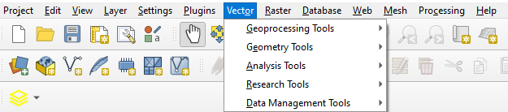

3.3 Working with Vector Data
Vector Data Tools
QGIS comes with a variety of built-in vector processing tools
Additional tools are available via installed plug-ins
SOURCE: QGIS
18
Notes:
The ecosystem of geospatial data and tools for energy planning leverages geographic information and technology to facilitate the efficient and sustainable management of energy resources. It involves the integration of various geospatial data sources, analytical tools, and software platforms to support decision-making in the energy sector.

Slide 19
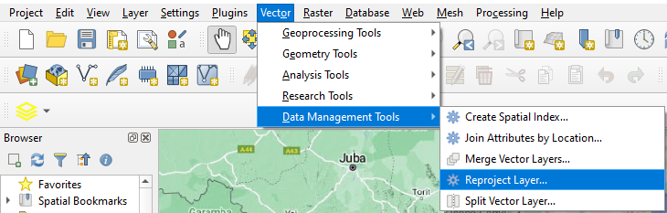
3.3 Working with Vector Data
Reproject Vectors
Energy Access Explorer automatically reprojects input data through Paver, the automated data processing tool in the system backend
It is sometimes still necessary to reproject layer for pre-upload processing
  A recommended, meter-denominated CRS is 100102 – Web Mercator Sphere
19
Notes:
The ecosystem of geospatial data and tools for energy planning leverages geographic information and technology to facilitate the efficient and sustainable management of energy resources. It involves the integration of various geospatial data sources, analytical tools, and software platforms to support decision-making in the energy sector.

Slide 20

3.3 Working with Vector Data
Simplify Vectors
Datasets with lots of features and detail may be very large files
The Simplify function reduces the number of vertices
This reduces file size and improves performance, but limits accuracy
SOURCE: QGIS
20
Notes:
Datasets with lots of features and detail may be very large files (examples: roads, distribution network)
The Simplify function reduces the number of vertices for lines and polygon features
This reduces file size and improves performance, but limits accuracy

Slide 21
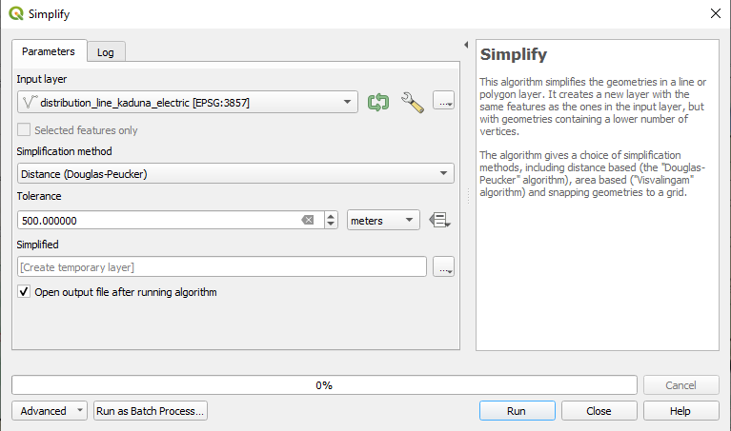
3.3 Working with Vector Data
Simplify Vectors
Select input
data
Set Tolerance: maximum distance from existing points to approximate
Caution: you may need to reproject layer
21
Notes:
Find the ‘Simplify’ tool in your QGIS toolbar. Vector > Geometry > Simplify.
Select input data
Set tolerance. This value should be no larger than 1000 meters to maintain accuracy in the standard 1 km sq resolution in EAE
- If meters are not populating for the map unit, then you may need to reproject the layer to a meter-denominated CRS (ex. 102100 – Web Mercator Sphere)

Slide 22
3.3 Working with Vector Data
Dissolve Tool
Dissolve enables users to consolidate features within a layer with matching attributes
  Example: Match district and provincial boundaries
  Example: Combine lines that are the same capacity (kV)
Dissolving reduces the number of features, and file size
Unselected attributes may be lost or overwritten
SOURCE: QGIS
22
Notes:
The ecosystem of geospatial data and tools for energy planning leverages geographic information and technology to facilitate the efficient and sustainable management of energy resources. It involves the integration of various geospatial data sources, analytical tools, and software platforms to support decision-making in the energy sector.

Slide 23
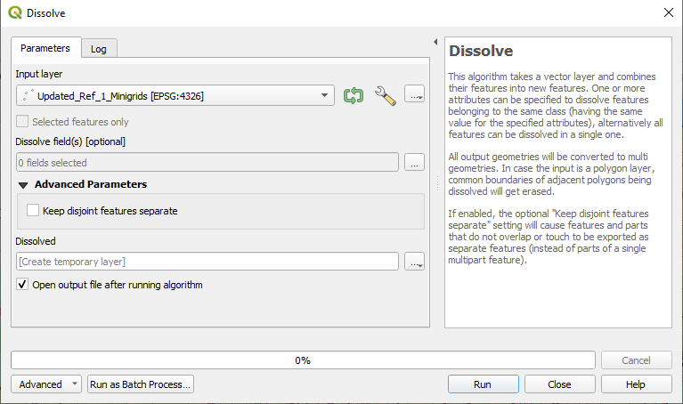
3.3 Working with Vector Data
Dissolve Tool
Select input data
Select one or more attributes
Caution: unselected attributes may be lost
23
Notes:
The ecosystem of geospatial data and tools for energy planning leverages geographic information and technology to facilitate the efficient and sustainable management of energy resources. It involves the integration of various geospatial data sources, analytical tools, and software platforms to support decision-making in the energy sector.

Slide 24
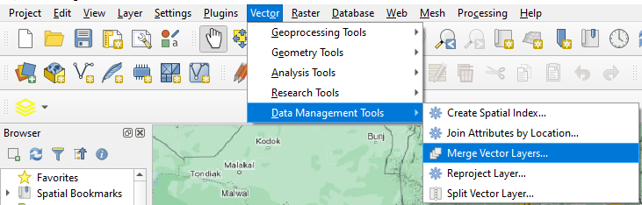
3.3 Working with Vector Data
Merging Vector Data
When to merge vector datasets:
  Multiple versions or sources of the same data with distinct features
  Similar use case for features from each data set
24
Notes:
When to merge vector datasets:
Multiple versions or sources of the same data with distinct features
Similar use case for features from each data set
Merged datasets may have duplicate features, inconsistent attributes, etc. and typically require further cleaning

Slide 25
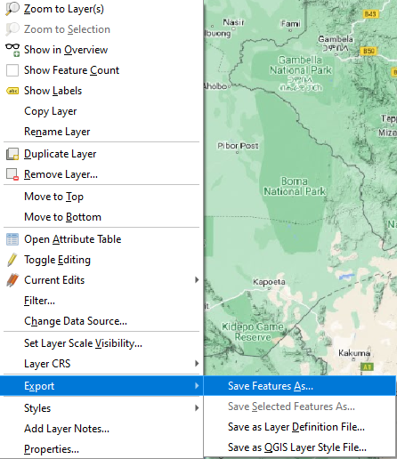
3.3 Working with Vector Data
Vector Data Conversion
For uploads to Energy Access Explorer, data must be in GeoJSON format
It is easy to convert and export datasets in QGIS in various formats:
  Right-click on your data layer
  Export > Save Features As
  Select GeoJSON from the menu
  Save as a new dataset in the desired format
25
Notes:
The ecosystem of geospatial data and tools for energy planning leverages geographic information and technology to facilitate the efficient and sustainable management of energy resources. It involves the integration of various geospatial data sources, analytical tools, and software platforms to support decision-making in the energy sector.

Slide 26
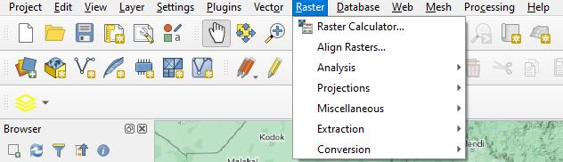
3.4 Working with Raster Data
Raster Data Tools
QGIS comes with a variety of built-in raster processing tools
Additional tools are available via installed plug-ins
SOURCE: QGIS
26
Notes:
The ecosystem of geospatial data and tools for energy planning leverages geographic information and technology to facilitate the efficient and sustainable management of energy resources. It involves the integration of various geospatial data sources, analytical tools, and software platforms to support decision-making in the energy sector.

Slide 27
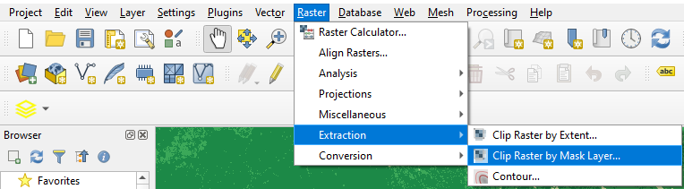
3.4 Working with Raster Data
Clip Raster
Raster source data often extends beyond national boundary
  Regional/continent-wide datasets
  Satellite imagery in geometric ‘tiles’
This results in large file size, especially for high-resolution rasters
  Clipping to national boundary only keeps the values we’re interested in
SOURCE: QGIS
27
Notes:
Raster source data often extends beyond national boundary
Regional/continent-wide datasets
Satellite imagery in geometric ‘tiles’
This increases file size, especially for high-resolution rasters
Clipping to national boundary only keeps the values we’re interested in
While Paver, EAE’s automated data processing tool, also clips raster to country boundaries, for large countries we still recommend this as a pre-processing step to streamline data uploads

Slide 28
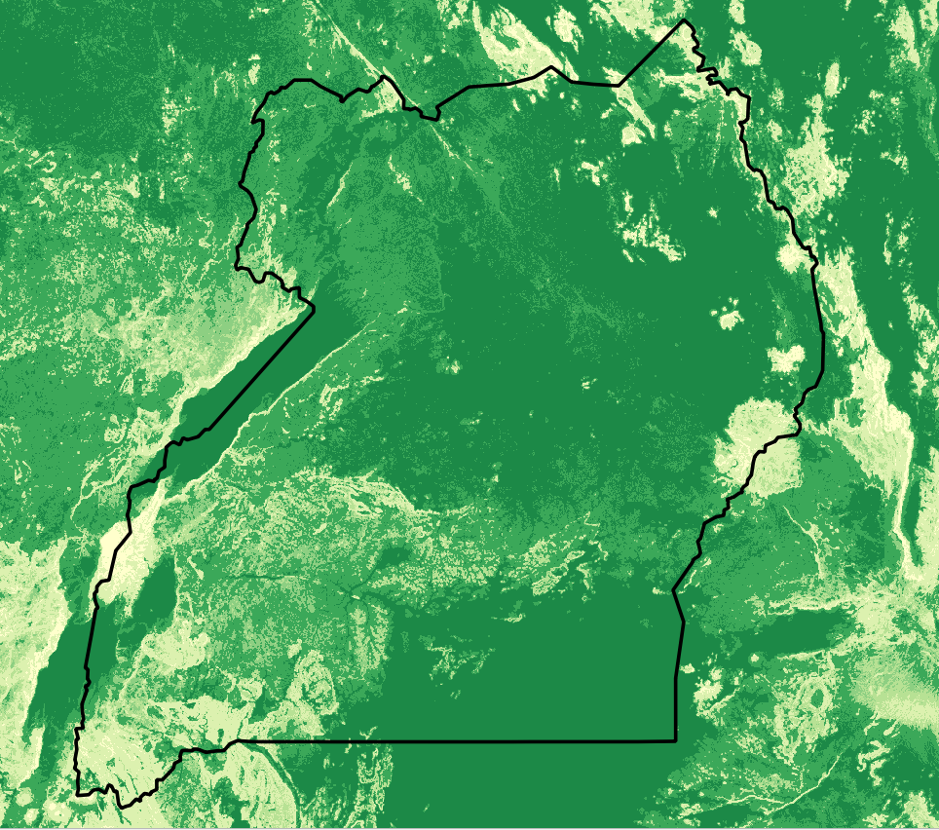
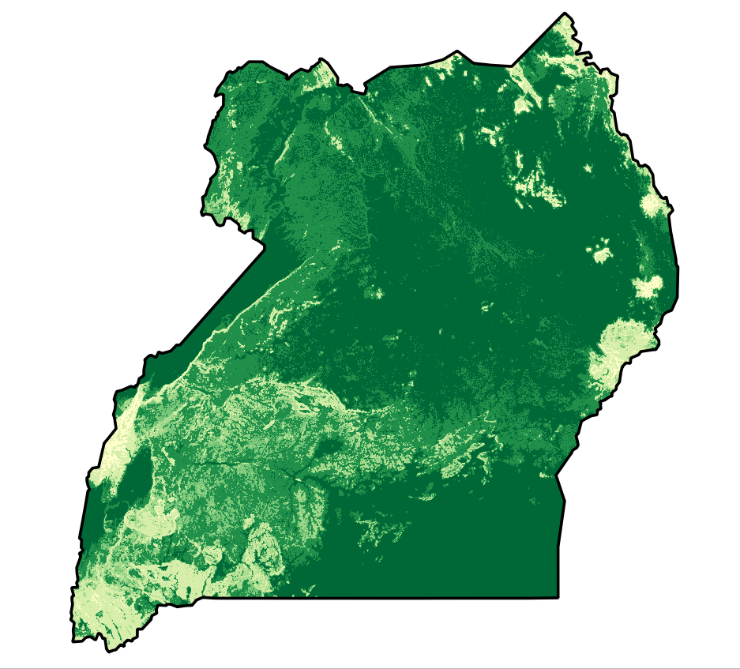
3.4 Working with Raster Data
Clip Raster
SOURCE: Africa Land Surface Forms, USGS
28
Notes:
The ecosystem of geospatial data and tools for energy planning leverages geographic information and technology to facilitate the efficient and sustainable management of energy resources. It involves the integration of various geospatial data sources, analytical tools, and software platforms to support decision-making in the energy sector.

Slide 29
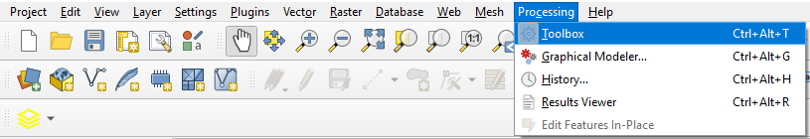
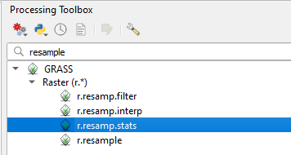
3.4 Working with Raster Data
Resample Raster
Source raster files may come in a higher resolution (finer pixel size) than what is supported in the Energy Access Explorer
Resampling the raster reduces the file size by adjusting the pixel size.
  You may need to install the GRASS plugin to access r.resamp.stats
29
Notes:
Raster source data often extends beyond national boundary
Regional/continent-wide datasets
Satellite imagery in geometric ‘tiles’
This increases file size, especially for high-resolution rasters
Clipping to national boundary only keeps the values we’re interested in
While Paver, EAE’s automated data processing tool, also clips raster to country boundaries, for large countries we still recommend this as a pre-processing step to streamline data uploads

Slide 30
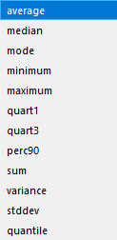
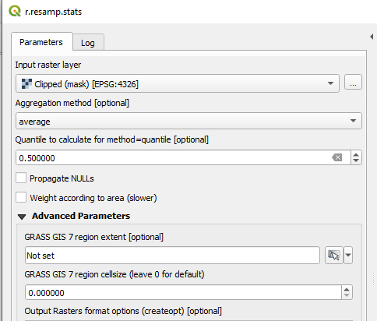
3.4 Working with Raster Data
Aggregation Method
Resample Raster
Select input data
Set target resolution
(pixel size)
30
Notes:
Select input data (raster layer you wish to resample)
Select aggregation method – this is important! Different methods yield different outcomes and support different data types:
For population density, you should use ‘sum’ to capture the aggregate of the smaller cells
For some continuous data (e.g. elevation), you may wish to use an average
For categorical data, you may wish to use a geometric rather than arithmetic resampling method. You can use the ‘warp’ tool (not pictured, but similar process) for methods like nearest neighbor.
Set target resolution (pixel size)

Slide 31
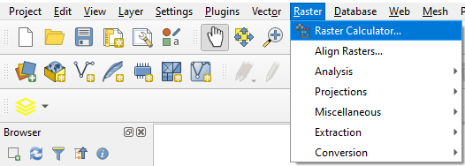
3.4 Working with Raster Data
Raster Calculator
One of the advantages of raster data is the ability to perform calculations on the pixel values
The Raster Calculator enables users to perform calculations on all pixels
31
Notes:
Source raster files may come in a higher resolution (finer pixel size) than what is supported in the Energy Access Explorer
Resampling the raster reduces the file size by adjusting the pixel size.
You may need to install the GRASS plugin to access r.resamp.stats

Slide 32
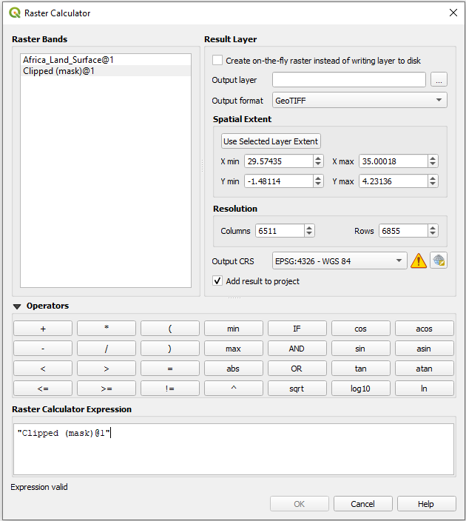
3.4 Working with Raster Data
Raster Calculator
Users can enter an expression using logical and mathematical operators
Examples:
  Unit conversions
  Set null values to zeroes
32
Notes:
Source raster files may come in a higher resolution (finer pixel size) than what is supported in the Energy Access Explorer
Resampling the raster reduces the file size by adjusting the pixel size.
You may need to install the GRASS plugin to access r.resamp.stats

Slide 33
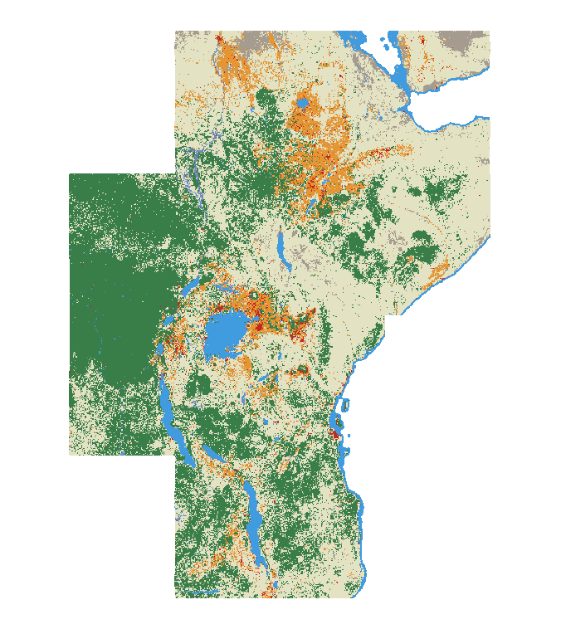
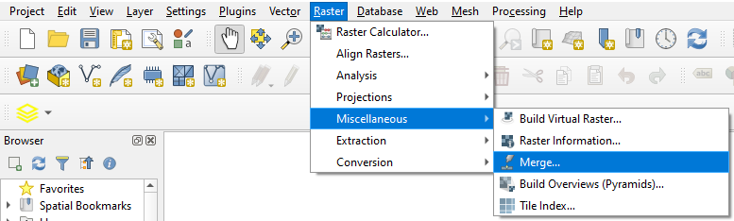
3.4 Working with Raster Data
Merge Raster (Mosaic)
It is sometimes necessary to combine raster files together to cover the entire target area
  Remote sensed data (e.g. digital elevation models) are often release in rectangular ‘tiles’ which do not align to national boundaries
To combine rasters, use the merge tool in QGIS:
33
Notes:
Source raster files may come in a higher resolution (finer pixel size) than what is supported in the Energy Access Explorer
Resampling the raster reduces the file size by adjusting the pixel size.
You may need to install the GRASS plugin to access r.resamp.stats

Slide 34
Lecture 3 Appendix: Supplemental QGIS Tutorials
QGIS Tutorials
For course participants with limited prior experience using GIS software, you may wish to supplement the contents of this course with QGIS Tutorials
QGIS Tutorials and Tips — QGIS Tutorials and Tips
This website includes guided exercises on various GIS operations, ranging from basic to advanced. The exercises include sample data and step-by-step instructions. It is entirely free to use and content is available in multiple languages. The website also features helpful links to other GIS learning content.
34
Notes:
Source raster files may come in a higher resolution (finer pixel size) than what is supported in the Energy Access Explorer
Resampling the raster reduces the file size by adjusting the pixel size.
You may need to install the GRASS plugin to access r.resamp.stats

Slide 35
Thank you
www.climatecompatiblegrowth.com
Supported by and in collaboration with
World Resources Institute
Consolidated by Alemayehu Agizew Woldeamanuel, Abdul Khalid, Shikha Anand, Tarannum Sahar, Akansha Saklani, Santiago Sinclair-Lecaros, Dimitris Mentis, Douglas Ronoh and Jake Stockman from the World Resources Institute
Woldeamanuel, A. A., Khalid, A., Anand, S., Sahar, T., Saklani, A., Sinclair-Lecaros, S., Mentis, D., Ronoh, D., & Stockman, J., 2026.
Lecture 3: Key GIS Concepts. Release Version 3.0
[online presentation]. Climate Compatible Growth Programme, World Resource Institute

