Slide 1


Maximum 32 point Arial in white
LECTURE 2 INTRODUCTION TO ENERGY ACCESS EXPLORER
Supported by and in collaboration with World Resources Institute
Notes:
License:
This work is licensed under the Creative Commons Attribution 4.0 International License (CC BY 4.0). To view a copy of this license, visit https://creativecommons.org/licenses/by/4.0/.
Attribution:
Please cite as: Woldeamanuel, A. A., Khalid, A., Anand, S., Sahar, T., Saklani, A., Sinclair-Lecaros, S., Mentis, D., Ronoh, D., & Stockman, J., 2026. Data Driven, Integrated and Inclusive Energy Planning with Energy Access Explorer. Version 1. Climate Compatible Growth Teaching Kit Website, Climate Compatible Growth.

Slide 2
Learning Outcomes
By the end of this lecture, you will:
ILO1: Understand the key aspects and contributions of Energy Access Explorer
ILO2: Explain the uses of Energy Access Explorer
ILO3: Describe the basic datasets used in EAE
ILO4: Explore the multi-criteria analysis method applied to identify areas for energy access interventions using four indices
2
Notes:
This lecture has four Intended Learning Outcomes. By the end of this lecture, you will:
Explain the uses of Energy Access Explorer
Describe the basic datasets used in EAE
List key features of Geographical Information Systems (GIS)
Describe the role of geospatial data and the Sustainable Development Goals

Slide 3
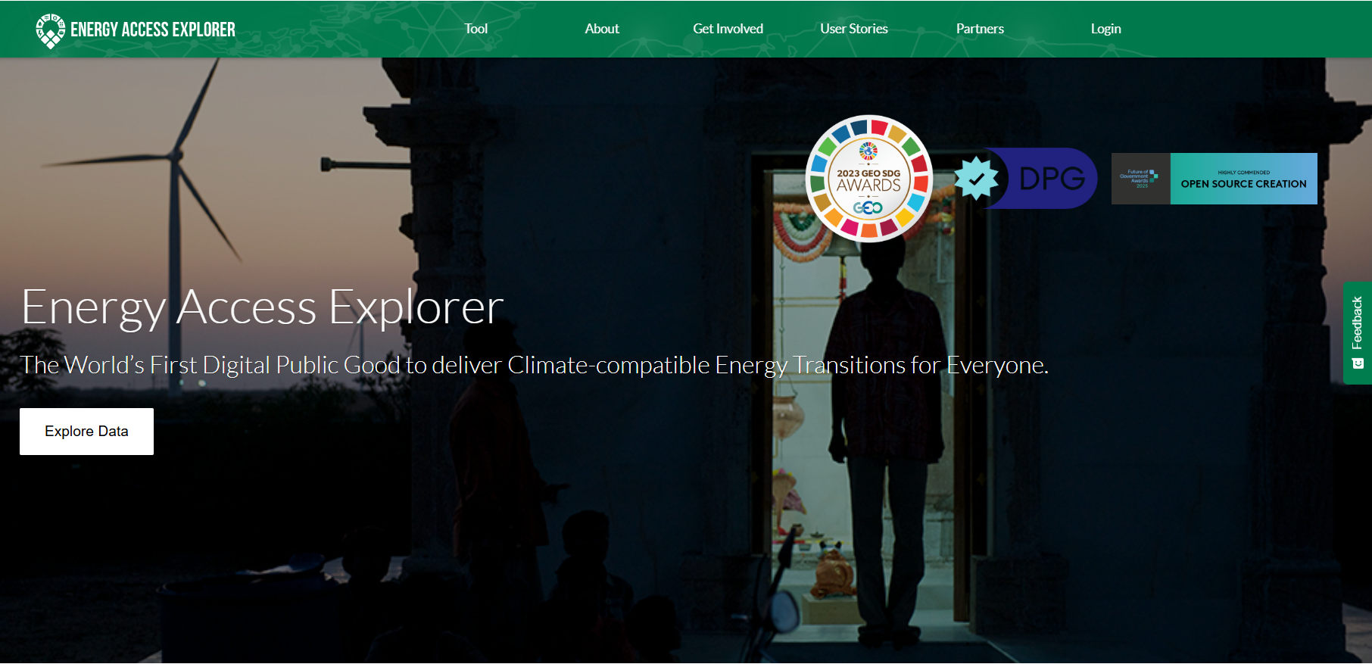
2.1 Introduction to Energy Access Explorer
Energy Access Explorer
Energy Access Explorer (EAE) is an online, open-source, interactive, geospatial platform that enables clean energy entrepreneurs, energy planners, donors, and development-oriented institutions to identify high priority areas where energy access can be expanded.
Using spatial data to link energy supply with growing or unmet demand is essential to gaining a better picture of energy access and expanding energy services to those who need it the most.
Notes:
Energy Access Explorer (EAE) is an online, open-source, interactive, geospatial platform that enables clean energy entrepreneurs, energy planners, donors, and development-oriented institutions to identify high priority areas where energy access can be expanded. Using spatial data to link energy supply with growing or unmet demand is essential to gaining a better picture of energy access and expanding energy services to those who need it the most.

Slide 4
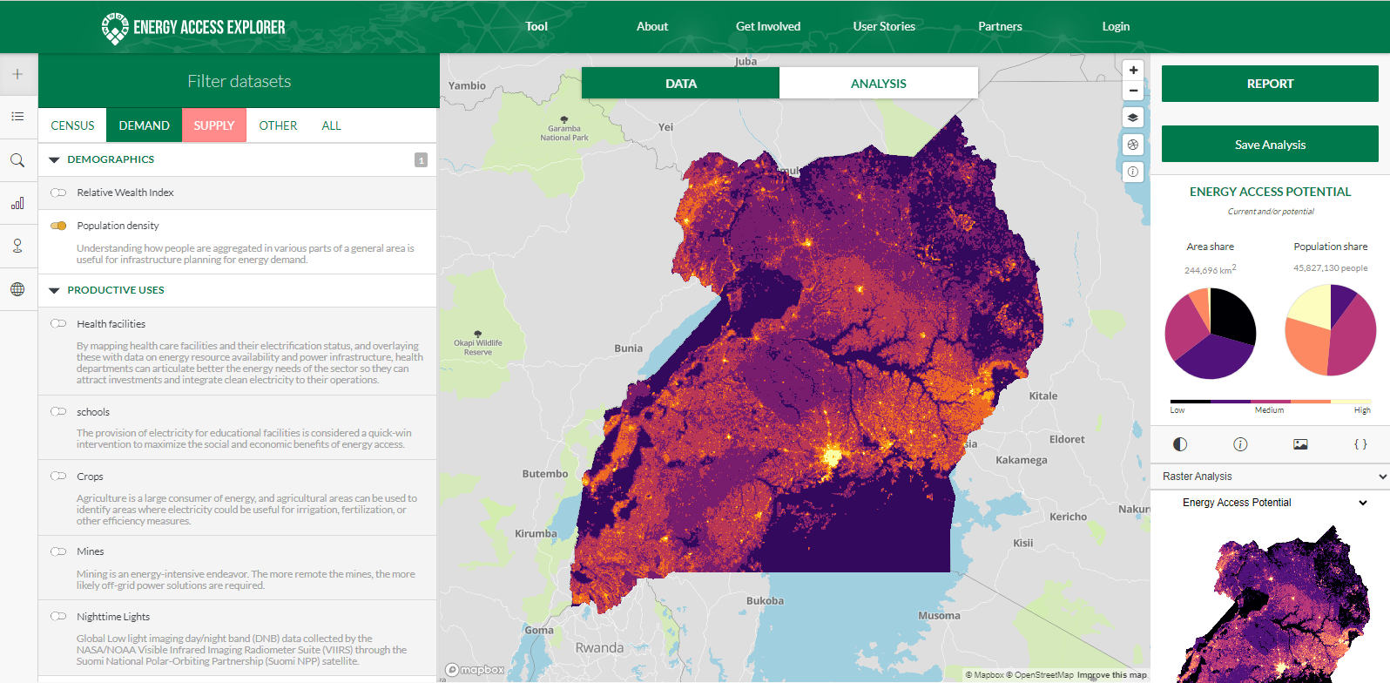
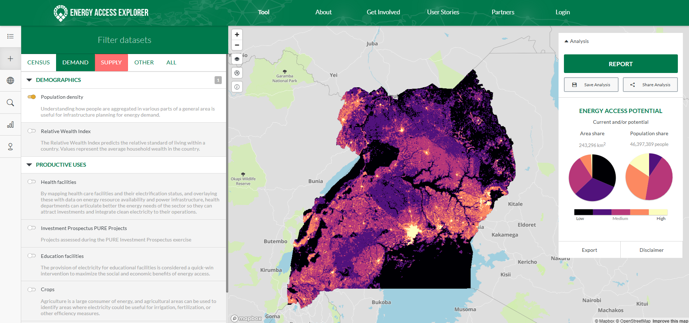
2.1 Introduction to Energy Access Explorer
Key Aspects of Energy Access Explorer
High resolution Priority Areas for Energy Interventions: Energy Access Explorer identifies and prioritizes areas where energy and socio-economic development can be linked to meet the needs of underserved or unserved communities.
EAE functions also as a Dynamic Information System / Spatial Data Infrastructure that facilitates effective Data Management and Data Governance
EAE complements cost optimization planning tools that energy planners already use, providing a bottom-up representation of energy affordability and demand.

Slide 5
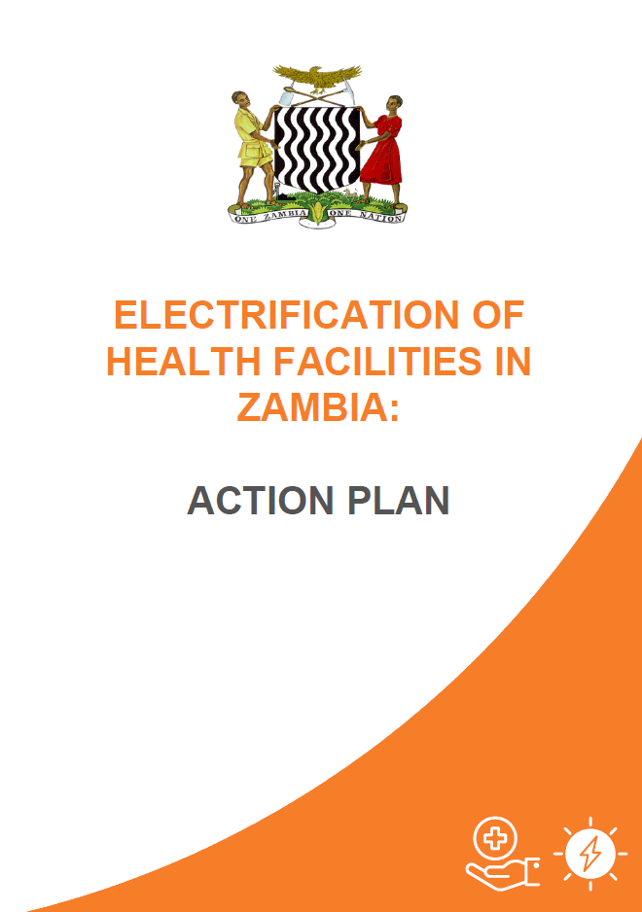
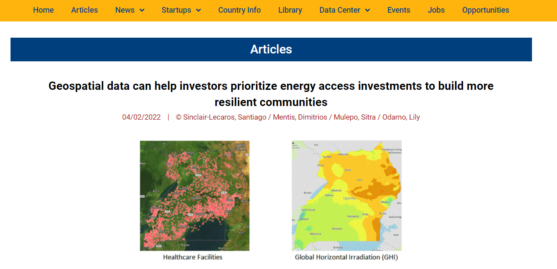
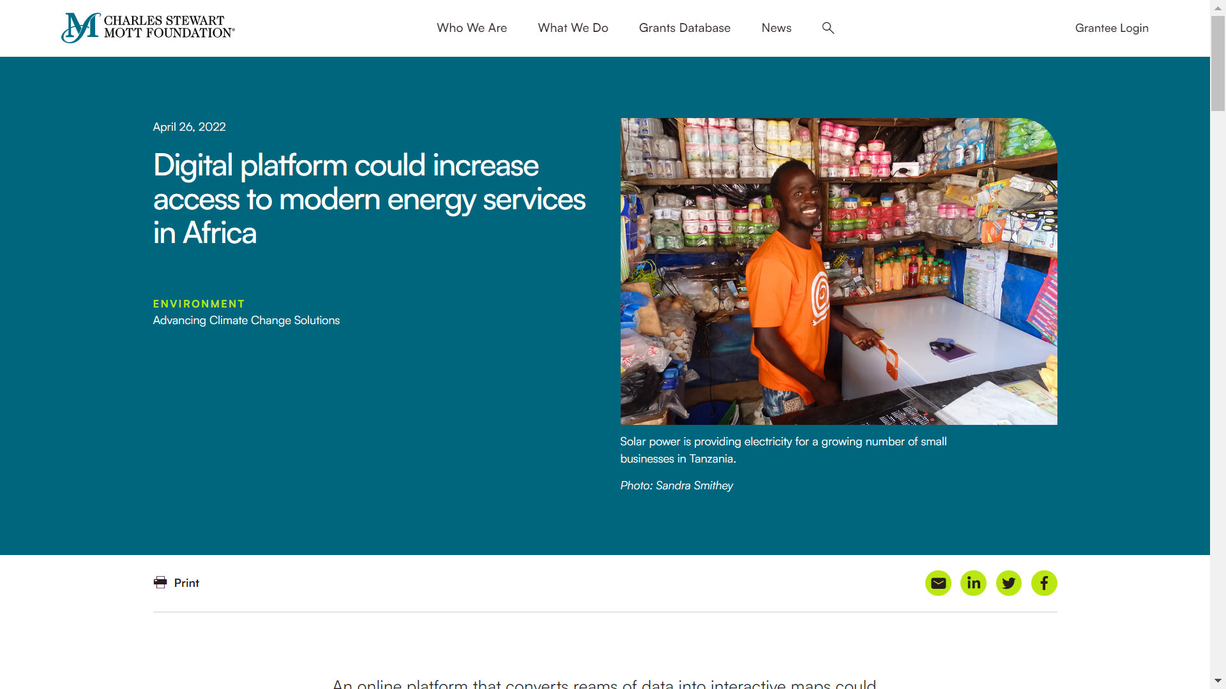
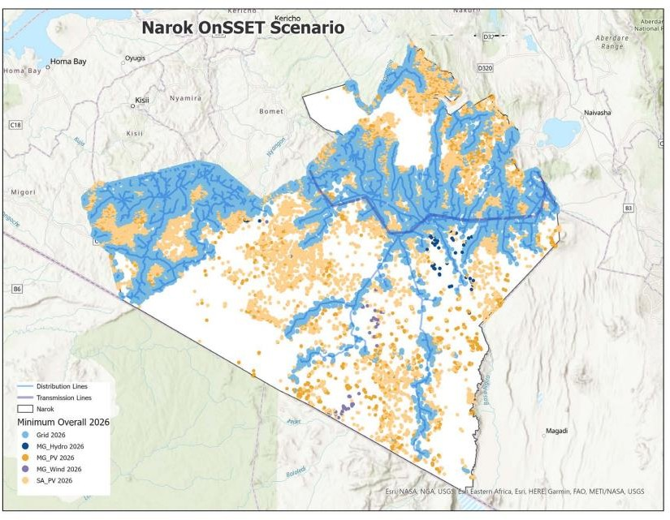
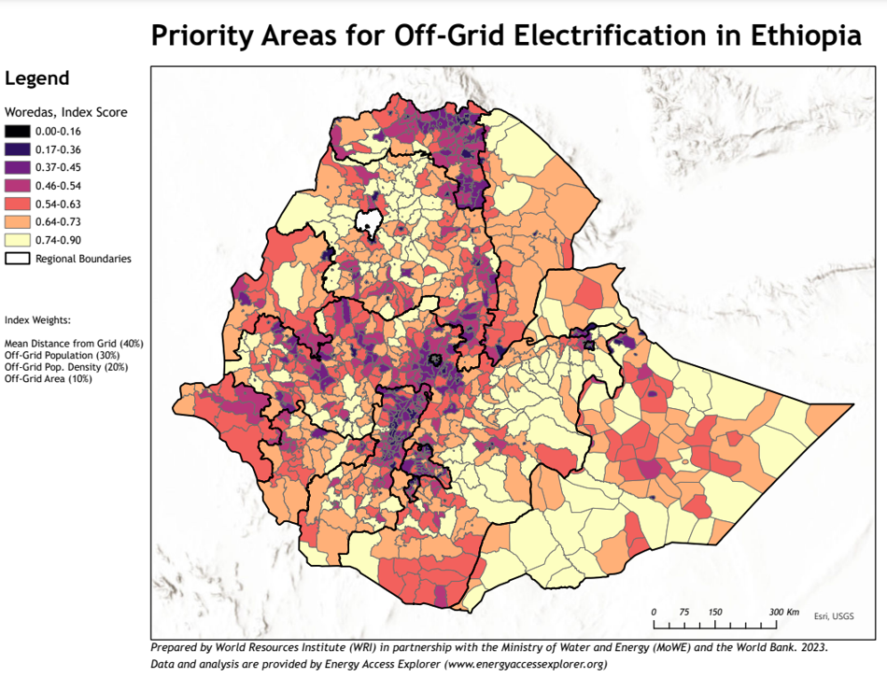
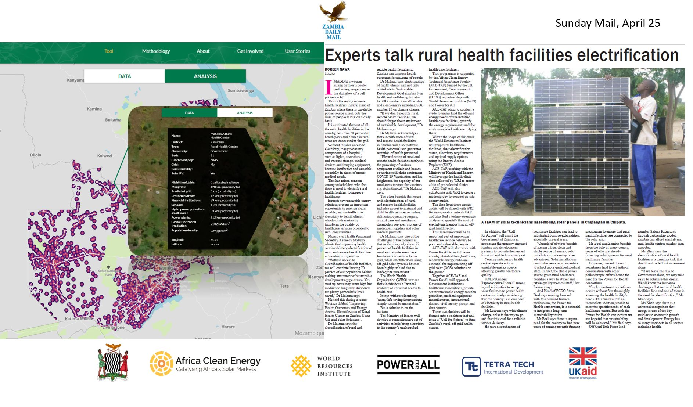
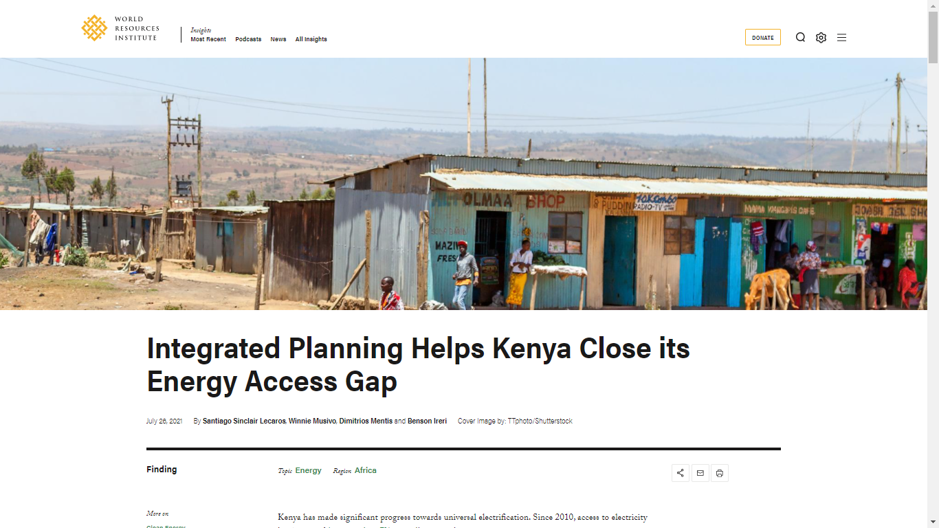
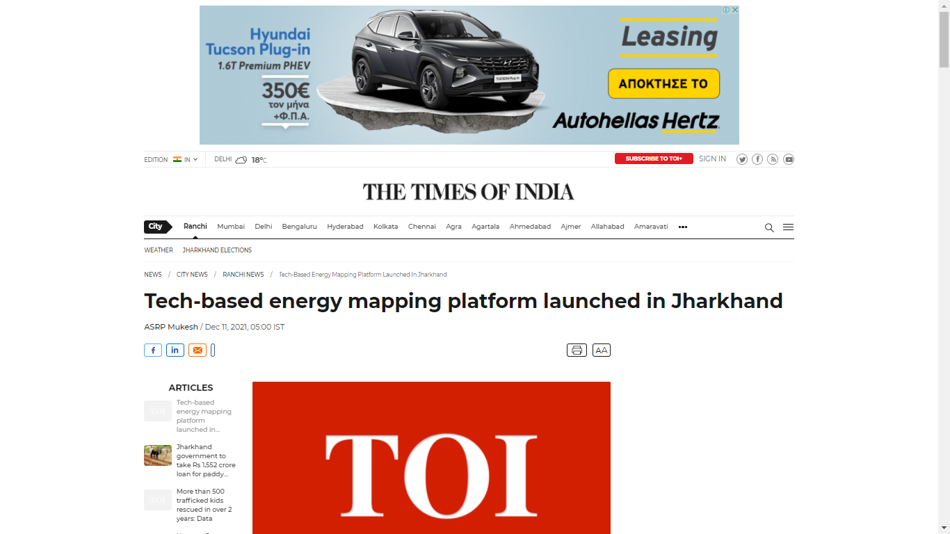

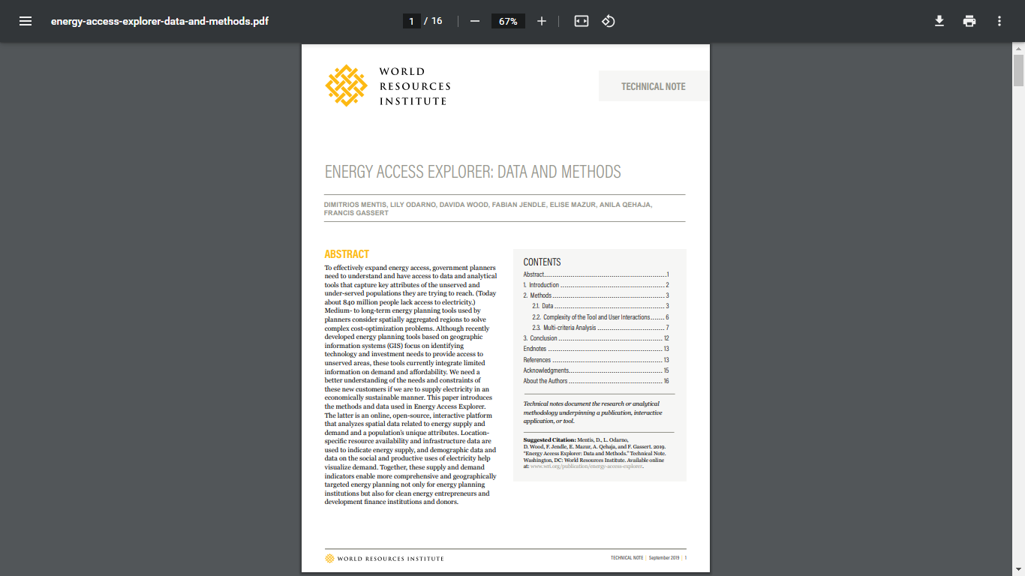
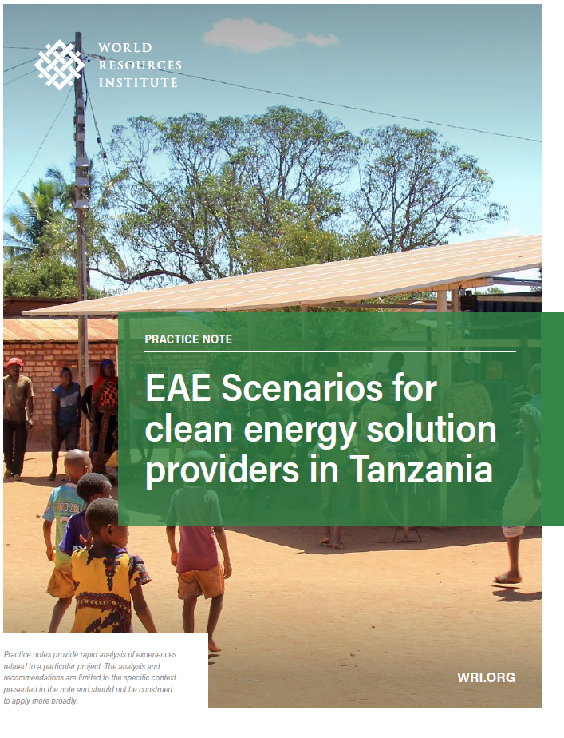
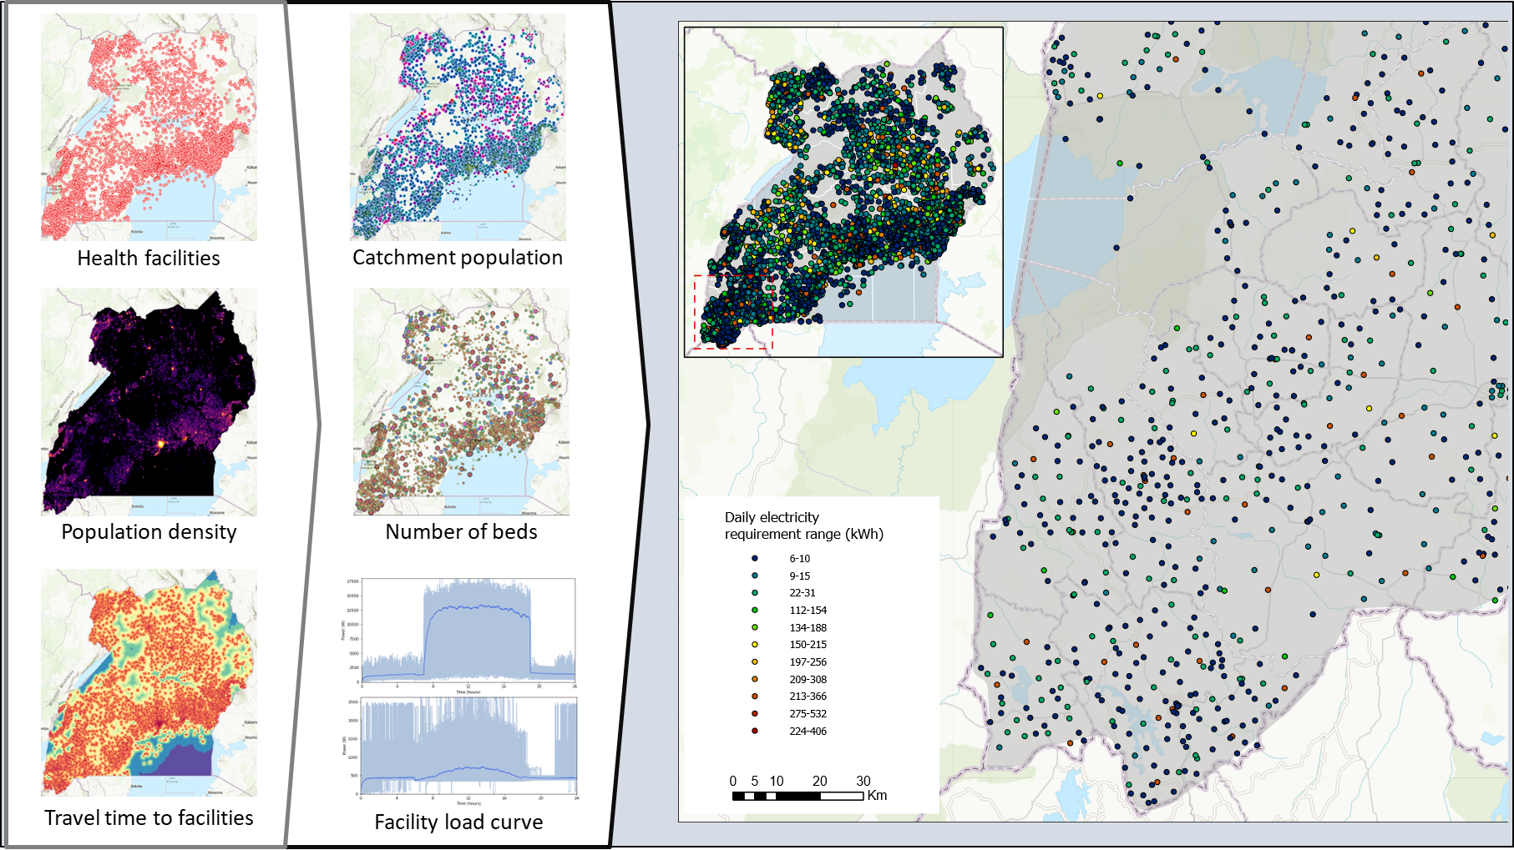

2.1 Introduction to Energy Access Explorer
Select Contributions of Energy Access Explorer
EAE supports the development of healthcare roadmaps and on-the-ground implementation in Zambia, Uganda, Jharkhand (India), and Makueni (Kenya), providing valuable insights and strategies.
It plays a pivotal role in the development of local County Energy Plans in Kenya, enhancing energy planning at a grassroots level.
It supports the 0.5 billion USD Africa Mini Grid Program in Nigeria.
It informs the design of the World Bank's Results Based Financing for Off-Grid Electrification in Ethiopia.
It supports the development of the Tanzania mini-grids geospatial database to expand businesses and introduce targeted investment for electricity service solutions.
It enables an integrated and inclusive approach to planning through cross sectoral EAE working groups.
5

Slide 6
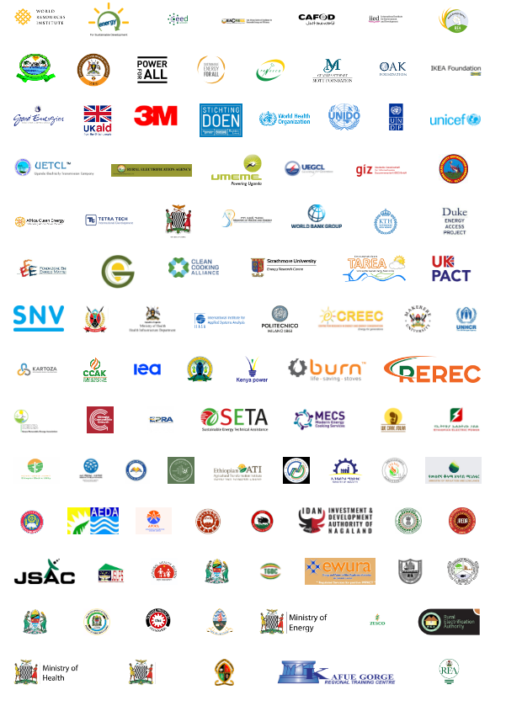
2.1 Introduction to Energy Access Explorer
Covers countries with 48% of the total unserved population globally
Originally prototyped for 3 countries
Currently developed for over 20 geographies, at both national and subnational levels
F𝗶𝗿𝘀𝘁 𝗲𝘃𝗲𝗿 𝗼𝗳𝗳𝗶𝗰𝗶𝗮𝗹𝗹𝘆 𝗿𝗲𝗴𝗶𝘀𝘁𝗲𝗿𝗲𝗱 𝗗𝗶𝗴𝗶𝘁𝗮𝗹 𝗣𝘂𝗯𝗹𝗶𝗰 𝗚𝗼𝗼𝗱 with a special focus on Energy Access and Energy Transitions
Close partnership with > 300 stakeholders
> 35,000 users
> $15 MUSD in-kind contributions (costs avoided compared to closed alternatives)
Notes:
The development and enhancement of EAE has been possible due to the engagement and long-term partnerships as well as active working EAE groups across the countries. (And it couldn’t be otherwise considering the multidimensionality of the energy access challenges.)
Covers countries with 32% of the total unserved population globally
Originally prototyped for 3 countries and is now being developed for 23 geographies, at both national and subnational levels
F𝗶𝗿𝘀𝘁 𝗲𝘃𝗲𝗿 𝗼𝗳𝗳𝗶𝗰𝗶𝗮𝗹𝗹𝘆 𝗿𝗲𝗴𝗶𝘀𝘁𝗲𝗿𝗲𝗱 𝗗𝗶𝗴𝗶𝘁𝗮𝗹 𝗣𝘂𝗯𝗹𝗶𝗰 𝗚𝗼𝗼𝗱 with a special focus on Energy Access and Energy Transitions. This marks a significant leap in 𝗱𝗲𝗺𝗼𝗰𝗿𝗮𝘁𝗶𝘇𝗶𝗻𝗴 𝗲𝗻𝗲𝗿𝗴𝘆 𝗱𝗮𝘁𝗮 𝗮𝗻𝗱 𝗮𝗻𝗮𝗹𝘆𝘁𝗶𝗰𝘀, 𝗲𝗺𝗽𝗼𝘄𝗲𝗿𝗶𝗻𝗴 𝘂𝗻𝗱𝗲𝗿𝘀𝗲𝗿𝘃𝗲𝗱 𝗰𝗼𝗺𝗺𝘂𝗻𝗶𝘁𝗶𝗲𝘀 𝘄𝗶𝘁𝗵 𝘃𝗶𝘁𝗮𝗹 𝗶𝗻𝘀𝗶𝗴𝗵𝘁𝘀 𝗳𝗼𝗿 𝘀𝘂𝘀𝘁𝗮𝗶𝗻𝗮𝗯𝗹𝗲 𝗱𝗲𝘃𝗲𝗹𝗼𝗽𝗺𝗲𝗻𝘁.
Close partnership with > 200 stakeholders and users.
> 30,000 users
> 15 MUSD in kind contributions

Slide 7
2.2 Uses of Energy Access Explorer
Primary Uses of Energy Access Explorer
Energy Access Explorer empowers a diverse range of stakeholders in the energy sector. By providing data-driven insights into energy access and consumer demographics, the platform enables informed decision-making, targeted interventions, and more effective planning for clean energy deployment and development initiatives.
Strategic, integrated & inclusive energy planning
Expansion of clean energy markets
Prioritization of investments in the clean energy space
Estimation of energy needs for development services
7

Slide 8
2.2 Uses of Energy Access Explorer
Strategic, Integrated & Inclusive Energy Planning
Analysts and/or decision-makers within energy planning functions (a rural electrification agency, a planning unit of an energy ministry, etc.) can use the tool to improve linking energy access and socioeconomic development to meet people’s needs.
Energy Access Explorer complements the cost-optimization planning tools these agencies use and provides a bottom-up representation of aspects of affordability and demand.
Further, it serves as a database (Spatial Data Infrastructure) that aggregates up-to date information. This reduces high transaction costs for data aggregation and sharing.
8
Notes:
Analysts and/or decision-makers within energy planning functions (a rural electrification agency, a planning unit of an energy ministry, etc.) can use the tool to improve linking electrification and socioeconomic development to meet people’s needs. Energy Access Explorer complements the cost-optimization planning tools these agencies use and provides a bottom-up representation of aspects of affordability and demand. Further, it serves as a database that aggregates up-to date information. This reduces high transaction costs for data aggregation and sharing.

Slide 9
2.2 Uses of Energy Access Explorer
Expansion of Clean Energy Markets
Off-grid and mini-grid developers can use the tool to better assess the level of service needed. Understanding where their customers are likely to be located and where there is a concentration of demand will help clean energy entrepreneurs identify market opportunities.
With insights into consumer demographics and market opportunities, companies can tailor their products and services to match the energy needs and financial capacities of specific regions.
This customization increases the viability and adoption of clean energy solutions, contributing to the expansion of clean energy markets and fostering sustainable growth within the industry.
9
Notes:
Off-grid and mini-grid developers can use the tool to better assess the level of service needed. Understanding where their customers are likely to be located and where there is a concentration of demand will help clean energy entrepreneurs identify market opportunities.

Slide 10
2.2 Uses of Energy Access Explorer
Prioritization of Investment in the Clean Energy Space
Analysts and/or decisionmakers within development finance institutions and donors can understand better where to most effectively channel funds into electrification and clean cooking efforts to ensure that no one is left behind.
The platform's data highlights areas with the greatest potential for impact, allowing these stakeholders to prioritize investments that align with local needs and have the potential to drive significant positive change.
This data-driven approach maximizes the effectiveness of funding and accelerates the growth of energy access rates.
10
Notes:
Analysts and/or decisionmakers within development finance institutions and donors can understand better where to most effectively channel funds into electrification efforts to ensure that no one is left behind.

Slide 11
2.2 Uses of Energy Access Explorer
Estimation of Energy Needs for Development Services
Service delivery institutions in the health, education and agriculture sectors will be able to conduct bottom-up assessment of energy needs associated to development services.
Understanding energy needs is crucial for planning and providing consistent, high-quality services. For instance, healthcare facilities require reliable electricity for medical equipment, while educational institutions need power for lighting and technology.
This platform helps service delivery institutions tailor their operations to ensure energy availability aligns with their service delivery goals.
11
Notes:
Service delivery institutions in the health, education and agriculture sectors will be able to conduct bottom-up assessment of energy needs associated to development services.

Slide 12
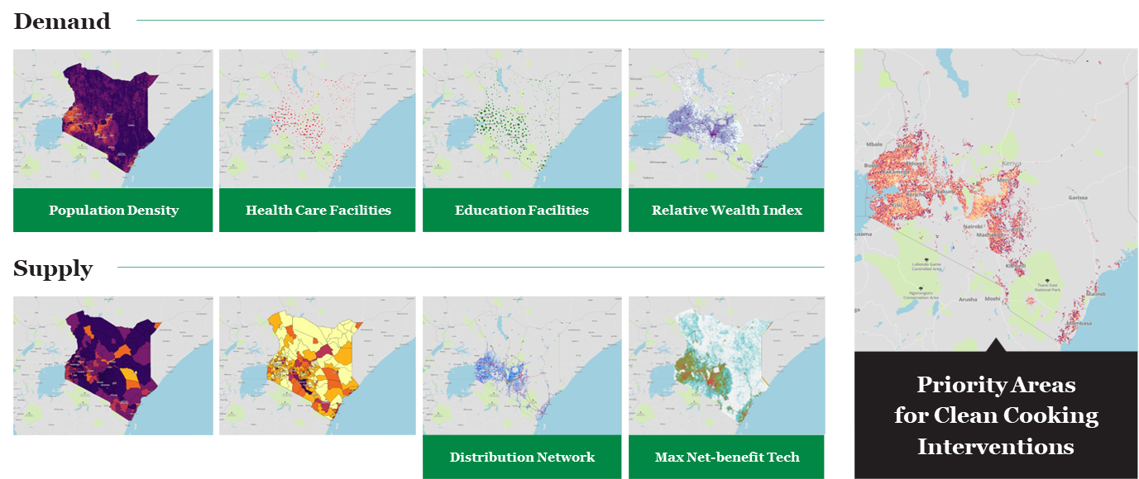
2.2 Uses of Energy Access Explorer
Identifying Priority Areas for Clean Cooking Interventions
The spatial multi-criteria analysis provided by the EAE allows stakeholders identify areas with high energy demand and pinpoint regions with significant potential for energy supply.
12
Notes:
Service delivery institutions in the health, education and agriculture sectors will be able to conduct bottom-up assessment of energy needs associated to development services.

Slide 13
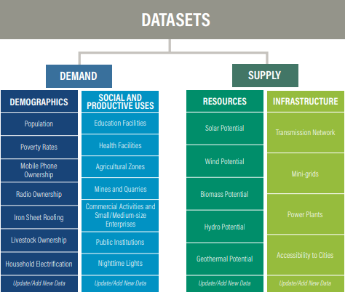
2.3 Key Datasets used in Energy Access Explorer
Data Scoping
EAE aggregates geospatial data related to both energy demand and supply.
More specifically, data on demographics and the social and productive uses of electricity are used to represent current and potential demand, and energy resource availability and infrastructure data are used to visualize current and potential supply.
13

Slide 14
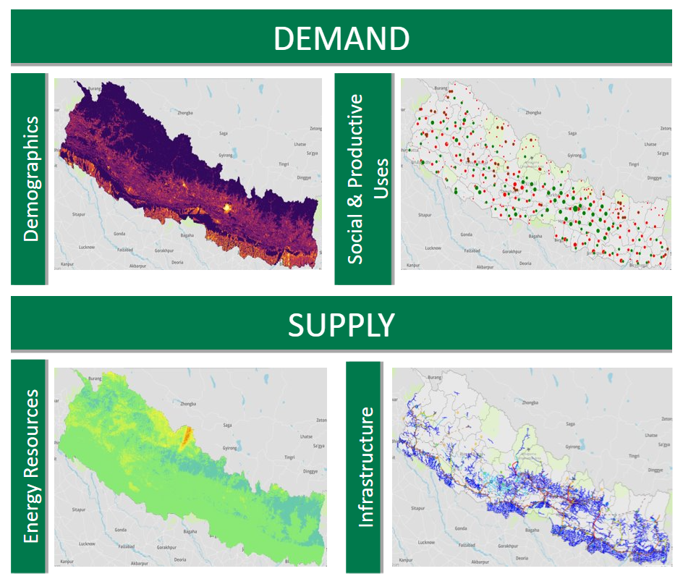
2.3 Key Datasets used in Energy Access Explorer
Data Scoping
Data from different sources, and in different scales and formats are integrated in EAE, such as:
Open source
Satellite
Global
National
Sub-national
Primary
14

Slide 15
2.3 Key Datasets used in Energy Access Explorer
Demographics
The demographic data incorporated in the platform include the following:
Population density data are critical for understanding the distribution of people across a country and are useful for planning for future energy infrastructure
Energy expenditure is a critical parameter in energy planning. However, since granular data on energy expenditures are usually scarce, relevant proxies are used to understand aspects of affordability. These may include iron sheet roofing, radio ownership, mobile phone ownership and coverage, and livestock ownership. The proxies provide insights about a household’s ability to pay for electricity.
Household electrification rate data map the percentage of the population (relative to the total population) that have electricity in their households or the lack thereof to reflect unmet demand.
15

Slide 16
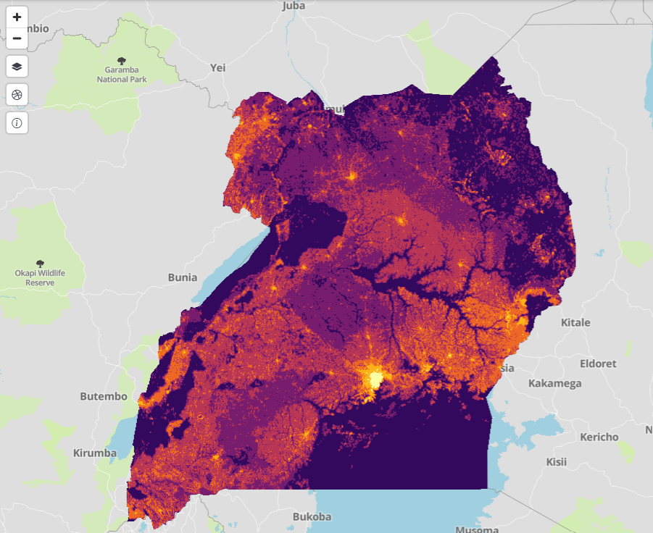
2.3 Key Datasets used in Energy Access Explorer
Demographics – Population Density
Understanding how people are aggregated in various parts of a general area is useful for infrastructure planning for energy demand.
Census/projection-disaggregated gridded population datasets Uganda provides estimates of human population distribution at a resolution of 3 arc-second (approximately 100m).
16

Slide 17
2.3 Key Datasets used in Energy Access Explorer
Social and Productive Uses
Social and productive uses of electricity constitute significant factors that influence electricity demand and boost income and welfare.
Education and health care facilities are potential sites for expanding access to electricity. This provision may improve the quality of education and health care services.
Agriculture is a large consumer of energy, and agricultural areas (data integrated in the platform) can be used to identify areas where electricity could be useful for irrigation, fertilization, or other efficiency measures.
Mines and quarries are other important consumers of energy, and mines in rural areas may be suitable for off-grid power solutions.
Nighttime lights illustrate existing demand for electricity and are an indicator of socioeconomic activity.
17

Slide 18
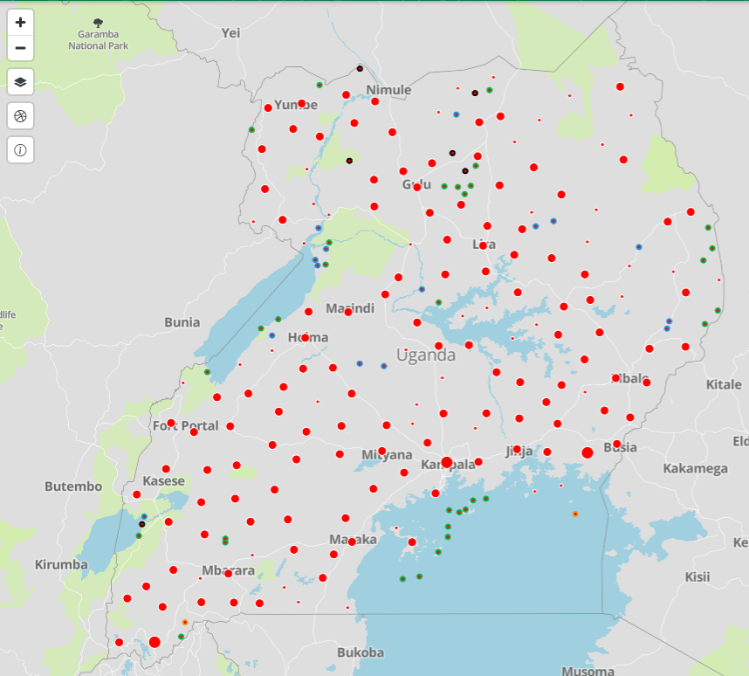
2.3 Key Datasets used in Energy Access Explorer
Social and Productive Uses – Health Care Facilities
By mapping health care facilities and their electrification status and overlaying these with data on energy resource availability and power infrastructure, health departments can articulate better the energy needs of the sector so they can attract investments and integrate clean electricity to their operations.
18

Slide 19
2.3 Key Datasets used in Energy Access Explorer
Renewable Energy Resources
Local renewable energy resources can play an important role in expanding energy access in a viable, clean manner in unserved and under-served areas.
Planners as well as off-grid and mini-grid developers have a strong interest in geospatial renewable energy potential data sets that facilitate decision-making regarding the
deployment of clean energy solutions.
Energy Access Explorer incorporates data on global horizontal irradiance (indicating solar power potential), wind speed (indicating wind power potential), small-scale hydropower potential (mini and small hydropower potential) and geothermal energy potential.
19

Slide 20
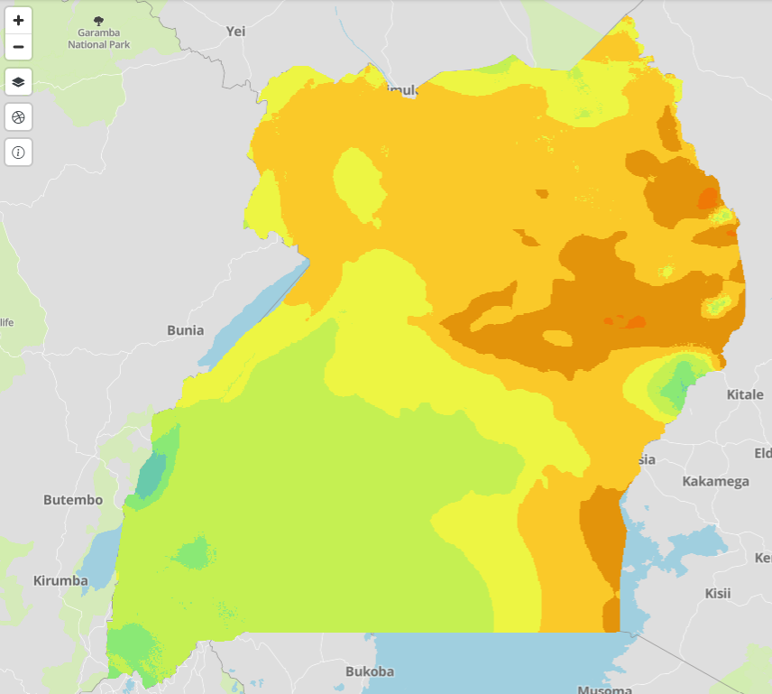
2.3 Key Datasets used in Energy Access Explorer
Renewable Energy Resources – Solar Energy Potential
Global Horizontal Irradiation (GHI), is the total amount of shortwave radiation received from the Sun by a surface horizontal to the ground.
These values measure the solar potential in an area, and therefore, are of particular interest to solar PV installations.
The global horizontal irradiation (GHI) reflects the sum of direct and diffuse components of solar radiation with a resolution of 1 km and spatial coverage between latitudes 60°N to 45°S.
20

Slide 21
2.3 Key Datasets used in Energy Access Explorer
Infrastructure
Proximity to power and road infrastructure influences the selection of the optimal supply type and the associated investment needs for future energy projects:
Existing and planned transmission and distribution network provides the locations of infrastructure and combined with nighttime lights, can indicate which part of a country is or may become connected.
Powerplant locations show where power is being generated and illustrate grid existence and potential grid extension.
Locations of existing mini-grids display current supplies of electricity off the main grid and potential future economic developments
Road network and accessibility to cities gives an insight about how well connected a specific area is.
21

Slide 22
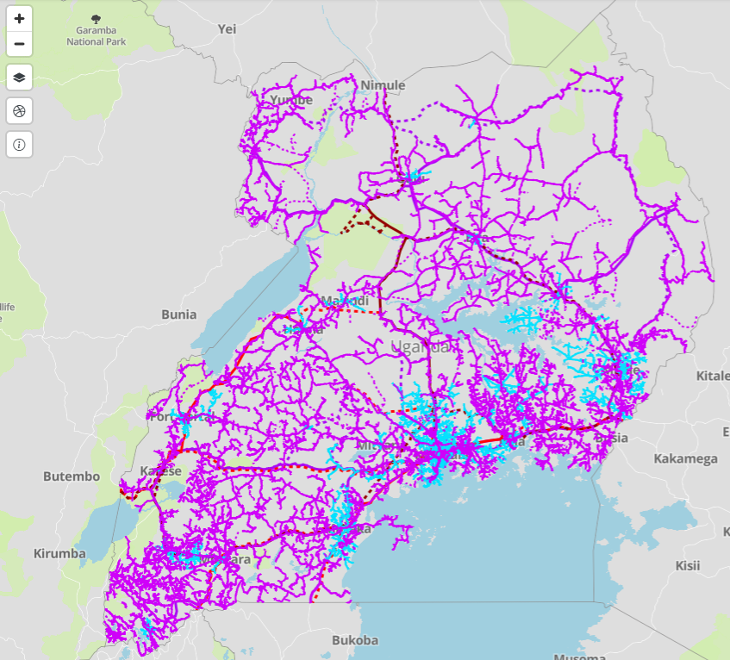
2.3 Key Datasets used in Energy Access Explorer
Infrastructure – Distribution and Transmission Lines
Electrification options, such as grid extensions and mini grids, depend on existing and planned grid infrastructure.
Data includes distribution lines for voltages: 11kV and 33 kV; and existing and under construction transmission lines for voltages: 66, 132, 220 and 400 kV.
22

Slide 23
2.4 Multi-criteria Analysis for Spatial Energy Planning
Multi-Criteria Analysis Framework
Multi-Criteria Analysis (MCA) is a decision-making tool developed for complex multi-criteria problems that include qualitative and/or quantitative aspects of the problem in the decision-making process.
MCA comprises various classes of methods, techniques and tools, with different degrees of complexity, that explicitly consider multiple objectives and criteria (or attributes) in decision-making problems
SOURCE: Mendoza, G and Macoun, P, 1999; Dean, 2022
23

Slide 24
2.4 Multi-criteria Analysis for Spatial Energy Planning
Multi-Criteria Analysis Framework
Key steps for conducting a basic multi-criteria analysis involve:
Primary problem analysis
Development of the options to be assessed
Identification of objectives and associated criteria against which to test options
Construction of the performance profile of each option
Scoring of impacts of each option
Weighting of criteria
Combination of scores and weights
Normalization of data
Sensitivity analysis
Presentation of the results of the MCA exercise as a support for the final decision-making
SOURCE: Dean, 2022
24

Slide 25
2.4 Multi-criteria Analysis for Spatial Energy Planning
Multi-Criteria Analysis Framework
The main function of Energy Access Explorer is a multi-criteria analysis (MCA) to identify areas of interest to expand energy access.
The MCA produces four indices:
Demand Index
Supply Index
Energy Access Potential
Need for Assistance Index.
SOURCE: Dean, 2022
25

Slide 26
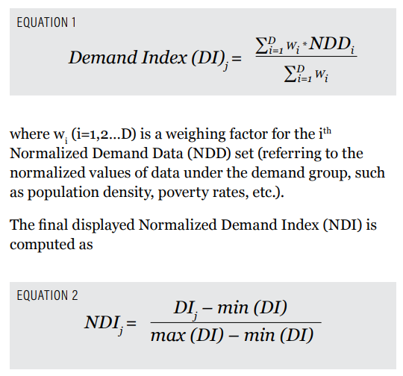
2.4 Multi-criteria Analysis for Spatial Energy Planning
Multi-Criteria Analysis Framework: Demand Index
The Demand Index is the weighted sum of normalized demographic data and social and productive use data.
The formula inverts the percentage of people who live below the poverty line to provide the number of people who live above the poverty line, which is used as a proxy for where people have an ability to pay for electricity.
Proximity to social and productive uses, such as schools, hospitals, and mines, are added so that higher values highlight areas closer to potential demand.
Nighttime lights are added to identify where there is already light and existing demand for electricity.
SOURCE: Mentis, et.al, 2019
26

Slide 27
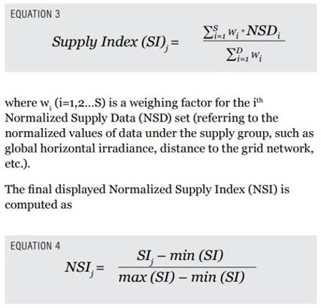
2.4 Multi-criteria Analysis for Spatial Energy Planning
Multi-Criteria Analysis Framework: Supply Index
The Supply Index is the weighted sum of normalized renewable energy resources potential and existing infrastructure.
Solar and wind potential values are added together, and proximity to potential hydropower and geothermal sites are added to find areas with high renewable potential.
Proximity to existing and planned transmission lines, mini-grids, power plants, and cities are added to identify where there is potential for renewable energy and there is existing or planned infrastructure to make a map of existing and potential supply.
SOURCE: Mentis, et.al, 2019
27

Slide 28
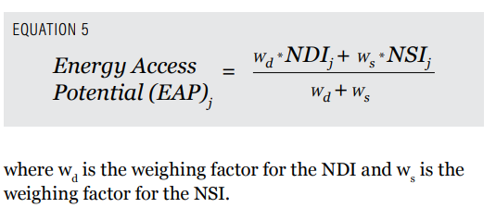
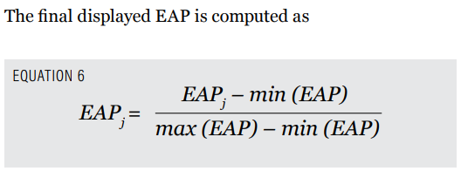
2.4 Multi-criteria Analysis for Spatial Energy Planning
Multi-Criteria Analysis Framework: Energy Access Potential Index
The Energy Access Potential Index is the weighted sum of the Demand Index and Supply Index.
It indicates areas where the population has an ability to pay for electricity and that are close to social and productive uses of energy, have potential for renewable energy, and have existing or planned infrastructure.
Thus, the Energy Access Potential displays a score for how much current and potential demand and current and potential supply for electricity there is in the areas of interest
SOURCE: Mentis, et.al, 2019
28

Slide 29
2.4 Multi-criteria Analysis for Spatial Energy Planning
Multi-Criteria Analysis Framework: Need for Assistance Index
The Need for Assistance Index is a weighted sum of certain demand and supply data and is used to indicate areas where financial assistance may be needed more.
For example, areas with the potential to develop economic activity (e.g., agribusinesses) and significant social loads—but with current low ability to pay—may require more financial support than areas where economic activities are already high, all else being equal.
Assistance to finance renewable energy for agriculture would need to be integrated into a full package from the agriculture sector or organizations supporting the sector.
29

Slide 30
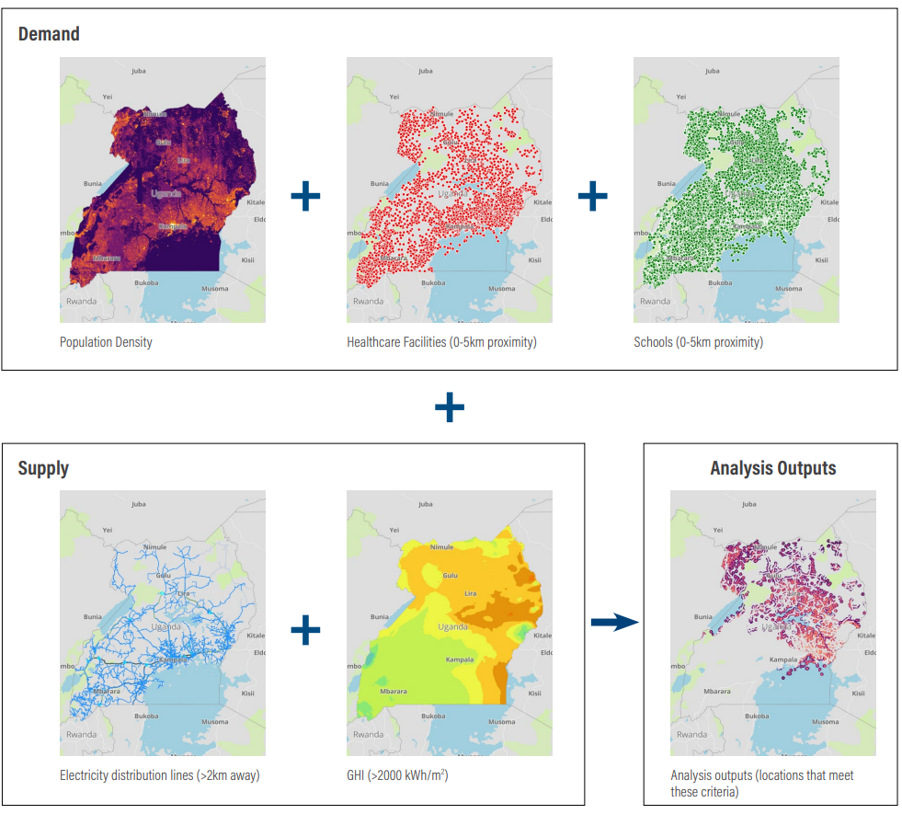
2.4 Multi-criteria Analysis for Spatial Energy Planning
Multi-Criteria Analysis
Examples of Energy Access Explorer’s high-resolution, multi-criteria prioritization analysis.
This analysis identifies priority areas which are close to health care and education facilities, far from the power network and where solar potential is significant. This is a sample analysis.
Users can combine more than 25 geospatial datasets and generate custom prioritization analysis, maps and reports based on their criteria and perspectives.
30

Slide 31
Lecture 2.4 References
Dean, Marco. (2022). A Practical Guide to Multi-Criteria Analysis. Technical Report, DOI : 10.13140/RG.2.2.15007.02722. https://www.researchgate.net/publication/358131153_A_Practical_Guide_to_Multi-Criteria_Analysis
Mendoza, G and Macoun, P. (1999) Guidelines for Applying Multi-Criteria Analysis to the Assessment of Criteria and Indicators; Center for International Foresty Research (CIFOR): Bogor, Indonesia. https://www.cifor-icraf.org/knowledge/publication/769/
Mentis, D., L. Odarno, D. Wood, F. Jendle, E. Mazur, A. Qehaja, and F. Gassert. 2019. “Energy Access Explorer: Data and Methods.” Technical Note. Washington, DC: World Resources Institute. Available online at: www.wri.org/publication/energy-access-explorer.
Mini Lecture Learning Objective
31

Slide 32
Thank you
www.climatecompatiblegrowth.com
Supported by and in collaboration with
World Resources Institute
Consolidated by Alemayehu Agizew Woldeamanuel, Abdul Khalid, Shikha Anand, Tarannum Sahar, Akansha Saklani, Santiago Sinclair-Lecaros, Dimitris Mentis, Douglas Ronoh and Jake Stockman from the World Resources Institute
Woldeamanuel, A. A., Khalid, A., Anand, S., Sahar, T., Saklani, A., Sinclair-Lecaros, S., Mentis, D., Ronoh, D., & Stockman, J., 2026. Lecture 2: Introduction to Energy Access Explorer. Release Version 3.0 [online presentation]. Climate Compatible Growth Programme, World Resource Institute

