Slide 1


Maximum 32 point Arial in white
LECTURE 1 INTRODUCTION TO THE COURSE
Supported by and in collaboration with World Resources Institute
Notes:
License:
This work is licensed under the Creative Commons Attribution 4.0 International License (CC BY 4.0). To view a copy of this license, visit https://creativecommons.org/licenses/by/4.0/.
Attribution:
Please cite as: Woldeamanuel, A. A., Khalid, A., Anand, S., Sahar, T., Saklani, A., Sinclair-Lecaros, S., Mentis, D., Ronoh, D., & Stockman, J., 2026. Data Driven, Integrated and Inclusive Energy Planning with Energy Access Explorer. Version 1. Climate Compatible Growth Teaching Kit Website, Climate Compatible Growth.

Slide 2
Learning Outcomes
By the end of this lecture, you will:
ILO1: Be able to explain the importance of energy planning for socio-economic development
ILO2: Understand the importance of integrated and inclusive energy planning
ILO3: Be familiar with the ecosystem of geospatial data and tools for strategic energy planning
ILO4: Be able to create your own MyEAE user account after you register
2
Notes:
This lecture has four Intended Learning Outcomes.
By the end of this lecture, you will:
Be able to explain the importance of energy planning for socio-economic development
Understand the importance of integrated energy planning
Be familiar with the ecosystem of geospatial data and tools for strategic energy planning
Be able to create your own MyEAE user account after you register
These learning outcomes will be important to understand the context of the course.

Slide 3
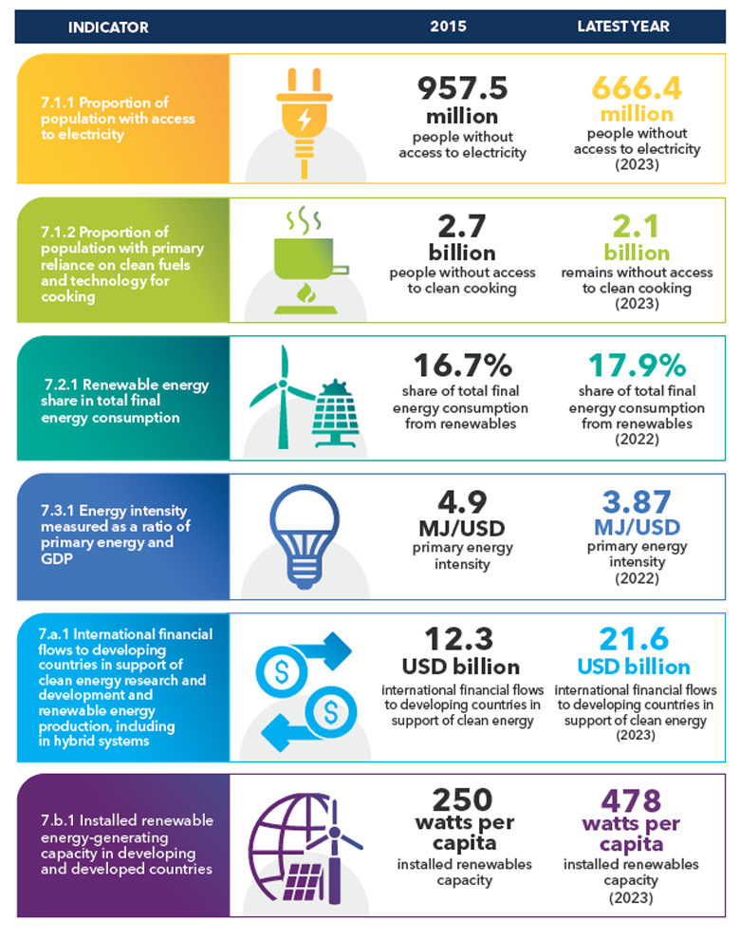
1.1 Energy Planning for Socio-Economic Development
Energy Access Scenario
Energy is a critical service that is highly interconnected with socioeconomic development and human well-being
SOURCE: IEA, IRENA, UNSD, World Bank, WHO, 2025
Notes:
Energy is a critical service that is highly interconnected with socioeconomic development and human well-being. Yet, life without reliable energy is a reality for more than 666 million people globally while more than 2 billion people use polluting fuels to cook their meals, and 1 billion people are served by healthcare facilities with unreliable energy. In order to achieve universal energy access by 2030, efforts need to be substantially increased towards the target by scaling up investments and policy support.

Slide 4
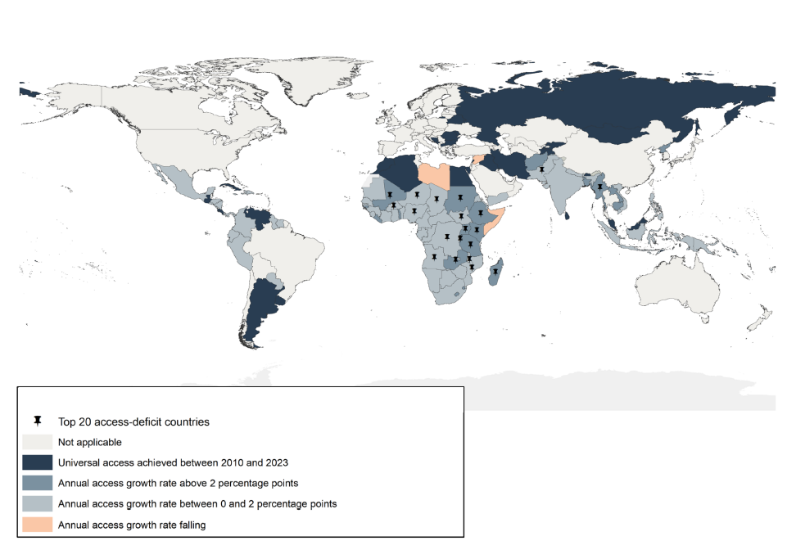
1.1 Energy Planning for Socio-Economic Development
Energy Access Scenario
In 2023, increases in the number of people with access to electricity outpaced population growth
Central and Southern Asia have made significant progress towards universal access, but Sub-Saharan Africa still accounts for 85% of the global population without electricity
8 out of 10 people living without electricity in 2023 reside in rural areas.
SOURCE: IEA, IRENA, UNSD, World Bank, WHO, 2025

Slide 5
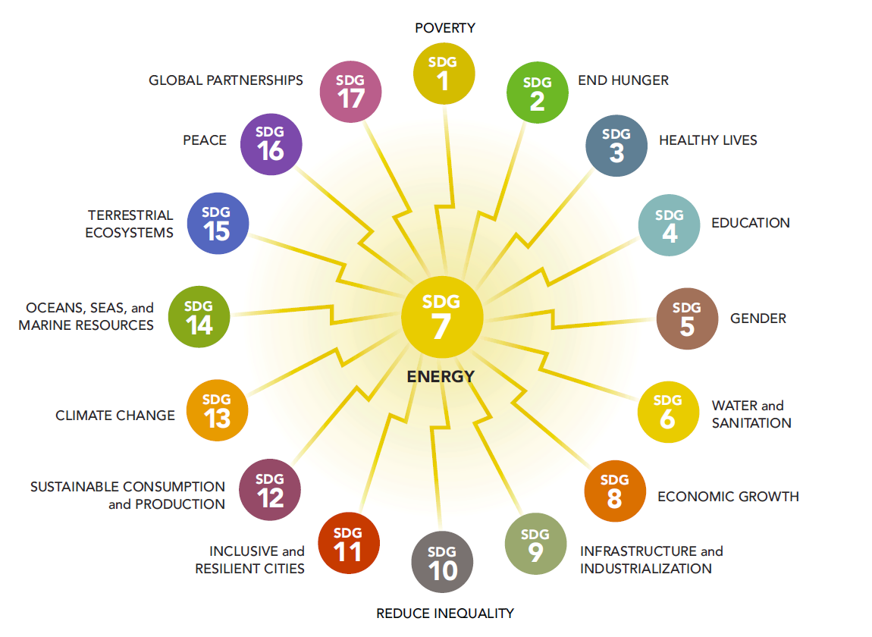
1.1 Energy Planning for Socio-Economic Development
Energy Access and Sustainable Development Outcomes
Sustainable Development Goal 7 (SDG7) calls for “affordable, reliable, sustainable and modern energy for all” by 2030. Energy is interconnected with 125 (74%) out of 169 SDG targets.
SOURCE: UN, World Bank
5
Notes:
Sustainable Development Goal 7 (SDG7) calls for “affordable, reliable, sustainable and modern energy for all” by 2030. Energy is interconnected with 125 (74%) out of 169 SDG targets. Energy is central to both the 2030 Agenda for Sustainable Development and the Paris Agreement on Climate Change. Energy access can open up new economic opportunities, empower marginalized communities, enhance education and healthcare, establish equitable and inclusive societies, as well as strengthen the resilience of at-risk communities to climate change.

Slide 6

1.1 Energy Planning for Socio-Economic Development
Role of energy in well-being
Access to energy plays a pivotal role in driving economic development and improving the overall well-being of individuals worldwide.
For unserved and underserved communities, the absence of reliable and affordable energy sources hampers the functioning of healthcare facilities, limits educational opportunities, and restricts access to economic activities.
The expansion of energy access and the associated investment decisions require proper energy planning and access to reliable data and transparent analytical tools.
Photo Credit: The Climate Group/Flickr
SOURCE: WRI
6

Slide 7
Lecture 1.1 References
IEA, IRENA, UNSD, World Bank, WHO. 2025. Tracking SDG 7: The Energy Progress Report. World
Bank, Washington DC. © World Bank. License: Creative Commons Attribution—NonCommercial 3.0 IGO (CC BY-NC 3.0 IGO). URL https://trackingsdg7.esmap.org/sites/default/files/download-documents/SDG7-Report2025-0804-V11.pdf
Mentis, D., L. Odarno, D. Wood, F. Jendle, E. Mazur, A. Qehaja, and F. Gassert. 2019. “Energy Access Explorer: Data and Methods.” Technical Note. Washington, DC: World Resources Institute. Available online at: www.wri.org/publication/energy-access-explorer.
World Bank. 2017. State of Electricity Access Report. Copyright © 2017 International Bank for Reconstruction and Development. URL https://documents1.worldbank.org/curated/en/364571494517675149/pdf/
United Nations. Sustainable Development Goal 7. URL https://sdgs.un.org/goals/goal7
International Energy Agency. Access to Electricity. URL https://www.iea.org/reports/sdg7-data-and-projections/access-to-electricity
Course Name
Mini Lecture Learning Objective
7

Slide 8

1.2 Why is integrated and inclusive energy planning important?
Energy Planning
Energy Planning: “It is the act of assessing the ability of a regional energy system to provide dependable energy services under constantly changing conditions – which involves variables such as the cost of materials and fuels, investment costs in technologies, demand levels, and distribution.”
SOURCE: World bank
8

Slide 9
1.2 Why is integrated and inclusive energy planning important?
Integrated Energy Planning
Integrated energy planning harmonizes a region's energy system goals and priorities for expanding energy access and deploying cost-effective technologies by matching supply with growing demand.
Inclusive energy planning accounts for varying, cross-sectoral stakeholder perspectives, assesses energy needs from the bottom-up, and links energy systems at different geographic levels.
Inclusive Energy Planning
Notes:
Effectively expanding energy access requires integrated and inclusive planning.
Considering integrated energy plans that brings in a geography’s energy system aims and priorities for expanding energy access and least-cost technology to be deployed by matching supply with growing demand…..
Also, that energy plans are inclusive involving the various stakeholders’ perspectives and needs from a bottom-up approach when developing energy plans

Slide 10
1.2 Why is integrated and inclusive energy planning important?
Geospatial dimensions of energy planning
Typical energy planning tools
Are largely inadequate for regional energy access planning;
Fail to consider the spatial fluctuations of energy systems:
Intermittent energy sources (such as wind, solar, hydro) vary in space
Power infrastructure, energy demand and economic activities differ from one area to another
Without geospatial models, these critical factors for energy planning cannot be effectively captured.
10

Slide 11
Lecture 1.2 References
Howells, Mark; Rogner, Hans Holger; Mentis, Dimitris; Broad, Olivia, 2017. Energy Access and Electricity Planning. Copyright © 2017 International Bank for Reconstruction and Development / The World Bank. URL https://documents1.worldbank.org/curated/en/364571494517675149/pdf/
Course Name
Mini Lecture Learning Objective
11

Slide 12
1.3 Ecosystem of Geospatial Data and Tools for Energy Planning
Energy Planning Tools
The ecosystem of geospatial data and tools for energy planning leverages geographic information and technology to facilitate the efficient and sustainable management of energy resources.
It involves the integration of various geospatial data sources, analytical tools, and software platforms to support decision-making in the energy sector.
12
Notes:
The ecosystem of geospatial data and tools for energy planning leverages geographic information and technology to facilitate the efficient and sustainable management of energy resources. It involves the integration of various geospatial data sources, analytical tools, and software platforms to support decision-making in the energy sector.

Slide 13
1.3 Ecosystem of Geospatial Data and Tools for Energy Planning
Examples of existing Geospatial Data and Tools
World Bank Renewable Energy Resource Mapping – the Global Solar Atlas and Global Wind Atlas of World Bank are free, web-based platform that provides users with data and tools to assess renewable energy potential.
Fraym – it assists users in identifying potential markets for off-grid electrification and sites for mini-grid development.
Global Electrification Platform – it provides electrification investment scenarios for achieving universal access
SEforALL Integrated Energy Access Planning Tool (IEPs) - a framework that helps direct resources effectively and efficiently where they are needed the most
VIDA - AI -powered, map-based geospatial software that uses satellite imagery and other data to identify and evaluate off-grid electrification options in remote, frontier markets
EU's Africa Knowledge Platform Clean Energy Access Prioritiser (CEAP) - an open-source, web-based decision-support tool that uses geospatial data and multi-criteria analysis to help stakeholders identify the best locations for clean energy projects
SOURCE: World Bank, Fraym, GEP, SEforALL, VIDA, EU
13
Notes:
The ecosystem of geospatial data and tools for energy planning leverages geographic information and technology to facilitate the efficient and sustainable management of energy resources. It involves the integration of various geospatial data sources, analytical tools, and software platforms to support decision-making in the energy sector.

Slide 14
1.3 Ecosystem of Geospatial Data and Tools for Energy Planning
Limitations of Existing Geospatial Data and Tools
Medium- to long-term energy planning tools used by planners consider spatially aggregated regions to solve complex cost-optimization problems.
Although recently developed energy planning tools based on geographic information systems (GIS) focus on identifying technology and investment needs to provide access to unserved areas, these tools currently integrate limited information on demand and affordability.
Additionally, the tools often have limited or no local ownership, which is critical for the success and sustainability of energy projects.
We need a better understanding of the needs and constraints of these new customers if we are to supply electricity in an economically sustainable manner
SOURCE: WRI

Slide 15
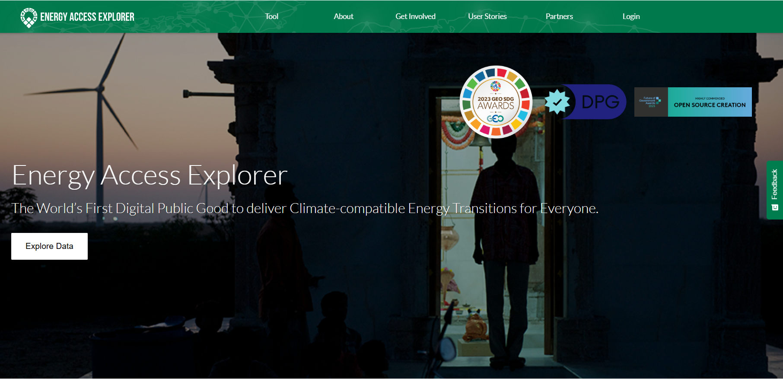
1.3 Ecosystem of Geospatial Data and Tools for Energy Planning
Energy Access Explorer
Energy Access Explorer (EAE) is an online, open-source, interactive, geospatial platform that enables clean energy entrepreneurs, energy planners, donors, and development-oriented institutions to identify high priority areas where energy access can be expanded.
Using spatial data to link energy supply with growing or unmet demand is essential to gaining a better picture of energy access and expanding energy services to those who need it the most.
SOURCE: WRI

Slide 16
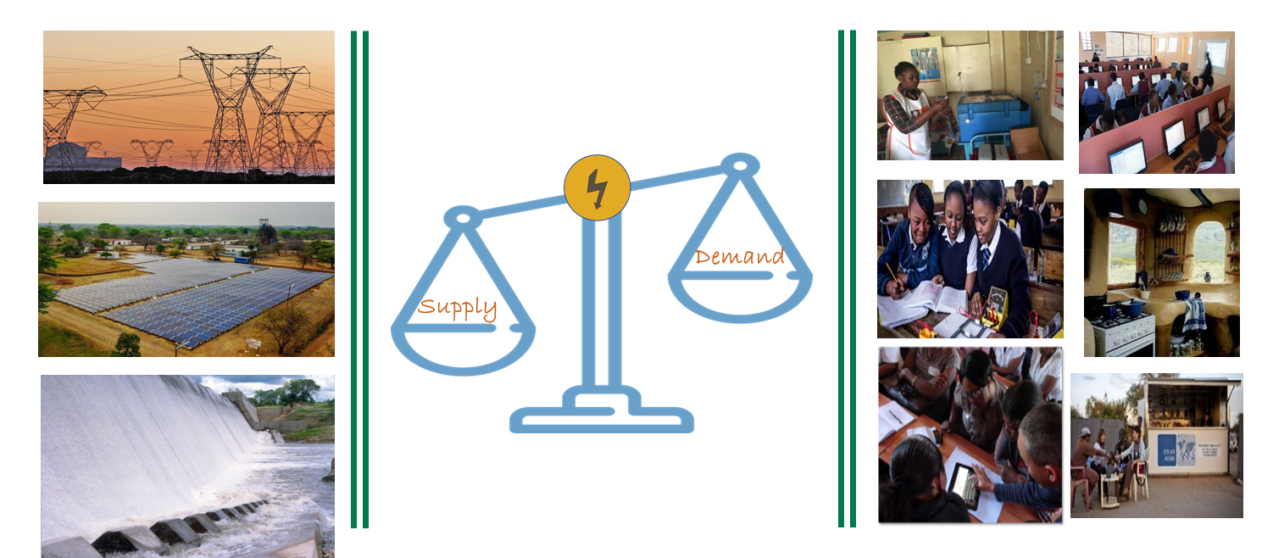
1.3 Ecosystem of Geospatial Data and Tools for Energy Planning
Treat Demand and Supply as Equal
Equitable Access to Energy: To effectively address energy access challenges, there was a need for a platform that synthesizes granular information on both demand and supply side, allowing stakeholders with diverse needs to identify priority areas for targeted energy interventions. EAE treats demand and supply as equal, which sets it apart from most geospatial planning tools that primarily focus on the supply side.
Understanding the nuances of energy demand at the grassroots level is crucial to ensuring the viability of solutions for consumers, whether they are households or institutions, as well as for energy service providers like utilities, mini-grid developers, and clean cooking technology providers.
EAE provides a bottom-up representation of electricity affordability and demand by integrating granular details of how electricity affordability and demand play out at the community level, and offers more localized, community-centric insights on energy planning.
SOURCE: WRI

Slide 17
1.3 Ecosystem of Geospatial Data and Tools for Energy Planning
Reduce Reliance on GIS and Programming Expertise for Data Users
Equitable Access to Software: EAE functions as a geographic information system which enables energy planning agencies with limited or no GIS capacity to better process, store, manage and update data in a cost-effective manner.
Stakeholders that were previously left outside energy planning conversations, are now able to utilize granular data and analytics and gain actionable insights with regards to the expansion of energy services where it’s needed the most.
EAE offers a user-friendly interface that enables stakeholders to map, analyze and visualize intricate energy demand patterns, infrastructure gaps, and environmental factors at a local, regional, and national scale.
By democratizing access to critical energy information, EAE empowers a broader range of stakeholders to access granular data and analytics, facilitating informed decision-making for integrated and inclusive energy planning.

Slide 18

1.3 Ecosystem of Geospatial Data and Tools for Energy Planning
Deploy an Open-Source Dynamic Information System for Data Providers
Equitable Access to Resources: In resource-constrained geographies, data providers, such as rural electrification agencies or health ministries, can use EAE as an open-source dynamic information system and minimize software engineering costs.
Open source in this context pertains to the programming infrastructure, which allows for collaborative development and cost-effective solutions. While the data itself can vary in accessibility, from open access to password-protected, utilizing open-source software helps overcome limitations in regions where resources for developing dynamic geographic information systems and software are scarce.
This approach fosters greater accessibility and affordability for creating and maintaining essential information systems.

Slide 19
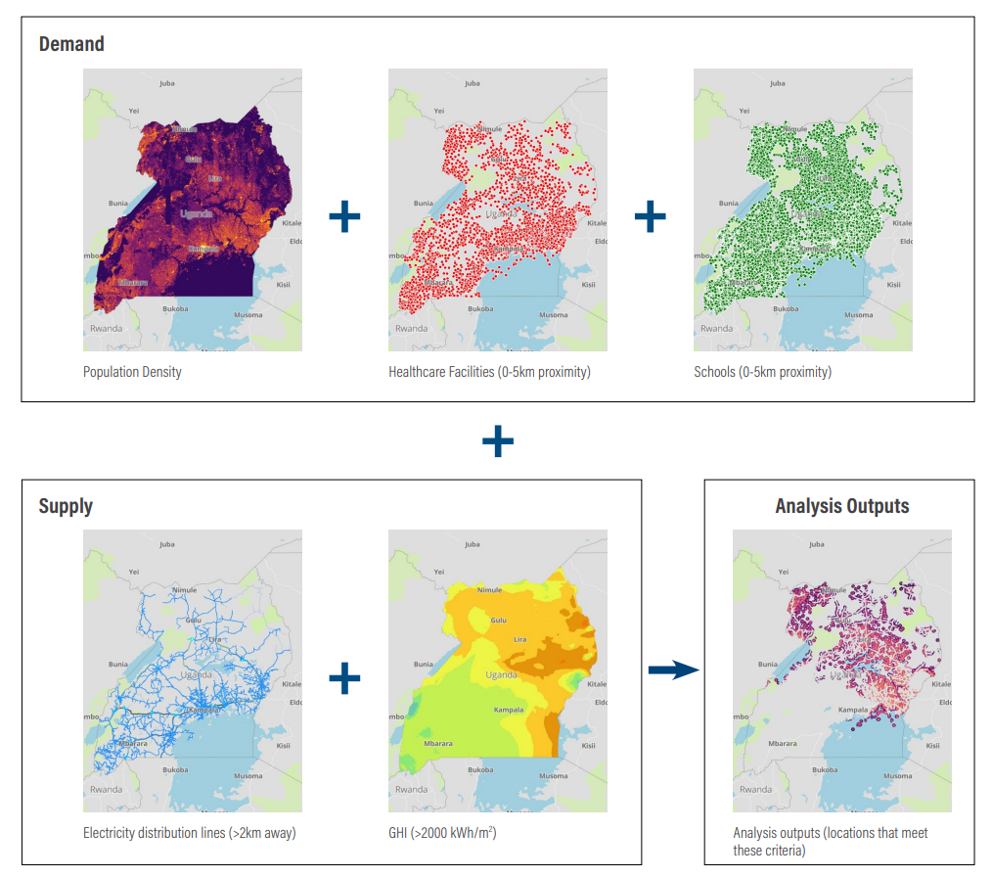
1.3 Ecosystem of Geospatial Data and Tools for Energy Planning
This is an example of Energy Access Explorer’s high-resolution, multi-criteria prioritization analysis.
This sample analysis identifies priority areas which are close to health care and education facilities, far from the power network and where solar potential is significant.
Users can combine more than 50 geospatial datasets and generate custom prioritization analysis, maps and reports based on their criteria and perspectives.
SOURCE: WRI
19
Notes:
This is an example of Energy Access Explorer’s high-resolution, multi-criteria prioritization analysis. This analysis identifies priority areas which are close to health care and education facilities, far from the power network and where solar potential is significant. This is a sample analysis. Users can combine more than 25 geospatial datasets and generate custom prioritization analysis, maps and reports based on their criteria and perspectives.

Slide 20
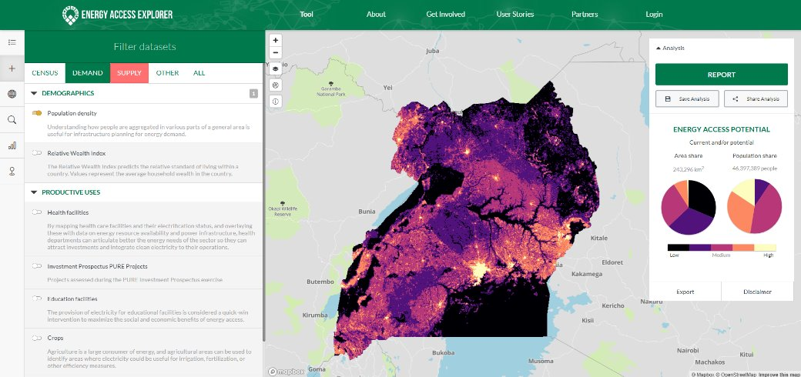
1.3 Ecosystem of Geospatial Data and Tools for Energy Planning
Energy Access Explorer enables:
Integrated & Inclusive Energy Planning
Expansion of clean energy markets
Impact investment
Bottom-up assessment of energy needs
20

Slide 21
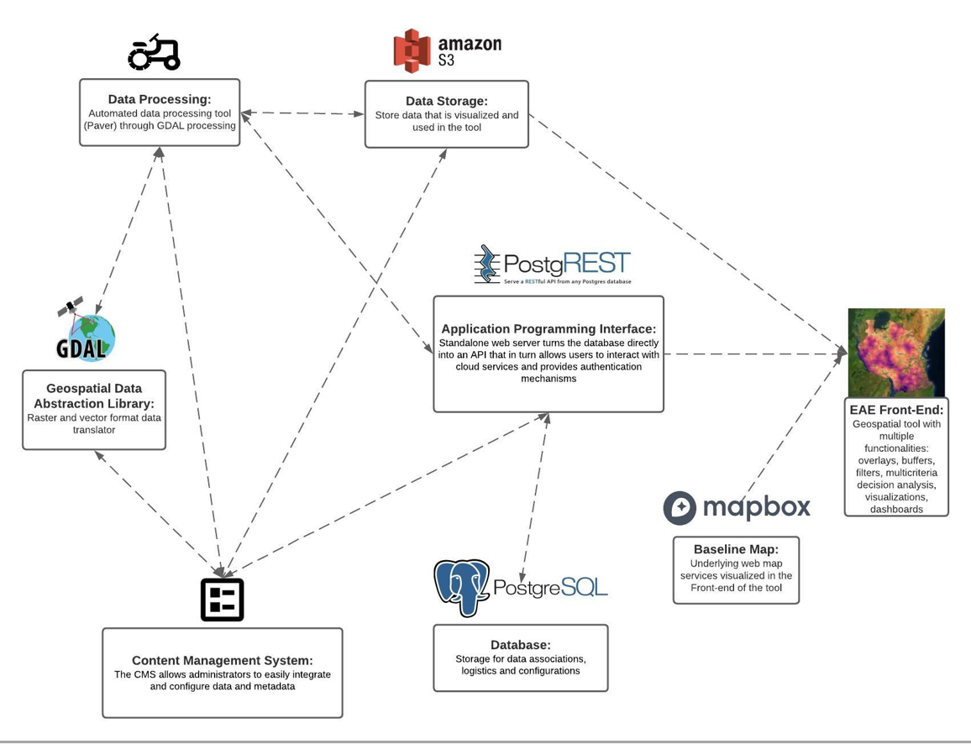
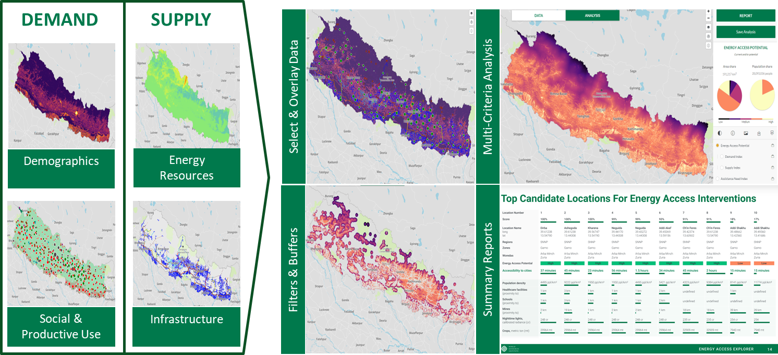
1.3 Ecosystem of Geospatial Data and Tools for Energy Planning
Energy Access Explorer
Frontend - Data & Analysis users
No programming experience is required
No GIS experience is required
Backend - Data Administrators
No programming experience is required
Basic GIS experience is useful
21

Slide 22
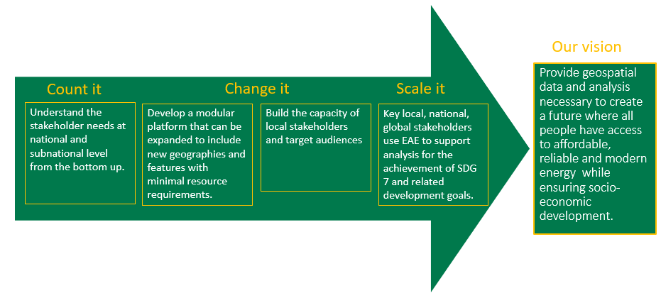
1.3 Ecosystem of Geospatial Data and Tools for Energy Planning
"COUNT IT" - "CHANGE IT" - "SCALE IT"
SOURCE: WRI
22

Slide 23
Lecture 1.3 References
Mentis, D., L. Odarno, D. Wood, F. Jendle, E. Mazur, A. Qehaja, and F. Gassert. 2019. “Energy Access Explorer: Data and Methods.” Technical Note. Washington, DC: World Resources Institute. Available online at: www.wri.org/publication/energy-access-explorer.
Mini Lecture Learning Objective
23

Slide 24

1.4 MyEAE User Account
Login
To access advanced functions such as download, save and share the analysis, users are recommended to login into the EAE platform (if they have previously registered)
You can also request a new password if you forgot your previous password
Note: Users with back-end training permissions are required to login in the training environment using the link https://training.energyaccessexplorer.org/login/
24

Slide 25
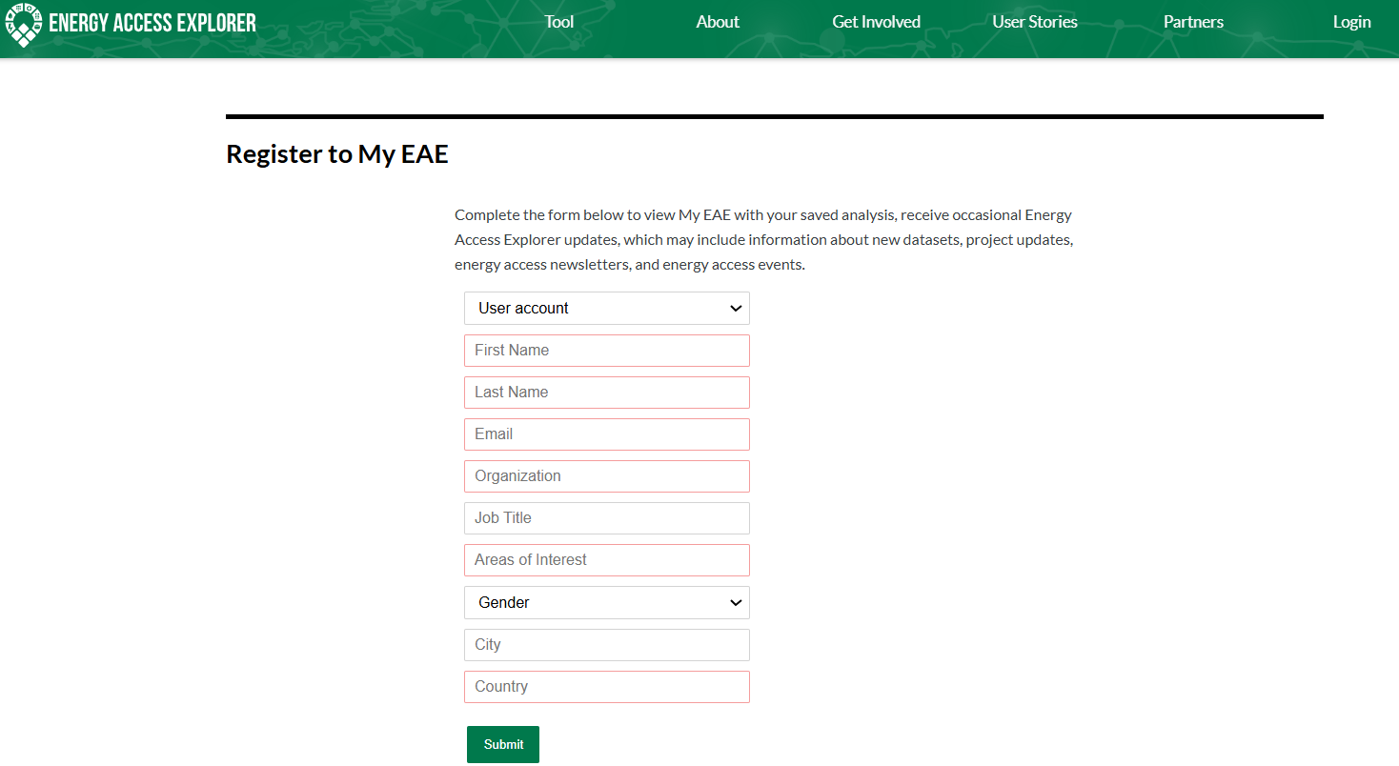
1.4 MyEAE User Account
Register to MyEAE
New users should register to My EAE by completing the form below (click ‘Create one here’ in the login page)
Once your account is created, you will receive a confirmation email and confirm using the link provided. If you do not see the confirmation email in your inbox, check your email's spam folder.
25

Slide 26
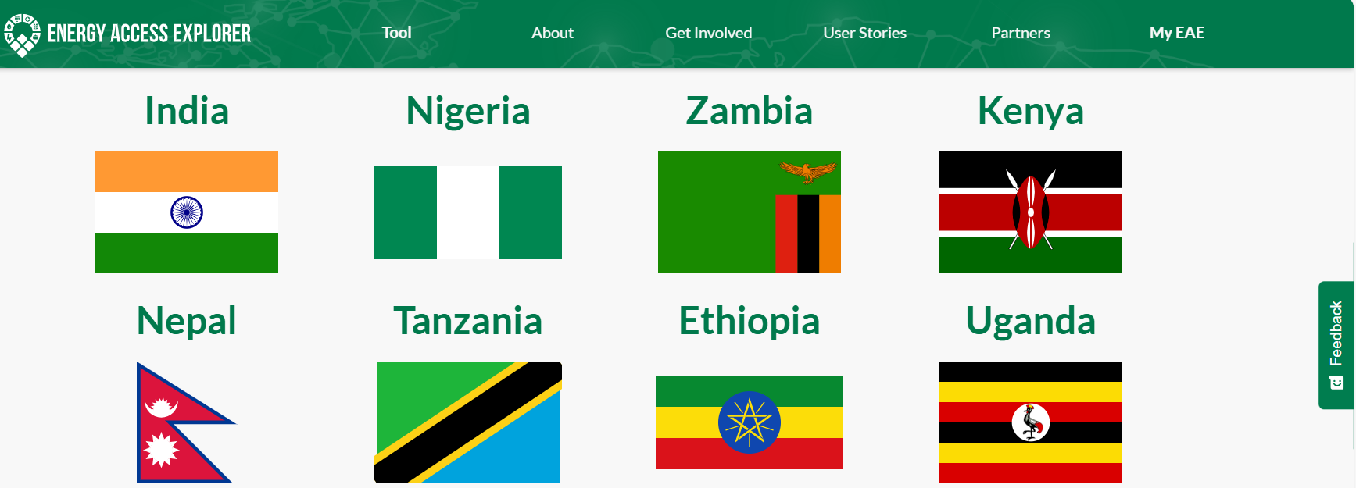
1.4 MyEAE User Account
MyEAE
After login, users can see the frontend of EAE for all Geographies or the geography where the back-end training is provided
The 'Login' icon at the top right corner also changes into 'MyEAE'
Facing any login challenges, you can send an email to energyaccessexplorer@wri.org
26

Slide 27
Thank you
www.climatecompatiblegrowth.com
Supported by and in collaboration with
World Resources Institute
Consolidated by Alemayehu Agizew Woldeamanuel, Abdul Khalid, Shikha Anand, Tarannum Sahar, Akansha Saklani, Santiago Sinclair-Lecaros, Dimitris Mentis, Douglas Ronoh and Jake Stockman from the World Resources Institute
Woldeamanuel, A. A., Khalid, A., Anand, S., Sahar, T., Saklani, A., Sinclair-Lecaros, S., Mentis, D., Ronoh, D., & Stockman, J., 2026. Lecture 1: Introduction to the Course. Release Version 3.0 [online presentation]. Climate Compatible Growth Programme, World Resource Institute

